Slide 1
MIS5101: Business Intelligence Business Intelligence and Data Analytics
Sunil Wattal

Slide 2
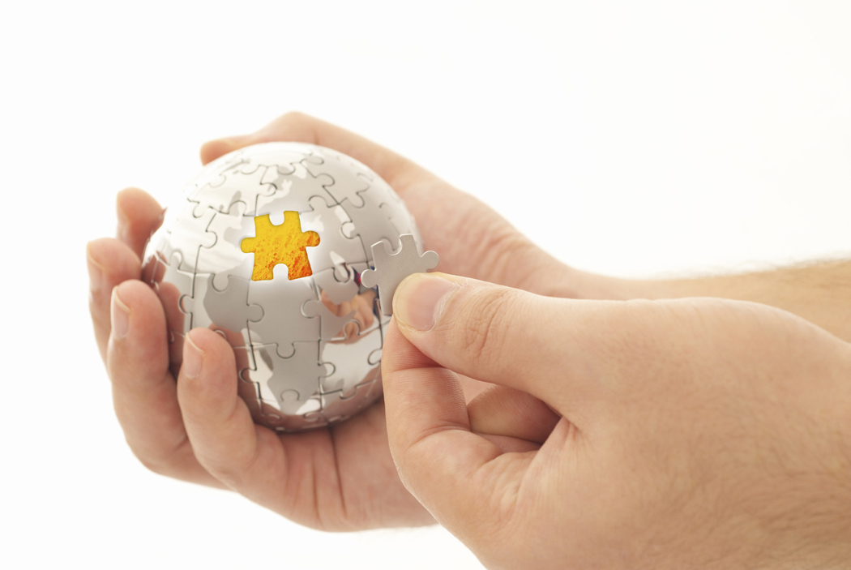
Analytics is
Extraction of implicit, previously unknown, and potentially useful information from data
Exploration and analysis of large data sets to discover meaningful patterns

Slide 3
Case Study: Matchmaking with Math
What did they do?
How did they do it?
What do you think of the result?
What do you think of the process?

Slide 4
Analytics Techniques
Decision Trees
Clustering
Association Rule Mining

Slide 5
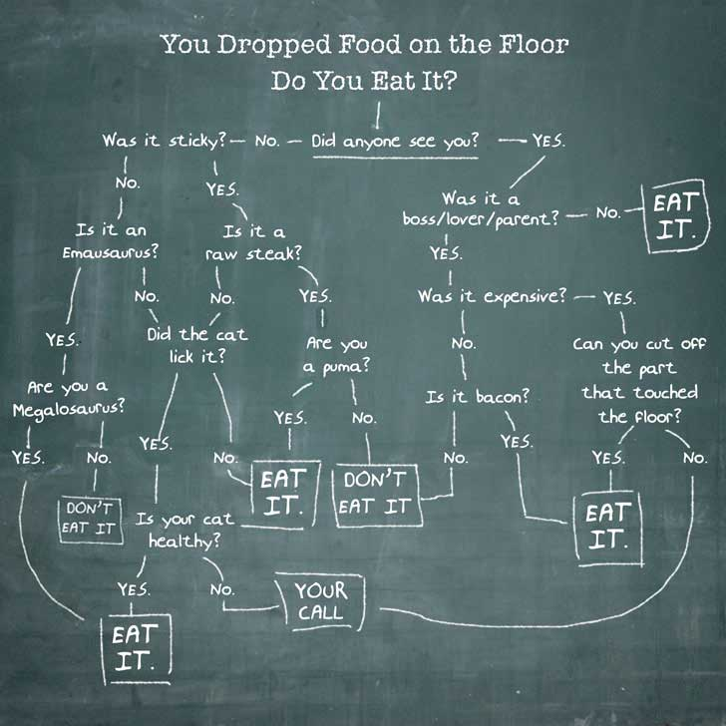
Decision Trees
Used to classify data according to a pre-defined outcome
Based on characteristics of that data
http://www.mindtoss.com/2010/01/25/five-second-rule-decision-chart/
Uses
Predict whether a customer should receive a loan
Flag a credit card charge as legitimate
Determine whether an investment will pay off

Slide 6
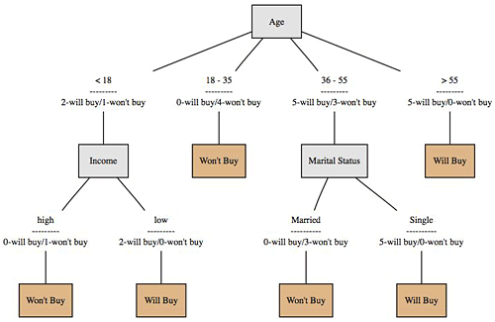
A more realistic one…
Will a customer buy some product given their demographics?
What are the characteristics of customers who are likely to buy?
http://onlamp.com/pub/a/python/2006/02/09/ai_decision_trees.html

Slide 7
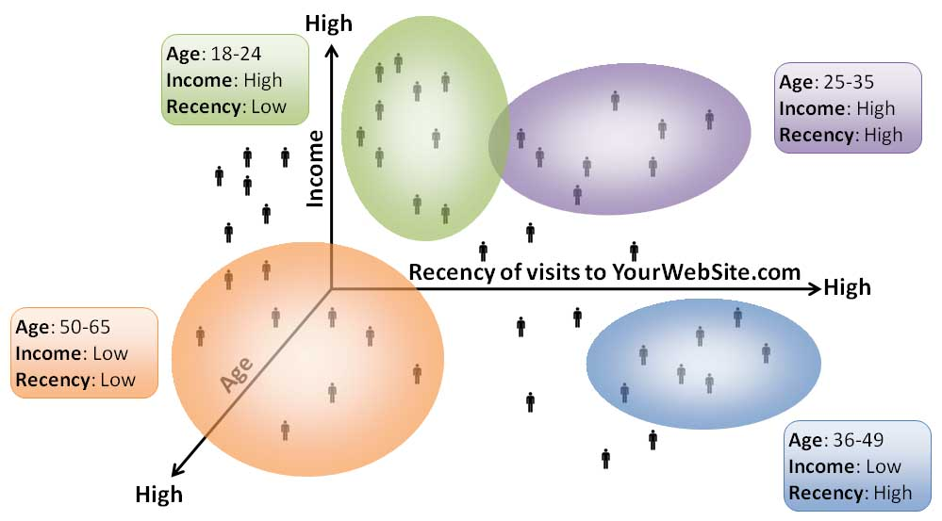
Clustering
Used to determine distinct groups of data
Based on data across multiple dimensions
Here you have four clusters of web site visitors.
What does this tell you?
Uses
Customer segmentation
Identifying patient care groups
Performance of business sectors
http://www.datadrivesmedia.com/two-ways-performance-increases-targeting-precision-and-response-rates/

Slide 8
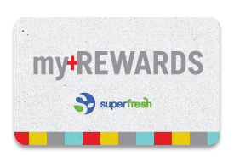
Association Rule Mining
Find out which items predict the occurrence of other items
Also known as “affinity analysis” or “market basket” analysis
Uses
What products are bought together?
Amazon’s recommendation engine
Telephone calling patterns

Slide 9
Market-Basket Transactions
Basket | Items
1 | Bread, Milk
2 | Bread, Diapers, Beer, Eggs
3 | Milk, Diapers, Beer, Coke
4 | Bread, Milk, Diapers, Beer
5 | Bread, Milk, Diapers, Coke
X → Y (antecedent → consequent)
{Diapers} → {Beer}, {Milk, Bread} → {Diapers} {Beer, Bread} → {Milk}, {Bread} → {Milk, Diapers}
Association Rules from these transactions

Slide 10
Core idea: The itemset
Itemset A group of items of interest {Milk, Beer, Diapers}
Association rules express relationships between itemsets
X → Y {Milk, Diapers} → {Beer} “when you have milk and diapers, you also have beer”
Basket | Items
1 | Bread, Milk
2 | Bread, Diapers, Beer, Eggs
3 | Milk, Diapers, Beer, Coke
4 | Bread, Milk, Diapers, Beer
5 | Bread, Milk, Diapers, Coke

Slide 11
Support
Support count (σ)
In how many baskets does the itemset appear?
σ{Milk, Beer, Diapers} = 2 (i.e., in baskets 3 and 4)
Support (s)
Fraction of transactions that contain all items in X → Y
s({Milk, Diapers, Beer}) = 2/5 = 0.4
You can calculate support for both X and Y separately
Support for X = 3/5 = 0.6
Support for Y = 3/5 = 0.6
Basket | Items
1 | Bread, Milk
2 | Bread, Diapers, Beer, Eggs
3 | Milk, Diapers, Beer, Coke
4 | Bread, Milk, Diapers, Beer
5 | Bread, Milk, Diapers, Coke
2 baskets have milk, beer, and diapers
5 baskets total
X
Y

Slide 12
Confidence
Confidence is the strength of the association
Measures how often items in Y appear in transactions that contain X
Basket | Items
1 | Bread, Milk
2 | Bread, Diapers, Beer, Eggs
3 | Milk, Diapers, Beer, Coke
4 | Bread, Milk, Diapers, Beer
5 | Bread, Milk, Diapers, Coke
This says 67% of the times when you have milk and diapers in the itemset you also have beer!
c must be between 0 and 1 1 is a complete association
0 is no association

Slide 13
Some sample rules
Association Rule | Support (s) | Confidence (c)
{Milk,Diapers} → {Beer} | 2/5 = 0.4 | 2/3 = 0.67
{Milk,Beer} → {Diapers} | 2/5 = 0.4 | 2/2 = 1.0
{Diapers,Beer} → {Milk} | 2/5 = 0.4 | 2/3 = 0.67
{Beer} → {Milk,Diapers} | 2/5 = 0.4 | 2/3 = 0.67
{Diapers} → {Milk,Beer} | 2/5 = 0.4 | 2/4 = 0.5
{Milk} → {Diapers,Beer} | 2/5 = 0.4 | 2/4 = 0.5
Basket | Items
1 | Bread, Milk
2 | Bread, Diapers, Beer, Eggs
3 | Milk, Diapers, Beer, Coke
4 | Bread, Milk, Diapers, Beer
5 | Bread, Milk, Diapers, Coke

Slide 14
But don’t blindly follow the numbers
i.e., high confidence suggests a strong association…
But this can be deceptive
Consider {Bread} →{Diapers}
Support for the total itemset is 0.6 (3/5)
And confidence is 0.75 (3/4) – pretty high
But is this just because both are frequently occurring items (s=0.8)?
You’d almost expect them to show up in the same baskets by chance

Slide 15
Lift
Takes into account how co-occurrence differs from what is expected by chance
i.e., if items were selected independently from one another
Support for total itemset X and Y
Support for X times support for Y

Slide 16
Lift Example
Basket | Items
1 | Bread, Milk
2 | Bread, Diapers, Beer, Eggs
3 | Milk, Diapers, Beer, Coke
4 | Bread, Milk, Diapers, Beer
5 | Bread, Milk, Diapers, Coke
What’s the lift for the rule: {Milk, Diapers} → {Beer}
So X = {Milk, Diapers} Y = {Beer} s({Milk, Diapers, Beer}) = 2/5 = 0.4 s({Milk, Diapers}) = 3/5 = 0.6 s({Beer}) = 3/5 = 0.6 So
When Lift > 1, the occurrence of X → Y together is more likely than what you would expect by chance

Slide 17
Another example
 | Checking Account
Savings Account |  | No | Yes
 | No | 500 | 3500 | 4000
 | Yes | 1000 | 5000 | 6000
 |  |  |  | 10000
Are people more inclined to have a checking account if they have a savings account?
Support ({Savings} →{Checking}) = 5000/10000 = 0.5
Support ({Savings}) = 6000/10000 = 0.6
Support ({Checking}) = 8500/10000 = 0.85
Confidence ({Savings} →{Checking}) = 5000/6000 = 0.83
Answer: No
In fact, it’s slightly less than what you’d expect by chance!

Slide 18
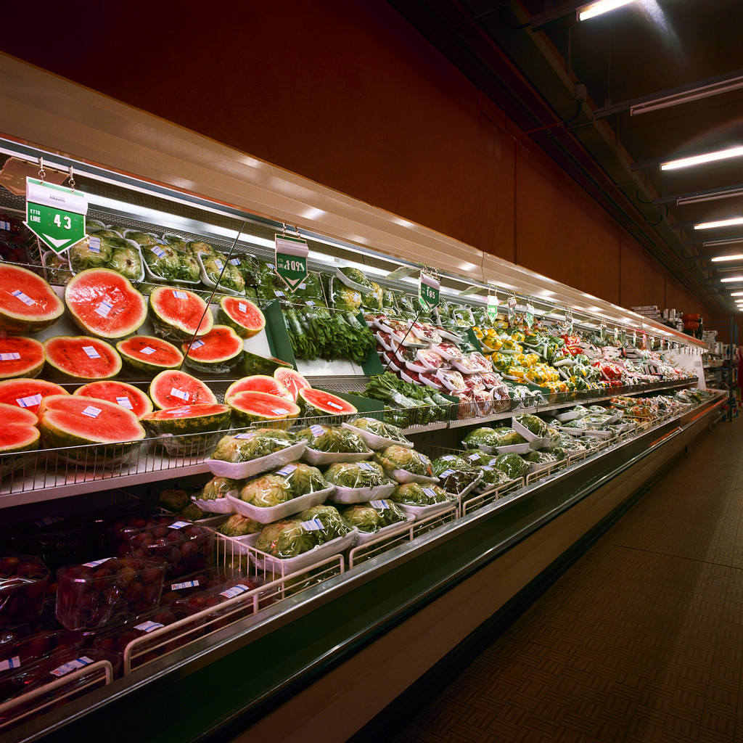
But this can be overwhelming
Thousands of products
Millions of combinations
Many customer types
So where do you start?

Slide 19
Selecting the rules
The steps
List all possible association rules
Compute the support and confidence for each rule
Drop rules that don’t make the thresholds
Use lift to further check the association
We know how to calculate the measures for each rule
Support
Confidence
Lift
Then we set up thresholds for the minimum rule strength we want to accept

Slide 20
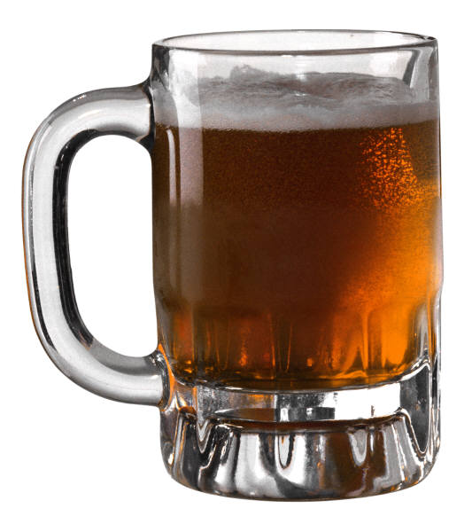
Once you are confident in a rule, take action
{Milk, Diapers} → {Beer}
Possible Marketing Actions
Create “New Parent Coping Kits” of beer, milk, and diapers
What are some others?

