Slide 1
MIS5101: Business Intelligence Digital Information Goods
Sunil Wattal

Slide 2
What is an information good?

Slide 3
Publishers have become “information intermediaries.”
What does this mean?

Slide 4
Characteristics of “information goods” markets
High fixed, low marginal costs
Non-rival goods
Advertising-sponsored
Tend to be experience goods
Single hardware/software solution
Network effects
Is an information good necessarily digital?

Slide 5
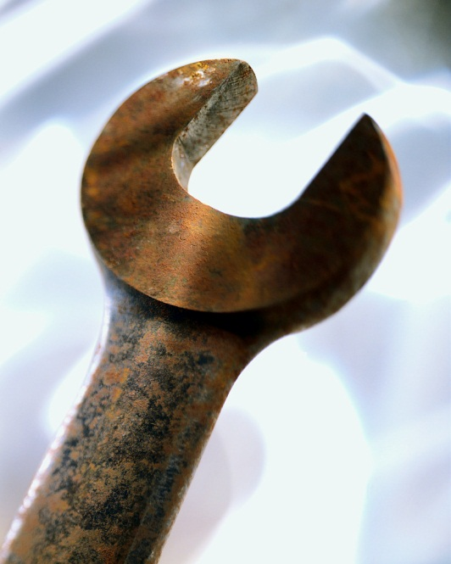
The communications infrastructure “buildout”
Hardware
(the Internet)
Software
(the Web)
What has happened to the cost of sharing data (information)?
What is the relationship with social media?
What has happened to the cost of creating data (information)?

Slide 6
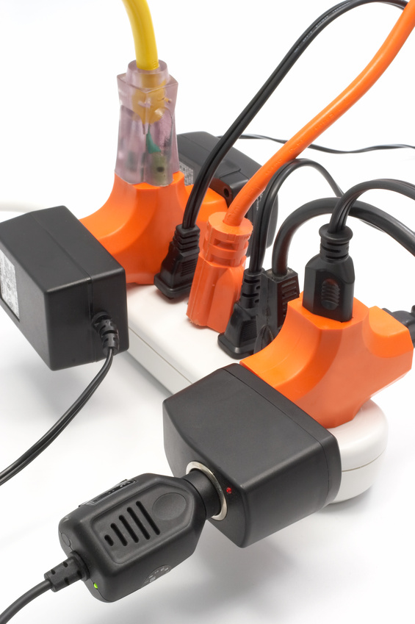
Challenges
Consumption
Presentation
Organization
What skills do people need to work with digital information goods?
Skills for consumers?
Skills for producers?

