Slide 1
MIS5101: Business Intelligence Information Privacy
Sunil Wattal

Slide 2
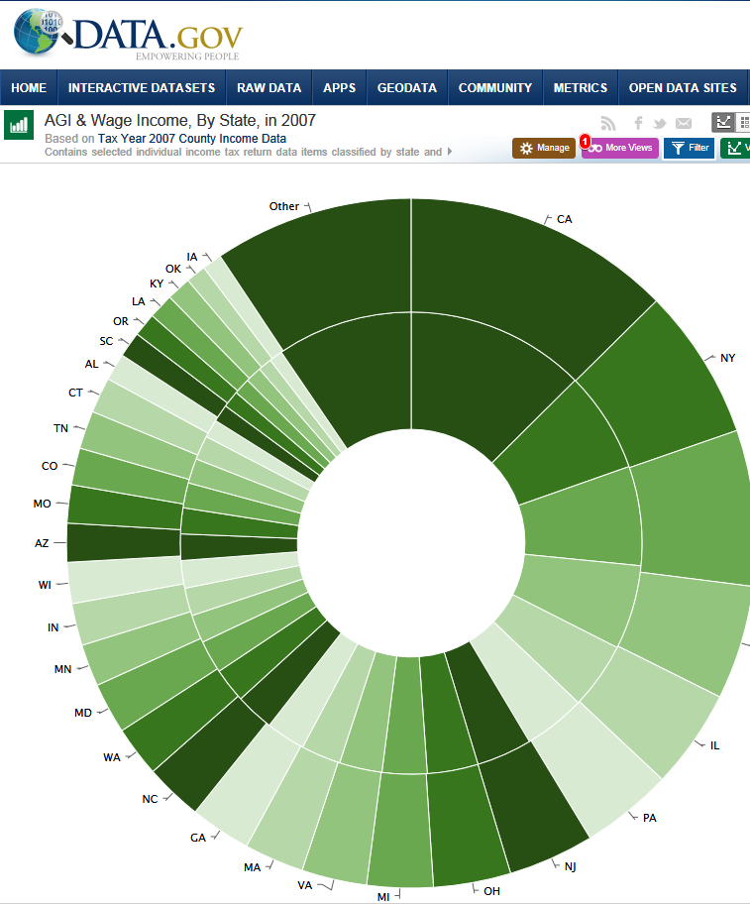
How do views on privacy differ?
deCode Genetics

Slide 3
How do views on privacy differ?
deCode Genetics
ShopSense

