Slide 1
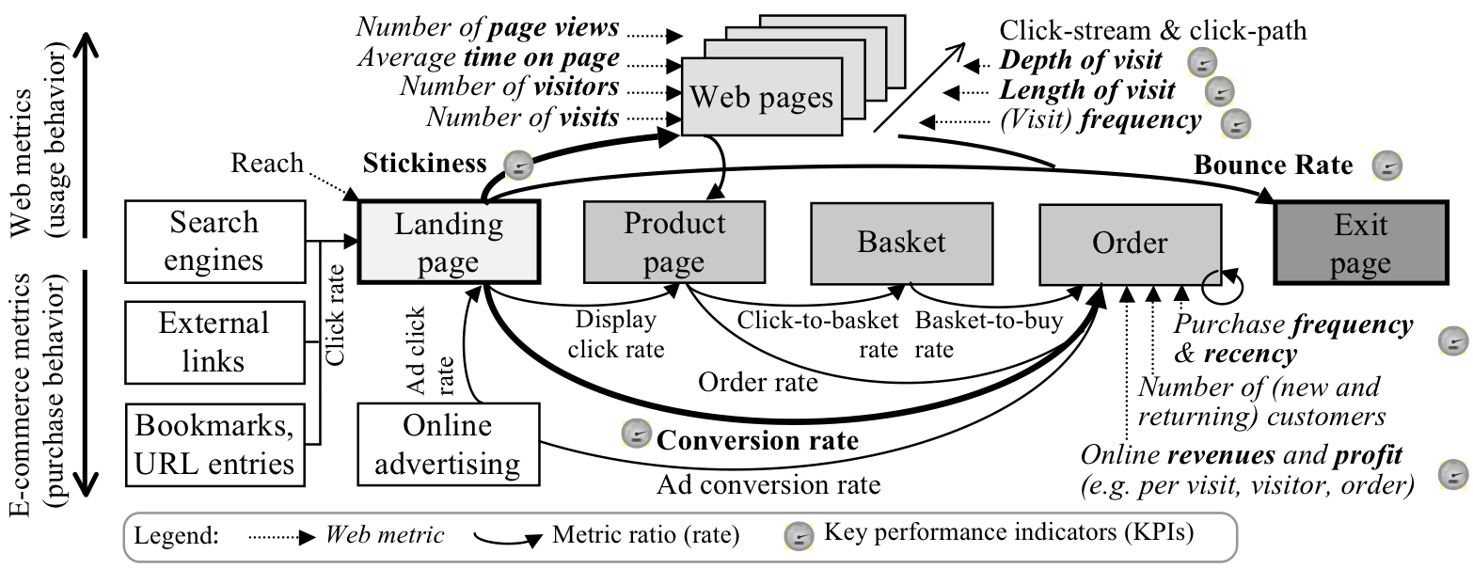
Is your website working Hard enough?

