Slide 1
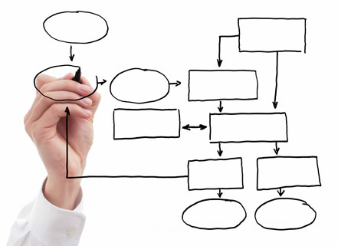
MIS 5121:Enterprise Resource Planning Systems Real World Control Failures: By: ____________

Slide 2
Control Failure: Skimming
Background:
Control Failures:
Results:
Reference:
_____ Fraud: Link
Notes:
Notes:

