Slide 1
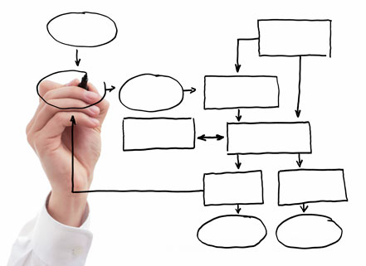

MIS 5121:Business Process, ERP Systems & Controls Week 7: General I/T vs. SAP System Controls,
Security Authorizations 1,
Financial Accounting and Controlling Controls
James Baranello
James.Baranello@temple.edu

Slide 2
Video: Record the Class

Slide 3
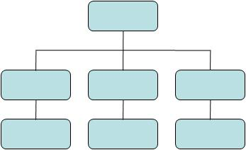
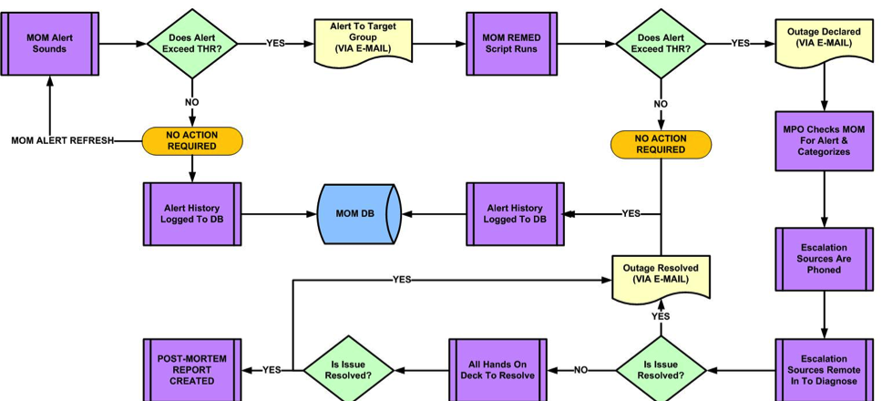
Business Function vs. Process
Function
  ‘An operation / group who perform related tasks routinely to achieve a part of an organization’s mission .’
  Business Dictionary
Process
  ‘A series of logically related activities / tasks performed together to produce a defined set of results.’
  Business Dictionary

Slide 4

Procurement at GBI
Marketing / Sales
Customers
Supplier
s
Customer Service
Supply Chain
Purchase
Order
Reqmts
Warehouse Distribution
Goods Receipt
Conversion
Procurement
Vendor /
Sourcing
Finance / HR
Billing
Invoice
Verify
Accounts Receivable
Accounts Payable
Payment

Slide 5
Order to Cash at GBI
Marketing / Sales
Customers
Supplier
s
Customer Service
Inquiry
Order
Supply Chain
Delivery /
Shipment
Warehouse Distribution
Conversion
Procurement
Invoice
Finance / HR
Billing
Accounts Receivable
Accounts Payable
Payment

Slide 6

The Many Flavors of Sales Order
Standard Orders
Free of Charge (samples, compensation)
Services / Not delivery related
Consignment
Miscellaneous Sales (Assets, RM’s, Leases, etc.)
Returns
Debit memo
Credit Memo
Rebate Settlement
Special country / tax scenarios

Slide 7

Inventory: Quantities
Inventory Record Accuracy (IRA): Does Physical inventory match system records
  Material / Batch
  Quantity
  Location
Methods: Physical Counting
    Periodic (e.g. yearly, quarterly, …) Frequency can depend on risk (e.g. value)
    Complete Count?
    If ‘miss’ someone else Adjusts Records based on Count

Slide 8

Inventory: Quantities
Inventory Record Accuracy (IRA): Does Physical inventory match system records
Methods: Cycle Counting
    Continuous counting of sections of inventory
    Hit or Miss based on tolerances (e.g. zero for package, +/- for bulk)
    If ‘miss’ someone else Adjusts Records based on Count
    Root cause analysis of reason and correction for ‘miss’
    Track IRA % (# Hits / # checks)
    Acceptable alternative for full physical counts
Common Issue: timing of physical moves vs. system recording
Notes:
Inv Rec Accuracy – will be on the test

Slide 9

Environment Favorable to Fraud
Framework for spotting high-risk situations
Perceived opportunity (I can do it / conceal it and not get caught)
  Poor internal controls
  Lack of oversight
Incentive or Pressure (Financial or emotional force pushing to commit fraud)
  Meet expectations
  Avoid criticism
  Cover a mistake
  Personal failures, needs
Rationalization (Personal justification for dishonest actions)
  Low compensation
  Company is profitable
Fraud
Opportunity
Incentive / Pressure
Rationalization
Fraud Triangle

Slide 10

Questions Re: Exam 1

Slide 11
Class Logistics
See ‘Roster / Schedule / Team’ section of Blog for:
  Schedule of Real World Control Failure Presentation (you’re deadline)
  Assigned Exercise / assignment teams for Exercises 3, 4, Final
Guest Lecturer on October 24
  SAP User and Controls in HANA (new version) vs. R/3
  Experiences as an auditor
  Some course content scheduled for that day

Slide 12



Discussion
Something really new, different you learned in this course in last week
Questions you have about this week’s content (readings, videos, links, …)?
    Question still in your mind, something not adequately answered in prior readings or classes?

Slide 13

General Computer vs.
SAP System Controls

Slide 14

Key Information Technology Risks
System Security
Information Security Administration
Data Migration
Data Interface
Instance Profile Security
Change Management
Transport Security
Table Security
Data Dictionary, Program and Development Security
Logs and Traces
Firefighter access
Powerful User ID’s and Profiles
Background Processing (Batch vs. foreground: real-time)

Slide 15

SAP Environment Security Components
Network
Security
Workstation
Security
SAP
Application
Security
Operating
System
Security
DataBase
Security
Goal:
Lockdown SAP Security

Slide 16
Enterprise Security Architecture
Behind the scenes, end users navigate through layers of security to reach the SAP Application
A Security Team generally handles all activities related to SAP Application Security
SAP Security Team works with IT Team to ensure appropriate security is implemented at levels: Database, System (e.g. Unix), Host and Network
Application
Security
SAP
SAP
Security
Database
Operating
System
Security
Unix
IT
Security
Host
Technology
Infrastructure
Security
Network
End User

Slide 17
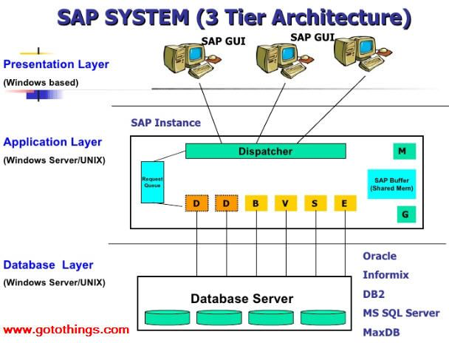
SAP R/3 Layer View

Slide 18

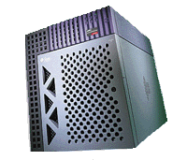
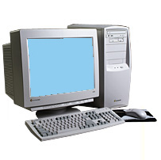


Our Exercises: who’s in Charge?
Internet Connection
Account on SAP UCC
Temple PC with SAP Gui
Security Layer | Owner
End User (sign-on)
Network
Host
Operating System
Database
SAP

Slide 19
Enterprise Security Architecture
Module Transaction Controls
Security and Security Administration is necessary at all levels of SAP Architecture
Different teams often responsible for each layer e.g. basis team handles the database, data dictionary & repository
End Users/Mgmt
Module / Process Transactions
Super Users
Application
Data
Module Level Master Data
Master Data Team
Client-level Master Data
Application Link E???__ (ALE)
Commercial
Data &
Company Structure
Module / Process Owners
Module Org Structure
And Master Data
Security, Change Control
Basis Configuration
Basis
Team
Data Dictionary
Repository
System
Control
Database
Operating
System
Network
End
User
Technical Architecture Team

Slide 20

SAP Landscape: Instance and Clients
SAP Instance
  Instance also referred to as a system
  An Instance has a dedicated physical database
  One installation of SAP software (source code / modules) and related logical database is an instance
  Instance shares SAP and developed software ‘code’ base
  No delivered integration of data or functionality between systems (possible with Application Linking and Enabling – ALE)
  Documentation of instances (systems) and clients often called: ‘Client / System Landscape’

Slide 21
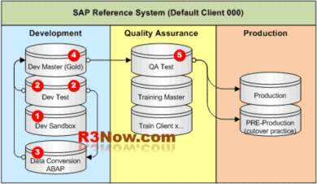
Minimum Rec’d SAP Landscape

Slide 22
SAP Landscape: Instance and Clients
SAP Clients
  Client is highest organization level with SAP System
  At least one client per system (e.g. ‘100’)
  Business transactions occur within a client
  Data Table view:
Column (attribute)
Field
Mandt
Client
201
202
Row
(Record)
203
204
205

Slide 23
SAP Landscape: Instance and Clients
SAP Clients
  Clients have two types of data:
    Client dependent – separate and unrelated
    Client independent – same for all clients in system (e.g. currency, units of measure, system parameters)
  Single logical database (linked to system / instance) may contain several clients
  Client typically represents a logical grouping of multiple companies
Column (attribute)
Field
Mandt
Client
201
Row
(Record)
202
203
204
205

Slide 24
Client setup for a hypothetical company
SAP 5 Server
Client 501
Client 502
Client 503
01 Global Bike
01 Global Bike
01 Global Bike
02 Global Bike
02 Global Bike
02 Global Bike
03 Global Bike
03 Global Bike
03 Global Bike
99 Global Bike
99 Global Bike
99 Global Bike

Slide 25
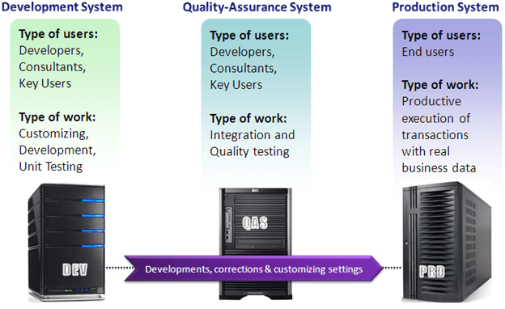
Typical SAP Landscape

Slide 26
External Financial Reporting regulations
Other Reg’s
Organization’s Objectives & Policies
Balance Sheet
P & L
Notes
FDA etc.
Performance & Policies
Arise through
Must be observed / achieved in
Business Processes
Procurement
Production
Order to $$
Finance
IT
Quality
Logistics
HR
…
Contain
Risks
Completeness
Existence, rights
Accuracy
Valuation
Presentation
Product quality
Delivery (OTD)
Unused capacity
Excess Costs
Lower Sales
Assertions
Errors & Fraud
Minimized by
ISC framework in the ERP environment
Entity level controls
Automated application controls
Manual and semi-automated business process controls
Authorizations and access protection (confidentiality, integrity)
IT General controls (change management, operation, security)
Automated testing and monitoring of business processes, KPIs, etc.

Slide 27
Security: SAP Authorization Concept

Slide 28
Key Information Technology Risks
System Security
Information Security Administration
Data Migration
Data Interface
Instance Profile Security
Change Management
Transport Security
Table Security
Data Dictionary, Program and Development Security
Logs and Traces
Firefighter access
Powerful User ID’s and Profiles
Background Processing (Batch vs. foreground: real-time)

Slide 29
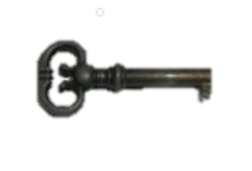
SAP Environment Security Components
Network
Security
Workstation
Security
SAP
Application
Security
Operating
System
Security
DataBase
Security

Slide 30

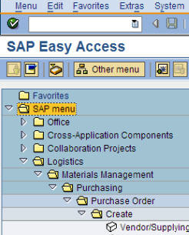
SAP Security Terminology
Transaction (T-code): used to access SAP Functions
or run programs. Each function & program in SAP has a
t-code assigned to it (e.g. VA01, ME23N, S_ALR_87012291)
T-code Insights
  All transactions and names stored in table TSTC
  Some common structures: M E 2 3 N
  S_ALR… : System Report
  Z…; Y…. : Custom transaction (non-SAP development) Typically company has naming convention
N – New version
Of existing transaction
Consult German
Dictionary
1 – Create
2 – Change
3 – Display
4, 5 Group Display
Notes:
Logon and view table TSTC via transaction SE16N HANA uses windows screens with access to function modules

Slide 31
SAP Security: Lock Concept
Transactions & Programs
Lock: Authorization Object
Core: Authorization Checks
Tumblers: Authorization Fields
SAP Terminology

Slide 32
SAP Security Terminology
Authorization Object: Logical template (‘lock’)
  Implements access restrictions in SAP
  Contains 1+ fields
  Referenced by authority-check statements coded in programs
  Often many objects referenced by same program
  Objects are ANDed together
  More than 900 SAP Supplied authorization objects
  Examples:
    V_VBAK_AAT: Sales Document: Auth for Sales Document Types
    V_VBAK_VKO: Sales Document: Auth for Sales Area
    F_BKPF_BES: Account Authorization for G/L Accounts
Transactions & Programs
Lock: Object
Core: Checks

Slide 33
SAP Security Terminology
Authority Check: (the lock ‘core’)
  Program statement(s)
  Checks the user’s authorizations buffer for fields and values (based on the referenced authorization object)
Authorization Field: (the lock ‘tumblers’)
  1-10 fields used in each object / check.
  Examples:
    Activity: function to be performed (create, change, display, etc.)
    Document type (e.g. sales, purchasing, production, …)
    Enterprise Hierarchy node (e.g. company, sales org / area, plant, etc.)
    Account type (e.g. customer, vendor)

Slide 34
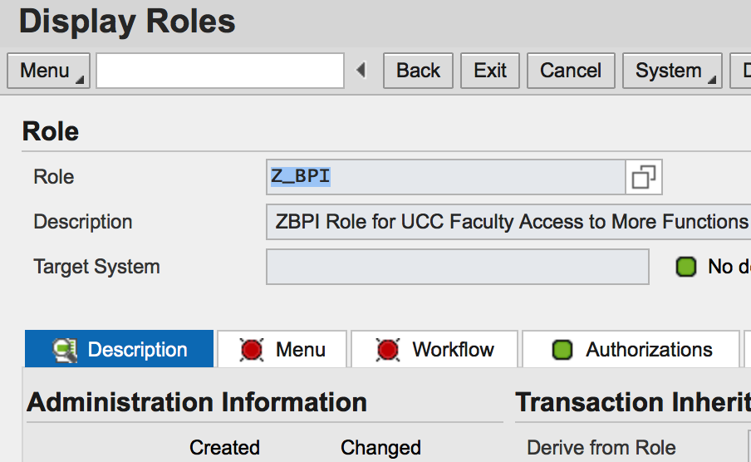
SAP Example
  Transaction: SUIM
  Select Role: ‘Z_BPI’
    – Authorizations tab
Notes:
Logon and use transaction SUIM
User Info… System -> Roles -> by Role Name
Select Z_BPI then hit Display Details Icon (Portrait)

Slide 35
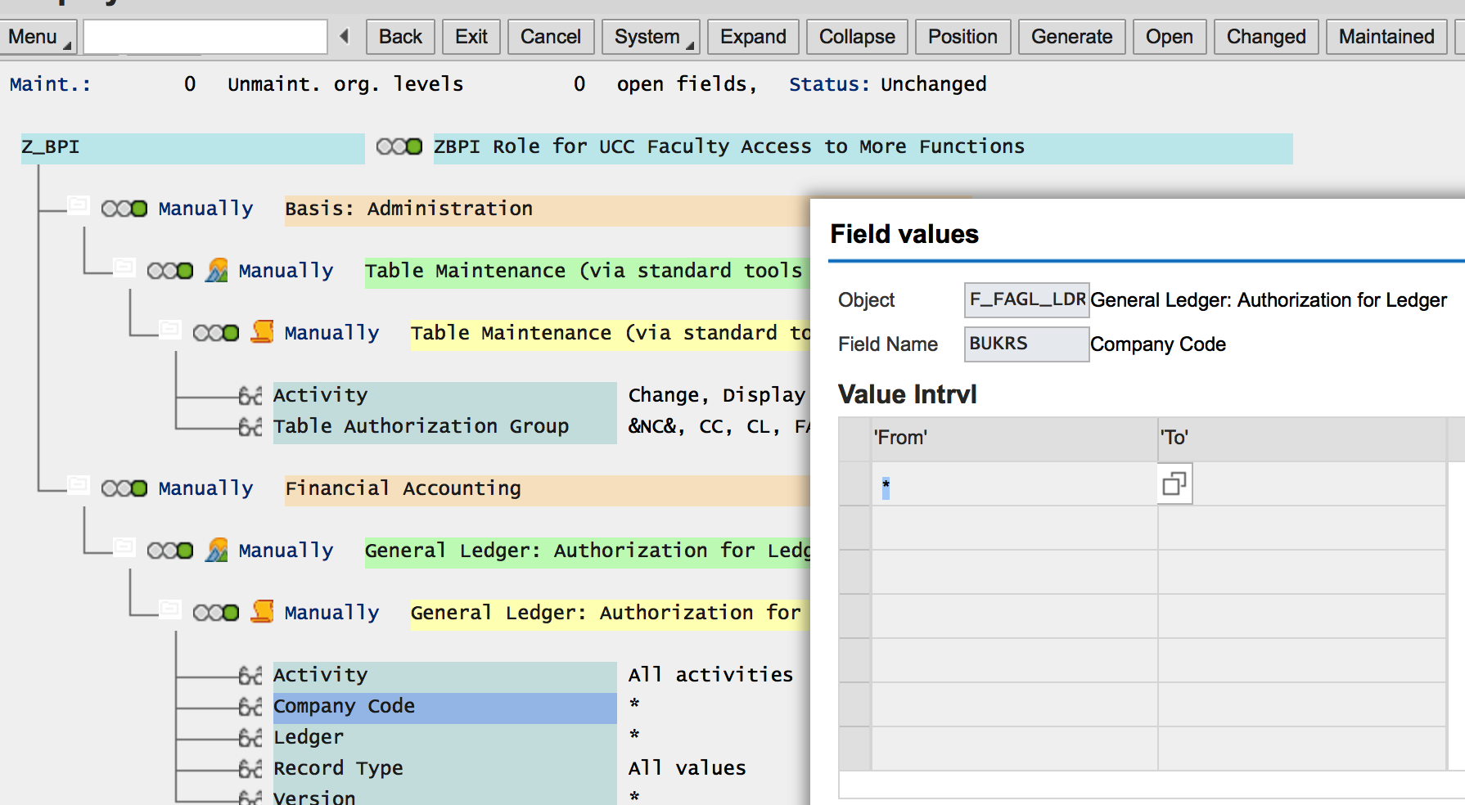
SAP Example
  Transaction: SUIM - Select Role: ‘Z_BPI’ – Authorizations tab
Notes:
Authorizations Tab -> Display Authorization Data (eyeglasses)

Slide 36
SAP Security: Key Concept
Lock: Authorization Object
Key Slot
Key
Authorization Values
Core: Authorization Checks
SAP Terminology
Transactions & Programs

Slide 37
SAP Security Terminology
Authorization Values:
  Collection of fields & values (‘keys’) referencing authorization objects
  Contained in user’s assigned authorization roles / profiles
  May or may not match values checked by an authorization check statement
  Values for same fields are ORed together
Lock: Authorization Object
Key Slot
Key
Core: Authorization Checks
Authorization Values
Transaction / Program
SAP Terminology
Notes:
Key ring has thousands of keys – given program / transaction will only reference a few of these

Slide 38
External Financial Reporting regulations
Other Reg’s
Organization’s Objectives & Policies
Balance Sheet
P & L
Notes
FDA etc.
Performance & Policies
Arise through
Must be observed / achieved in
Business Processes
Procurement
Production
Order to $$
Finance
IT
Quality
Logistics
HR
…
Contain
Risks
Completeness
Existence, rights
Accuracy
Valuation
Presentation
Product quality
Delivery (OTD)
Unused capacity
Excess Costs
Lower Sales
Assertions
Errors & Fraud
Minimized by
ISC framework in the ERP environment
Entity level controls
Automated application controls
Manual and semi-automated business process controls
Authorizations and access protection (confidentiality, integrity)
IT General controls (change management, operation, security)
Automated testing and monitoring of business processes, KPIs, etc.

Slide 39

Financial Accounting and
SAP System Controls

Slide 40

Company Code: Core SAP Definition
Company: central organizational unit of external accounting within SAP
  Definition:
    Usually corresponds to a legally independent company
    Should be depicted from a tax law, commercial or other financial accounting view
  Configuration:
    Defined / stored in table T001
    Each company has exactly one domestic currency
    Active company or not
    Do NOT delete company codes
    BUKRS – technical name
Notes:
SAP SE16N - T001 table, SPRO
At it’s core SAP has the heart of an accounting system

Slide 41

Finance: Critical Master Data
Chart of Accounts
  Centrally defined but individual company differences are possible:
    Nature of the company (e.g. holding company vs. operating company)
    Country
  Currency:
    Business transactions can be entered in foreign currencies based on exchange rates defined
    Need policies about definitions / maintenance
    Commonly imported from central banks
    Monthly exchange rates are common – some countries (e.g. Brazil) require daily rates
  Finance views of core master data:
    Materials (e.g. valuation)
    Customers (Pay from information, Credit)
    Vendors (Payment information)

Slide 42

Finance: Transaction Data Timing
Real-Time
  Routine Transactions (as result of business processes)
    Posted ‘real-time’
    But What is timing from event occurring vs. when entered in system?
  Captured in fiscal year posting periods (usually only 1 period ‘open’ for real-time events at a time)
  Important to verify for _______ assertion claim?
  Control focus: application controls
Manual postings
  Non-routine: Accounting / Finance entered based on own judgment / expert opinion
  SAP has tools for Recurring entries (e.g. monthly rent payments)
  Closing entries (later)
  Control focus: Substantive audit (check individual
  transactions)
Notes:
Assertions:
Occurrence / Existence – exist on a given date / actually occurred during the period

Slide 43

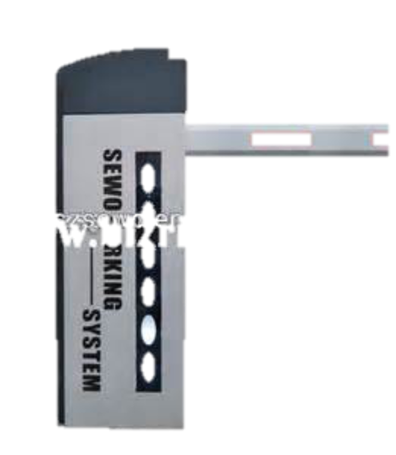
Finance: Document Parking
Used to enter / store (park) incomplete documents in SAP
  Parked documents are not posted documents
  Bypass extensive entry checks
  Complete / check / post at later date
  Values in parked documents can be used in some reports
Examples
  Vendor invoices missing needed information (e.g. PO #)
  3 way match is incomplete
  Customer payments missing needed information (e.g. invoice #’s payment linked to) or incorrect taxes
  Customer payments pending payment discount approval
  …

Slide 44

Finance: Document Parking
Used to enter / store (park) incomplete documents in SAP
Risks
Recommended Controls

Slide 45
Finance: Document Parking
Used to enter / store (park) incomplete documents in SAP
Risks
  Occurrence / Existence assertions unclear (does transaction really exist?)
  Incorrect transactions included in results
  If uncontrolled, continued eroding validity of data / assertions
Recommended Controls
  Parking policy: when allowed, how resolved
  Configuration to trigger workflow (rules based)
  Active monitoring of parked documents (#, value, aging) to assure in control (not growing, not becoming older)
  Audit and decision making of select entries (e.g. high value, oldest)
  Segregation of duties
  …
Notes:
Assertions:
Occurrence / Existence – exist on a given date / actually occurred during the period

Slide 46

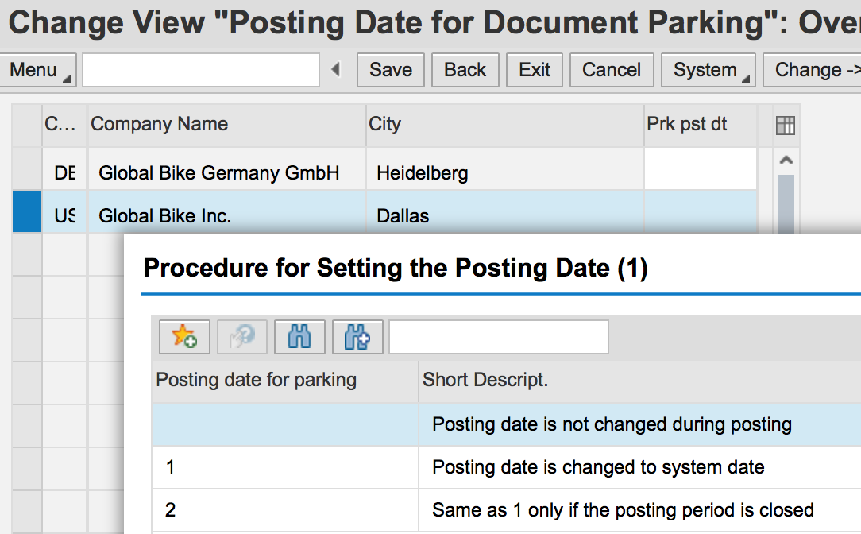
Finance: Document Parking
Configuration
  Trigger workflow (rules based)
  Financial Accounting (New) -> .. Global Settings (New) -> Document -> Document Parking …
Notes:
Assertions:
Occurrence / Existence – exist on a given date / actually occurred during the period

Slide 47


Finance: Reconciliation
Consistency Checks
  SAP standard transactions
    Sum of documents matches vendor, customer & G/L account totals
    Results maintained on ‘logs’
    Manufacture
Balance Confirmations:
  Validate vs. external data
    Bank statements / balances
    Balance confirmation letters to business partners (vendors and customers)
  Compare G/L balances and Ledgers
    Standard SAP transactions / reports
    Relatively low risk due to direct postings of activity

Slide 48
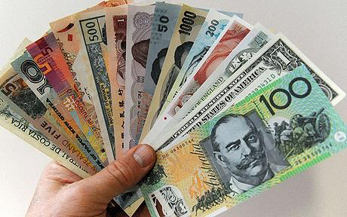
Finance: Other Controls
Account Determination
  Configured rules to define which G/L accounts are posted with transactions
  Also Master data (e.g. customer reconciliation account)
Foreign Currencies
  Maintain
    Manually or automated input from Central Banks
    Frequency? Some countries require daily
  Handling rounding, differences, dates
Notes:
Assertions:
Occurrence / Existence – exist on a given date / actually occurred during the period

Slide 49
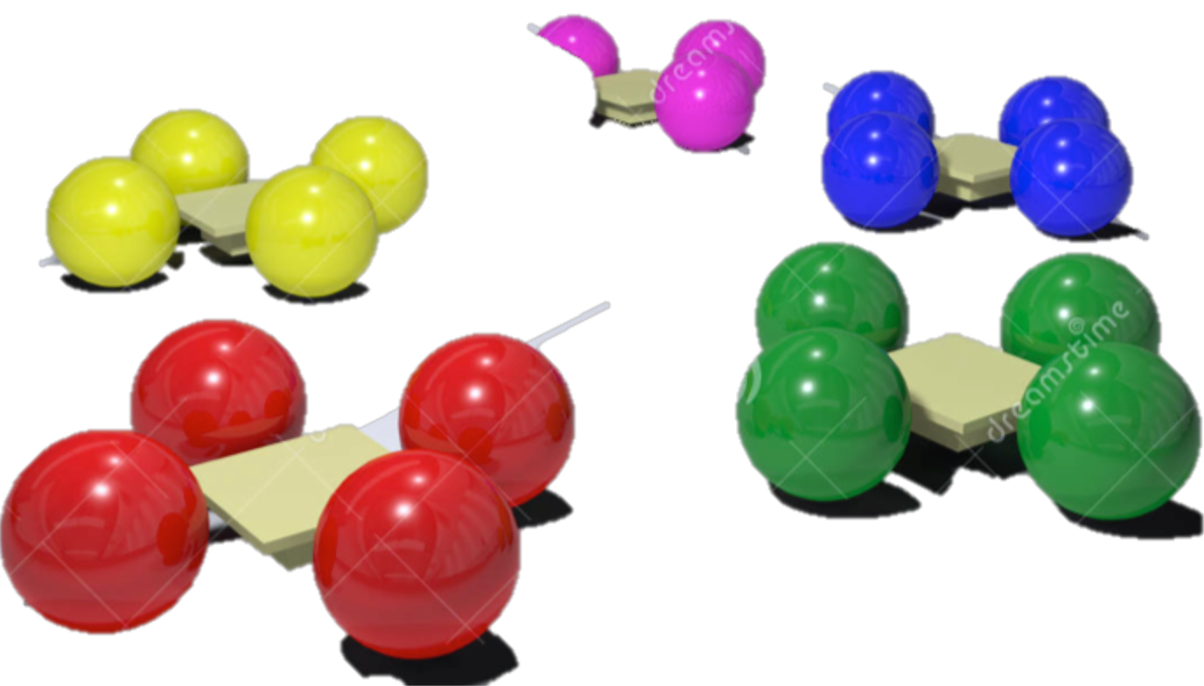
Breakout Activity – Rules
Break into teams – max of 5 people / team
  Diversity a must.
Assignment – return via WebEx Notes or Word Document
How: WebEx breakout?
Time: assigned today 20 min (including break)
  Start back on-time

Slide 50


Breakout Question
Finance and Accounting Processes
  What Could go Wrong?
  ______________
  ______________
  ______________
  ______________
  ______________

Slide 51


Slide 52

Report Back

Slide 53

Remaining Exercises
Exercise 3: Journal Entries Due: October 27
Exercise 4: Segregation of Duties Due: November 10
Final Case: Risk / Control Matrix Due: December 15
Work for these will be completed by 2-3 person Teams
  Tried to pair those with some accounting background with someone who does not
  One (1) submission by each team
  Share the grade

Slide 54
Journal Entries Exercise
Primary learning objectives are:
  Experience concepts of beginning financial accounting
  Work with a manual accounting information system
  Experience how an ERP system handles the steps of the accounting cycle
  Investigate related application controls in an ERP system

Slide 55
Exercise 3: Journal Entries
Agenda
  This Class (October 17): Tasks 1 - 3 (Manual steps)
  Next Class (October 24): Tasks 4 - 6 (SAP steps)
  Due October 26 11:59 PM: Assignment Submission sheet

Slide 56
Exercise 3: Journal Entries
Task 1: In SAP ERP system , review the chart of accounts for GBI.
  Accounting ➔ Financial Accounting➔ General Ledger ➔ Information System➔ General Ledger reports➔ Master Data➔ Chart of Accounts➔ Chart of Accounts (S_ALR_87012326)
  Examine the GLXX chart of accounts(XX is your assigned SAP student login ID#.)

Slide 57
Exercise 3: Journal Entries
Task 2: Record the daily transactions
  Record if appropriate, (some events may not involve journal entries)
  Record into Excel
  Review the post of these journal entries into t-accounts (Excel automation) and the calculated account balances using cell formulas in Excel.
  Review t-account balance flow into your Excel worksheet as a trial balance. Assure validity of links within spreadsheet that expedites the process and minimize risk of an error in data entry

Slide 58
Exercise 3: Journal Entries
Task 3: Record the adjusting entry transactions
  Based on the Month-end Adjustment Checklist, Record the needed journal entries into Excel
  Review the post of these journal entries into t-accounts (Excel automation) and the calculated account balances using cell formulas in Excel.
  Review t-account balance flow into your Excel worksheet as a trial balance. Assure validity of links within spreadsheet that expedites the process and minimize risk of an error in data entry

Slide 59
Extra Slides

Slide 60
Exercise 3: Journal Entries
Task 4: Use SAP ERP system to make all above entries using the general ledger system in SAP.
(Instructions for using the SAP ERP system start on page 15 of this document)
Accounting ➔ Financial Accounting ➔ General Ledger ➔ Posting ➔ Enter G/L Account Document (FB50)
Record beginning account balances in the SAP general ledger. Enter as one composite journal entry (first journal entry). Use journal entry date of January 1.
Be sure to compare to Excel spreadsheet to make sure the entries are correct.

Slide 61
Exercise 3: Journal Entries
Step 4: Using SAP general ledger system
Accounting ➔ Financial Accounting ➔ General Ledger ➔ Posting ➔ Enter G/L Account Document (FB50)
Record the daily and month-end transactions for January in the SAP general ledger
    Do each journal entry as a separate entry, not as one giant composite entry
    Use appropriate dates – this allows for a good audit trail.

Slide 62
Exercise 3: Journal Entries
Task 5: Using SAP General / Ledger system
  Display the trial balance.
  Compare this balance to your manual entries.
  If the trial balance does not match your manual entries, research the errors and make necessary corrections.

Slide 63
Exercise 3: Journal Entries
Task 5: SAP General / Ledger system:
Options for viewing the journal entries:
  Document Journal: Information System → General Report Selection → Financial Accounting → General Ledger Reports → Document → General → Compact Document Journal → Compact Document Journal (S_ALR_87012289)
  Source Document Drill Down: Accounting → Financial Accounting → General Ledger → Account → Display/Change Line Items (FBL3N)
  Line Item Journal: Information System → General Report Selection → Financial Accounting → General Ledger Reports → Document → General → Line Item Journal → Line Item Journal (S_ALR_87012291)

Slide 64
Exercise 3: Journal Entries
Task 6: Using SAP general ledger system
Review the Balance Sheet and Profit and Loss Statement:
  Accounting → Financial Accounting → General Ledger → Information System → General Ledger Reports → Balance Sheet/ Profit and Loss Statement/Cash Flow → General → Actual /Actual Comparisons → Balance Sheet/ Profit and Loss Statement (S_ALR_87012284)
  How do these statements match your manual trial balances?
  Print or save in Excel or Word format

Slide 65
Participation Grades
Easiest method to
accumulate Grade points
Points for:
  Attend and participate in Class
  Blog posts (each week)
Blog Post Expectations
  Substantive comments (not just an
  I agree reply)
  More than 1 -2 sentences
  Include your own original thoughts, experiences, etc.
  Focused on topic of question
Blog Posts have been improving

