Slide 1
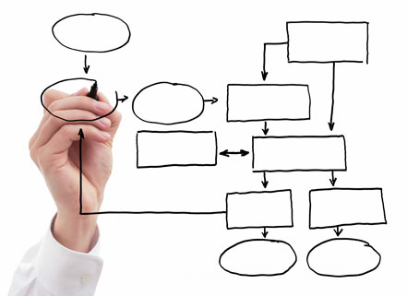
MIS 5121: Business Process, ERP Systems & Controls Week 9: Security: User Management, Segregation of Duties (SOD)
James Baranello James.Baranello@temple.edu

Slide 2
Video: Record the Class

Slide 3
Discussion
Something really new, different you learned in this course in last week
Questions you have about this week’s content (readings, videos, links, …)?
Question still in your mind, something not adequately answered in prior readings or classes?

Slide 4
Competencies of Security Manager
Detail Oriented / Data Analytic
Communication Skills
Integrity
Curiosity (find risk, vulnerabilities)
Eager to Learn
Flexible / Adaptable
Business Acumen
Deep Knowledge of system / function
Good Manager
Juggle multiple projects
Delegate
Notes:
Logon and follow along

Slide 5
Competencies of Security Manager
Detail Oriented / Data Analytic
Communication Skills
Integrity
Curiosity (find risk, vulnerabilities)
Eager to Learn
Flexible / Adaptable
Business Acumen
Deep Knowledge of system / function
Good Manager
Juggle multiple projects
Delegate
Notes:
Logon and follow along

Slide 6
Security (Continued): User Management

Slide 7
SAP Security: Review
_______
_____: Authorization Object
______
Imbedded In
____________ : Authorization Values
Assigned To
____: Authorization Checks
_______: Authorization Fields
____: Roles / Profiles

Slide 8
SAP Security: Review
Program
Lock: Authorization Object
User ID
Imbedded In
Values on Key: Authorization Values
Assigned To
Core: Authorization Checks
Tumblers: Authorization Fields
Keys: Roles / Profiles

Slide 9
SAP Security: Key Concepts
Program
Lock: Authorization Object
Imbedded In
Key Slot
User ID
Key
Assigned To
Authorization Values
Core: Authorization Checks
Tumblers: Authorization Fields
Transactions & Programs
SAP Terminology

Slide 10
SAP Security Terminology
Authorization Object: Logical template (‘lock’)
Implements access restrictions in SAP
Contains 1+ fields
Referenced by authority-check statements coded in programs
Often many objects referenced by same program
Objects are ANDed together
More than 900 SAP Supplied authorization objects
Examples:
V_VBAK_AAT: Sales Document: Auth for Sales Document Types
V_VBAK_VKO: Sales Document: Auth for Sales Area
F_BKPF_BES: Account Authorization for G/L Accounts
Transactions & Programs
Lock: Object
Core: Checks

Slide 11
SAP Security Terminology
Authority Check: (the lock ‘core’)
Program statement(s)
Checks the user’s authorizations buffer for fields and values (based on the referenced authorization object)
Authorization Field: (the lock ‘tumblers’)
1-10 fields used in each object / check.
Examples:
Activity: function to be performed (create, change, display, etc.)
Document type (e.g. sales, purchasing, production, …)
Enterprise Hierarchy node (e.g. company, sales org / area, plant, etc.)
Account type (e.g. customer, vendor)

Slide 12
SAP Example
Transaction: SUIM
Select Role: ‘Z_BPI’
– Authorizations tab
Notes:
Logon and use transaction SUIM
User Info… System -> Roles -> by Role Name
Select Z_BPI then hit Display Details Icon (Puzzle pieces)

Slide 13
SAP Example
Transaction: SUIM - Select Role: ‘Z_BPI’ – Authorizations tab
Notes:
Authorizations Tab -> Display Authorization Data (eyeglasses)

Slide 14
User Administration – SU01
User Master Record
Key: User ID (Same as for other Systems?)
Contains privileges of the user
Roles (and related profiles) assigned
During SAP logon all assigned authorizations loaded from master record into User Buffer
Other Data:
Address, Contact Info
Default Date format, decimal format
User Parameter data (can be used to prepopulate Data)
User Groups
User ID
Notes:
Logon and follow along

Slide 15
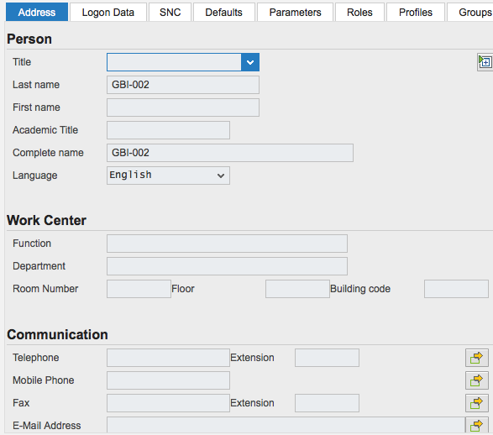
Create user ID – SU01
Complete as many fields as possible (per user administration standards)
Certain fields may be required
Menu ➔ Role ➔ Create ➔ Role (F5)

Slide 16
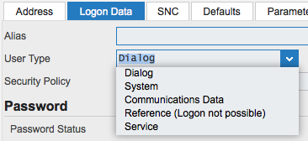
Create user ID – SU01: User Type
Dialog (A): Normal type user
Password enabled (check, change expired, …
Multiple logons checked and logged
System (B): e.g. Batch User
Communication without dialog in one system or
Background processing in one system
Excluded from general password validity settings (change, expiration, etc.)
Communication (C): Communication between systems (without dialog)
RFC or CPIC service users. E.g. ALE, Workflow, TMS, CUA
Notes:
RFC: Remote Function Call SAP Proprietary interface over TCP/IP, CPI-C
CPIC: Common Programming Interface for Communications IBM SNA now in X/Open C210
ALE: Application Link Enabling: Exchange of business data between loosely-coupled R/3 applications
TMS: Transportation Management System
CUA: Central User Administration – user accounts in central client

Slide 17
Create user ID – SU01: User Type
Reference (L):
General user not assigned to person
Cannot log on using Reference User
Used to equip Internet users with identical authorizations
Service (S):
Required for dialog-free communication between central components of SAP via PI
Used by Java components of PI
PI (Process Integration) is SAP Netweaver integration tool
Used between SAP modules (e.g. ECC, GTS, CRM, SRM, …) and non-SAP applications
Generally this user is assigned very restricted authorizations

Slide 18
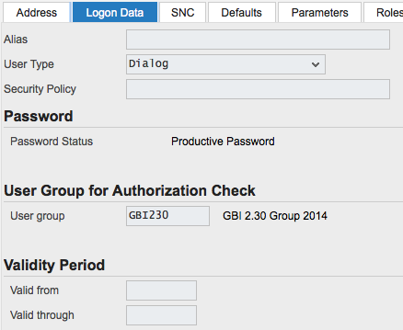
Create user ID – SU01: Logon Data
Alias: Reference for internet applications / users. Max 40 characters
Password: Initial password
User Group: Department, country, …Can be used for security and in SUIM
Validity Period: For temporary users (e.g. contractors)

Slide 19
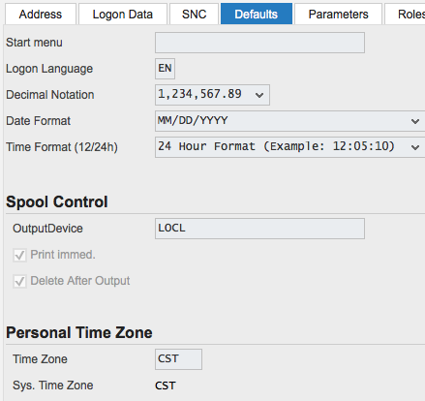
Create user ID – SU01: Defaults Tab
Complete fields per User Administration Standards
Formatting: Changes what appears on screen, not what’s stored in system (display format only)
Language
Decimal Notation
Date Format
Time Format
Output Device: Default printer / output parameters LOCL – uses PC’s default printer (can be formatting issues)
Time Zone: Display only? Note system time zone

Slide 20
Create user ID – SU01: Parameters
Parameters: Screen independent data
Usually linked to a field (e.g. plant, sales org, …)
Useful to automatically provide a default value for a field
Also used to manage via user settings how SAP works (e.g. ability to save OTC variants

Slide 21
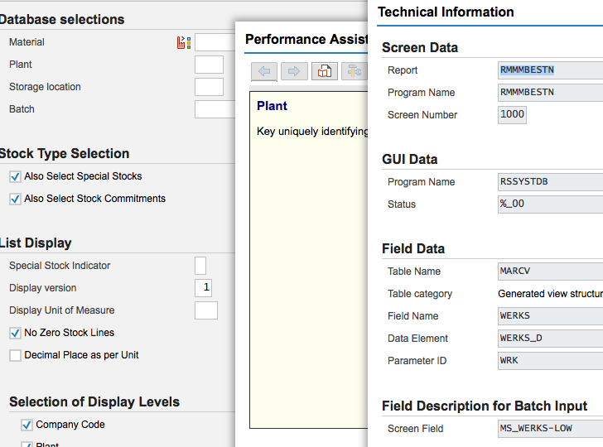
Parameters: Most fields Have one
F1 - Help

Slide 22
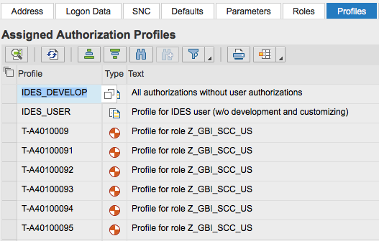
Create user ID – SU01: Roles / Profiles
Security Repository for User
Note: Effective dates for Roles
Profiles tab auto-populated based on Roles Assigned
Details from these tabs pulled into User Buffer during Logon

Slide 23
Leftover Question: SAP Roles vs. Profiles
Profiles: (e.g. T-I3550199 - Profile for role SAP_AUDITOR_ADMIN)
Only contain the authorization objects and values
Means of assigning authorizations prior to 4.0 versions that introduced Roles
Assignable to users in user master record
Max 150 authorizations in user master record
Roles: (e.g. SAP_AUDITOR_ADMIN - AIS - Administration)
Includes assignment of transactions and related auth objects
During role creation (PFCG) when you select transactions, the related profiles are system generated (not directly assignable) to pull the auth objects to the role
Can be assigned to users

Slide 24
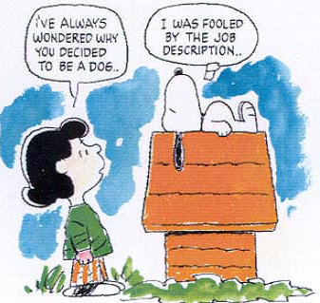
Application Security: Example
SAP Enterprise Central Component (ECC)
Role: Maintain Purchase Requisitions
T-code: ME51
Create Purchase Req
T-code: ME52
Change Purchase Req
Business Job / Role (e.g. Buyer)
Role: Display Purchase Requisitions
T-code: ME5K
Reqs by account Assign
User
SAP Business Intelligence System (BI)
Role: Procurement Reports
T-code: ME51
Create Purchase Req
T-code: ME51
Create Purchase Req

Slide 25
Delete user ID – SU01
Deleting ID’s impacts items associated with ID
Parked documents
Workflow requests
Batch Jobs
Recommend inactivating rather than deleting in production (e.g. for defined transition period of time)
Inactivate by ‘Locking’ the user

Slide 26
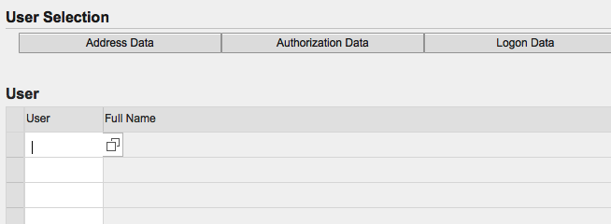
SU10: Mass User Maintenance
Same action – multiple IDs
Limited data tabs (e.g. Address, Authorizations, …)
When would you use?

Slide 27
SU01 / SU10: Lock / Unlock
User / Password Administration
Recommend Users manage their own passwords / sign-on credentials when possible
Change password – for dialog users requires resetting at next logon session
SU01 – single User ID
SU10 – Multiple ID’s

Slide 28
SUGR: User Groups
Define user groups with SUGR
Assign Users to groups in SU01, SU10, ???
Can do following with User Groups
Segregate users by technical teams (e.g. Basis, development, training, etc.) or process teams
Pull ID’s into SU10 (Mass Maintenance) by user groups
Reporting: can help with auditing

Slide 29
User Authentication
And You are Who ??!?
Designed to protect system availability, integrity and privacy
Authentication methods provided in SAP include:
Logon with password (Dialog user)
Secure Network Communications (SNC) (Single sign on?)
Client Certificates (interfaces?)
SAP Logon Tickets
Pluggable Authentication Services
Alignment of client policies and auditor judgment is important

Slide 30
Logon with Password Security
Initial password must be assigned to user
Passwords must meet internal requirements set by system (SAP Password Rules)
Cannot be more than 8 characters
First character not ‘ , ? or space
First three (3) characters not same order as User ID
First three (3) characters not identical
Password cannot be ‘Pass’ or ‘SAP’
User can change password maximum of once per day
User defined password cannot be same as last five (5) passwords

Slide 31
Logon with Password Security
Password parameters that Can be set by Customer (Customer Password Rules)
May not be in a list of impermissible passwords (table USR40)
Must be at least 6 characters long
System profile parameter login/min_password_ing
At least one (1) character in the new password must be different from old password (can’t shuffle same characters)
login/min_password_diff
Must be changed periodically (e.g. every 60 days)
login/min_expiration_time
Password Contents
login/min_password_uppercase login/min_password_lowercase
login/min_password_letters login/min_password_digits
login/min_password_specials

Slide 32
Access Other than User ID / Password
Secure Network Communication (SNC)
Available when using SAP GUI for Windows or Remote Function Call
Uses external security product to authenticate
Client Certificates
Used for Web applications such as SAP Web AS ABAP
Authenticate by user presenting X.509 client certificate
Authenticate takes place on Web server using Secure Sockets Layer (SSL) protocol
Transfer of passwords not needed
‘Single Sign-On’

Slide 33
Access Other than User ID / Password
SAP Logon Tickets
Single Sign-on to multiple SAP Systems
Authenticate once and SAP logon ticket is issued
Log in to other systems (SAP / non-SAP) via ticket
Pluggable Authentication
Delegates authentication to external system
E.g. Windows Domain Controller or a Directory Server
External system obtains SAP User ID from mapping table USREXTID
If successful: User issued a logon ticket (see above)

Slide 34
User Management Overview
User Types (examples, why different)
User Maintenance (Create / Change / Delete)
Examples of data maintained and why
Password Options
Couple Examples of SAP password rules and why useful
Couple Examples of Customer Password Rules (configuration options and why useful)

Slide 35
Security and Segregation of Duties (SOD)

Slide 36
Segregation of Duties
Definition
‘ensuring that at least two individuals are responsible for the separate parts of a task’
Goal: prevent error and fraud

Slide 37
Segregation of Duties
Implementation
Break down tasks that might reasonably be completed by a single individual into multiple tasks
No one person is solely in control
Prevent one person from having 2 of:
access to / custody of assets (operational responsibility)
Responsibility for asset’s accounting / recording
Approval / Authorization
Independent verification / Reconciliation
Prevent opportunity to commit and hide errors, fraud, theft
Notes:
Use Inventory as working example

Slide 38
Segregation of Duties
Other names
Separation of duties
Four eyes / two-man / two-person principle: two individuals approve some action before it can be taken
Implications
Break down can make process less efficient, require more people
Choose where to implement (high risk, mission critical)

Slide 39
SOD Examples
Examples of SOD related risks and controls in each area discussed
Procure to Pay Process
Order to Cash Process
Master Data
Financial Processes
Inventory
Person who ______________ should not be the person who ______________ .

Slide 40
SOD Examples
Procure to Pay
Person who requisitions the purchase of goods or services should not be the person who approves the purchase.
The person who approves the purchase of goods or services should not be the person who reconciles the monthly financial reports.
The person who approves the purchase of goods or services should not be able to obtain custody of checks.
Order to Cash
The person who negotiates Customer Prices should not be the person who approves the prices
The person who negotiates or approves Customer Prices should not be the person who enters the prices used on orders
The person who opens the mail and prepares a listing of checks received should not be the person who maintains the accounts receivable records.

Slide 41
SOD Examples
Master Data
Person who creates / maintains customer master data should not be the person who processes customer orders or receives payment.
Person who creates / maintains vendor master data should not be the person who processes purchase orders or processes vendor payments.
Financial Processes
The person who approves journal entry values should not be the person who enters or reconciles the journal entries
The person who maintains and reconciles the accounting records should not be able to obtain custody of checks.
The person who opens the mail and prepares a listing of checks received should not be the person who makes the deposit.

Slide 42
SOD Examples
Inventory Controls
Person who physically handles inventory should not be the person who enters inventory related transactions
The person who counts inventory stock should not be the person who reconciles vs. system inventory records not enters inventory adjustments.

Slide 43
Segregation of Duties (SOD) Overview
SOD Definitions
SOD Implementation Concepts
SOD Examples
1 or 2 in each area
How phrased
Note: The words ‘Segregation of Duties’ will no longer be sufficient response on an exam, assignment. You must delineate SOD risk: Person who ______________ should not be the person who ______________ .

Slide 44
Breakout Activity – Rules
Break into teams – max of 5 people / team
Diversity a must.
Assignment – return via WebEx Notes or Word Document
How: WebEx breakout?
Time: assigned today 20 min (including break)
Start back on-time

Slide 45
Breakout Question
Security
What has been your Experience?
______________
______________
______________
Why is Security so Complex?
______________
______________
______________
What about SAP Security don’t you Understand?
______________
______________
______________

Slide 47
Report Back

Slide 48
Segregation of Duties Exercise 4
Primary learning objectives are:
Experience specifying controls to address known business risks
Review and assign positions appropriate to handle process tasks
Make choices to manage the tension of SOD controls vs. excess personnel costs
Translating process tasks assignments to computer task assignments
Creating authorization design details necessary to implement security that enforce SOD

Slide 49
Segregation of Duties Exercise 4
Steps
Determine appropriate controls to mitigate defined business process risks. You will also be asked to assess additional risks associated with this business process.
Using the risk analysis as a base, examine assigned positions within the organization to be sure that there is adequate segregation of duties without incurring excess personnel costs.
Develop an authorization matrix that specifies the extent of computer access for each of the employees designated in the previous step (transitioning from paper-based to integrated ERP System environment)
Examine the SAP authorizations where you will see how to establish rules that enforce segregated duties.

Slide 50
Segregation of Duties Exercise 4
Agenda
This Class (October 30): Steps 1 – 2 (Risks / Control & Organizational design with SOD)
Next Class (November 6): Step 3 - 4 (Paper process to system process with SOD and authorizations to design)
Due November 9 11:59 PM: Assignment Submission
2017

Slide 51
Segregation of Duties Exercise 4
Step 1: Determine appropriate controls to mitigate defined business process risks. You will also be asked to assess additional risks associated with this business process.
For first 5 listed risks – Identify from suggested list the top 3 Controls to use
Identify for GBI 3 additional risks for the process defined (an Order to Cash example). Then from suggested list choose top 3 Controls you recommend using

Slide 52
Segregation of Duties Exercise 4
Step 2: Using the risk analysis as a base
Examine matrix of assigned positions within the organization vs. each process task
Adjust (including adding positions) to be sure that there is adequate segregation of duties for the process without incurring excess personnel costs.

Slide 53
Extra Slides

Slide 54
Leftover Question: SAP Roles vs. Profiles
Positions: (e.g. ZSAP_AUDITOR - AIS - Audit Information System)
Defined grouping of roles
Can be assigned to User (which pulls along the roles)
Profiles cannot be assigned to a position

Slide 55
Segregation of Duties Exercise 4
Step 3:
Examine the list of ERP System documents required to execute the process (from Step 2)
Develop an authorization matrix for each document and each organization position who uses document (e.g. specifies the extent of computer access for each of the employees)

Slide 56
Segregation of Duties Exercise 4
Step 4: Examine the SAP authorizations where you will see how to establish rules that enforce segregated duties.
Tools -> Administration -> User Maintenance -> Role Administration -> Roles (PFCG) View predefined roles and related authorizations (Page 18 of guide)
Answer questions related to your review / analysis

