Slide 1
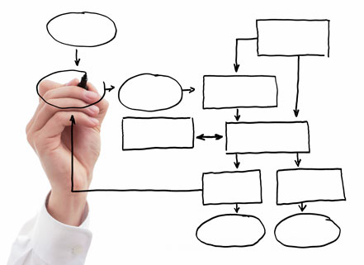

MIS 5121: Business Process, ERP Systems & Controls
Week 6: Order to Cash: Invoice, Payables,
Configuration Audit
James Baranello
James.Baranello@temple.edu

Slide 2
Video: Record the Class

Slide 3



Discussion
Something really new, different you learned in this course in last week
Questions you have about this week’s content (readings, videos, links, …)?
    Question still in your mind, something not adequately answered in prior readings or classes?

Slide 4
Exam 1
Will finish grading this evening. You’ll have until next Monday to review
I will curve the test base on best scores
Next week:
  Summary of scores
  Few slides, content that may be included in future exams
I will finish grading Exercise 1 this week (send via return e-mail) and will publish grades to date.

Slide 5
Assignment: Real World Control Failure
Starting in Week 7 (October 10) it’s your turn. 2 – 3 of you each week will be responsible to:
Find a real world example of a business process control failure (vs. just a hacking control failure).
Prepare brief review of failure. PowerPoint (PPT) template (see post) contains all the content components / points required
In video format, create a presentation of your review / story. Post that video as a comment to the blog post prior to class time of your scheduled week (based on an agreed sign-up schedule).

Slide 6
Assignment: Real World Control Failure
By Wednesday October 10: Send me (by e-mail) proposed 2+ potential weeks for scheduling your presentation. I'll prepare a final schedule and publish in blog's roster section.
Note: 5% of your course grade is earned by this project. Evaluation is based on:
  Including the required content components
  Clear, concise presentation of the control failure ‘story’ and lessons learned
  Originality in presentation of the control failure ‘story’
Notes:
Email to those responsible for week 7 (next week)

Slide 7
MIS 5121: Business Process, ERP Systems & Controls
Week 6: Accounts Receivable Control Failure s
Edward Beaver
Edward.Beaver@temple.edu
ff

Slide 8


Control Failure: Skimming
Background:
  Beverage company
  Controller became disillusioned with his job and employer
  Controller found skimming cash was ‘simple’ after accidentally receiving $1,000 more in cash than on deposit slip. He pocketed the $ vs. correcting the error
Control Failures:
  Cash from customer payments, direct customer sales and vending machine collections came to his desk (Last person to see the $$ before bank deposit)
  No monitoring of cash receipt process. Used new deposit forms to remove cash from bank deposit -> his pocket
  Discrepancies between cost of sales and inventory not monitored
  What was missing: ___________________________
Results:
  2 years -> $475,000 in controller’s pocket
  controller was fired for poor conduct (missing work, filing financial statements and tax returns late)
  Scheme uncovered when replacement temporary CPA found discrepancies
  Controller arrested
Reference:
  Accounts Receivable Fraud Link
Notes:
Awoke AT&T the sleeping giant – long distance carrier remaining from AT&T split

Slide 9
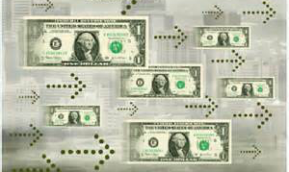

Control Failure: A/R Lapping
Background:
  Financial institution
  Programmer needed to quickly pay back a company bridge loan of $15,000 granted temporarily for moving / housing expenses as result of promotion and transfer
  Had unrestricted access to customer accounts
  Created fictitious account (elderly uncle’s name)
  Monthly would locate a customer account was large enough to handle a funds transfer of $15,000. Realizing that a funds transfer would create a record on the customer's statement, the programmer simply removed the funds from the "ending balance" field on the statement itself
  With monthly statement cycle – assumed he had 29 days to use the funds Created program to roll the $15,000 through the ending balance field on other accounts on a predetermined schedule.
  $$ bounced from account to account until he was able to repay.
  Scheme worked so well he expanded and eventually the $$ ‘loaned’ exceeded $150,000 and thousands of customer accounts.
Control Failures:
  Broad security privilege: Had unrestricted access to customer accounts
  No inter-month reconciliation of customer accounts
Results / Outcomes:
  Programmer forgot there were 28 days in February
  Many angry customer complaints from discrepancies in their February statements
  Fraud was uncovered
Reference:
  Accounts Receivable Fraud Link

Slide 10
External Financial Reporting regulations
Other Reg’s
Organization’s Objectives & Policies
Balance Sheet
P & L
Notes
FDA etc.
Performance & Policies
Arise through
Must be observed / achieved in
Business Processes
Procurement
Production
Order to $$
Finance
IT
Quality
Logistics
HR
…
Contain
Risks
Completeness
Existence, rights
Accuracy
Valuation
Presentation
Product quality
Delivery (OTD)
Unused capacity
Excess Costs
Lower Sales
Assertions
Errors & Fraud
Minimized by
ISC framework in the ERP environment
Entity level controls
Automated application controls
Manual and semi-automated business process controls
Authorizations and access protection (confidentiality, integrity)
IT General controls (change management, operation, security)
Automated testing and monitoring of business processes, KPIs, etc.

Slide 11
Business Process Controls
Order to Cash
(OTC, O2C)

Slide 12
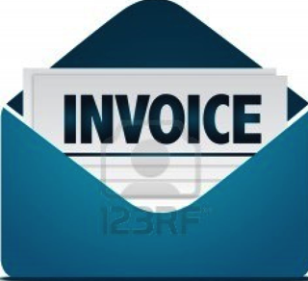
Order to Cash Process Flow
Pre-Sales
Customer
Order
Create Delivery
Create Shipment
Picking
Create Invoice
Payment
Packing
Goods Issue:
- Update Inventory
- Post General Ledger
Shipping
Documentation

Slide 13
Order to Cash: Document Flow
Pre-Sales
Inquiry
Quote
Contract
Sales (Scenarios)
Free of
Charge
Consignment
Regular
Order
Returns
Service
No Delv
Debit / Credit
Memo Request
Procurement
Shipping
Materials Management
Shipment
Shipping
Cost
Delivery
Billing
Invoice
Credit
Memo
Debit
Memo
Financial Accounting
Payment

Slide 14
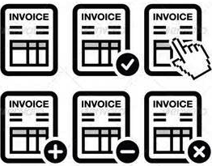
Billing / Invoicing
Billing Functions
  Issuing invoices, credit notes, debit notes, etc.
  Calculating, settling rebates / commissions
  Transfer billing data to FI (revenue recognition)
Billing Process
  Values copy from sales order, quantities from Delivery (if present)
  Commonly a small back-end / small accounting group function
  Created selectively or in batch (scheduled)
  Linked to delivery or sales order (config)
  Can combine several deliveries in one invoice (manual, calendars)
  Summary invoice
    Multiple linked customers
    Periodic (e.g. month-end) billing
    Individual invoice documents created (sent to FI) but output delayed
  Invoice outputs in various forms (mail, e-mail, EDI, …)

Slide 15
Billing / Invoicing
Postings following (controlled by config):
  Accounting document (revenue) FI
  Customer account (accounts receivable) FI
  Sales / Sales adjustment FI
  Accruals (rebates / commissions) FI
  Profitability analysis CO
Updates these documents:
  Delivery (VL03N)
  Linked order document (VA03)
Blocked Billing Documents
  Manual blocks (Order, Delivery) (e.g. value not defined)
  Accounting block (incompletion)
  If billing document is blocked -> no revenue recognized
  Blocked documents must be explicitly released

Slide 16

Sales Adjustments
Discounts / surcharges:
  From pricing conditions FI
Rebates:
  Special Discounts paid retroactively to a customer
  Rebate agreement defines criteria (e.g. material, material group, etc.) & calculation
  All billing documents when recreated can check for applicable rebate(s) and post calculated accruals
  Agreement is ‘settled’ when credit memo is issued for accumulated rebate total
Commissions
  Payment / remuneration to an agent (sales person for hire)
  Internal and External
  Commission agreement defines criteria (e.g. material, customer, etc.) & calculation
  All billing documents when recreated can check for applicable commission(s) and post calculated accruals
  Commission agreement is periodically ‘settled’. Payment via vendor payment
  Typically original invoice must be paid by customer before commission payment

Slide 17
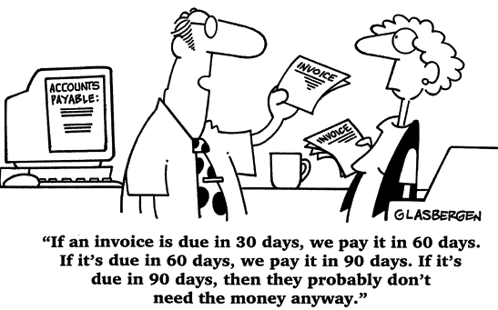
Customer Payments
Payment Process
  Receive payments (Cash, Checks, direct bank transfers, etc.)
  Record amounts in cashbook
  Matching receipts to invoices in the sales ledger (reconciliation)
  Some can be automated (esp. when customer sends document reference information)
Postings
  Cash
  Accounts Receivable (customer ledger)
Past Dues
  Customer Statements
  Dunning (Output to customer)
  Collections process
Notes:
Accounts receivable talks to customer’s accounts payable.

Slide 18
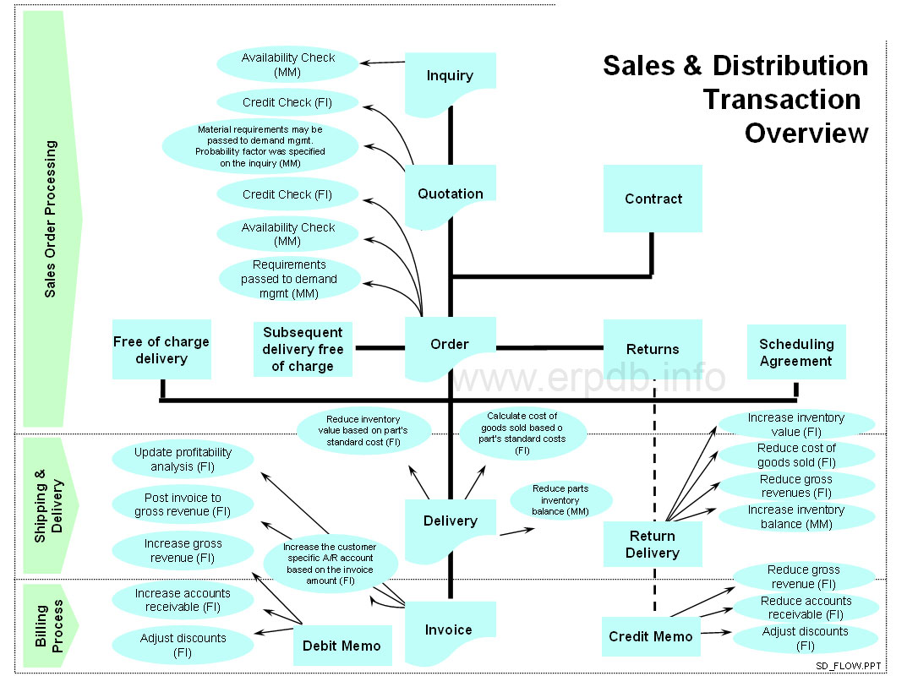
Notes:
Another view of the process

Slide 19

Breakout Activity – Rules
Break into teams – max of 5 people / team
  Diversity a must.
Assignment – return via WebEx Notes or Word Document
How: WebEx breakout?
Time: assigned today 20 min (including break)
  Start back on-time

Slide 20

Breakout Question
Order to Cash Process: Invoicing and Payment
  What Could go Wrong?
  ______________
  ______________
  ______________
  ______________
What Controls would you Implement to address?
      ______________
      ______________
      ______________
      ______________

Slide 21


Slide 22

Report Back

Slide 23

Order to Cash (b) : Common Risks
Invoicing / Billing
Manipulation of names and address on vouchers / refund
Records lost / destroyed
Wrong invoices / duplicate invoices
Revenue of various types of sales improperly categorized
Sales and cost of sales are recognized during an inappropriate time period.
Complex sales transactions are often difficult to determine when a sale actually takes place. For example, title passes only when some contingent situations are met, or the customer may have an extended period to return the goods. Specifically:
  What is the point in time when revenue should be recognized
  Impact of unusual terms and whether title has passed to the customer
  How to assure all goods recorded as sales have been shipped and were new goods
  Treating sales transactions made with recourse or that have an abnormal or unpredictable amount of returns
Unauthorized returns / adjustments

Slide 24

Order to Cash (b) : Common Controls
Invoicing / Billing
Automatic invoicing (once PGI occurs)
Backlog of invoicing monitored and controlled
Unusual or sensitive documents are subject to further management review prior to posting. Only valid cash payments are made
Policy to define and procedures at closing to assure revenue recognition (posting) timing corresponds to when title and risk / reward of ownership transfer to customer
Return policy with crisp guidelines and decision criteria (written, taught, monitored)
Use pre-numbered invoicing documents with subsequent accounting of all documents
Use of pre-numbered return documents with subsequent account of all documents
Period reconciliation of shipping and invoicing records
Review all changes made to invoice / billing documents (authorized, not material)
Internal and regulatory audits of tax collections
Notes:
Documents open 1-2 days past due dates are reviewed. No open past __ days without specific knowledge of issue and action plan.

Slide 25
Order to Cash (b) : Common Risks
Customer Payment
Not All cash payments that occurred are recorded
Cash payments /refunds are in-correctly recorded in the ledger
Cash payments / refunds are executed without valid authorization
Not all cash receipts are recorded and / or not in correct amounts
Cash receipts not recorded to correct receivables accounts and to the general ledger
Cash receipts are recorded in the incorrect accounting period
Recognition of revenue on shipments that never occurred
Hidden “side letters” giving customers an irrevocable right to return the product
Recording consignment sales as final sales
Early recognition of sales that occurred after the end of the fiscal period
Creation of fictitious invoices
Sales of receivables made with recourse but recorded as sales of the receivables rather than as financing transactions
Receivables pledged as collateral against specific loans. Disclosures of such restrictions are required.
Receivables incorrectly classified as current when the likelihood of collection during the next year is low
Collection of receivables contingent on specific events that cannot currently be estimated
Payment is not required until the purchaser sells the product to its end customers.

Slide 26
Order to Cash (b) : Common Controls
Customer Payment
Monthly statements sent to customers. Group independent of those recording transactions receives and follows up on complaints
Payment Policy and procedures (Written, taught, monitored)
Reconciliation of bank accounts with internal cash accounts and A/R
Monitor and control aged receivables
Write-off of receivables handled: segregated from operations, separate authorization, document trail supporting decisions
General / Other
Segregation of duties
Limiting access to the files to authorized individuals
Review / validate handling of Complex, large ($$), high impact transactions
Notes:
Documents open 1-2 days past due dates are reviewed. No open past __ days without specific knowledge of issue and action plan.

Slide 27
Real Examples: Improper Revenue Recognition
Coca-Cola charged with coercing its largest distributors to accept delivery of more syrup than they needed at the end of each quarter. Inflated sales by about $10 million/ year
Gateway recorded revenue for each free subscription to AOL services that was given with each computer sale, thus overstating pre-tax income by over $450 million.
Kmart improperly included as revenue an American Greetings Corp $42.3 million payment that was subject to repayment under certain circumstances (should not be fully booked)
Xerox improperly accelerated $6 billion revenue from long-term office equipment leases
Qwest immediately recognized long-term contract revenue, vs. the 18-24 month contract period thus inflating revenue by $144 million in 2000–2001.
Quest inflated revenue ($950 million) by swapping network capacity with Global Crossing.
Rite-Aid sold 189 stores to J.C. Penney. Instead of booking $82.5 million one-time gain, put amount into internal reserve account and used it to absorb future operating expenses.
Bristol-Myers inflated 2001 revenues up to $1 billion via wholesaler sales incentives to take delivery of the products with intent to sell the following year (channel stuffing).
Lucent Technologies improperly booked $452 million in revenue (2000) via products sent to distribution partners that were never actually sold to end customers (channel stuffing).
Charter Communications (cable company) added $17 million to revenue (2000) via phony ad sales deal with unnamed set-top decoder maker. Maker tack $20 onto invoice price of each box. Charter held cash as an ad sale. Net income not affected but revenue increased.
￼Sources: Atlanta Business Chronicle, June 2, 2003; Accountingweb.com, July 14, 2003; Accountingweb.com, May 19, 2003; The Wall Street Journal Online, February 25, 2003; The Wall Street Journal Online, February 26, 2003; The Wall Street Journal Online, June 28, 2002; St. Cloud Times, February 26, 2003, p. 6A; The Wall Street Journal Online, February 8, 2001; The Wall Street Journal Online, July 11, 2002; The Wall Street Journal Online, February 9, 2001; USA Today, July 25, 2003

Slide 28
Reference
Checklist: Standards of Internal Control: Invoice processing (IOFM)
Thomson Learning: Auditing Revenue Chapter

Slide 29

Real World Control Example
Configuration Control
(Order to Cash)

Slide 30
Control Definition Outline
Reference #: OCRW-608
Control Activity: Tolerance groups have been appropriately configured inline with managements intentions.
Process Order to Cash
Sub-Process Cash Application
Location Headquarters
  Frequency: Used: Z: Multiple x/day
            Review: A: Annual
Automated: vs. Manual: Automated
Control type: P: Preventative
Control Owner: Order to Cash Business Process Architect

Slide 31
Configuration Review Procedure
Transaction: SPRO (SAP Reference IMG)
  Financial Accounting (New) > Accounts Receivable and Accounts Payable > Business transactions > Open item clearing > Clearing Differences > Define Tolerances for Customers/Vendors
Click on Company Codes under review
Ensure tolerance settings are appropriate
Conclusion: ________________________

Slide 32
Configuration Review Procedure (Alternate)
Download related configuration table.
Transaction: SE16N
  Table: T043G (Tolerances for Groups of Customers /Vendors)
Download table
Review active entries and ensure tolerance settings are appropriate
Conclusion: ________________________

Slide 33


Order to Cash Exercise
Primary learning objectives are:
  Experience the steps in a typical sales transaction
  See how an ERP system handles a typical sales transaction
  Work through the procedures involved in a test of transactions
  Look at a special feature of the sales and distribution (SD) module of SAP
  See the integration between Sales and Distribution (SD) and financial accounting (FI) modules of SAP

Slide 34
Exercise 2: Order to Cash
Agenda
  Prior Class (September 26): Steps 1 – 8
  Last Class (October 3): Steps 9 – 15
  This Class (October 10): Steps 16 – 23
  Due October 13 11:59 PM: Assignment Submission

Slide 35
Exercise 2: Order to Cash
Agenda
  Last Class (Feb 8): Steps 1 – 8
  This Class (Feb 15): Steps 9 – 15
  Next Class (Feb 22): Steps 16 – 23
  Due Feb 25 11:59 PM: Assignment Submission

Slide 36
Exercise 2: Order to Cash
Task 16 – Create an Invoice for the Delivery
  Menu: Logistics ► Sales and Distribution ► Billing ► Billing Document ► Create
  Transaction: VF01
Task 17 - Check Status of Various Accounts
  See details of Task 5
Task 18 – Display the Document Flow for the Sales Order
  Within transaction use menu: Environment ► Display Document Flow
  Transaction: VA03

Slide 37
Exercise 2: Order to Cash
Task 19 – Locate the Accounting Document Number
  Menu: Logistics ► Sales and Distribution ► Billing ► Billing Document ► Display
  Transaction: VF03
Task 20 – Post the Customer’s Payment on Account
  Menu: Accounting ► Financial Accounting ►Accounts Receivable ► Document Entry ► Incoming Payment
  Transaction: F-28

Slide 38
Exercise 2: Order to Cash
Task 21 - Check Status of Various Accounts
  See details of Task 5
Task 22 – Display the Document Flow for the Sales Order
  Within transaction use menu: Environment ► Display Document Flow
  Transaction: VA03
Task 23 – Write Down the Journal Entries the System Made
  Non-SAP Task

Slide 39
Extra Slides

Slide 40
Order to Cash Process Flow:
Order Blocks
Pre-Sales
Delivery
Block
Customer
Order
Create Delivery
Create Shipment
Picking
Billing
Block
Create Invoice
Payment
Packing
Goods Issue:
- Update Inventory
- Post General Ledger
Shipping
Documentation

Slide 41
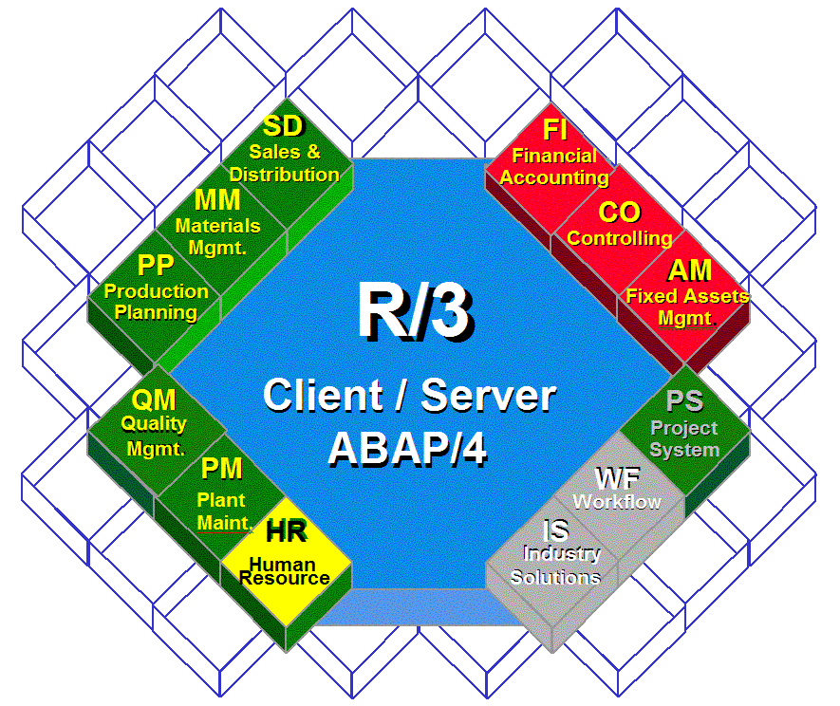
Order to Cash Functions in SAP
Customers
Payment
Invoice
Delivery
Order
Inquiry

Slide 42
Order to Cash Functions in SAP
Task | SD | MM | QM | FI | CO
Inquiry | ☑
Order | ☑ | ☑ |  | ☑
Delivery | ☑ | ☑ | ☑ | ☑ | ☑
Invoice | ☑ |  |  | ☑ | ☑
Payment |  |  |  | ☑

Slide 43
Reading Assignment Questions:
What is dunning?
The book noted that while sending dunning notice, customer relationship should be actively managed. Is there a limit of sending dunning notices (e.g. if five notices have been sent, but the customer still doesn’t make the payment, should the company end relationship with this customer)?
Returns & credit memos- how is communication handled if there have been a great amount of returns for items sold in a month that sales numbers have already gone out?

Slide 44
Exercise 2: Order to Cash
Task 1 – Extend the Material Master Record for Sales
  Menu: Logistics ► Materials Management ► Material Master ► Material ► Create (Special) ► Trading Goods
  Transaction: MMH1
Task 2 – Extend the Material Master Record for Sales
  Menu: Logistics ► Sales and Distribution ► Master Data ► Business Partners ► Customer ► Create ► Complete
  Transaction: XD01
Task 3 – Set up Credit Limits for the Customer
  Menu: Logistics ► Sales and Distribution ► Credit Management ► Master Data ► Change
  Transaction: FD32

Slide 45
Exercise 2: Order to Cash
Task 4 – Check Inventory Availability
  Quantity:
    Transaction: MMBE
  Value:
    Menu: Accounting ► Financial Accounting ► General Ledger ► Account ► Display Balances
    Transaction: FS10N or FAGLB03

Slide 46
Exercise 2: Order to Cash
Task 5 - Check Status of Various Accounts
  Check Inventory: MM Inventory Quantity
  Transaction: MMBE (Stock Overview)
  Check Account Values: GL Inventory, GL Cash, Sales Revenue, Cost of Goods Sold (COGS), GL A/Receivable : Transaction: S_ALR_87012291 (Line Item Journal)
  Check A/P Vendor sub-ledger:
  Transaction: FBL5N (Customer line item display)

Slide 47
Exercise 2: Order to Cash
Task 6 – Create a Sales Order
  Menu: Logistics ► Sales and Distribution ► Sales ► Order ►Create
  Transaction: VA01
Task 7 – Display the Sales Order
  Menu: Logistics ► Sales and Distribution ► Sales ► Order ► Display
  Transaction: VA03
Task 8 – Display the Document Flow for the Sales Order
  Within transaction use menu: Environment ► Display Document Flow
  Transaction: VA03
Task 9 - Check Status of Various Accounts
  See details of Task 5

Slide 48
Exercise 2: Order to Cash
Task 10 – Create the Delivery for the Sales Order
  Menu: Logistics ► Sales and Distribution ►Shipping & Transportation ► Outbound Delivery ►Create ►Single Document ►With Reference to Sales Order
  Transaction: VL01N
Task 11 - Check Status of Various Accounts
  See details of Task 5
Task 12 – Display the Document Flow for the Sales Order
  Within transaction use menu: Environment ► Display Document Flow
  Transaction: VA03

Slide 49
Exercise 2: Order to Cash
Task 13 – Post the Goods Issue
  Menu: Logistics ► Sales and Distribution ► Shipping & Transportation ► Outbound Delivery ► Change ►Single Document (VL02N)
  Transaction: VL02N
Task 14 - Check Status of Various Accounts
  See details of Task 5
Task 15 – Display the Document Flow for the Sales Order
  Within transaction use menu: Environment ► Display Document Flow
  Transaction: VA03

