Slide 1
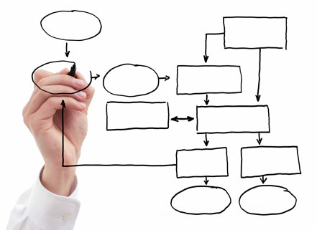
MIS 5121:Business Processes, ERP Systems & Controls Week 12: Auditing, Systems Development 2, Table Security, Control Framework
James Baranello James.Baranello@temple.edu

Slide 2
Video: Record the Class

Slide 3
Questions Re: Exam 2

Slide 4
MIS 5121: Upcoming Events
November 28th: Complete Student Feedback Forms [in class]
December 11th : Extra Credit Assignment – Due by Noon
December 12th: Final Exam (at class time)
December 13th : Final Exercise (Risk Control Matrix)- Due by Noon

Slide 5
Discussion
Something really new, different you learned in this course in last week
Questions you have about this week’s content (readings, videos, links, …)?
Question still in your mind, something not adequately answered in prior readings or classes?

Slide 6
SAP Security: Review
Program
Lock: Authorization Object
User ID
Imbedded In
Values on Key: Authorization Values
Assigned To
Core: Authorization Checks
Tumblers: Authorization Fields
Keys: Roles / Profiles

Slide 7
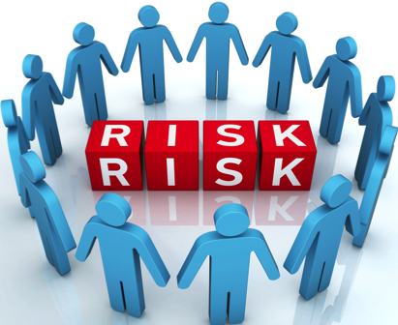
Risk / Control Matrix: Design Approach
Risks
Control, system and Security Design + Implementation
Automated Controls
Manual Controls
Application Security
Segregation of Duties
Approvals
Reports
Procedures
Define
Control Objectives
Influence
Control Activities / Controls
Drive
CONTROL DESIGN

Slide 8
Controls: Integration Points
Risk/Control Matrix can serve as the primary vehicle for integrating control design into project activities and deliverables
Automated (Access) Control
Security Analysis Tool
IT / Security
Risk / Control Matrix
SOD Controls & Sensitive Access
Segregation of Duties
Security Configuration
GRC
Subset
Business Process Teams
Program Development
Automated: Standard & Configuration
Bus Process Reqmts
Functional Spec
Automated (Custom) & Manual Controls
SOX Section 404 Integration
Technical Specification
Training & Procedures
Manual Controls

Slide 9
Controls: Integration Points
Risk/Control Matrix can serve as the primary vehicle for integrating control design into project activities and deliverables
Automated (Access) Control
Security Analysis Tool
IT / Security
Risk / Control Matrix
SOD Controls & Sensitive Access
Segregation of Duties
Security Configuration
GRC
Subset
Business Process Teams
Program Development
Automated: Standard & Configuration
Bus Process Reqmts
Functional Spec
Automated (Custom) & Manual Controls
SOX Section 404 Integration
Technical Specification
Training & Procedures
Manual Controls

Slide 10
SAP: Table Driven System Execution
SAP Processing is customized using thousands of Configuration tables
Access via the ‘Implementation Guide’ (Transaction SPRO)
Entries determine how transactions are processed
Entries also support implementation of controls (e.g. processing parameters and limits)
ERP Systems are Dynamic
Configuration table values and therefore system processing, are continually changed (process changes, business structure, etc.
Effective processing and control Requires:
Managed Design
Documentation
Notes:
Class Exercise: SE16N - TVAK – Sales Order Types
SPRO -> Sales and Distribution -> Sales -> Sales Document Header -> Define Sales Document Types

Slide 11
Real World Control Example Configuration Control (Order to Cash)

Slide 12
Control Definition Outline
Reference #: OCRW-608
Control Activity: Tolerance groups have been appropriately configured inline with managements intentions.
Process Order to Cash
Sub-Process Cash Application
Location Headquarters
Frequency: Used: Z: Multiple x/day
Review: A: Annual
Automated: vs. Manual: Automated
Control type: P: Preventative
Control Owner: Order to Cash Business Process Architect

Slide 13
Configuration Review Procedure
Transaction: SPRO (SAP Reference IMG)
Financial Accounting (New) > Accounts Receivable and Accounts Payable > Business transactions > Open item clearing > Clearing Differences > Define Tolerances for Customers/Vendors
Click on Company Codes under review
Ensure tolerance settings are appropriate
Conclusion: ________________________

Slide 14
Configuration Review Procedure (Alternate)
Download related configuration table. Transaction: SE16N
Table: T043G (Tolerances for Groups of Customers /Vendors)
Download table
Review active entries and ensure tolerance settings are appropriate
Conclusion: ________________________

Slide 15
Controls: Integration Points
Risk/Control Matrix can serve as the primary vehicle for integrating control design into project activities and deliverables
Automated (Access) Control
Security Analysis Tool
IT / Security
Risk / Control Matrix
SOD Controls & Sensitive Access
Segregation of Duties
Security Configuration
GRC
Subset
Business Process Teams
Program Development
Automated: Standard & Configuration
Bus Process Reqmts
Functional Spec
Automated (Custom) & Manual Controls
SOX Section 404 Integration
Technical Specification
Training & Procedures
Manual Controls
Notes:
Details in videos included in week 12 page
These slides are summary of key points, risks and controls (what might be included in test)

Slide 16
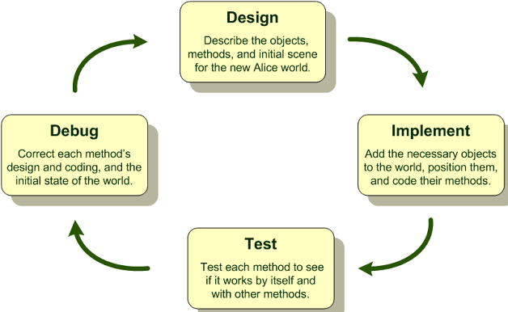
Program & Development Security
Types of Development Objects (FRICE)
Forms – outputs (invoices, Purchase orders, ...)
Reports – custom reports
Interfaces – SAP to other systems
Conversions – Data migration
Enhancements – Change system logic, use additional fields, etc.
User-Exits: defined SAP branches to custom code (lower risk)
Change SAP code (high risk, long term extra maintenance)
Workflow – non-config components, logic
Development: custom programs
Typically ABAP (SAP SQL extension programming language)
Notes:
Class Exercise: SE38 (Program Editor) SAPMV45A (VA01) - User exit: mv45afzz SD_Sales_Orders_view (VA05N

Slide 17
Program & Development Security
Is program code ‘good’
Does what it’s supposed to do
Limited to requirements only (not branch off to perform other nefarious actions)
Well-behaved: doesn’t mess up other programs, logic, operation of ERP system
Good Development Practices
Clear, documented, approved requirements defined before coding
Define Requirements, Design Logic before major coding (e.g. use of function modules for common logic)
Peer Code Reviews
Experienced development leadership
Test, Test, retest BEFORE moving to PRD (strong change management governance)
Notes:
Class Exercise: SE38 (Program Editor) SAPMV45A (VA01) - User exit: mv45afzh SD_Sales_Orders_view (VA05N)

Slide 18
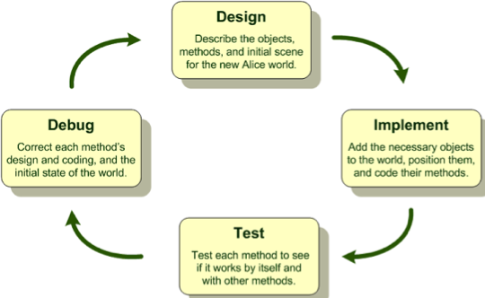
Risk and Recommendation Program Security
Risks:
Unintended, nefarious uses of program code
Users capable of executing programs directly can compromise standard controls (access security, audit trails)
Users with access to run ALL programs are allowed to run all executable programs (note not all programs are executed directly)
Display access to ABAP code gives backdoor access to program execution
Debug authority provides unsecured table viewing and table change
Recommendations:
Active review, manage program code details
Access to run programs restricted via SAP Security / Authorizations
Further secure programs via assignment to authorization groups
Basis Admin no Display access to ABAP code (prevent backdoor access)
Debug authority restricted to effectively monitored ‘emergency users’

Slide 19
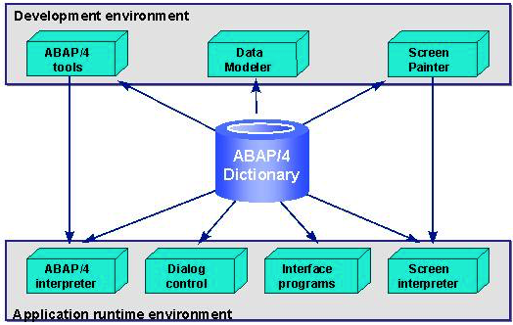
Risk and Recommendation Data Dictionary
Risks:
PRD Access to S_DEVELOP Allows direct changes to Data Dictionary which could compromise integrity of the data
Any Data Dictionary change could compromise integrity of the data
Recommendations:
No one (including Basis Administrators) should have update access to Data Dictionary in Production (PRD)
Changes to data dictionary performed in DEV, tested in QA and migrated to PRD per change management process
Developer access restricted appropriately using SAP Security / authorization concept

Slide 20
Key IT Controls Overview
Program, Development, Data Dictionary
2-3 risks that exist
Common control recommendations for each

Slide 21
Risk and Recommendation Change Documents
Risks:
If users are not restricted from maintaining change documents, the system audit trail from changes documents could be deleted accidentally or via malicious intent
Recommendations:
Users in production have activity level of security object S_SCD0 set to ‘08’ (Display Change Documents).
Investigate ways access to maintenance of change documents could be further restricted (locking transaction)
Notes:
Details in videos included in week 12 page
These slides are summary of key points, risks and controls (what might be included in test)

Slide 22
Risk and Recommendation System Logs and Trace Files
Risks:
If audit files (Logs and traces) are not secured at the operating system level for each application server, they could be maliciously deleted
Recommendations:
Secure folders where log and traces files are stored at the operating system level
Develop and use procedures for how to review and run traces at part of routine system security monitoring
Notes:
Details in videos included in week 12 page
These slides are summary of key points, risks and controls (what might be included in test)

Slide 23
Key IT Controls Overview
Logs and Traces
2-3 risks that exist
Common control recommendations for each

Slide 24
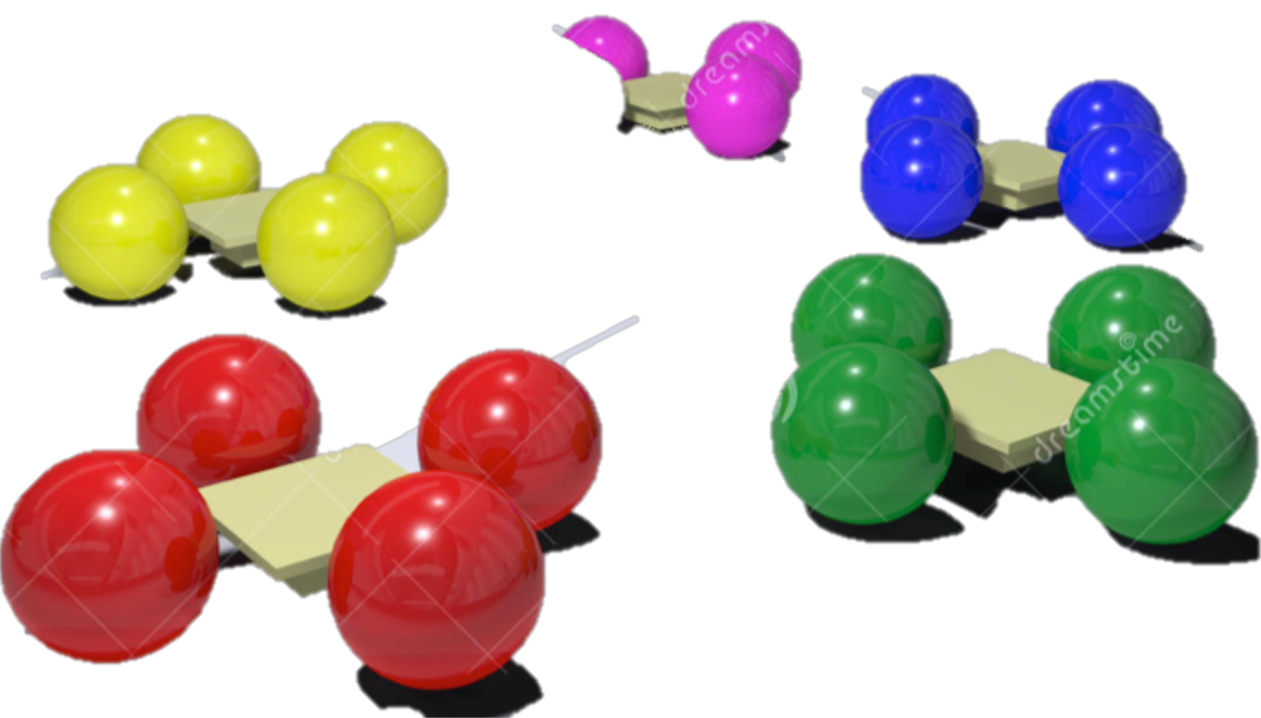
Breakout Activity – Rules
Break into teams – max of 5 people / team
Diversity a must.
Assignment – return via WebEx Notes or Word Document
How: WebEx breakout?
Time: assigned today 20 min (including break)
Start back on-time

Slide 25
Breakout Question
Suppose you have the opportunity to interview an audit manager (external auditor or internal auditing executive). What questions would you ask?
______________
______________
______________

Slide 27
Report Back

Slide 28
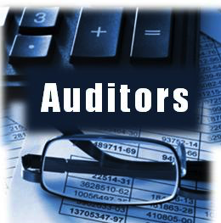
What Question Would you Pose to an Auditor?
Skills
What real world auditing software tools are used
What other certifications beside CISA is worth pursuing?
Life of Auditor
Biggest risk ever found in an audit
How to handle communication within team and stakeholders of audit
How to handle communication with those on staff of associate level?
What is the most common control failure you’ve seen?
How to get enough material if client won’t cooperate?
In an audit, what kind of questions will you ask?
Client Relationships
__
__
__
Internal vs. External
__
__
Challenges
What are most common challenges facing IT auditors?

Slide 29
What Question Would you Pose to an Auditor?
Life of Auditor
How long is the working timeline for a typical project? Does it vary among different industries?
Are there typical questions (the right questions), auditors always ask clients?
How do you teach yourself about the business line/group that you’re auditing? What resources do you use?
What is it like in the day of an Auditor (common jobs, assignments)? Is travel common for the job?
Client Relationships
How do you perform audits in a manner that develops trust? How do they maintain relationships with clients?
Do you question employees directly with hypothetical questions of how and where would they commit fraud if possible?
How does an auditor recommend changes to controls to increase buy-in?
Is it recommended when errors are discovered that auditors help employees correct them before the audit is complete?
How to document errors without harming relationships (e.g. reduce assistance with future audits)?
Internal vs. External
What is the difference in the approach of an internal and an external auditor? Are activities coordinated?
What is the relationship between internal audit and the audit committee?
How is the effectiveness of internal audit function assessed? To whom does internal audit report ?
What is relationship of external auditors with the audit committee? How often do they meet?
Skills
What advice do you give us (grad students in ITACS)? How should we prepare ourselves with little experience in auditing for success in profession?
What technologic skills should be obtained for IT auditor? Communication skills?
What are the few key skills/traits successful auditors should have?
How do you continue to grow within the audit profession?

Slide 30
What Question Would you Pose to an Auditor?
Challenges
What is the biggest challenge that the company or audit department has gone through?
What are the biggest challenges in this profession?
What would you say is the most rewarding part of being on the job?
How could auditors deliver value to the company?
What kinds of controls is organization most likely to miss?
What was the most challenging audit you ever worked on? What made it so difficult?
What is the most challenging problem for the it audit field How is and will technology change the field of auditing?
Notes:
Based on prior discussions, my working experience with auditors

Slide 31
Success with Internal and External Auditing My Personal Experience

Slide 32
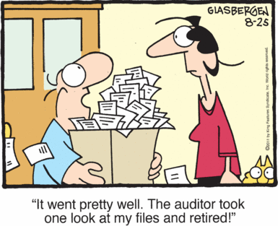
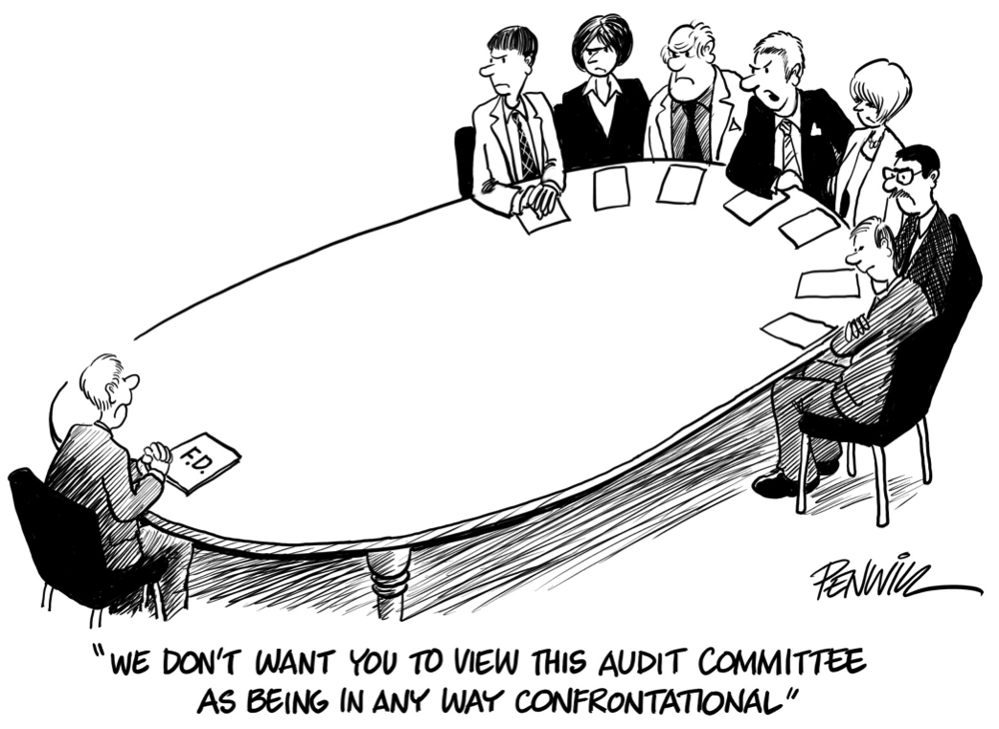

Slide 33
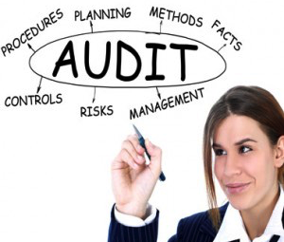
Success with Auditors
Have Strong / Deep Knowledge
Process
Business / real world scenarios
Able to Master the Details
Understand Auditor perspectives
Job / Role to accomplish
Risks
Vocabulary

Slide 34
Success with Auditors
Work Cooperatively
Balance the Tension: Know which side you’re on and be an effective counter-weight
Focus on what’s “best” for the organization
Risk Free
Efficiency

Slide 35
Risk / Control Matrix Final Exercise

Slide 36
Risk / Control Matrix: Design Approach
Risks
Control, system and Security Design + Implementation
Automated Controls
Manual Controls
Application Security
Segregation of Duties
Approvals
Reports
Procedures
Define
Control Objectives
Influence
Control Activities / Controls
Drive
CONTROL DESIGN

Slide 37
Risk / Control Matrix: Final Exercise
Agenda
Last Class (November 7): Part 1 (Identify Risks)
This Class (November 14): Part 1b, 2, 3
Risk Priority (Severity & Likelihood)
Identify Controls
Link Controls to Risks
Future Class (November 28): Part 4 (Complete Control Definitions)
Future Class (December 5): Part 5, 6 (Control Process / Audit Details; Personal Questions)
Due December 13 11:59 AM: Assignment Submission

Slide 38
Risk / Control Matrix: Final Exercise
Part 1:
Analyze the key risks that exist for the Order to Cash (OTC) process at GBI
Define and document the key risks that exist for the Order to Cash (OTC) process at GBI
Tab: Part 1 – GBI Risks
Identify at minimum 25 risks in the process
Identify a minimum 4 risks in each of the OTC sub-processes:
OR&H: Order Receipt and Handling
MF: Material Flow (shipping)
CI: Customer Invoicing
PR&H: Payment Receipt and Handling

Slide 40
Risk / Control Matrix: Final Exercise
Part 2: Identify key controls for the Order to Cash (OTC) process at GBI
Tab: Part 2 – GBI Controls
Identify at minimum 15 controls for the process
Identify a minimum 3 controls in each of the OTC sub-processes:
OR&H: Order Receipt and Handling
MF: Material Flow (shipping)
CI: Customer Invoicing
PR&H: Payment Receipt and Handling
At least two (2) controls must be Automated / Config controls

Slide 41
Risk / Control Matrix: Final Exercise
Part 3: Link Risks (Part 1) to the Controls (Part 2)
Tab: Part 1 – GBI Risks
At least one (1) control must be identified for each risk identified as High Severity or High Likelihood / Frequency
A given control may address multiple risks (listed once in Part 2 tab and multiple times in Part 1 tab)
A given risk may be addressed by multiple controls (listed once in Part 1 tab and multiple times in Part 2 tab)
Risks without out a control:
Acceptable Risk: Business agrees no controls will be developed
TBD (To Be Determined)

Slide 42
Extra Slides

Slide 43
Extra Slides

Slide 44
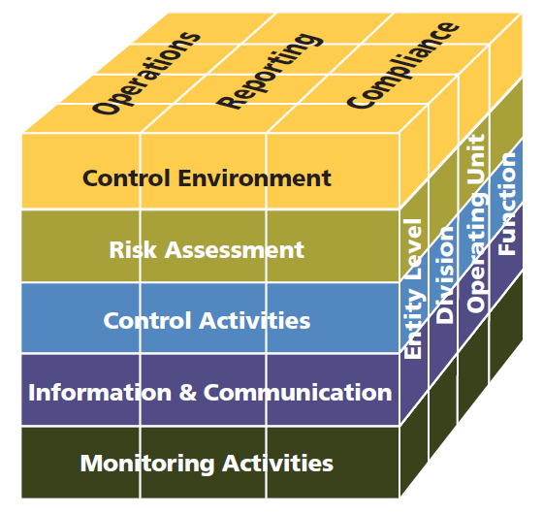
COSO Framework (2013)
Notes:
Have you worked with before? Explain !!!

Slide 45
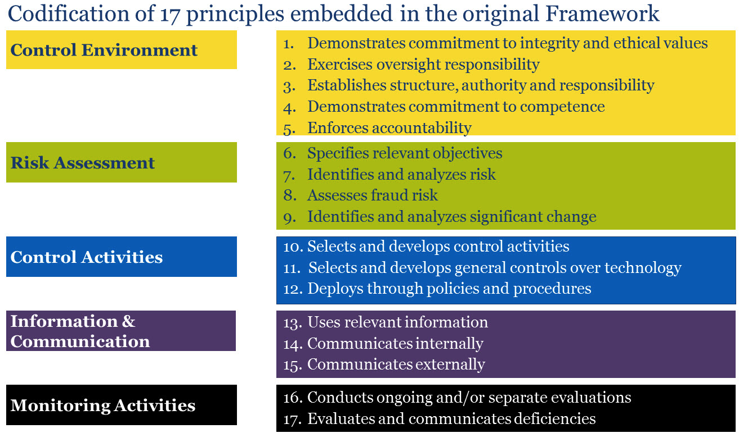
COSO Framework (2013)
Notes:
Callouts – focus of exercise

Slide 46
Controls: Integration Points
Risk/Control Matrix can serve as the primary vehicle for integrating control design into project activities and deliverables
Automated (Access) Control
Security Analysis Tool
IT / Security
Risk / Control Matrix
SOD Controls & Sensitive Access
Segregation of Duties
Security Configuration
GRC
Subset
Business Process Teams
Program Development
Automated: Standard & Configuration
Bus Process Reqmts
Functional Spec
Automated (Custom) & Manual Controls
SOX Section 404 Integration
Technical Specification
Training & Procedures
Manual Controls

Slide 47
Controls: Integration Points
Risk/Control Matrix can serve as the primary vehicle for integrating control design into project activities and deliverables
Automated (Access) Control
Security Analysis Tool
IT / Security
Risk / Control Matrix
SOD Controls & Sensitive Access
Segregation of Duties
Security Configuration
GRC
Subset
Business Process Teams
Program Development
Automated: Standard & Configuration
Bus Process Reqmts
Functional Spec
Automated (Custom) & Manual Controls
SOX Section 404 Integration
Technical Specification
Training & Procedures
Manual Controls

Slide 48
Risk / Control Matrix: Final Exercise
Parts
Analyze and define the key risks that exist for the Order to Cash (OTC) process at GBI
Guided by the risks you identified (esp. the High Severity and High Likelihood / Frequency risks) identify the key controls that will be used in the OTC process.
Link the Risks from Part 1 to the controls in Part 2.
Complete definition of the controls (classifications, links to assertions, etc.)
Write auditable control process documentation for 1 manual and 1 automated (configuration) control identified.
(Individual vs. Team submission): Couple questions about your work as a team to complete this and other exercises. (Optional) Details will be announced via a blog post in last couple weeks of class.
Notes:
Parts 1, 2 and 3 fully defined. Parts 4-6 will be defined within a week or 2.

Slide 49
Auditing: Helping Hands
Kapish Vanvaria
Ernst & Young
Manager | Advisory Services (assists clients address complex compliance, financial, operational and technology risks)
Temple MIS Advisory Council

Slide 50
MIS 5121: Auditor’s Visit Topics
What is the most common ‘weak’ or vulnerable control area?
How to you define your audit scope for a complex business? How do you organize, define focus?
What is the most important document to review in an audit?
Are companies being audited serious about security in SAP?
What tools is most effective when auditing clients?
How do you plan the scope of an audit?
Who are the people they interview during an audit? Who do they interview first?
What do they audit in an ERP system – what do they look at?
What are the risk assessment tools they use? Has their assessment of them changed over the years?
Notes:
Complete next week

Slide 51
MIS 5121 : Auditor’s Topics
Have you personally detected a fraud scenario in your audit? If so, please explain
How do you maintain your independence? Is that easy?
What are the general methodologies used for auditing?
How do you classify risks?
Since SAP can be customized in so many ways, how does an auditor know what to audit when everything is different with each client?
Since SAP can be customized in so many ways, how does an auditor know what to audit when everything is different with each client?

Slide 52
MIS 5121 : Auditor’s Topics 2015
What are the general methodologies used for auditing?
How do you classify risks?
How do you review Segregation of Duties (modules vs. employees)?
Since SAP can be customized in so many ways, how does an auditor know what to audit when everything is different with each client?

