Slide 1
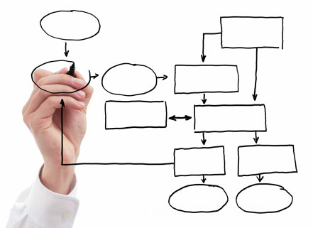
MIS 5121:Business Processes, ERP Systems & Controls Week 14: SAP GRC, Character
Edward Beaver Edward.Beaver@temple.edu ff

Slide 2
Video: Record the Class

Slide 3
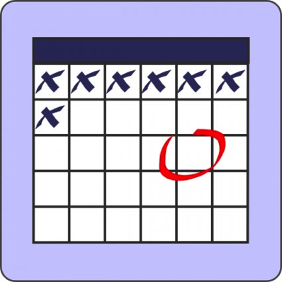
MIS 5121: Upcoming Events
November 28th: Complete Student Feedback Forms [in class]
December 11th : Extra Credit Assignment – Due by Noon
December 12th: Final Exam (at class time)
December 13th : Final Exercise (Risk Control Matrix)- Due by Noon

Slide 4
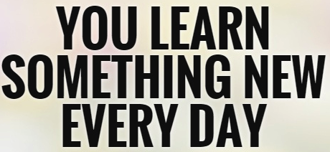
Discussion
Something really new, different you learned in this course in last week
Questions you have about this week’s content (readings, videos, links, …)?
Question still in your mind, something not adequately answered in prior readings or classes?

Slide 5
Key IT Controls Overview
SAP GRC Module
What is means
2-3 Functions Included
1-2 Benefits of Use

Slide 6
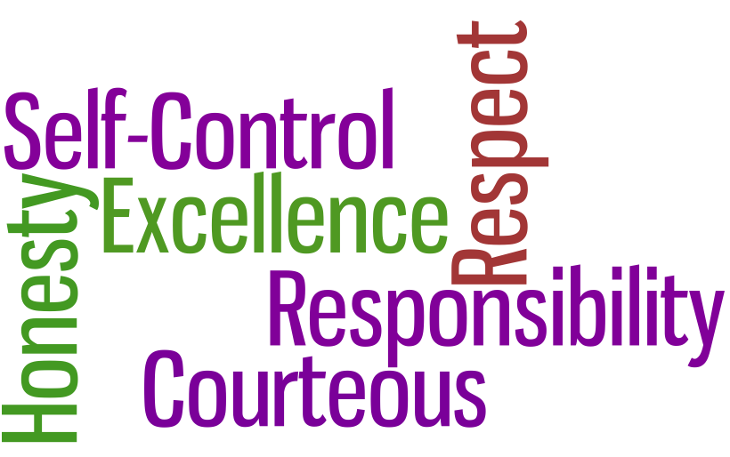
Character

Slide 7
Character and Controls
Character:
the mental and moral qualities distinctive to an individual (Oxford Dictionary) Who you are when no one is looking
Decisions made in moment of moral crisis shows our true character and morality.
In the Real World Control Failures we’ve reviewed, Describe the character of the leaders involved (a root of the control failures)?
_______________________________
Notes:
RCCF examples - why I inserted this topic.

Slide 8
Character and Controls
What are the differences between the ‘Adams’?
Adam I - ‘Big Me’
_________
_________
_________
_________
Adam II - ‘Little Me’
_________
_________
_________
_________

Slide 9
Character and Controls
Adam I - ‘Big Me’
Career-oriented: build, create, produce
Ambitious – “Success”
Selfishness – has infinite desires
Economic logic – cultivate your strengths
Adam II - ‘Little Me’
Internal: moral qualities, right vs. wrong
Sacrifice self in service to others “Charity, love and redemption”
Moral logic - give to receive
Humble
Wisdom isn’t a body of information. It’s the moral quality of knowing what you don’t know and figuring out how to handle your ignorance, uncertainty and limitations.
Go down to go up – valley of humility to climb heights of character
Basis for grace

Slide 10
Character and Controls
Which Adam does our Culture nurture?
Which Adam are you?

Slide 11
Character and Controls
Which Adam does Culture nurture?
Adam I - ‘Big Me’
Be the best you can be
Natural disposition (self)
Adam II - ‘Little Me’ has been displaced by Adam I – ‘Big Me’
Mental space once occupied with moral struggle has become occupied with struggle to achieve
Notes:
What has caused this so called shift?

Slide 12
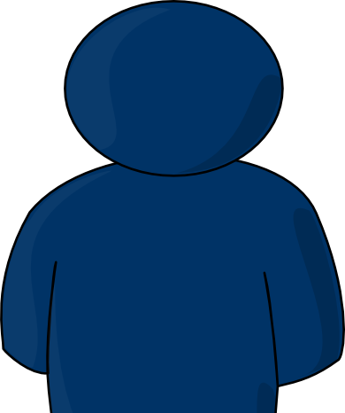
Character and Controls
Which Adam are you?
My Lessons Learned:
Character is on the inside
Not what we do
But directly shapes what we do
OK to be flawed – we all are.
Character can be developed
Face our imperfect nature with humility
Move from Success to Significance (Deep Satisfaction)
No good life is possible unless it’s organized around a vocation, not serving ourselves. Look outside yourself for a problem / opportunity addressed by an activity you intrinsically enjoy

Slide 13
Character and Controls
IT Governance:
“Do the right thing, the right way”
Character:
“Do the right thing, because it is the right thing to do.”

Slide 14
Character and Controls
Humility Code
We’re not wired to live for happiness, we live for holiness
Holiness defines the goal of life – at our core we’re flawed
Although we are flawed creatures, we are splendidly endowed
Pride is the central vice
Character is built in the course of our inner confrontation
Things that lead us astray are short term – Character endures for the long term
We cannot achieve self-mastery on our own – we need redemptive assistance from outside (God, family, traditions, …)
No good life is possible unless it’s organized around a vocation – a problem addressed by an activity you intrinsically enjoy (Passion matters)
Person who successfully struggles against weakness may or may not become rich and famous, but that person will become mature
David Brooks: The Road to Character

Slide 15
US Army 7 Values
1. Loyalty: My company and customers are my family. I will pledge allegiance to both.
2. Duty: Fulfill all my obligations & try to go beyond the norm.
3. Respect: How I treat others will define my character.
4. Selfless Service: Others Welfare before my own.
5. Integrity: Do what is legally and morally right. Moral compass and inter-values
6. Honor: Hold my values close to me
7. Personal Courage: Ability to face fear and danger

Slide 16
Professor Ed Beaver Thoughts on Success (Gleaned from my 40 Year Career) Provided ‘Free’ – worth?
Notes:
Idea from Linda Dillman’s speech at Fox IT Awards

Slide 17
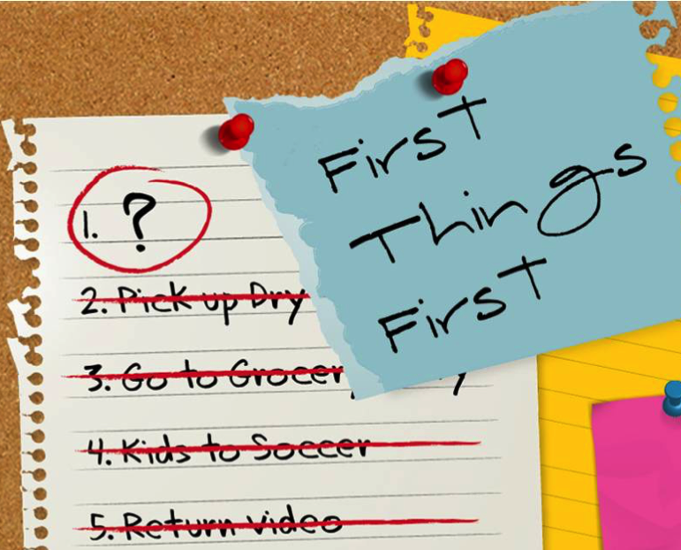
Success . . . First Things First
Solve Business Problems
Learn all you can about the business
Outcome is business / organization’s success / value
Right role of Technology (IT and Supply Chain)
Technology is Fun
Business Value is the end – not Technology (Beware of technology driven initiatives)
Notes:
Take every opportunity to learn – esp. with SC – learn the physical
Talk to business leaders – ‘How’s business today?’
Read business, investor publications
‘Raj’ hat

Slide 18
Success . . . Your Personal Act
Whatever our Job / Role is – Do it Well
Interpersonal Skills are Critical – hone them
Speak and write well
Be Inquisitive, Learn Continually
Energy – in all you do, exude it
In your career you’ll have many bosses – some good, some bad. Manage the relationship
Boss knows what you’re working on – contributions
Boss working to support your efforts
Notes:
Hone – sharpen - take time to sharpen your saw
Exude – discharge steadily, display strongly and openly Passion

Slide 19
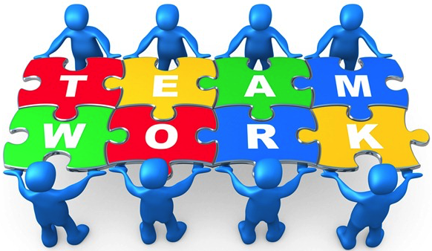
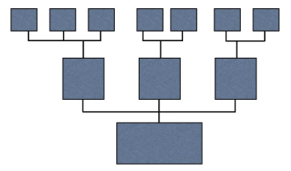
Success . . . Beyond Yourself
Team
Leadership
Vision – clear, actionable
Other Focus
Notes:
Team – global dispersed individuals as ‘team’ story
Actionable by all – how to translate to everyone – often first line leaders (FLL) key job to translate exec messages – SC Game – Rona story

Slide 20
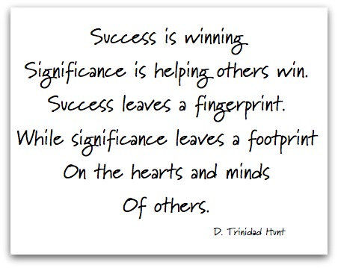
Success . . .
Initial Focus in life (business) - Success
Later focus of life (personal) - Significance
More to life than work – work / Life balance
Me
Faith
Family
Ref: Halftime book by Bob Buford
Notes:
My consulting firm: The Significant Half LLC Love my 3rd teaching role each week – Awana with 3 – 6th graders

Slide 21
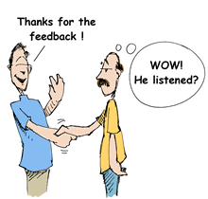
SFF: Student Feedback Forms
Value
Your feedback already (after test, etc.) has already helped me improve the class
Better class for subsequent students and to FOX MIS in total
Request
Have you received the e-SFF e-mail??
Take 10-15 minutes to complete – NOW!
http://esff.temple.edu

Slide 22
Break Time
‘The wisdom of moderation is not just realize the midpoint between two opposite poles, but instead, it is an awareness of the inevitability of conflict.’

Slide 23
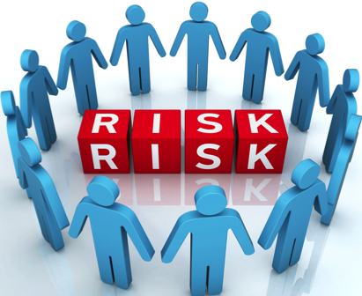
Risk / Control Matrix Final Exercise

Slide 24
Risk / Control Matrix: Design Approach
Risks
Control, system and Security Design + Implementation
Automated Controls
Manual Controls
Application Security
Segregation of Duties
Approvals
Reports
Procedures
Define
Control Objectives
Influence
Control Activities / Controls
Drive
CONTROL DESIGN

Slide 25
Risk / Control Matrix: Final Exercise
Part 5: Create Control Process and Auditing Documentation for the Order to Cash (OTC) process
Appendix 2 and 3 of the Exercise Guide has documentation examples from the Procure to Pay process:
Appendix 2: Automated Configuration Control
Appendix 3: Manual Monitoring Control
Using these examples and format, create one example document for one of your identified OTC Controls (Part 3)
Submit as separate Word document or insert as tab in Submission Spreadsheet
Resources:
Professor: in class, e-mail, phone (609-206-9783)
Table TSTC (List of transaction codes – reports)
Internet: many good examples, ideas there

Slide 26
Risk / Control Matrix: Final Exercise
Part 6: Team Member Evaluation (Optional)
All members of a team receive the same points for the exercise submissions.
If you feel that one or more members are not doing their fair share, please submit the Team Member Evaluation form to me by email.
All responses will be kept confidential.

Slide 27
Extra Slides

Slide 28
Risk / Control Matrix: Final Exercise
Part 1:
Analyze the key risks that exist for the Order to Cash (OTC) process at GBI
Define and document the key risks that exist for the Order to Cash (OTC) process at GBI
Tab: Part 1 – GBI Risks
Identify at minimum 25 risks in the process
Identify a minimum 4 risks in each of the OTC sub-processes:
OR&H: Order Receipt and Handling
MF: Material Flow (shipping)
CI: Customer Invoicing
PR&H: Payment Receipt and Handling

Slide 30
Risk / Control Matrix: Final Exercise
Part 2: Identify key controls for the Order to Cash (OTC) process at GBI
Tab: Part 2 – GBI Controls
Identify at minimum 15 controls for the process
Identify a minimum 3 controls in each of the OTC sub-processes:
OR&H: Order Receipt and Handling
MF: Material Flow (shipping)
CI: Customer Invoicing
PR&H: Payment Receipt and Handling
At least two (2) controls must be Automated / Config controls

Slide 31
Risk / Control Matrix: Final Exercise
Part 3: Link Risks (Part 1) to the Controls (Part 2)
Tab: Part 1 – GBI Risks
At least one (1) control must be identified for each risk identified as High Severity or High Likelihood / Frequency
A given control may address multiple risks (listed once in Part 2 tab and multiple times in Part 1 tab)
A given risk may be addressed by multiple controls (listed once in Part 1 tab and multiple times in Part 2 tab)
Risks without out a control:
Acceptable Risk: Business agrees no controls will be developed
TBD (To Be Determined)

Slide 32
Risk / Control Matrix: Final Exercise
Part 4: Augment key controls information for the Order to Cash (OTC) process at GBI
Tab: Part 2 – GBI Controls
Control Description (Columns F -> K) Mark each using taxonomy provided
Control Owner (Title): Choose one title from Appendix 1 or define appropriate missing title
Financial Statement Assertions (Columns L-> Q) Mark with x
Control Risk Assessment (Columns R -> U) Taxonomy column top
Financial Statement Impact (Columns V -> AK) Mark statements impacted with x
Notes:
Each Column – why included?
Control Owner:
- Why this column?
- Why not name??

Slide 33
Extra Slides

Slide 34
Risk / Control Matrix: Final Exercise
Parts
Analyze and define the key risks that exist for the Order to Cash (OTC) process at GBI
Guided by the risks you identified (esp. the High Severity and High Likelihood / Frequency risks) identify the key controls that will be used in the OTC process.
Link the Risks from Part 1 to the controls in Part 2.
Complete definition of the controls (classifications, links to assertions, etc.)
Write auditable control process documentation for 1 manual and 1 automated (configuration) control identified.
(Individual vs. Team submission): Couple questions about your work as a team to complete this and other exercises. (Optional) Details will be announced via a blog post in last couple weeks of class.
Notes:
Parts 1, 2 and 3 fully defined. Parts 4-6 will be defined within a week or 2.

Slide 35
Risk / Control Matrix: Design Approach
Risks
Control, system and Security Design + Implementation
Automated Controls
Manual Controls
Application Security
Segregation of Duties
Approvals
Reports
Procedures
Define
Control Objectives
Influence
Control Activities / Controls
Drive
CONTROL DESIGN

Slide 36
Controls: Integration Points
Risk/Control Matrix can serve as the primary vehicle for integrating control design into project activities and deliverables
Automated (Access) Control
Security Analysis Tool
IT / Security
Risk / Control Matrix
SOD Controls & Sensitive Access
Segregation of Duties
Security Configuration
GRC
Subset
Business Process Teams
Program Development
Automated: Standard & Configuration
Bus Process Reqmts
Functional Spec
Automated (Custom) & Manual Controls
SOX Section 404 Integration
Technical Specification
Training & Procedures
Manual Controls

Slide 37
Controls: Integration Points
Risk/Control Matrix can serve as the primary vehicle for integrating control design into project activities and deliverables
Automated (Access) Control
Security Analysis Tool
IT / Security
Risk / Control Matrix
SOD Controls & Sensitive Access
Segregation of Duties
Security Configuration
GRC
Subset
Business Process Teams
Program Development
Automated: Standard & Configuration
Bus Process Reqmts
Functional Spec
Automated (Custom) & Manual Controls
SOX Section 404 Integration
Technical Specification
Training & Procedures
Manual Controls

Slide 38
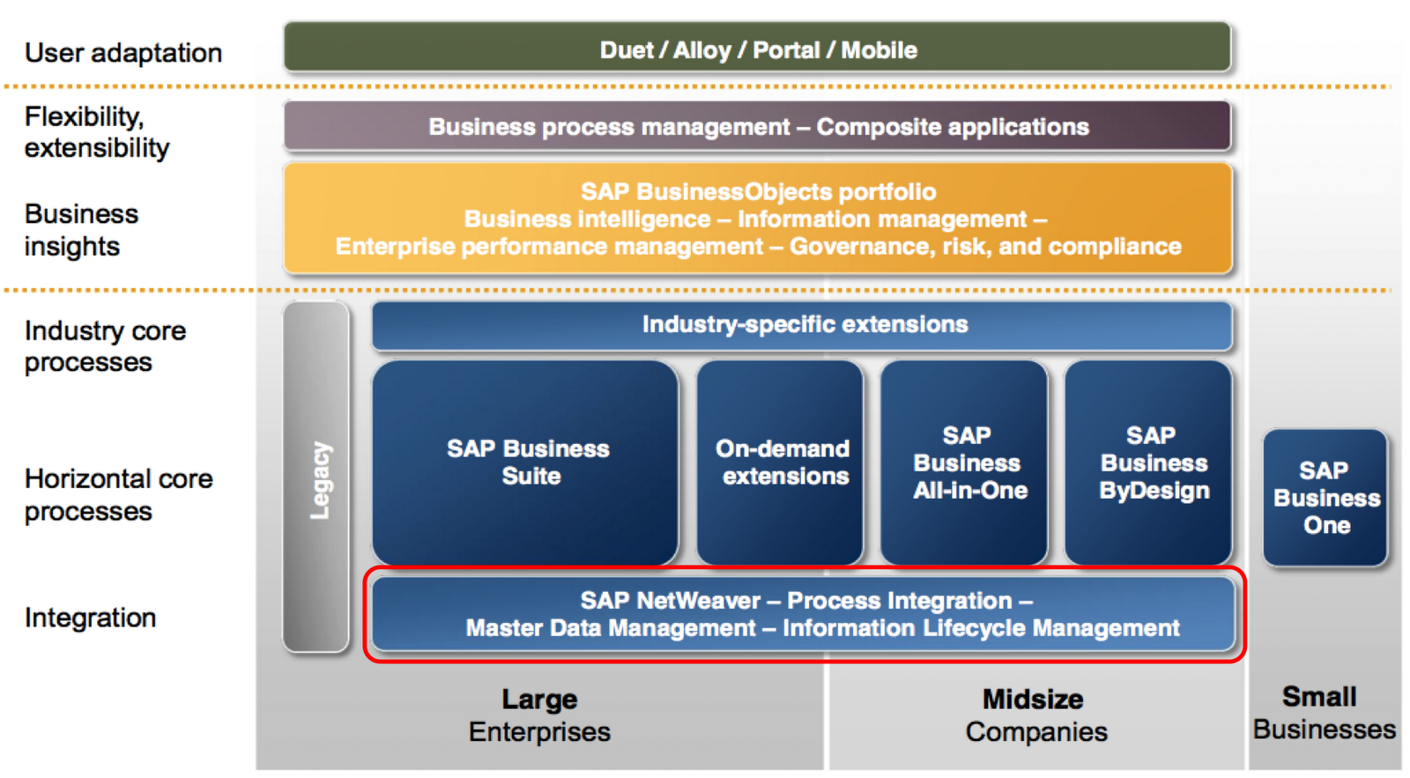
SAP: Not Just ECC/ERP

Slide 39
‘The wisdom of moderation is not just realize the midpoint between two opposite poles, but instead, it is an awareness of the inevitability of conflict.’
Notes:
Idea from Linda Dillman’s speech at Fox IT Awards

Slide 40
Assignment Questions - Character
What mindset is more helpful in being successful; being humble or more self-absorbed and concerned with yourself?
Do you think self-awareness can be practiced or not? If possible, how to practice?
In the valley of humility they learned to quiet the self. However, when you facing difficulty or disaster, how can you overcome the fear can see the world clearly?
In your life, have you faced any hardships, and what did you do to overcome those hardships to make yourself better?
How to make you not only grateful or humble in respect to others but also make you realize who you really are?
Why it is importance of practicing small acts of self-control?
What are some examples of their road to character?
Life stories of persons in book show how they met diversity and rose to a level of success. However, what toll did their journey have on the family and how did they cope?
Which character is more suitable for the current society, big me or little me?

Slide 41
Assignment Questions - Character
A person’s character is very crucial in the audit industry. How do we build our reputation and maintain a good ethical character in this industry?
How would you define “ eulogy virtues” and “resume virtues”?
Is there something that a person should change in themselves to build character?
In the book, David Brooks highlighted some instances where individuals were not exceptionally talented, but through hard work and dedication, they were able to achieve their goals. So in your opinion, is it better to work harder or smarter?
I would like to discuss with classmates that from where or whom do you get your morality, or your moral center?

