Slide 1
Module 1 – MIS Careers & Intro to Systems Architecture
MIS5122: Enterprise Architecture for IT Auditors

Slide 2
Agenda
Case Study Overview
MIS Careers
Intro to Computer Systems Architecture
Processor
Control unit, ALU, and registers
Storage
Primary and secondary
I/O capability
System bus
Software
Networks

Slide 3
Case Study – Focus on Systems
Desktops
Special Purpose Machines
NAS
Routers
Servers
Notes:
https://en.wikipedia.org/wiki/Network-attached_storage

Slide 4
Case Study – Focus on Storage
Desktops
Servers
Special Purpose Machines
NAS
SAN

Slide 5
Case Study – Focus on Networks
LANs
Switches
DNS & DHCP
Routers

Slide 6
Case Study – Focus on Operating Systems
Special Purpose Operating Systems
Server Operating Systems
Routers
NAS
Desktop Operating Systems

Slide 7
Case Study – Focus on Systems Administration
Business Continuity?
Disaster Recovery?
High-Availability
Backup/Recovery
Electrical power
Heat dissipation
Moisture
Cable routing
Fire protection
Password Controls & Auditing
Physical Security
Virus Protection & Updates
Firewalls
Monitoring & Metrics

Slide 8
Question?
How many of you will interact with…
Application developers
Systems programmers
Hardware personnel
Systems managers

Slide 9
Roles and Job Titles
Classification of computer professionals
Application developers
Systems programmers
Hardware personnel
Systems managers
Computer hardware and software knowledge requirements of each group
Notes:
Will be asking questions about each of these roles in upcoming slides.

Slide 10
Application Developers
What do application developers do?
What does a systems analyst do?
What does a systems designer do?
What does an application programmer do?
Notes:
Contribute to different part of SDLC
Systems analyst (business modeling and requirements)
Systems designer (design discipline, sometimes deployment)
Application programmer (builds and tests software)
Need hardware and system software knowledge

Slide 11
Types of Applications
Type | Role | Education needed
Information processing | Process business transactions or provide information to managers | College or technical degree in management or business with specialization in information processing
Scientific | Meet data processing and numerical modeling needs | Degree in computer science or a branch of engineering
Technical | Control or directly interact with hardware devices | Degree in computer science or a branch of engineering

Slide 12
Systems Programmers
What do systems programmers do?
What kind of education to they typically have?
Notes:
Develop system software (operating systems, compilers, database management systems, network security monitors)
Perform hardware troubleshooting and software installation and configuration
Have degrees in computer science or computer engineering
Need in-depth knowledge of system software, computer hardware, and networks
System software often directly controls computer hardware or interacts with networks

Slide 13
Hardware Personnel
What do hardware personnel do?
What kind of education do they typically have?
Notes:
Design, install, and maintain hardware
Education
Technical degree and/or vendor-specific training (lower level)
Degree in computer science or computer engineering (higher level)
Require extensive knowledge of computer hardware (processing, data storage, input/output, and networking devices)

Slide 14
Systems Managers
Common job titles
Computer operations manager
Network administrator
More like a systems programmer vs. manager
Database administrator
More like a systems programmer vs. manager
Chief information officer (CIO)
Notes:
Questions on each of these on the next few slides.

Slide 15
Computer Operations Manager
What does a computer operations manager do?
What kind of skills does the computer operations manager need?
Notes:
Oversees operation of a large information–processing facility
(scheduling, staffing, security, system backups, maintenance, upgrades)
Knowledge requirements
Broad base of technical knowledge to understand organization’s information systems and infrastructure
Capability of understanding advice of technical staff

Slide 16
Network Administrator Roles
What does a network administrator do in a large shop?
What does a network administrator do in a small shop?
What kind of skills are needed?
Notes:
Large Shop
Responsible for network infrastructure
Requires technical expertise in computer hardware, telecommunications, and system software
Emphasis on network and data communication technology
Small Shop
Operates and maintains network
Installs and maintains end-user software
Installs and configures hardware
Trains users
Assists management in selecting and acquiring software and hardware
One of the most demanding positions
Got an electric cord? It’s your responsibility!

Slide 17
Database Administrator
What does a database administrator do?
What kind of skills are needed?
Notes:
Responsible for management of large collections of data
Requires technical expertise and ability to help the organization exploit its data resources

Slide 18
Chief Information Officer (CIO)
What are the responsibilities of a CIO?
What are the requirements of a CIO?
Notes:
Responsibilities of a CIO
Responsible for the organization’s computers, networks, software, and data
Strategic planning
Vision for effective use of information and computing technology
Requirements of a CIO
Broad base of technical knowledge to interact effectively with all technical specialists
Vision of how technology is changing and how best to respond to changes to support organizational objectives

Slide 19
Systems Architecture
Describes structure, interaction, and technology of computer system components

Slide 20
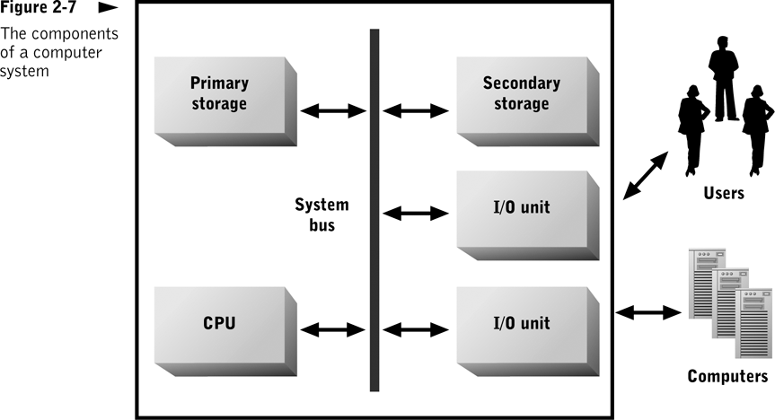
What are the major components?
Notes:
Processor - Device that performs data manipulation and transformation functions -Computation, Comparison, Data movement
General Purpose vs. Special Purpose
Storage - Types of information to be stored
Intermediate processing results, Data, Programs
Characteristics of storage devices vary widely
Cost, Access speed, Reliability
Input/output
Must encompass many communication modes
Sound, text, and graphics (for humans)
Electronic or optical communication (for other computers)

Slide 21
Question?
If I double the speed of my processor, will my programs run in half the time?
Notes:
http://www.tech-faq.com/cpu-speed.html
Just Faster CPU alone with more cores, but without significant architectural improvements will mean little, especially since your old apps are probably all single threaded.

Slide 22
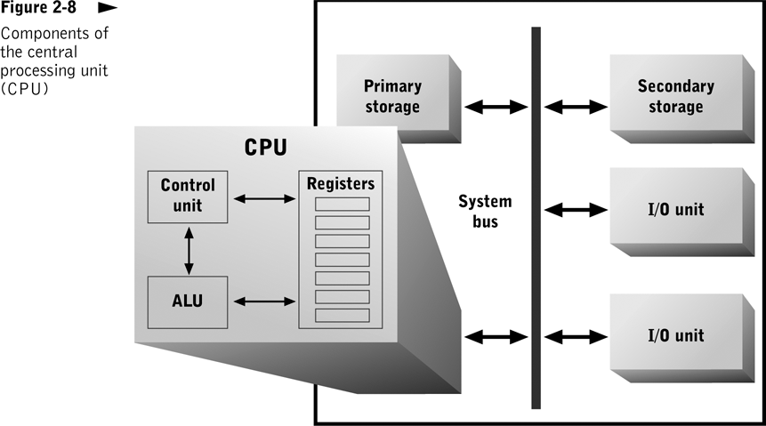
Notes:
CPU
General-purpose processor
Executes all instructions (computation and comparison functions)
Directs all data movement
ALU – Contains electrical circuits that implement each instruction
Registers - Internal storage locations that can each hold a single instruction or data item
Control Unit - Controls movement of data to and from CPU
Accesses program instructions and issues appropriate commands to ALU

Slide 23
What did you learn?
What is a CPU? What are its primary components?
What are registers? What is/are their function(s)?
Notes:
What is a CPU? What are its primary components?
The CPU is the brain of a computer system. It fetches and executes instructions in a stored program and controls the movement of data between computer system components. The primary CPU components are the control unit, arithmetic logic unit (ALU), and registers.
What are registers? What are their functions?
Registers are storage locations in the CPU used to hold instructions and data temporarily.

Slide 24
Question?
If I double the speed of my bus and double the speed of my processor, will my programs run in half the time?
Notes:
The Bus is the connection between the CPU and system memory.
The Front Side Bus operates at a speed that is a percentage of the CPU clock speed.
The faster the speed at which the Front Side Bus allows data transfer, the better the CPU performance.
What about RAM?

Slide 25
Notes:
System Bus
Internal communication channel that connects all other hardware devices
Primary pathway for moving data and instructions among hardware components
Capacity is critical to performance, secondary storage, and I/O device performance
http://pc.net/helpcenter/answers/primary_and_secondary_storage

Slide 26
Question?
If I double my RAM and double the speed of my bus and double the speed of my processor will my programs run in half the time?
Notes:
Still many factors affecting speed, but handling these 3 factors will help greatly
Everything in the system affects total system performance, from the rotational speed and access time of the hard disk drive to the speed of video RAM and the GPU (Graphical Processing Unit) in the graphics card.

Slide 27
Notes:
Primary Storage (main memory)
Holds program instructions and data for currently executing programs
Implemented with random access memory (RAM)
Provides access speed and allows CPU to read or write to specific memory locations
Volatile; does not provide permanent storage
Secondary Storage
Composed of high-capacity nonvolatile storage devices that hold:
Programs not currently being executed
Data not needed by currently executing programs
Data needed by currently executing programs that does not fit within available primary storage

Slide 28
What did you learn?
What is main memory? In what way(s) does it differ from registers?
What are the differences between primary and secondary storage?
Notes:
What is main memory? How does it differ from registers?
Main memory is a collection of storage locations, typically implemented with random access memory (RAM), that holds instructions and some or all of the data of currently running programs. Primary storage has more capacity than registers but is slower to access.
What are the differences between primary and secondary storage?
Primary storage is more volatile, faster, and more expensive than secondary storage. Because of its higher cost, its capacity is usually lower than in secondary storage. These differences determine differences in use—chiefly, primary storage supports ongoing CPU activity by storing instructions and data of currently running programs.

Slide 29
Notes:
Input/Output Devices
Implement external communication functions
Human-oriented communication devices (e.g., keyboard, mouse, printer)
Computer-oriented communication devices (e.g., modem, network interface unit)

Slide 30
Software Types
What is system software?
What are utility programs?
What are application programs?
Notes:
Application program
Stored set of instructions for responding to a specific information-processing tasks
Used directly by end users
Utility program
Contains instructions for performing general-purpose tasks
Usually operates invisibly in the background
System software
Implements utility functions needed by many application programs
Allocates computer resources to application programs
Manages computer resources
Does not interact with end users

Slide 31
Operating Systems
Most important system software component
Collection of utility programs that provides:
Administrative utilities
Utility services to application programs
Resource allocation functions
Direct control over hardware
Notes:
Operating System Functions

Slide 32
Application Development Software
Programs used to develop other programs
Types
Program translators
Program editors
Debugging tools
System development tools

Slide 33
Computer Networks
Set of hardware and software components that enable multiple users and computer systems to share information, software, and hardware resources
Enables many types of personal communication

Slide 34
Review
Case Study Overview
MIS Careers
Intro to Computer Systems Architecture

