Slide 1
Module 5 – Operating Systems
MIS5122: Enterprise Architecture for IT Auditors

Slide 2
Agenda
Operating Systems
  Overview
  Resource allocation
  Process management
  CPU allocation
  Memory allocation

Slide 3
Case Study – Focus on Operating Systems
Special Purpose Operating Systems
Server Operating Systems
Routers
NAS
Desktop Operating Systems

Slide 4
Question?
What is the best operating system for business applications?
Why should I be worried if anyone on my team thinks they can answer this question?

Slide 5
What’s your favorite OS?
Desktop/Laptop
  Windows (Windows 8, Windows 7, Vista, XP, 2000 Pro, 98, 95, other)
  Linux
  Mac
Midrange
  Windows Server (various flavors)
  Linux
  OS/400
  Proprietary UNIX (AIX, Solaris, HP-UX)
  Other UNIX?
Mainframe
  Z/OS (variants of MVS and OS/390)
  Z/VM (variants of VM)

Slide 6
Operating System Overview
Most important component of system software
Primary purpose: Manage hardware resources and provide support services to users and application programs
Manages CPU, memory, processes, secondary storage (files), I/O devices, and users
Consists of kernel, service layer, and command layer

Slide 7
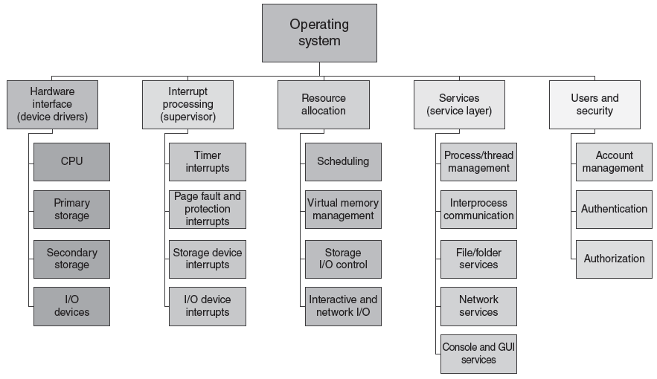
OS Management Functions

Slide 8
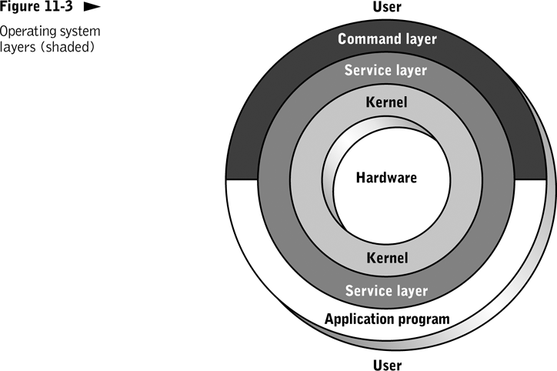
User’s interface to OS
Contains set of functions executed by application programs and command layer
Manages resources; interacts directly with computer hardware
What is more stable, a Mac or a PC? Ever seen a barebones Mac?

Slide 9
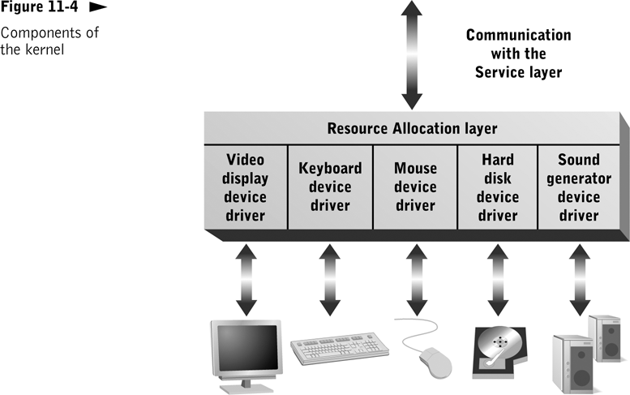
Notes:
Multitasking Resource Allocation
Norm for modern general-purpose computers
Allows flexibility of application and system software
Resource Allocation Goals
Meet resource needs of each program
Prevent programs from interfering with one another
Efficiently use hardware and other resources
Resource Allocation Tasks
Keep detailed records of available resources; know which resources can satisfy which requests
Schedule resources based on specific allocation policies
Update records to reflect resource commitment and release by programs and users

Slide 10
Question?
In your own words, what is the difference between a real resource and a virtual resource?
Give an example of a real resource
Give an example of a virtual resource
Notes:
Real resources
Physical devices and associated system software
Virtual resources
Resources that are apparent to a process or user
Meet resource requirements by:
Rapidly shifting resources unused by one program to other programs that need them
Who can juggle?
Substituting one type of resource for another

Slide 11
Process Management
What is a “process”?
Notes:
Unit of executing software managed independently by OS
Can request and receive hardware resources and OS services
Can be stand-alone or part of a group that cooperates to achieve a common purpose
Can communicate with other processes executing on the same computer or on other computers

Slide 12
Question?
How do I figure out how many processes are running on my machine?
How does my system keep track of each of these processes?
How does my system keep track of the resources allocated to each process?

Slide 13
Process Control Data Structures
What is a “process control block (PCB)”?
Notes:
Created, updated, and deleted by OS
Used by OS to perform many functions (e.g., resource allocation, secure resource access, protecting active processes from interference with other active processes)
Normally organized into a larger data structure (called a linked list, process queue, or process list)

Slide 14
Demonstration
Cross your fingers
Let’s take a look at processes using
  Task Manager – taskmgr
  Performance Monitor - perfmon

Slide 15
Threads
What is a “thread”?
What is a “thread control block (TCB)”?
Notes:
Multithreaded Process – Made up of multiple threads that can execute independently
Portion of a process that can be scheduled and executed independently
Can execute concurrently on a single processor or simultaneously on multiple processors
Share all resources allocated to parent process
Advantage: Reduce OS overhead for resource allocation and process management
Thread control block (TCB) and run queues

Slide 16
Question?
How do I figure out how many threads are running on my machine?
How does my system keep track of each of these threads?
How does my system keep track of the resources allocated to each thread?

Slide 17
Demonstration
Cross your fingers
Let’s take a look at threads using
  Task Manager – taskmgr
  Performance Monitor - perfmon

Slide 18
What did you learn?
A(n) ____________ process contains subunits that can be executed concurrently or simultaneously.
Multithreaded

Slide 19
Question?
On a system with a single quad core processor:
  How many threads can be in the running state?
  How many threads can be in the blocked state?
  How many threads can be in the ready state?

Slide 20
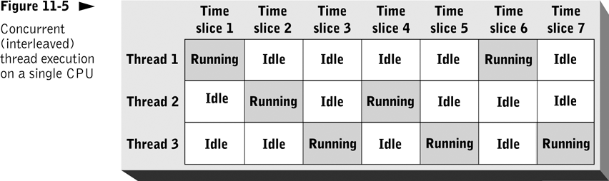
CPU Allocation
Notes:
OS makes rapid decisions about which threads receive CPU control and for how long that control is retained
Threads usually share CPUs (concurrent or interleaved execution)

Slide 21
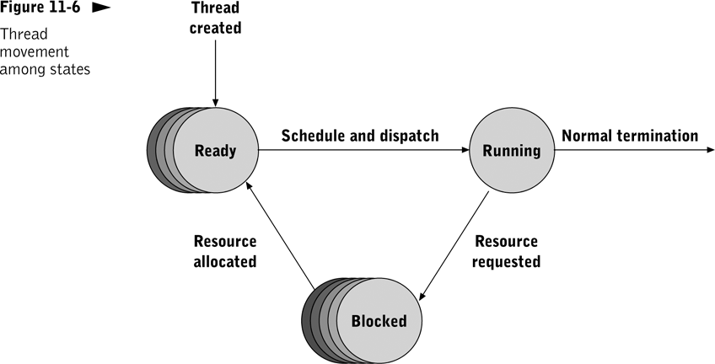
Thread States
Notes:
Thread States
Ready
Waiting for access to the CPU
Running
Retains control of CPU until the thread or its parent process terminates normally or an interrupt occurs
Blocked
Waiting for some event to occur (completion of service request or correction of an error condition)

Slide 22
Thread States

Slide 23
Demonstration
Cross your fingers
Let’s take a look at thread state/wait reason
  Perfmon
    System
      Processor Queue Length
    Thread
      Thread State
      Thread Wait Reason

Slide 24
What did you learn?
A(n) ______ is an executable subunit of a process that is scheduled independently but shares memory and I/O resources.
Dispatching a thread moves it from the _________ to the ____________.
thread
ready state
running state

Slide 25
Question?
When a thread is moved from the running state to the blocked state (bumped off the CPU for any of a variety of reasons), where is the “state” of the CPU preserved so that the thread can resume execution at a later time when it is moved from the ready state to the running state again?

Slide 26
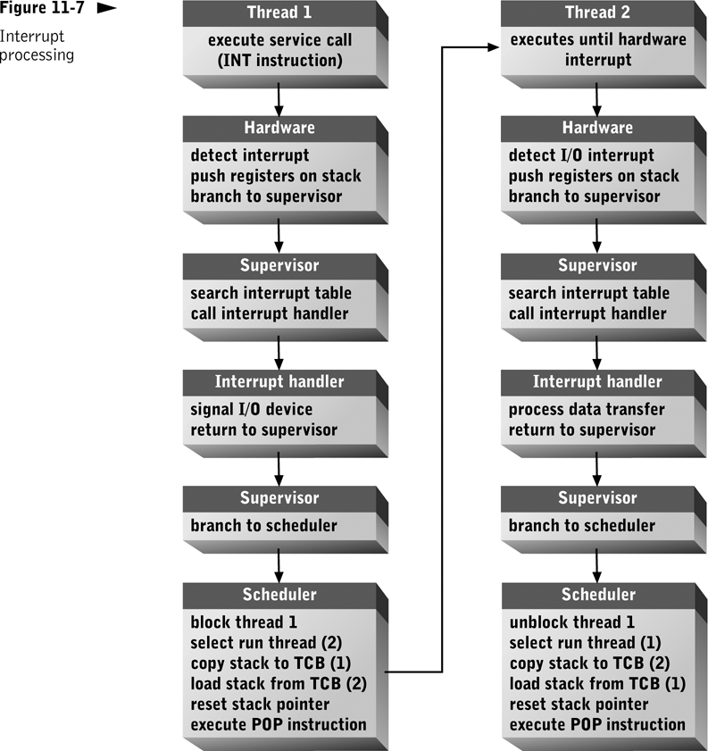
Interrupt Processing
Processing steps on left occur after Thread 1 makes an I/O service call.
Processing steps on right occur after I/O device completes I/O operation.
Where is the “state” of the machine preserved when a thread is not running?
Notes:
CPU automatically suspends currently executing thread, pushes current register values onto the stack, and transfers control to OS master interrupt handler
Suspended thread remains on the stack until interrupt processing is completed (blocked state)
Once interrupt has been processed, OS can leave suspended thread in blocked state, move it to ready state, or return it to running state

Slide 27
Scheduling
Decision-making process used by OS to determine which ready thread moves to the running state
Typical methods
  Preemptive scheduling
  Priority-based scheduling
  Real-time scheduling

Slide 28
Demonstration
Cross your fingers
Let’s take a look at context switches
  perfmon
    System
      Context Switches/sec
      Process Queue Length
  taskmgr
    Select a process
      Right click and adjust priority

Slide 29
Preemptive Scheduling
What is “preemptive scheduling”?
Notes:
A thread can be removed involuntarily from the running state
Functions of the supervisor (portion of OS that receives control)
Calls appropriate interrupt handler
Transfers control to the scheduler

Slide 30
Timer Interrupts
What is a “timer interrupt”?
Notes:
Generated at regular intervals by CPU to give scheduler an opportunity to suspend currently executing thread
Not a “real” interrupt; no interrupt handler to call; supervisor passes control to the scheduler
Important CPU hardware feature for multitasking OSs

Slide 31
What did you learn?
timer interrupt
The CPU periodically generates a(n) ____________ to provide the scheduler an opportunity to allocate the CPU to another ready process.
__________ scheduling refers to any type of scheduling in which a running process can lose control of the CPU to another process.
Preemptive

Slide 32
What did you learn?
When a process makes an I/O service request, it is placed in the ___________ (which state?) until processing of the request is completed.
A(n) ________ causes the currently executing process to be _______ and control passed to the _________.
blocked state
interrupt
pushed
supervisor

Slide 33
Question?
In your own words what is:
  Virtual memory?
  The page table?
  The page file?
  A page hit?
  A page fault?

Slide 34
Memory Allocation
OS allocates memory
  When threads are created; responds to requests for additional memory during a thread’s lifetime
  To itself and for other needs
    Device drivers, I/O ports, buffers, caches, etc.
Memory references are mapped to physical addresses through table lookups and address calculations

Slide 35
Multitasking Memory Allocation
The operating system:
  Finds free memory regions in which to load new processes and threads
  Reclaims memory when processes or threads terminate

Slide 36
Goals of Multitasking Memory Allocation
Allow as many active processes as possible
Respond quickly to changing memory demands of processes
Prevent unauthorized changes to a process’s memory region(s)
Implement memory allocation and addressing as efficiently as possible

Slide 37
What needs to be in memory?
Nothing for any inactive threads
For each active thread:
  The next instruction to be fetched & executed
  The data which that instruction will operate against

Slide 38
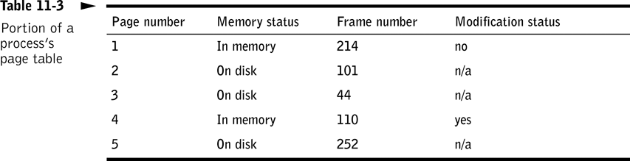
 |  |  |  |  |  | 4 |  |  |  |  |  | 3 |  |  |  |  |  | 2
 |  |  | 1
 |  |  |  |  |  |  |  |  |  |  |  |  |  |  |  | 6
 |  |  |  |  | 1
1
 |  |  |  |  |  |  |  |  |  |  |  |  |  |  | 4
 |  | 5 |  |  |  |  |  |  | 4
 |  |  |  |  |  |  |  |  |  |  |  |  |  |  |  |  |  | 2
 |  |  |  |  |  |  |  |  |  |  |  |  | 4
 |  |  |  |  |  |  |  |  |  |  |  |  | 3
Physical RAM broken up into 4K Page “frames”
5
3
Page File
2
P1
1 | 2 | 3 | 4
P2
1 | 2 | 3 | 4 | 5 | 6
P3
1 | 2 | 3 | 4 | 5

Slide 39
Memory Protection
Prevents errors in one program from generating errors in another
Adds overhead to each write operation

Slide 40
Memory Management Hardware
Complex memory management procedures incur substantial overhead
Modern CPUs incorporate advanced memory allocation and address resolution functions in hardware (e.g., Intel Pentium)

Slide 41
Demonstration
Cross your fingers
Let’s take a look at memory
  My page file
  taskmgr
  perfmon
    Paging file
    Memory

Slide 42
What did you learn?
To achieve efficient use of memory and a large number of concurrently executing processes, most operating systems use ______ memory management.
Under virtual memory management, the location of a memory page is determined by searching a(n) _________.
A(n) ________ occurs when a process or thread references a memory page not held in physical memory.
virtual
page table
page fault

Slide 43
What did you learn?
Memory pages not held in primary storage are held in the __________________ of a secondary storage device.
A(n) _____ is the unit of memory read or written to the swap space.
swap space/page file
page

Slide 44
Case Study – Focus on Operating Systems
Special Purpose Operating Systems
Server Operating Systems
Routers
NAS
Desktop Operating Systems

Slide 45
What is “Virtual Machine” technology?

Slide 46
Benefits of Virtual Machines
Server Consolidation
Utility Computing
  Windows
  Linux
New availability options
  Backup/Restore
  High Availability
  Disaster Recovery

Slide 47
Benefits of Virtual Machines
Ultimate Test/Development Platform
  I’m developing a 3 tier client/server application and a need a database server, and application/web server, and a client machine
  Is this patch going to screw up my machine?
  I wonder if I can actually rebuild this server from the backup tapes?
  I need an isolated test network
Low Demand Servers
  Microsoft Update Server

Slide 48
Server Consolidation

Slide 49
Utility Computing
Legacy Approach
  Over provisioning
  Underutilized CPU, memory, and I/O fragmented across many, many systems
Virtual Machines
  Purchase larger machines
  Dynamically shift resources from VM to VM as needed – No more over provisioning!
  Purchase commodity CPU, memory, and storage as demands of business require
Instant Provisioning

Slide 50
High-Availability & Disaster Recovery

Slide 52
What is cloud computing?

Slide 53
Key Attributes
Off-premises
Elasticity
Flexible Billing
Virtualization
Service Delivery
Universal Access
Simplified Management
Affordable Resources
Multi-tenancy
Service-level Management

Slide 54
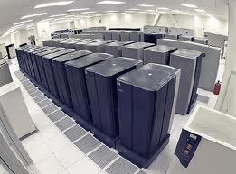
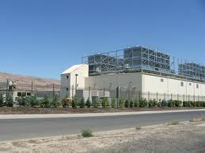
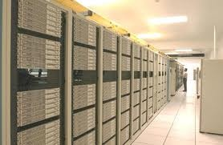
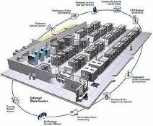
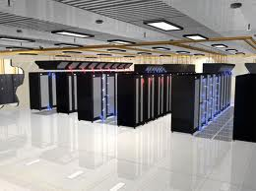
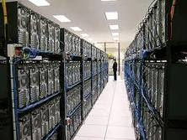
Traditional Infrastructure

Slide 55
Outsourced Infrastructure
Their Datacenter
My Datacenter

Slide 56
Cloud Infrastructure
Their Datacenter
My Datacenter

Slide 57
Drivers
Drivers for cloud computing
  Better
  Faster
  Cheaper

Slide 58
Drivers: Better
Scenario 1
  2 system admin
  Supports 20 servers, 5 printers, 2 copy machines, voice mail system, 200 desktops, UPS, etc. etc. etc.
Scenario 2
  10 system admin
  Supports 4,000 servers (all the same technology)

Slide 59
Driver: Better
What happens when I buy this
When I need that

Slide 60
Driver: Better
What happens when I buy that
When I need this
How about a retailer that does 80% of their business during November and December?

Slide 61
Driver: Better
What happens when I buy this
And cancel the project

Slide 62
Driver: Faster
How long does it take to provision gear…
  Create the purchase order
  Get a quote
  Order the gear
  Have the gear delivered
  Unpack and rack up the gear
  Whoops! New technology, better send administrator to training!
  Install and configure the operating system
  Install and configure the application
How quick, flexible, and nimble am I?

Slide 63
Driver: Faster
Their Datacenter
Small
Medium
Large

Slide 64
Driver: Cheaper
Economies of scale
  What kind of discounts do hardware vendors offer me when I buy a few boxes a year?
  What kind of discounts do hardware vendors offer cloud providers when they buy a few hundred boxes per year
Virtualization
  What if I only need ½ of a server for a little application?
Utilization of Personnel
  While I need 2 system admins to provide coverage 24x7, are they really utilized 100% of the time?

Slide 65
Driver: Cheaper
Time really is money!
  Is there value if I get my benefits sooner?
  Is there value if I defer my costs?

Slide 66
Discount rate | 10%
Traditional | Year 1 | Year 2 | Year 3 | Year 4 | Year 5 | Total
Benefits | $0 | $200,000 | $300,000 | $400,000 | $500,000 | $1,400,000
Hardware Costs | $150,000 | $0 | $0 | $0 | $0 | $150,000
Non-Hardware | $350,000 | $100,000 | $100,000 | $100,000 | $100,000 | $750,000
Total Costs | $500,000 | $100,000 | $100,000 | $100,000 | $100,000 | $900,000
Cash Flow | -$500,000 | $100,000 | $200,000 | $300,000 | $400,000 | $500,000
NPV | $231,635
Discount rate | 10%
Cloud | Year 1 | Year 2 | Year 3 | Year 4 | Year 5 | Total
Benefits | $25,000 | $225,000 | $325,000 | $425,000 | $525,000 | $1,525,000
Hardware Costs | $21,000 | $21,000 | $21,000 | $21,000 | $21,000 | $105,000
Non-Hardware | $350,000 | $100,000 | $100,000 | $100,000 | $100,000 | $750,000
Total Costs | $371,000 | $121,000 | $121,000 | $121,000 | $121,000 | $855,000
Cash Flow | -$346,000 | $104,000 | $204,000 | $304,000 | $404,000 | $670,000
NPV | $383,161
Delta | $151,527 | 65%
Pay for hardware up front
Benefits realized one quarter sooner
Pay for hardware over life of project
30% volume discount on hardware & better utilization of system admins

Slide 67
Variations
IaaS – Infrastructure as a Service
PaaS – Platform as a Service
AaaS – Application as a Service
Many other variations…

Slide 68
Review
Operating Systems
  Overview
  Resource allocation
  Process management
  CPU allocation
  Memory allocation

Slide 69
Windows Server 2012
Installation

Slide 70
Purpose
Get your hands dirty installing a server operating system
Provide a platform for our storage lab where we’ll create RAID arrays
Provide a platform for our MySQL Server
Get some exposure with virtual machine technology
Have fun (in a geeky sort of way)!

Slide 71
Plan
Break up into teams, 2 students per team
  If you’ve installed Windows Server 2012, please volunteer to be a team leader
  Team leaders can’t touch anything, they’ll just help direct the other team members
  You will be on the same team during our storage lab
Each team will create a virtual machine
  2 Virtual Intel Processors
  2 GB of Virtual Memory
  40 GB Virtual SCSI drive
  Virtual CD ROM
  Virtual NIC

Slide 72
Questions?
Any questions?
Have fun!

