Slide 1
Module 6 – Systems Administration
MIS5122: Enterprise Architecture for the IT Auditor

Slide 2
Agenda
Systems Administration
Concepts
Active Directory Activity

Slide 3
Case Study – Focus on Systems Administration
Business Continuity?
Disaster Recovery?
High-Availability
Backup/Recovery
Electrical power
Heat dissipation
Moisture
Cable routing
Fire protection
Password Controls & Auditing
Physical Security
Virus Protection & Updates
Firewalls
Monitoring & Metrics

Slide 4
Security
Well-integrated approach protects hardware, software, and data resources against accidental loss or damage, malicious tampering, unauthorized access, and accidental disclosure
What are some of the tools/technologies we have to help us with security?
Notes:
First line of defense: Authentication and authorization
Other defensive measures: Password control, auditing, virus protection, regular software updates, and firewalls

Slide 5
Case Study – Physical Security
Physical Security
Notes:
Physical Security
Restrict access to prevent theft, tampering, and unauthorized access
Lock doors
Limit distribution of keys, key cards, etc.
Reinforce doors and walls
Lock equipment to desks
Video Surveillance
Security Guards

Slide 6
Question?
What are the pros and cons of using passwords for authentication?
Are there better methods of authentication?
If they are better, why aren’t more people using them?
Notes:
Access Control
Based on two key processes
Authentication (verifies identity)
Password-based most common
Biometric
Authorization (verifies rights)
Based on security tickets
Access control list

Slide 7
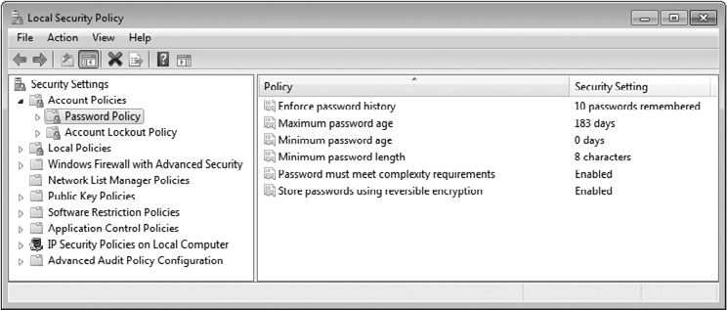
Password policies can be created and enforced on a per user, per group, or per system basis.
Notes:
Password Controls and Security
Ways to enhance password-based authentication
Restrictions on length and composition of valid passwords
Requirements that passwords periodically be changed
Analysis of password content to identify passwords that are easily guessed
Encryption of passwords in files and during transmission over a network

Slide 8
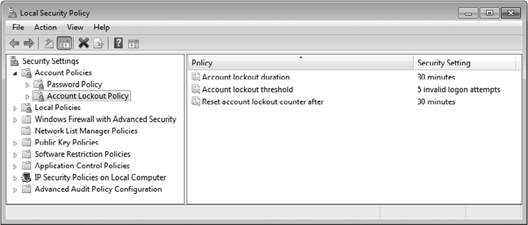
Policies can be set to deal with failed attempts to log on.

Slide 9
Authorization

Slide 10
Auditing
What is “auditing” all about, how is it used, and what are its limitations?
Notes:
Process of creating and managing records of user activity or resource access
Useful tool for examining security policy and analyzing security breaches
Limitations of Auditing
Size of log files
Reduction in system performance
Backward-looking; poor tool for prevention
Automated search tools required to extract useful information

Slide 11
Case Study – Password Controls & Auditing
Password Controls & Auditing

Slide 12
What did you learn?
_____________ is the process of determining or verifying the identity of a user or process owner.
After a user has been authenticated, ___________ determines what resources this user has access to.
Authentication
authorization

Slide 13
What did you learn?
_______________ focuses on restricting access to prevent theft, tampering, and unauthorized access.
The most common form of authentication in use today is _____________.
Physical security
Password based

Slide 14
Question?
How do you manage software updates at home?
Is this the way you’d handle software updates for a company?
How do you manage viruses at home?
Is this the way you’d manage viruses for a company?

Slide 15
Viruses
What is a computer virus?
What can you do to deal with them?
Notes:
Programs or program fragments that:
Infect computer by permanently installing themselves in a hard-to-find location
Perform malicious acts on infected computer
Replicate and spread using services of infected computer
Types: boot virus, macro virus, worm
Virus Protection
Common features of antivirus software
Scans e-mail messages and attachments for known viruses; disables or deletes them
Monitors access to important system files and data structures and logs or denies access as appropriate
Scans removable media for known viruses when they are inserted
Periodically scans file system and important data structures for viruses

Slide 16
Software Updates
What are “software updates” and how can you manage them on a large scale?
Notes:
Fix bugs, errors, and security holes as they are discovered
Used to be a manual process; now typically automated
Window Server Update Server (WSUS)

Slide 17
Case Study – Virus Protection & Updates
Virus Protection & Updates

Slide 18
What did you learn?
A(n) _____ is a program or program fragment that infects a computer by permanently installing itself, performs one or more malicious acts, and replicates and spreads itself using services of the infected computer.
virus

Slide 19
Question?
How many of you have a firewall at home?
Which type of firewall is this?
Do you believe it protects you from the chaos of the Internet?

Slide 20
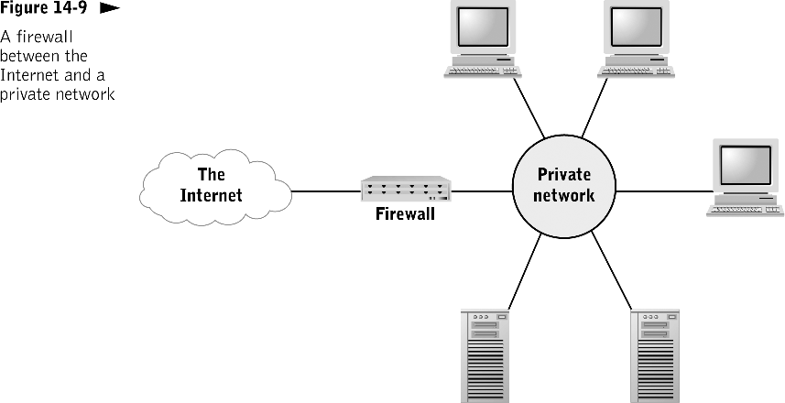
Notes:
A firewall is typically a stand-alone device with embedded software that physically separates a private network from a public network.
Firewall
Hardware devices, software, or a combination that prevents unauthorized users in one network from accessing resources on another network

Slide 21
Firewalls

Slide 22
Types of Firewalls
Packet-filtering firewall | Simplest type Examines each packet; matches header content to a list of allowed or denied packet types
Application firewall | Handles service requests of external users of applications Shields internal servers and resources from direct access by outside users
Stateful firewalls | Tracks progress of complex client-server interactions

Slide 24
Case Study – Firewalls & The DMZ
Firewalls

Slide 25
What did you learn?
A(n) _______ is a hardware device, software, or a combination thereof that prevents unauthorized users in one network from accessing resources in another network.
firewall

Slide 26
What did you learn?
A(n) _____________________________ accepts service requests from an untrusted network and relays the requests to the appropriate server or servers.
A(n) _____________ tracks the progress of complex client-server interactions and blocks packets that don’t conform to normal activity patterns.
application firewall or proxy server
statefull firewall

Slide 27
Question?
How much should an organization invest in:
Business Continuity Planning
Disaster Recovery
High Availability Solutions
Backup/Restore Capability
How much does downtime cost a company?
Notes:
BCP and DR are not in the book so simply discuss, don’t ask tough questions.

Slide 28
Business Continuity and Disaster Recovery
Catastrophic loss of ability to deliver services from primary location
Must resume services from alternate location
Disaster recovery plan driven by the business’
Recover time objective (RTO)
Recovery point objective (RPO)
Business Continuity – How you continue to provide essential business services between time of the disaster and the execution of DR plan

Slide 29
Sobering Statistics
From the U.S. National Fire Protection Agency and the U.S. Bureau of Labor
Nearly 75% of all U.S. businesses have experienced a business interruption
20% of small to medium size businesses suffer a major disaster every five years
43% of US companies never reopen after a disaster and 29% close within three years
93% of companies that suffer a significant data lose are out of business within five

Slide 30
It’s not always what you expect
It’s in not always an earthquake or a hurricane or an airplane crashing into a building:
http://www.youtube.com/v/ANU-oSE5_hU

Slide 31
Recover Time Requirements
MTD
RPO
RTO
WRT
Recover
Work
Backlog
Recover
Lost
Data
Lost
Data
Work
Backlog
Recover
Manually
Collected
Data
Collect Data Manually
Systems
Unavailable
Manual
Procedures
Normal
Procedures
Manual
And
Normal
Procedures
Normal
Procedures
Last
Backup
Disruptive
Event
Systems
Resources
Recovered
Start of
Normal
Processing
Notes:
Periodic data backup and storage of backups at alternate sites
Backup and storage of critical software at alternate sites
Installing duplicate or supplementary equipment at alternate sites
Arrangements for leasing existing equipment at alternate sites

Slide 32
High Availability
Clustering of redundant system components to ensure availability of a service regardless of a failure with a component
Pools of web servers with network load balancer
Failover for a database server
Microsoft Cluster Server
HACMP
Others – All platform specific
Notes:
High Availability is not in the book so just discuss.

Slide 33
Backup/Restore
Backup – Making duplicate copies of all necessary systems and application data on alternative media
Restore – Rebuilding original systems and applications using backed up data
Reasons
Hardware failure
Software failure
Human error (most prevalent)
Malicious destruction of data
Technology selected based on business’
Recover time objective
Recovery point objective

Slide 34
Case Study – Availability
Business Continuity?
Disaster Recovery?
High-Availability
Backup/Recovery

Slide 35
What did you learn?
________________________ is business process focused and keeps your business’ head above water until the DR plan has been executed
______________ is a technology focused exercise which is performed to get system back up and running after a catastrophic event
Business continuity planning
Disaster recovery

Slide 36
What did you learn?
______________ solutions focus on clustering of redundant system components to ensure availability of a service regardless of a failure with a component.
High-availability

Slide 37
Question?
Why do you want to know about serious problems or minor issues that could grow into serious problems before anyone else does?

Slide 38
Monitoring
Red Light/Green Light Monitoring
Know when your systems are down BEFORE your users contact the helpdesk (or your supervisor)
Performance Monitoring
Know when your users are experiencing performance problems BEFORE they contact the helpdesk (or your supervisor)

Slide 39
Metrics
Tuck aside the data collected by system monitoring to:
Report on service level compliance
Know your baseline so you can identify anomalies
Effectively troubleshoot problems

Slide 40
Case Study – Monitoring & Metrics
Monitoring & Metrics

Slide 41
Change Control
What changes are being made?
When?
By who?
Proper approval?
Potential impact?
Backout plan?
What changes have been made over time?
Essential information for troubleshooting

Slide 42
What did you learn?
__________ focuses on knowing about problems in your network before your users start calling the help desk (more importantly, before your supervisor knocks on your door).
Monitoring

Slide 43
Physical Environment
Considerations when choosing or preparing a location for computer hardware
Electrical power
Heat dissipation
Moisture
Cable routing
Fire protection

Slide 44
Question?
What is Halon?
Why can’t we use it any more?

Slide 45
Electrical Power
Fluctuations can cause momentary loss of operation or damage to electrical circuits
Types of fluctuations
Momentary power surges (surge protector)
Momentary power sags
Long-term voltage sags
Total loss of power (auxiliary power source, such as USP)

Slide 46
Heat Dissipation
Excessive heat can cause intermittent or total failure of electrical circuits
Means of heat dissipation
Vents or fans on the computer itself
Cooling the room
Auxiliary cooling of cabinet

Slide 47
Moisture
Excessive moisture: Danger of short circuits
Low humidity: Buildup of static electricity
Protective measures
Well-designed cabinets protect against spills and leaks
Mount hardware above floor level
Control humidity with optional components of heating, ventilation, and air conditioning systems

Slide 48
Cable Routing
Provide protection and ease of access with:
Raised floors
Dedicated cable conduits

Slide 49
Fire Protection
Protection
Carbon dioxide
Fire retardant foams and powders
Gaseous compounds
Supplemental detection equipment within computer room

Slide 50
What did you learn?
A(n) _____ provides auxiliary power during blackouts and can notify the operating system when it is activated.
Computer hardware must be protected against _______ and ____ in electrical power.
UPS
surges
sags

Slide 51
What did you learn?
______ does a great job at putting out fires. Too bad it is no longer legal to install one of these systems because in can kill people and can wear a hole in the ozone.
Halon

Slide 52
Case Study – Physical Environment
Electrical power
Heat dissipation
Moisture
Cable routing
Fire protection

Slide 53
Case Study – Focus on Systems Administration
Business Continuity?
Disaster Recovery?
High-Availability
Backup/Recovery
Electrical power
Heat dissipation
Moisture
Cable routing
Fire protection
Password Controls & Auditing
Physical Security
Virus Protection & Updates
Firewalls
Monitoring & Metrics

Slide 54
Review
Systems Administration

