Slide 1
Install MySQL Community Server and MySQL Workbench
By Paul Warner

Slide 2
Steps: Use Appendix A from the Text Book
Run Windows Update
Download
Microsoft .NET Framework if it is not on your computer
Visual Studio from the link below
https://visualstudio.microsoft.com/thank-you-downloading-visual-studio/?sku=Community&rel=15#
Access the Web Site and Download the software
MySQL community Server
MySQL Workbench
Install the software and verify it is installed
Download the source files for the book
Run the recommended script

Slide 3
Step 1: Run the script and verify it is installed
https://visualstudio.microsoft.com/thank-you-downloading-visual-studio/?sku=Community&rel=15#

Slide 4
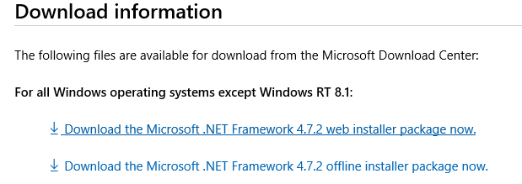
Step 1: Download .NET Framework
Go to the following Website https://support.microsoft.com/en-us/help/4054531/microsoft-net-framework-4-7-2-web-installer-for-windows
I used the Web Installer package

Slide 5
Step 2: Access Web Site and download Software
Go To
http://dev.mysql.com/downloads/installer/
Choose the Option that best work for you

Slide 6
Options for installing MySQL Workbench
Make sure you Select
DEVELOPMENT
Then Follow the Wizard

Slide 7
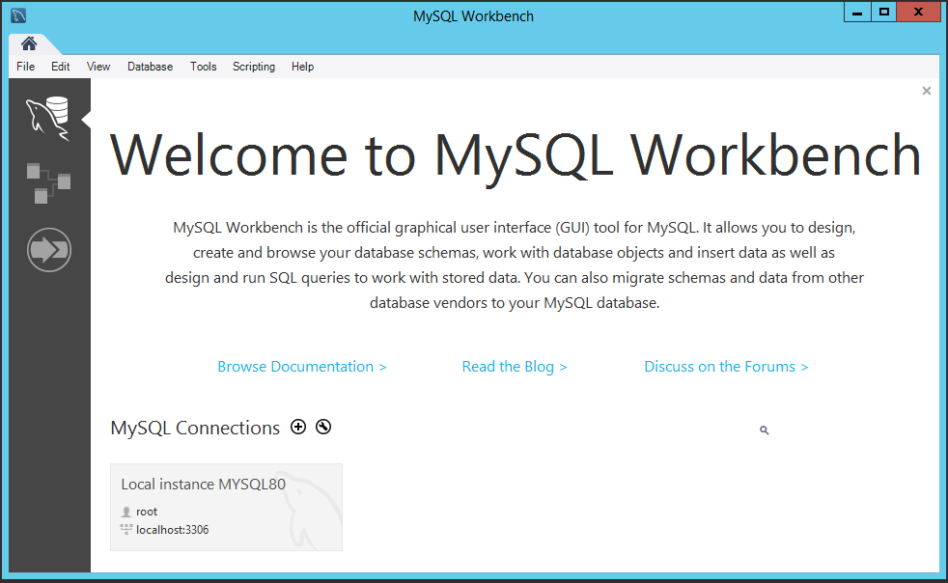
Step 3: Verify Software Installation
Look for MySQL Workbench
Double click on the Icon; The following below will appear
Login to Workbench with the user and password
you created.
Kindly review tutorial (Link) posted in Canvas about
learning how to use MySQL Workbench

Slide 8
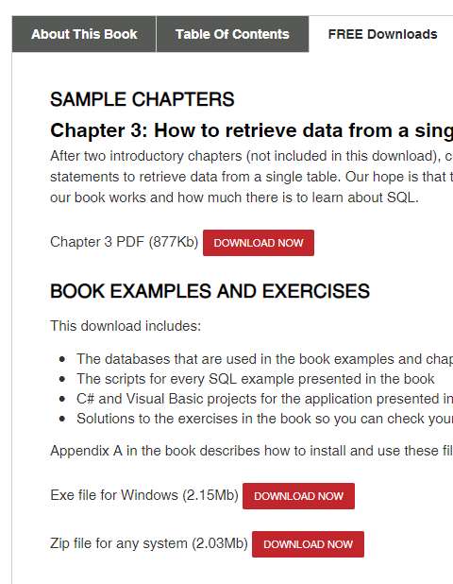
Step: Download Setup Files for the book
Go to the following link:
https://www.murach.com/shop/murach-s-sql-server-2016-for-developers-detail
Click on FREE Downloads
Under
Book Examples and Exercises
Download the Exe and Zip file
You may have to register in order
To download the files

