Slide 1
Database

Slide 2
Data vs Information
Data is simply raw facts
  Example:
    Paul
    21
    Johnson
Information is combining the facts so it means some thing
  Ex: Paul Johnson is 21 years old

Slide 3
Database vs Database Management System
Database is a shared computer system that stores or houses:
  Raw facts
  Metadata (data about data)
DBMS:
  Is normally software(programs) installed on a system that is the intermediary between the entity requesting the data and the system storing the data
  Manages the data which enables
    Controlling access to the data
    Organization and efficient use of the data
    Sharing of the data

Slide 4
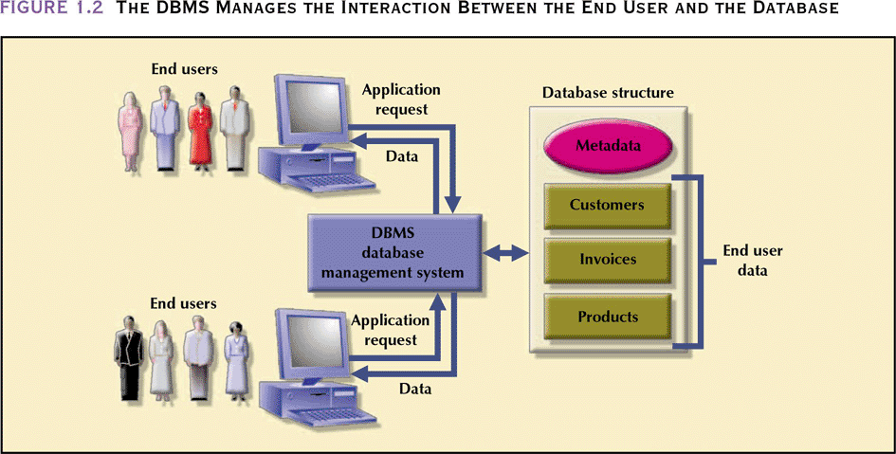
The DBMS Manages the Interaction Between the End User and the Database

Slide 5
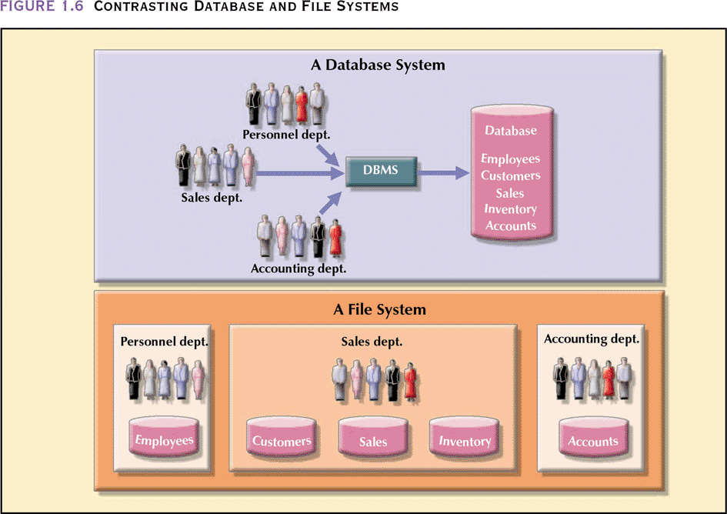
Contrasting Database and File Systems

Slide 6
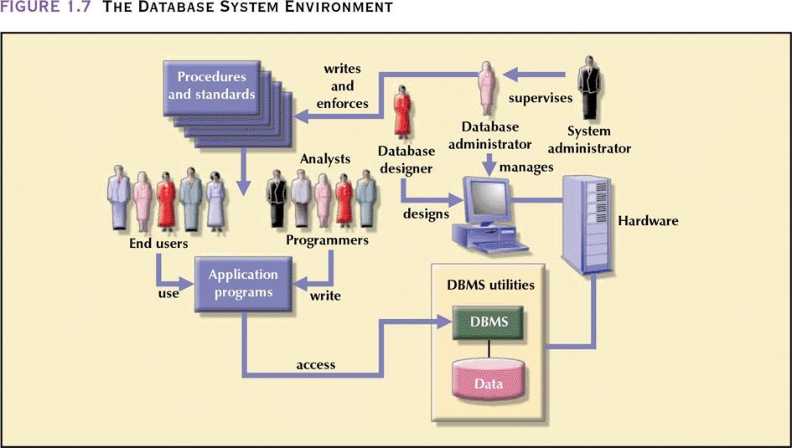
The Database System Environment

Slide 7
What are some types of Databases and the Importance of a Database
Single User: Only one user can used the database at a time, this is normally what you have on your desktop
Multi-User: Support multiple users
  Workgroup: Use for a small company with less that 15 employees
  Enterprise: Support larger companies
Importance of a database
  Decision making
  Transactions

Slide 8
Designing a Database
Structure is very important if this is not done correctly at first you can complicate your database. A single structure will not apply to all databases
In your design it is important to avoid redundancies
  Use normalization
Note: Poor design can cause
  Bad decisions and lots of errors

Slide 9
Designing a Database Process
What are the opportunities or need for a database
Do an initial interview and meet with the players and take very good notes
Upon review of your notes identify any nouns, these will possibly become your entities(Tables)
Agree on a SOW(Statement of Work), if you are doing this for a client
  History, timeline, scope and other objectives
Identify data Model and DBMS
  Entity Relational Model and Relational Database Management System
Design the structure of the database using ERD
  Conceptual view, logical view, physical view
Program and Test the database
Implement
Maintain

Slide 10
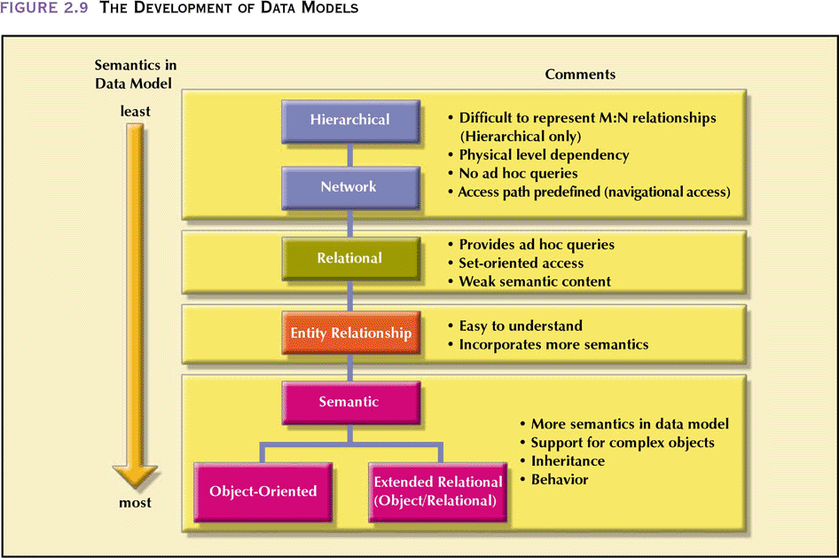
The Development of Data Models

Slide 11
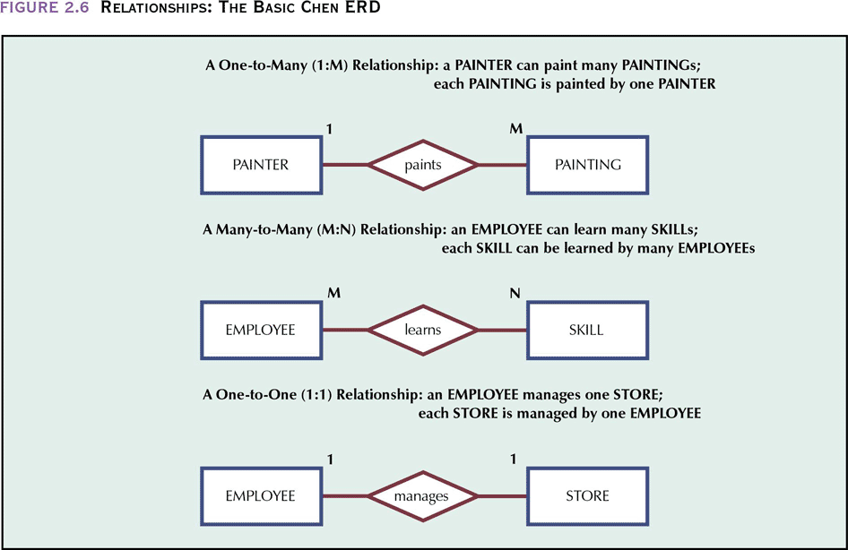
Relationships: The Basic Chen ERD

Slide 12
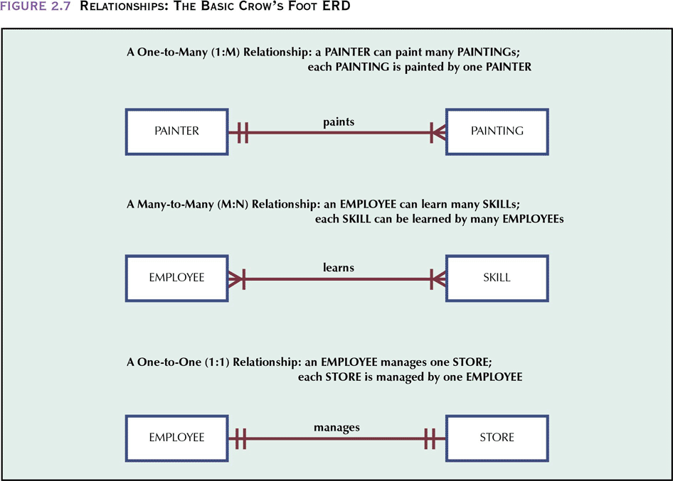
Relationships: The Basic Crow’s Foot ERD

Slide 13
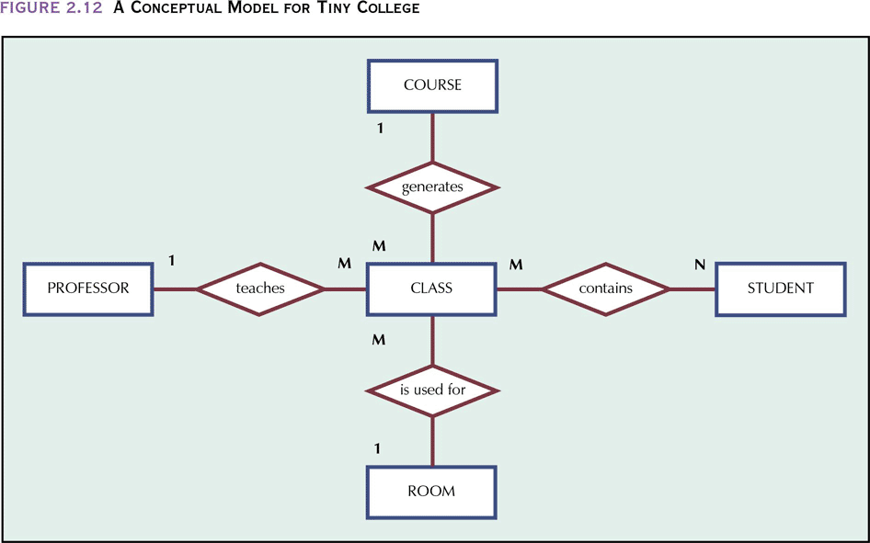
A Conceptual Model for Tiny College

Slide 14
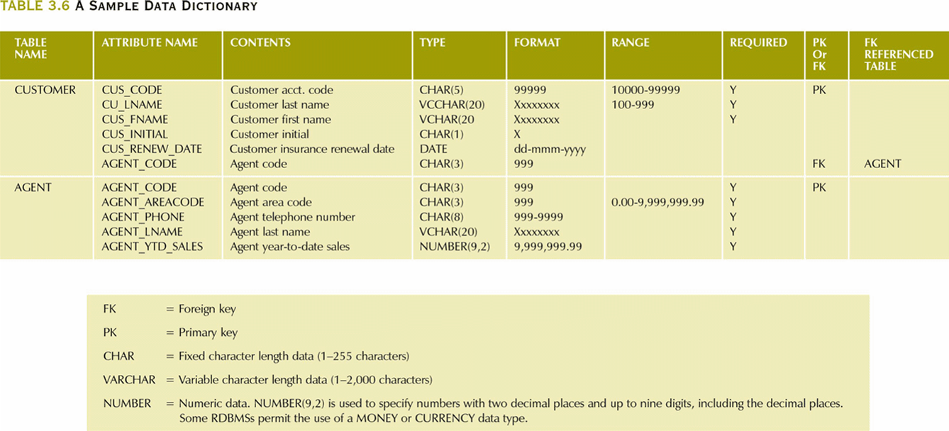
A Sample Data Dictionary

Slide 15
Key Terms You Should Know
Entity is the actual table
Attribute(Fields) defines the characteristics of the table
Value is the actual data
Primary Keys: Uniquely identifies a record in a table
Foreign keys: Identifies a record in another(second) table but references a unique key (primary key) in the first table

Slide 16
Creating a Database

Slide 17
Creating a Tables

Slide 18
Adding Fields to a Tables

Slide 19
Removing Fields to a Tables

Slide 20
Adding Records to a Tables

Slide 21
Modifying Records in a Tables

Slide 22
Deleting Records from a Tables

Slide 23
Obtaining Records from multiple Tables

Slide 24
Managing the Database

Slide 25
Securing the Database

