Slide 1
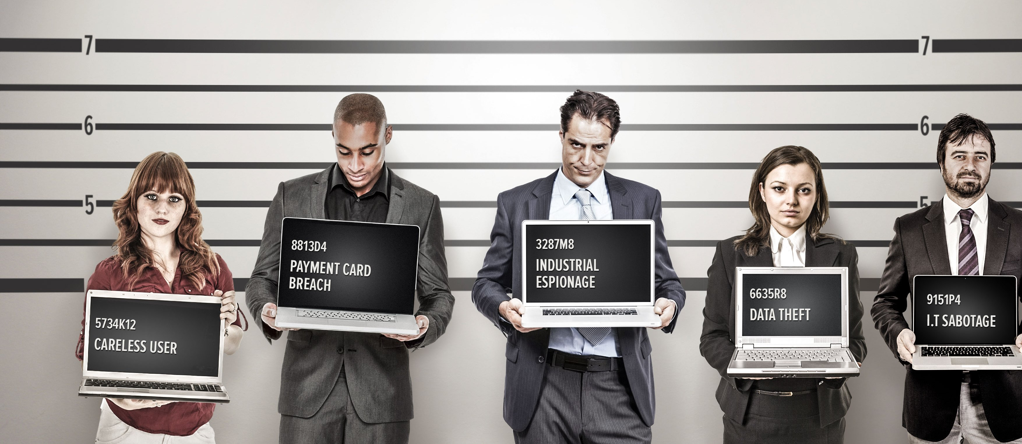
Forensics
Week 11

Slide 2
Agenda
Forensic Plan
Final Project
Assignment Outline Due (4/10)
Final Due (4/24)
Presentation (5 Minutes)
Insider Threat

Slide 3
In Class Assignment
Who Am I?
Mary in HR receives and email from the “President” asking for information on all employees. Mary sends the “President” the list.
Compromised actor * Negligent actor * Malicious insider * Tech savvy actor * The Third Party Contractor

Slide 4
In Class Assignment
Who Am I?
Steven Receives the following email…
As of April 3, 2018, your account with username: boyermusic and all associated surveys and responses is pending deletion due to inactivity. If your account is deleted, you will no longer be able to access this account or any data associated with it. Sign in between now and April 17, 2018 to keep your account active. Note: You may have to reset your password to log in. Read more at our Help Center for more details.
Compromised actor * Negligent actor * Malicious insider * Tech savvy actor * The Third Party Contractor

Slide 5
In Class Assignment
Who Am I?
Ed decides…
He is unhappy with how his company is handling the customers’ data.
He starts leaking this information on to public sites.
Compromised actor * Negligent actor * Malicious insider * Tech savvy actor * The Third Party Contractor

Slide 6
In Class Assignment
Who Am I?
Juan is the Tech person working for a small company…
He has a list of every username and password. Ransonware was “accidently” released to the environment.
Compromised actor * Negligent actor * Malicious insider * Tech savvy actor * The Third Party Contractor

Slide 7
In Class Assignment
Who Am I?
Copy of your companies inside website is found on wordpress.com.
The inside site requires sign-on, but there is no confidential information.
Compromised actor * Negligent actor * Malicious insider * Tech savvy actor * The Third Party Contractor

Slide 8
In Class Assignment
Who Am I?
Copy of your companies inside website is found on wordpress.com.
The inside site requires sign-on, but there is no confidential information.
Compromised actor * Negligent actor * Malicious insider * Tech savvy actor * The Third Party Contractor

Slide 9
In Class Assignment
Who Am I?
Your company hires another company to remotely manage the building heating and air conditioning system. The other company is hacked and a system administrator’s credentials are stolen.
Compromised actor * Negligent actor * Malicious insider * Tech savvy actor * The Third Party Contractor

Slide 10
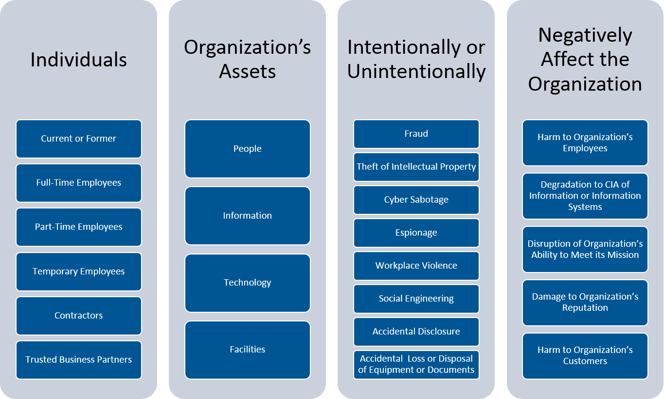

Slide 11
Actors
Compromised actors: Insiders with access credentials or computing devices that have been compromised by an outside threat actor. These insiders are more challenging to address since the real attack is coming from outside, posing a much lower risk of being identified.
Negligent actors: Insiders who expose data accidentally — such as an employee who accesses company data through public WiFi without the knowledge that it is unsecured.
Malicious insiders: Insiders who steal data or destroy company networks intentionally – such as a former employee who injects malware in corporate computers on his last day at work.
Tech savvy actors: Insiders who react to challenges. They use their knowledge of weaknesses and vulnerabilities to breach clearance and access sensitive information. Tech savvy actors can pose some of the most dangerous insider threats, and are likely to sell confidential information to external parties or black market bidders.
The Third Party Contractor Similar to the negligent or unknowledgeable employee, third party contractors provide another opportunity for malicious hackers to compromise your network security. Whether it’s as simple as the maintenance company contracted or outsources services. All depend on the strength of cybersecurity protocols employed by these third party contractors.

Slide 12
How do we protect against Insider Threat?

Slide 13
Focus on the right assets
Bad people want what you value most, what we call your businesses’ “crown jewels.” Identify the most-valuable systems and data, and then give them the strongest defenses and the most frequent monitoring.

Slide 14
Apply deep analytics
Humans are creatures of habits: They come to work at the same time and do familiar tasks. The same can be said for how they use and interact with technology. Deep analytics and AI can uncover deviations in behavior at the level of individual employees, which can make it much easier to spot indications that systems have been compromised. We recently helped a customer collect and analyze terabytes of such data, and within 15 minutes they saw violations of policy that they didn’t know existed.

Slide 15
Know your people
Understanding the users who hold the potential for greatest damage is critical. Addressing the security risks that these people represent, and the critical assets they access, should be a priority. In particular, monitor IT admins, top executives, key vendors, and at-risk employees with greater vigilance.

Slide 16
Don’t forget the basics
In security, we love the newest tools. But getting the basics done well can make the biggest impact on insiders: Applying software patches automatically closes that open window before a hacker can use it to access your network. Enforcing strong standards for user identities and passwords means stealing credentials is that much harder. Collecting all the data and forensics you can on every device that touches your network makes sure you’re the first to know if you’ve been hacked, not the last. But forget technology altogether — user awareness programs are the key to educating insiders. Train your people, test them, and then try to trick them with fake exercises. These basics make a disproportionate impact but they do require work and perseverance.

