Slide 1
Forensics
Week 13

Slide 2
Agenda
Federal Virtual Training Environment (Cyber Security)
https://niccs.us-cert.gov/training/federal-virtual-training-environment-fedvte
Forensic Plan Timing
Presentation (4/24) and Final (5/1-Study Day)
3 minutes – What you think you will remember 10 years from now?
Incident and Forensic Plan
How do you determine if it’s an event, incident or breach?
Who runs the investigation?
What’s the reporting structure?
What are you investigating?
How do you know where your data (crown jewels) is located?
When do you move from event to incident to breach?
Who else is getting involved?
How do you do your communication plan (internal and external)?
Are you going to call the CIO and CEO for every event or incident?
When is PR involved?
When is it outside PR?
Cloud Forensics
Social Media

Slide 3
Cloud Forensic
As cloud computing gains a firm foothold as an information technology (IT) business solution, an increasing number of enterprises are considering or have implemented as migration route for their IT infrastructures and business operations.
The centralization of data in the cloud has not gone unnoticed by criminal elements and, as such, data centers and cloud providers have become targets for attack.
Traditional digital forensic methodologies are not well suited to cloud computing environments because of the use of remote storage and virtualization technologies.
The task of imaging potential evidence is further complicated by evolving cloud environments and services such as infrastructure as a service (IaaS), software as a service (SaaS) and platform as a service (PaaS).
The implementation of forensics as a service (FaaS) appears to be the only workable solution, but until standards are formulated and implemented by service providers, the only option will be to use traditional forensic tools and rely on service level agreements to facilitate the extraction of digital evidence on demand.

Slide 4
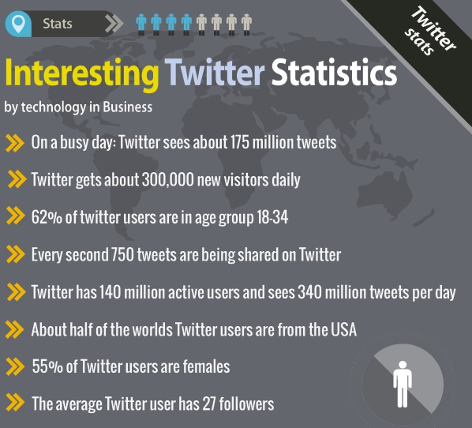

Slide 5
In Class Assignment
One Thursday AM, you’re notified by the Secret Service to an incident that occurred on your social media site. You are served a legal hold notification. Walk through your next steps.

Slide 6
Cloud Issues
StudentDoctor.net
Someone using a system at Temple
based on Firewall IP address
Not using Temple email account
Selling medical books online
Taking payment
Never sending the product
Boyfriend posting picture on illicit sites or sending emails
Girls under 21 caught in Social Media photo and expelled
TXT threats

Slide 7
Cloud and Social Media Challenges
Cloud ESI - typically managed offsite by a third party, rather than under the physical control of the company.
Defensible preservation
Integrated into the overall e-discovery
Cross Border Issues – Multinational – Can you get at the data from here (e.g. France and London EU)
Burden of proof and duty to preserve
Increased use of sharing and storing information via social media and cloud services
I’ve signed up and talking about the company or using the service (Yelp)
My company is signed up and using (google @Temple.edu, Microsoft, Box, Drop Box)
Mobile Device – tricky, hard to get and important to most cases
Extraction of all data types, including deleted files, photos, apps
How do you deal with BYOD?
Vast # of device types

Slide 8
Social Media Forensic, Why?
Criminal reasons
Missing Persons
Infidelity
Malware
Scams, Fraud, Human trafficking…
Child Pornography
Illegal media sharing...

Slide 9
Social Media Forensic

Slide 10
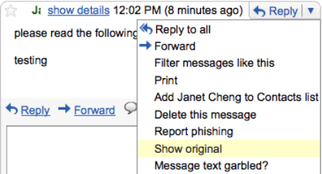
Tracing IP address from an E-mail
Gmail
Access your inbox
Click on the message
Click on the upside down triangle located on the right
Select “Show Original”
▫ Page 6

Slide 11
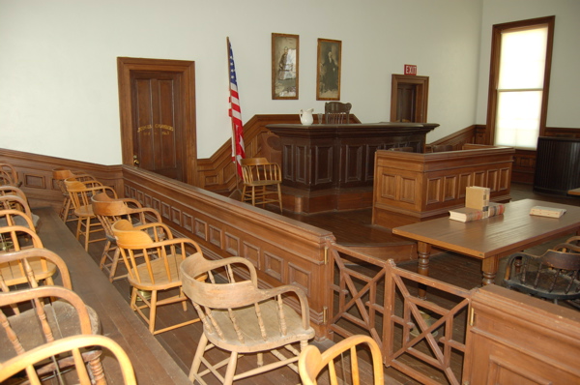
Admission of Evidence
Social media evidence is very commonly admitted into legal proceedings
Varying degrees of formality in proceedings
However, some criminal cases show skeptical courts
Criminal cases have higher standard of proof

Slide 12
Legal Steps to Access Non-Public Data
Consent of the user
E-discovery demand to user
Informal request to social network
Subpoena to social network
Search warrant for law enforcement
Find the data in an alternative, public location

Slide 13
Informal Request
Very commonly service providers – especially smaller ones – will cooperate with requests from government
Fugitive plays World of Warcraft
Howard County, Indiana, Sheriff sends polite letter to operator of game
Service provider reveals IP address, which leads to fugitive in Canada http://bit.ly/xzpMwh

Slide 14
Civil Subpoenas for Content
Big service providers tend to resist
Smaller service providers may be more cooperative
Crispin v. Christian Audigier, Inc.
Civil subpoena to FB and Myspace quashed
Content protected under Stored Communications Act
May be difference between private messages and wall postings

Slide 15
Alternative Locations for Evidence
Notices and copies to email or phone SMS (text)
Replication at other sites (my Facebook and LinkedIn repeat my tweets)
Sharing by friends
Cache on computer

Slide 16
General Principles for Investigators
Keep thorough, signed, time-stamped records
Record your justification
Keep the methods and evidence capture proportionate and within the scope of the justification
User consent (employment application or terms of employment) reduces risk
Be creative to find the data

