Slide 1
Forensics
Week 9

Slide 2
Agenda
Exam #2 Next Week
In Class Assignment
Event, Incident, Breach
Forensic Plan
Final Project
Assignment Outline Due (4/10)
Final Due (4/24)
Presentation (5 Minutes)

Slide 3
In Class Assignment
Event, Incident or Breach?
SONY
AOL
REN-ISAC
Laptop
Desktop
PasteBin

Slide 4
SONY - Event, Incident or Breach?
To whom it may concern,
Pursuant to Sony Interactive Entertainment LLC ("SIE") corporate policy, the below IP addresses were blacklisted from using our services because SIE detected activity that is abusive to our network services. In our determination, the abusive activity was not related to velocity or volume (many users behind the same IP address, i.e. NAT), but matched the specific patterns of known abuse of our publicly available services. This abuse may be the result of a computer on your network that has been compromised and is participating in a botnet abuse of our services.
The following table of IP addresses, dates and times should help you correlate the origin of the abusive activity. The time stamps are approximate from our logs. The actual timing of the events depend on the signature matched. It is very likely to have occurred both before, during and following the times listed.
Approximate Time Range (UTC), IP Address, Reason
2018-03-15 14:17 ~ 2018-03-15 14:47 (UTC), 129.32.121.186, Account Takeover Attempts
It is most likely the attack traffic is directed at one of the following endpoints:
account.sonyentertainmentnetwork.com
auth.api.sonyentertainmentnetwork.com
These endpoints on our network are resolved by Geo DNS, so the IP addresses they resolve to will depend on the originating IP address.
The destination port will be TCP 443.
Please take the necessary measures to correct the malicious activity from the above-listed IP addresses as soon as possible to avoid any further disruptions. If we were to remove any of these IP addresses from the blacklist and subsequent abusive activity is detected, the IP address will be promptly blacklisted again.
We thank you for your prompt attention to this matter. If you require assistance or additional information please contact snei-noc-abuse@am.sony.com and include the IP address in question.
Thank you

Slide 5
AOL - Event, Incident or Breach?
This is an email abuse report for an email message with the message-id of <1521008382.vzlGe4AVMxVzhvzlGeGlNE@mf-smf-ucb032c3> received from IP address 155.247.166.171 on Wed, 14 Mar 2018 02:19:48 -0400 (EDT)
For information, please review the top portion of the following page:
https://postmaster.aol.com/fbl-request#info
For information about AOL E-mail guidelines, please see https://postmaster.aol.com/best-practices
If you would like to cancel or change the configuration for your FBL please use the tool located at:
https://postmaster.aol.com/fbl-request

Slide 6
REN-ISAC - Event, Incident or Breach?
Greetings,
It has been brought to the attention of the REN-ISAC that some credentials from your institution have appeared in a credential dump. Most of these credential dumps are discovered on publicly accessible sources. These credentials may be the actual sets used to access your institution's information resources or it may be a user utilizing their email at a 3rd party site. Even if the credentials are not used on your institutions information resources, it may be worth investigating as these credentials are sometimes captured via password stealers. It is also common for users reuse their passwords or variations of the same password at different sites.
We have no way of determining when the credentials themselves were stolen/acquired. We only know that they have been disclosed within the last few days. This means we are unable to determine if the accounts listed are current, active, or years old. If the accounts are old, please respond and tell us. If you are reporting an account as old, please also state your re-use policy if you do re-use accounts, as we have no way of determining if the account will be put back into circulation. This will help us 'age' future credential sets and prevent re-notification on very old accounts/credentials.
By default we do not provide full details in the initial notification. If you would like the full details of the reported credentials, please reply to this notification and let us know.
Additional Information:
[Credentials]
cjc@temple.edu
owhite@temple.edu
dwrzos@temple.edu
[Credential Header]
Pastebin title: Elite Softs Combos 2018
Pastebin author: A Guest
email:password
[Comment]
[Source] pastebin http://pastebin.com/80RSZM60

Slide 7
Laptop - Event, Incident or Breach?
Theft of laptop with 43,000 patient records
A: Encrypted
B: Unencrypted

Slide 8
Desktop - Event, Incident or Breach?
Desktop of retiring researcher and doctor stolen. The desktop of a retiring researcher and doctor was stolen with no forcible entry. The desktop and monitor was missing. The desktop was not encrypted, however the doctor noted that he had an excel file with all of his surgerical procedures documented.

Slide 9
PASTEBIN - Event, Incident or Breach?
An email on a domain you're monitoring has appeared in a paste
You signed up for notifications when emails on temple.edu were pwned in a data breach and there's just been a match in a "paste".
A paste is information that has been published to a publicly facing website designed to share content, usually anonymously. Often a dump of email addresses in a paste is an early indicator of a data breach.
Read more on the pastes page.
Here's what's known about the paste:
If it hasn't already been removed (many pastes are quickly deleted), you can review it via the link below.
Title: | Untitled
Author: | Not provided
Date of paste: | 18 Mar 2018
Accounts found: | 16,415
Your accounts: | 7

Slide 10
What is an Event?
In its Computer Security Incident Handling Guide, the National Institute of Standards and Technology (NIST) defines an event as “any observable occurrence in a system or network,” such as sending an e-mail message or a firewall blocking an attempt to connect. The guide also defines adverse events as those with a “negative consequence, such as…unauthorized use of system privileges, unauthorized access to sensitive data, and execution of malware that destroys data.”

Slide 11
What is a Security Incident?
A security or privacy incident, on the other hand, is, an event that violates an organization’s security or privacy policies involving sensitive information such as social security numbers or confidential medical information. These can range from a lost thumb drive to missing paper files to what Bloomberg Business calls “sophisticated data attacks,” such as those associated with the Anthem and Sony breaches. Security incidents are part of everyday business—65 percent of healthcare organizations experienced electronic information-based security incidents over the past two years, according to the Ponemon study.

Slide 12
What is a Data Breach?
Data breach is a security (or privacy) incident that meets specific legal definitions as per state and federal breach laws. Data breaches require notification to the affected individuals, regulatory agencies, and sometimes credit reporting agencies and the media. Only a small percentage of privacy or security incidents escalate into data breaches but to identify them there’s a regulatory obligation to conduct an incident risk assessment when the incident evolves PHI or PII. (The Verizon 2015 Data Breach Investigations Report showed confirmed data loss in less than 3 percent of the almost 80,000 incidents reported.)
Despite the relatively low ratio of breaches to incidents, the burden to determine if the incident is a breach is high so you should not get tempted to to “play the odds,” and not treat each incident as a potential breach. The burden of proof is always on the organization to document and perform a multi-factor incident risk assessment to demonstrate compliance or face penalties and corrective action plans from regulators.

Slide 13
What is Personal Information?
Personal Information: An individual’s first name or first initial and last name plus one or more of the following data elements: (i) Social Security number, (ii) driver’s license number or state issued ID card number, (iii) account number, credit card number or debit card number combined with any security code, access code, PIN or password needed to access an account and generally applies to computerized data that includes personal information.
Personal Information shall not include publicly available information that is lawfully made available to the general public from federal, state or local government records, or widely distributed media. In addition, Personal Information shall not include publicly available information that is lawfully made available to the general public from federal, state, or local government records.
Breach of Security: The unlawful and unauthorized acquisition of personal information that compromises the security, confidentiality, or integrity of personal information.

Slide 14
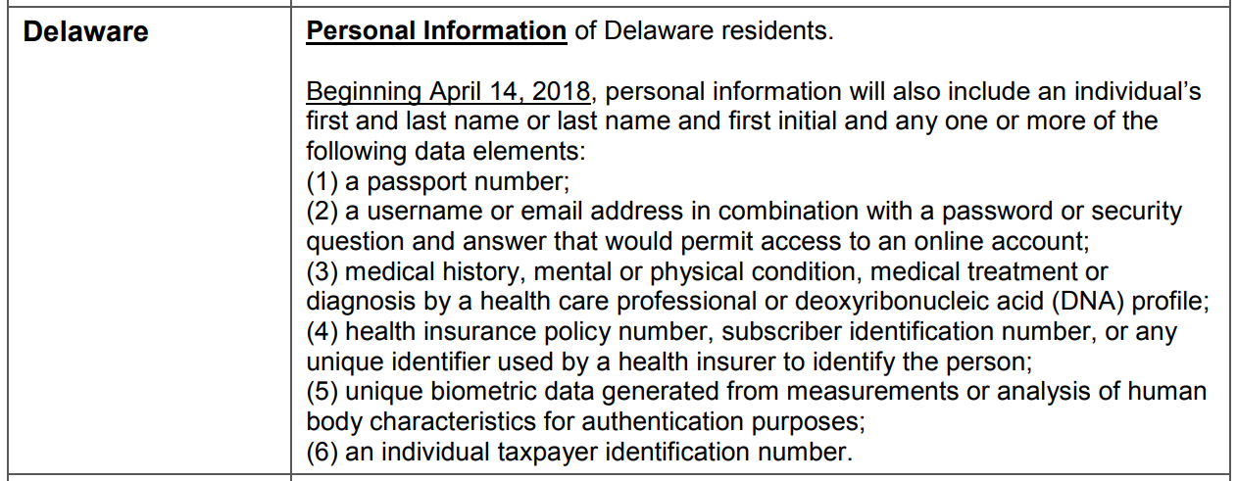
Broader than PII examples…

Slide 15
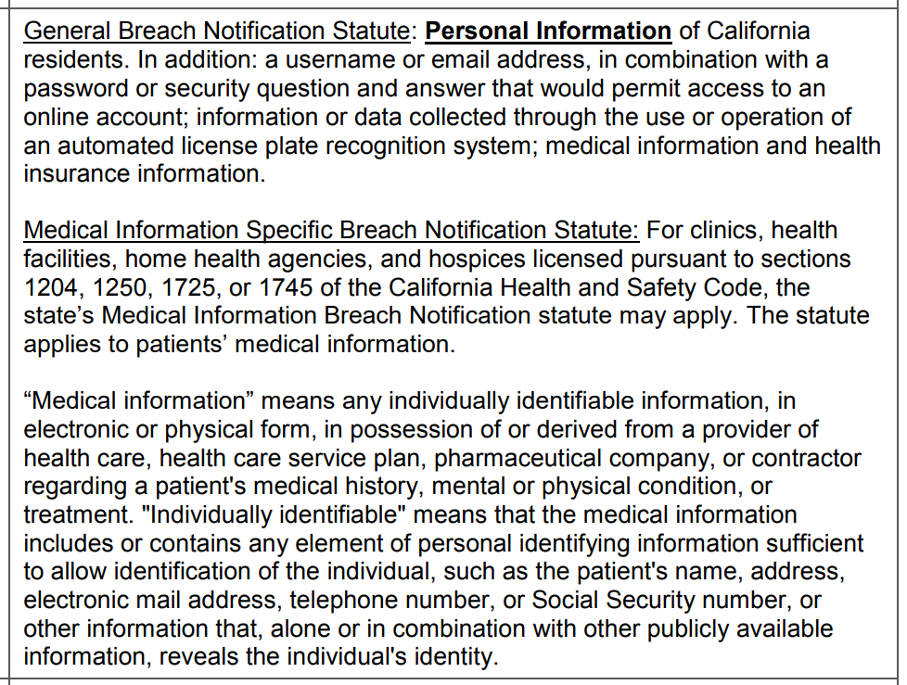
California Breach Notification Rules

Slide 16
Breach Plan
Executive Summary
Terminology
Data Collection
System/Technology
Process/Procedure
Interviews/Investigations
Chain of custody
Examination
Analysis
Reporting
Recommendation

Slide 18
