Slide 1
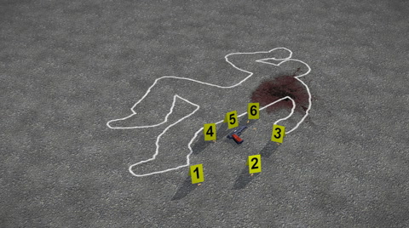
Forensics
Week 1

Slide 2
About this Class
There is no book for this class!
We use the MIS Community Site!
Class is based on current articles/videos/Gartner resources/Lynda.com
Still fine tuning and finding broken links
If you have articles or videos that are about the topics submit to the group
Exams on Canvas

Slide 3
Lets Review the Syllabus
Semester Structure
Forensic, Laws and Ethics
Current Issues, Holds, eDiscovery and Breach Notification
Cyber Threats (Internal/External), Cloud Issues with Forensic
What I expect
Cameras on or the online students
Participation in class
I’m the facilitator to get all the material covered
All material on time
Projects
Hard Drive Autopsy – its about following instruction and details!
Wire Shark – Its amazing what you find out there!
Cyber Security Plan
Exams 3x (Multiple Choice) via Canvas (Non-cumlative)

