Slide 1
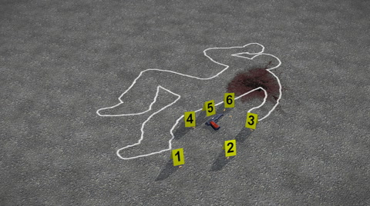
Forensics
Week 4

Slide 2
Ethics in the Forensic Industry
Your Ethical behavior
Ensuring that evidence isn’t compromised, mishandled, manipulated, or misinterpreted to potentially destroy a case and/or the lives of all individuals involved.
When asked to do an investigation; what stops you from just stating someone’s name (right or wrong)?
Issue is this industry lacks standards
Bias – define
Bias can cloud individual’s decision making process and impact outcomes and results.
What are you allowed to do at work?
Where do laws take over very policies?
So what impacts Ethic Behavior?
Laws
Policy
Morals
Bias

Slide 3
Issues in the Forensic Industry
New Technology
Social Media
Mobile – 75% allow BYOD
Cloud
Attitude – Younger doesn’t see the difference between work and personal devices
No excuses for not preserving
Who, what, where and why?
Collection (what purpose) Use - Did you tell them? And Disclosure
Addressing New Technology - Employment policy, security (data mapping), litigation strategy

Slide 4
