Slide 1
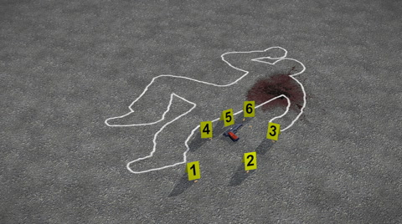
Forensics
Week 6

Slide 2
Digital Forensic Challenges
What are we trying to determine?
Who did or/is doing what?
When was it done?
What was it changed from and to?
Why? ... Being the most complicated Question
Programming
1st and foremost the application needs to have security in mind
Identity management, Role separation, Logging
Is the application designed to tell us who, when, what and why?
Company Investment in tracking technology
Basic ability to pull logs
Security Incident Event Monitor (SIEM) to correlate events
Challenges In the environment
Hardware – Ease of wiping machines, Ease to replace Hard Drives, Self-Wiping Drives
Cloud – SaaS and PaaS – logging, access, encryption, shared multi-tenant data
Cloud – Access from multiple devices (compromise or tracking)
Legal Issues – evolving Privacy and Protection rules, BYOD
Cloud – Preservation, Storage, Chain of Custody, Cross-Organizational Cooperation, Logging (current tools and process are insufficient)

Slide 3
Other Digital Forensic Challenges
Encryption
Lack of Training
Lack of Resources
Volume of Data
Internet of Things/Device Proliferation
Legal Challenges
Number of Cases and Expectations for what’s possible

