Slide 1
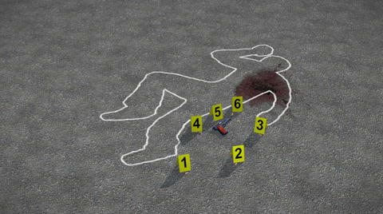
Forensics
Week 7

Slide 2
4th Amendment
The right of the people to be secure in their persons, houses, papers, and effects, against unreasonable searches and seizures, shall not be violated, and no Warrants shall issue, but upon probable cause, supported by Oath or affirmation, and particularly describing the place to be searched, and the persons or things to be seized.
How does the 4th Amendment apply to Digital Content?
Digital Seizure and Search
When do you Seizure?
When do you Search?
Do I need a search warrant or subpoena?
Police (FBI, SS, CIA)?
Security Officer?
HR?
Cyber Incidents
Reasonable Search
Chat - Phone conversation or Email?
What is the difference between Preservation and Legal Hold?

Slide 3
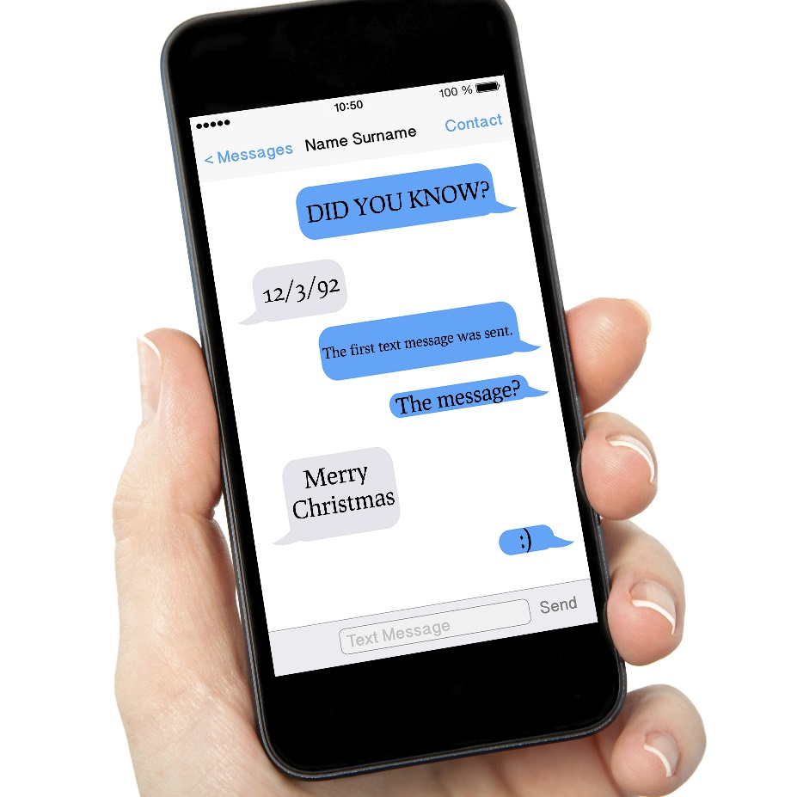
Ediscovery – Phone verse Text

