Slide 1
Forensics
Week 8

Slide 2
In Class Assignment
PROS for keeping all information or archive/purge
CONS for keeping all information or archive/purge

Slide 3
Issues in the Forensic Industry
Number 1: It is your duty to know where the evidence is and how to find it.
Building a practice – data mapping
Number 2: Reduce the size of the data
Example: 825,000 Emails / first cut down to 5,200
Number 3: Harmful email: good email. Be proactive instead of reactive. Familiarize yourself with the lingo and the likely terms that are used.
Number 4: The involvement of the client and the entire litigation team. Data or review.
Number 5: There is no cookie cutter case involving e-discovery. Tracking the data and decisions you make during the various phases of the case are very important if opposing counsel decides to challenge your process.

Slide 4
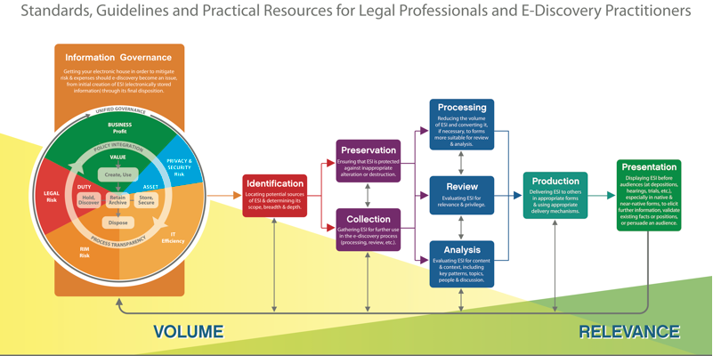
Electronic Discovery Reference Model (ERDM)

Slide 5
In Class Assignment Review
Can I just keep asking for more and more data?
Opinion on keeping everything forever.
Pros and Cons Assignment

