Slide 1
IT Audit Process
Michael Romeu-Lugo MBA, CISA
March 27, 2017

Slide 2
Agenda
Audit Planning
PS 1203 / PG 2203
Evidence
PS 1205 / PG 2205
References:
ITAF 3rd Edition
Information Systems Auditing: Tools and Techniques – Creating Audit Programs

Slide 3
Performance Standard 1203 – Performance and Supervision ITAF 3rd Edition, page 10
Statements - “IS audit and assurance professionals shall…”
1203.1 | Conduct the work in accordance with the approved IS audit plan to cover identified risk and within the agreed-on schedule.
1203.2 | Provide supervision to IS audit staff for whom they have supervisory responsibility, to accomplish audit objectives and meet applicable professional audit standards.
1203.3 | Accept only tasks that are within their knowledge and skills or for which they have a reasonable expectation of either acquiring the skills during the engagement or achieving the task under supervision.
1203.4 | Obtain sufficient and appropriate evidence to achieve the audit objectives. The audit findings and conclusions shall be supported by appropriate analysis and interpretation of this evidence.
1203.5 | Document the audit process, describing the audit work and the audit evidence that supports findings and conclusions.
1203.6 | Identify and conclude on findings.

Slide 4
Performance Guideline 2203 – Performance and Supervision ITAF 3rd Edition, Page 95
Planning and risk assessment
1201 Engagement Planning
1202 Risk Assessment in Planning
Identifying controls
Assessing controls and gathering evidence
Design effectiveness
Operational effectiveness
Documenting work performed and identifying findings
Confirming findings and following up on corrective actions
Confirm with Auditee
If corrected before end of engagement auditor should mention original findings and document actions taken
Drawing conclusions and reporting
1204 Reporting
Draw conclusions and report about impact of finding on audit objectives
Notes:
MAIN TASKS

Slide 5
Performance Guideline 2203 – Performance and Supervision ITAF 3rd Edition, Page 98
Documenting
Professionals should prepare sufficient, appropriate and relevant documentation in a timely manner that provides a basis for the conclusion and contains evidence of the review performed. Sufficient, appropriate and relevant documentation should enable a prudent and informed person, with no previous connection to the audit engagement, to re-perform the tasks performed during the audit engagement and reach the same conclusion. Documentation should include:
Audit engagement objectives and scope of work
Audit engagement project plan
Audit work programme
Audit steps performed
Evidence gathered
Conclusions and recommendations
Notes:
MAIN TASKS

Slide 6
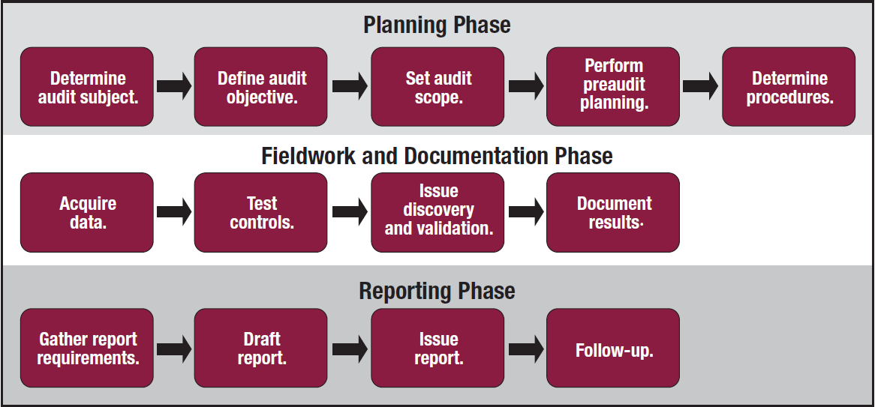
Audit Work Programme*
“Work Programme” = “Audit Program”
Procedures and instructions
Test controls
Evaluate results
Obtain suitable evidence to form an opinion
Report findings to stakeholders
Include:
Areas to be audited
High-level objectives
Tools and techniques for testing controls
* Information Systems Auditing: Tools and Techniques – Creating Audit Programs

Slide 7
Audit Program – Planning Phase

Slide 8
Audit Program – Planning
Steps | Examples | Sources of information
1. Define audit subject | ERP system Data Center BYOD Security | Annual audit plan Risk assessment Organizational change plans Legal / regulatory changes Mergers and Acquisitions
2. Define audit objective | ERP Inventory management DC environmental controls iOS devices | Annual audit plan Audit management Executive management Previous audit reports Internal policies, standards and procedures Risk assessments Legislation or regulations applicable to enterprise.
3. Set audit scope | Assuring compliance with SOX SAP MM – Inventory Management Data Center Temperature and Humidity Controls iOS data protection and encryption | Legislation or regulations applicable to enterprise Previous audit results SLA and compliance issues Problem and Incident tickets

Slide 9
Audit Program – Planning (continued)
Steps | Examples | Sources of information
4. Perform preaudit planning | Location of IT functions supporting SAP MM, location of supply operations personnel. Philadelphia Distribution Center: 2017 Broad Street, Philadelphia PA Mobile Management organization | Organization charts Previous audit reports Process maps and flow diagrams Vendor contracts Network maps

Slide 10
Audit Program – Planning: Step 5 Develop Procedure
Activity | Example
Identify and obtain departmental policies, standards and guidelines for review | Information security policies Segregation of duties (SoD) policies Purchasing policies Authorization matrix Industry standards or guidelines Compliance requirements
Identify a list of individuals to interview | Accounts payable clerks Subject matter experts (SME) Supervisors and Managers
Identify methods (including tools) to perform the evaluation. | Compliance Testing Substantive Testing Tools Questionnaires Checklists Spreadsheets Computer Assisted Auditing Tools (CAATs)

Slide 11
Audit Program – Planning: Step 5 Develop Procedure
Activity
Develop tools and methodology to test and verify controls. | See the previous step: “Identify methods (including tools)…”
Identify criteria for evaluating the tests (similar to a test script for the auditor to use in conducting the evaluation). | Organization Structure Review Policies, standards and procedures review Documentation review (user manuals, training material, …) Interviews with key personnel Observation of procedures as they are performed Reperformance Walk-Throughs Data analysis
Define a methodology to evaluate that the testing and its results are accurate (and repeatable if necessary). | Refer to standard 1205 – Evidence

Slide 12
Performance Standard 1205 - Evidence
Statements
1205.1 IS audit and assurance professionals shall obtain sufficient and appropriate evidence to draw reasonable conclusions on which to base the engagement results.
1205.2 IS audit and assurance professionals shall evaluate the sufficiency of evidence obtained to support conclusions and achieve engagement objectives.
Evidence must be:
Relevant – consistent with audit objectives and supports audit findings and recommendations.
Reliable – accurate, verifiable and from objective sources.
Sufficient – factual, adequate and convincing such that a prudent person would reach the same conclusions as the auditor.
Notes:
Must be relevant?
Is consistent with audit objectives and supports audit findings and recommendations.
Must be reliable?
Accurate, verifiable and from objective sources.
Must be sufficient?
Factual, adequate and convincing such that a prudent person would reach the same conclusions as the auditor.

Slide 13
Evidence-Gathering Procedures
Procedure | Comments
Inquiry and Confirmation | Least reliable. Consists of interviews usually driven by checklists.
Inspection of Records | Paper, computer printouts, plans and reports, etc. Originals are better than copies; system-generated; gathered by auditor.
Inspection of Assets | Existence and condition. Verify/record ID, serial#, etc.
Observation | Watching a person or system execute the process or transaction
Re-performance | Executing again and recording how it happens, not how it should happen.
Re-calculation | Carrying out calculations manually or by other independent means recording the results.
Scanning | Looking for things that do not belong or do not follow a pattern.
Notes:
Use the most appropriate of these.
Inquiry and Confirmation – password complexity example

Slide 14
Other Evidence Considerations
Source, nature and authenticity
Written rather than oral
From independent sources
Obtained professionally rather than by auditee
Certified
Kept by an independent party
The results of inspection and observation
Identify, cross-reference and catalogue
Retention, availability and disposal
Protect from unauthorized disclosure or modification

Slide 15
Coming Soon – Next Week
Sampling
Sampling Types
Sampling Techniques
Testing Techniques

