Slide 1
Remote Consulting Group
Remote Access Policy Training
InfoSec Representatives:
Sean Walsh, Loi Tran, Ahmed Alkaysi, & Jaspreet Marad

Slide 2
Topics
What is Remote Access?
Who does it affect?
Policy
Why should you care?
What are the consequences?
Concerns
What can you access?
How to remote access?
Compliance

Slide 3
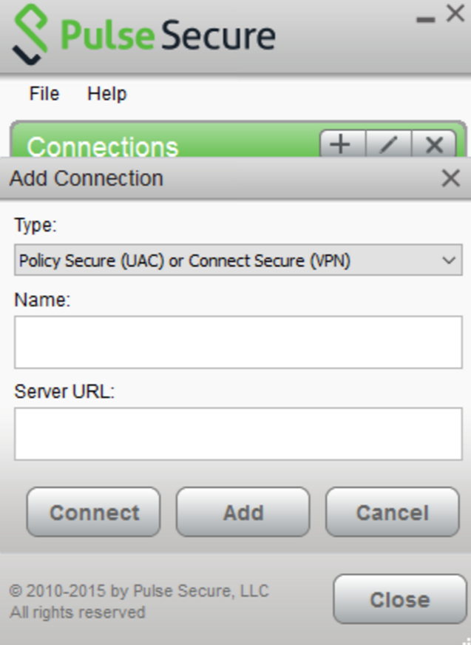
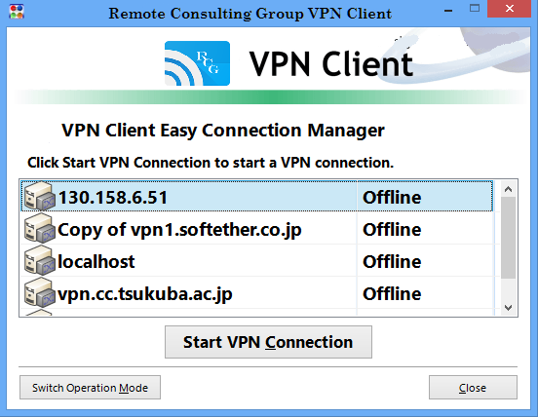
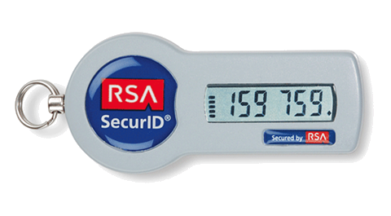
Policy
Authorized VPN Clients
What is Remote Access?
E/VPN Conn.
Enables authorized access to RCG intranet to access corporate information systems, data, and resources from the internet.
Internet
Who does it affect?
All RCG employees, contractors, vendors, suppliers, distributors, and any other third party entities that is authorized to access RCG’s network
Firewall
Two-Factor Authentications
RCG Network

Slide 4
Concerns
Why should you care?
What are the consequences?
Unauthorized Access can lead to:
Disclosure of confidential information
Disruption of services
Blackmail
Leave systems vulnerable to cyber attacks
To Business:
Negative media coverage
Financial implications
Low customer confidence
Sanctions by regulators
To Employees:
Potential loss of job
Personal information loss
Reduced remote access privileges
Individual Control Measures
Protect your credentials:
Use strong passwords
Protect RSA Token & Smart Badge
Use privacy screens when traveling
Do not write or tell anyone your passwords

Slide 5
Compliance
What can you access?
Employees:
Corporate Email Accounts
Employee Portal
Role-based ERP Access
Technical Helpdesk resources
Non-critical systems and applications
Third Parties (varies):
Invoice Application
Supplier’s Portal
Self-service Vendor Profile Management
Payment Services
Policy available at: https://inside.rcg.com/policy1_0_Remote_Access_Policy.html

Slide 6
Compliance - Demo

