Slide 1
FOX3T
Internal Policy Audit

Slide 2
Sony Pictures Hack
2014: The motion picture film studio was hacked.
Stolen information included:
Sony Pictures employee personal information
E-mails
Executive salaries
Copies of then-unreleased Sony films

Slide 3
Why Audit?
We ensure proper care of documents
Secures our confidential Information
Provides accountability and responsibility of assets
Encourages proper document destruction procedures

Slide 4
Compliance
Enforcement of SOX compliance
Reinforcement of ISO 15489 records management standard
Defines principles on creation, capture and management of records.

Slide 5
Confidence and Reputation
Due to the Sony breach the public lost confidence in products like PlayStation.
Sony’s online network (PSN) was down for more than two weeks.
Dec 14th, 2014; Sony shares plunged more than 10%.
Hurt Reputation:
A-list actors were wary of working with the studio
Fears of exposed PII were high

Slide 6
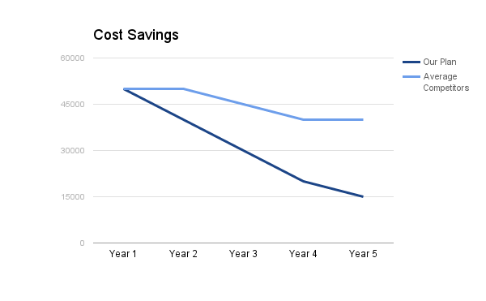
Cost
Contracts that cost you less over time

Slide 7
Our Team of Experts
Kevin Blankenship – Senior Sales Engineer
Xiaodi Ji – Senior Audit Associate
Sachin S Shah – Senior Audit Associate
Joseph Henofer – Level 2 Audit Associated

Slide 8
Thank you

