Slide 1
Cloud Computing
MIS5205 TERM PAPER
Xiaoyue Jiu, Fola Oyediran, Eboni Strawder | Group 10

Slide 2
Cloud Computing
What is the cloud? In general, the cloud is the concept of remotely hosted IT services, termed cloud apps, provided by a supplier. These suppliers are called cloud providers.
Typical cloud apps offered by cloud providers include email, calendar, documents, online storage, sales, customer service, and more.
Example of many cloud providers include companies such as Amazon, Google, 37signals, Intuit, Microsoft, and Box. A selection of the top cloud apps in the market today include Cloud Drive, Google Apps for Business, Skype, SalesForce, Basecamp, Quickbase, and Box Business.
Notes:
In the simplest terms, cloud computing means storing and accessing data and programs over the Internet instead of your computer's hard drive. The cloud is just a metaphor for the Internet. http://www.pcmag.com/article2/0,2817,2372163,00.asp
Cloud computing is a type of computing that relies on sharing computing resources rather than having local servers or personal devices to handle applications.
http://www.webopedia.com/TERM/C/cloud_computing.html

Slide 3
Architectural Layers of Cloud Computing
In practice, cloud service providers offer services that can be grouped into these 3 categories:
Software as a service (SaaS)
SaaS features a complete application offered as a service on demand. A single instance of the software runs on the cloud and services multiple end users or client organizations.
Platform as a service (PaaS)
PaaS encapsulates a layer of software and provides it as a service that can be used to build higher-level services. PaaS offerings can provide for every phase of software development and testing, or they can be specialized around a particular area such as content management.
Infrastructure as a service (IaaS)
IaaS delivers basic storage and compute capabilities as standardized services over the network.
Notes:
https://developers.google.com/appengine/training/intro/whatiscc - picture
http://webobjects.cdw.com/webobjects/media/pdf/Sun_CloudComputing.pdf

Slide 4
Regulatory Compliance in the Cloud
PCI DSS: Not all cloud providers are equal
HIPAA: Compliance is a two way street. Burden falls on you and the cloud computing provider
FedRAMP: Needed for any cloud service provider that intends to provide cloud computing services to Federal government agencies. Contractors to hire third-party assessment organizations that will verify whether they meet the basic security requirements.
GLBA: Requires that financial institutions establish appropriate standards for protecting the security and confidentiality of their customers' non-public personal information
Notes:
PCIDSS- Set of regulations that are responsible for ensuring that companies are handling users’ credit card data in a secure and responsible manner.
Health Insurance Portability and Accountability Act- Strict rules set in place in the healthcare field in order to protect patient privacy. Pertain to how medical information is collected, handled, protected, used, and disclosed.
Federal Risk and Authorization Management Program- Authorization, not certification, NIST-based, has Standardized requirements
Gramm-Leach-Bliley Act- Security and confidentiality of customer records and information Protect against any anticipated threats or hazards to the security or integrity Protect against unauthorized access which could result in harm or inconvenience to any customer
http://www.emrisk.com/sites/default/files/presentations/Compliance%20In%20The%20Cloud.pdf

Slide 5
Business Benefits
Reduced Cost: Minimizes IT requirements, reduces physical storage space, eliminates in-house maintenance and saves money on expensive hardware and licensing.
Updated: Automatically updated software
Backup Security: Reduces the risk of losing files and data because of natural disasters, human error, hackers and viruses by backing up your data off-site.
Collaboration: Saving and accessing files on the cloud means everyone can work from the same document.
Saves time: Increases response time, reduces travel time and enhances out-of-office work time.
Notes:
1. Instead of buying expensive equipment and programs, you can buy a subscription which is using/buying only what you need.
4. Most small/medium businesses don’t have servers with the capacity to send large documents. The cloud offers endless space increasing the potential for collaborations.

Slide 6
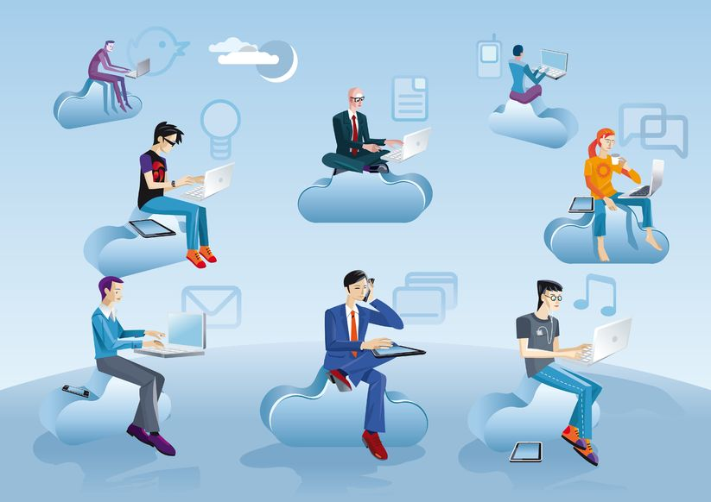
Keys Risks of Cloud Computing

Slide 7
Keys Risks based on C.I.A
Security & privacy
Lack of Total Control
Legal liability e.g. stolen personal info/ Litigation/ DDoS
Stuck with a supplier/vendor
Cyber attack

Slide 8
Risk Assessment and Controls
COSO ERM framework should be applied since it helps align the risk appetite of an enterprise with its control strategy.
Internal Environment: tone of the organization
Objective setting: Management needs to evaluate how cloud computing aligns with the organization’s objectives
Event identification: With the use of cloud computing, management needs to consider external and internal environment factors
Risk assessment: Management should evaluate risks associated with its cloud strategy

Slide 9
Risk Assessment and Controls
Risk response
With most cloud management, enterprises rely on third-party controls; this reduces management’s ability to mitigate the risks directly
Control activities
Policies and procedures should be established and implemented to help ensure the risk responses are effectively carried out
Information and communication
With cloud computing, an additional or different information process needs to be required by management
Monitoring
To properly manage risks and implement controls, the entire ERM process should be monitored to make needed modifications

Slide 10
Risk Assessment and Controls
Risk | Mitigating Control
Security and privacy | Data classification process and privacy controls Ensure that the purpose, ownership and sensitivity of this type of data are communicated and understood throughout the organization Enhance the effectiveness of data privacy controls
Cloud service providers | Building strong relationship with CSPs and determining appropriate controls Obtain copies of the service provider SAS 70 or the SSAE 16 audit reports to confirm CSPs’ controls Perform due diligence on the selected service provider
Governance, management and control | Management oversight and monitoring controls Board and senior management should have a precise understanding of the controls and determine the specific monitoring activities should implement
Notes:
http://icsa.cs.up.ac.za/issa/2011/Proceedings/Full/13_Paper.pdf
http://www.coso.org/documents/Cloud%20Computing%20Thought%20Paper.pdf

Slide 11
Risk Assessment and Controls
Risk | Mitigating Control
Noncompliance with regulations | Monitoring and auditing Third party audits should be performed on a regular basis to monitor the CSP’s compliance to agreed terms or procedures A compliance verification program will help organization enumerate all compliance requirements and validate the CSP’s compliance with the requirements
Cyber-attacks | Incident management Deploy encryption over data hosed on cloud infrastructure Maintain and implement BCP/DRP to prevent data loss or service disruption
Notes:
http://icsa.cs.up.ac.za/issa/2011/Proceedings/Full/13_Paper.pdf
http://www.coso.org/documents/Cloud%20Computing%20Thought%20Paper.pdf

Slide 12
Residual risks
Bandwidth: Network bandwidth is the most important component of the model without which the model is an illiquid asset.
Lack of standardization: A provider could have the latest security features, but due to the general lack of standardization, there are no clear-cut guidelines unifying cloud providers.
Insider threats: Once an employee gains or gives others access to your cloud, everything from customer data to confidential information and intellectual property are up for grabs.
Government Intrusion: government entities and technology companies in the U.S. and elsewhere may be inspecting your data as it is transmitted or where it resides in the Internet, including within clouds.
There’s ALWAYS a risk: The biggest risk when it comes to cloud computing is that you never know what is up ahead. Hackers are always trying to break in and as technology advances, so do the risks that come with adopting them

Slide 13
Thank you
http://www.youtube.com/watch?v=tAUuY0Yld0E
Notes:
Video- http://www.youtube.com/watch?v=tAUuY0Yld0E

Slide 14
References
http://www.youtube.com/watch?v=tAUuY0Yld0E
http://webobjects.cdw.com/webobjects/media/pdf/Sun_CloudComputing.pdf
http://www.businessnewsdaily.com/5215-dangers-cloud-computing.html
http://www.pwc.com/us/en/issues/cloud-computing/risks.jhtml
http://www.us-cert.gov/sites/default/files/publications/using-cloud-apps-for-business.pdf
http://icsa.cs.up.ac.za/issa/2011/Proceedings/Full/13_Paper.pdf
http://www.coso.org/documents/Cloud%20Computing%20Thought%20Paper.pdf
http://ebizresults.com/what-is-the-cloud/
http://www.emrisk.com/sites/default/files/presentations/Compliance%20In%20The%20Cloud.pdf

