Slide 1
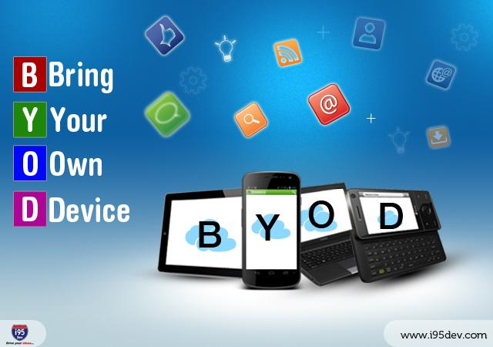
Kacper Rams, Matt Starr, Megan Stephens

Slide 2
Overview
BYOD Introduction
Risks
Controls

Slide 3
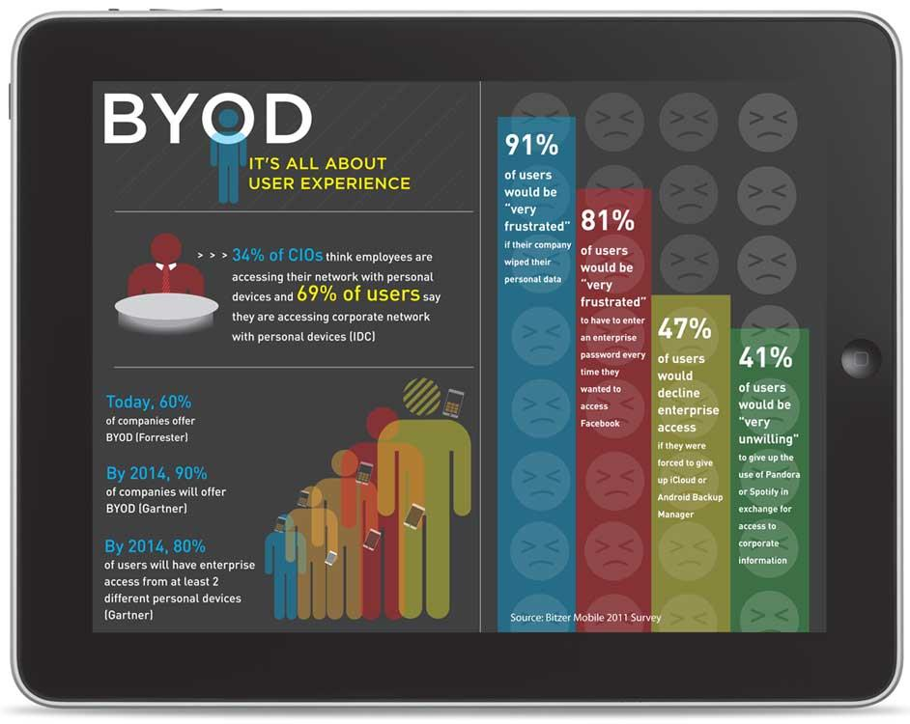

Slide 4
Introduction
Increase in use of portable devices
10 billion devices by 2018
15 exabytes of data transmitted via networks
74% employees using personal devices for work
44% using them outside the company location

Slide 5
What is a device?
Workstation
Tablet
Smartphone
USB drive

Slide 6
BYOD in the business
The needs of the business vs. the capabilities of the device
Business implementation methodology
BYOD-as-a-Replacement
BYOD-as-a-Complement
BYOD-as-an-Alternative

Slide 7
Risks
IT governance policies and personal devices
Who owns the data on a personal device?
How can you regulate usage on personal devices?

Slide 8
Risks
Security issues
Malware and viruses
Network upkeep

Slide 9
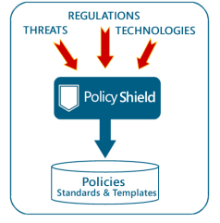
Controls
Clear IT security policies
acceptable uses
Controlled internet access
network security
VPN
WIPS

Slide 10
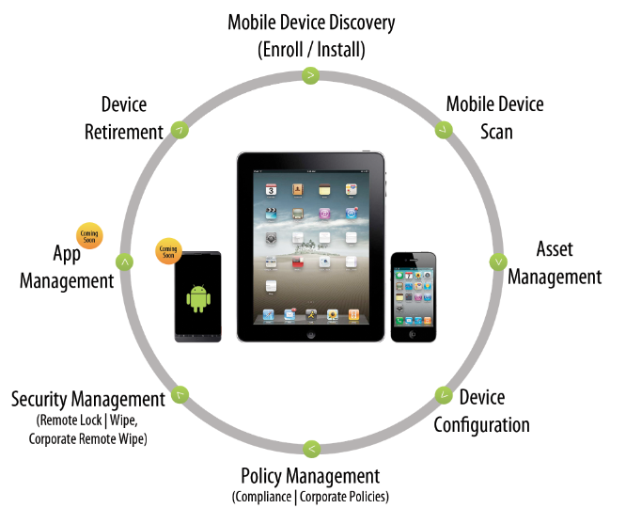
Controls
Device securitization
Mobile Device Management
Identity and access Management
Mobile application
Encrypted communication
Malware and virus protection

Slide 11
Q&A

