Slide 1
Big Data
Bijan Barikbin
Denisa Teme
Matthew Joseph

Slide 2
Background
Definition:
“Data sets with sizes beyond the ability of commonly used software tools to capture, curate, manage, and process the data within a tolerable elapsed time”
Defining characteristic
Real time information delivery

Slide 3
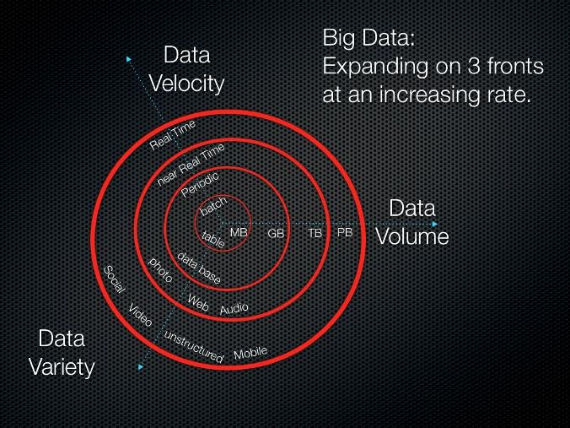
Gartner’s 3 V’s

Slide 4
How it Works...
Requires “massively parallel software running on tens, hundreds, or even thousands of servers.”
Inductive statistics
Regression
Nonlinear relationships
Causal Effects

Slide 5
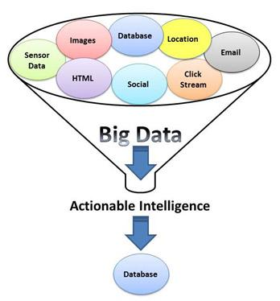
What Big Data Reveals
Reveal relationships
Find dependencies
Predict outcome and behavior of large data sets

Slide 6
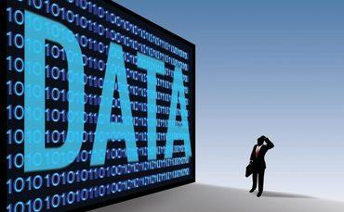
Benefits
Individual
Netflix, ISP
Community
Crash reports
Organization (Business, etc…)
Distribution methods, fight fraud, etc...
Society
optimal energy resources, etc...

Slide 7
Skepticism
Framework and skills
Less than 40% of companies have the framework, tools, and skills to effectively analyze big data
Biased results
Scientist choosing which information is “big data”
Too focused on choosing the big data sets and analyzing the vast amounts of data leads to biased or inaccurate results
Security

Slide 8
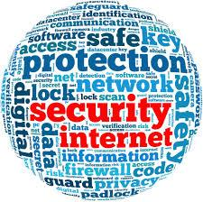
Risk #1: Loss of Security
Increased number of way to get into system
Results in data breach
Fines
Reputation loss
Increase in expense
loss in competitive advantage

Slide 9
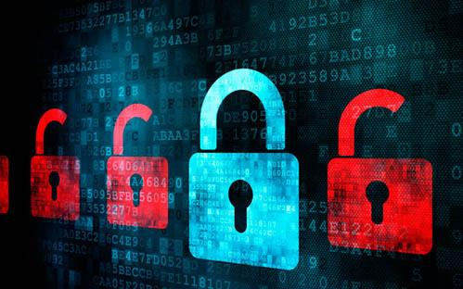
Risk #2: Lack of Cybersecurity
Increased number of transactions and data online
Great incentives for cyber criminals
Cyber criminals are better, more professional, and have powerful tools and capabilities to use

Slide 10
Risk #3: Loss of Agility
Data housed on multiple platforms
Management needs to be able to locate, analyze, and make decisions quickly
If data is not evaluated, organized and stored properly, critical information can be difficult to find
Slows down business when speed and timing is essential

Slide 11
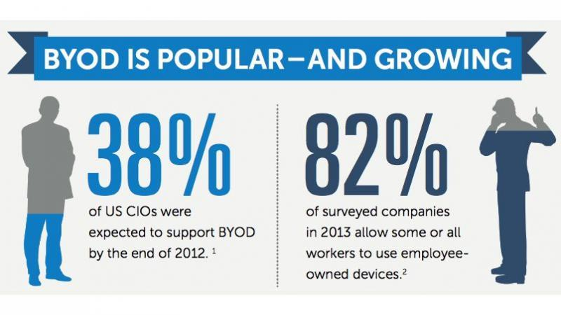
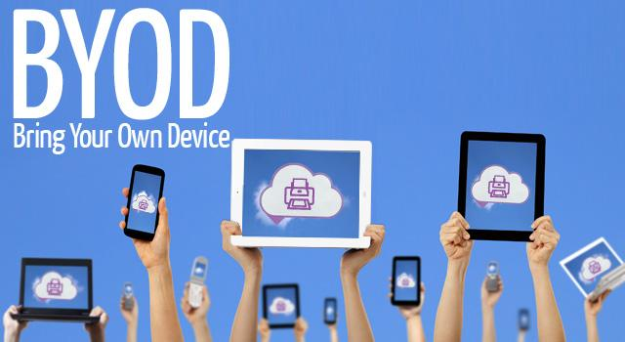
Risk #4: BYOD
Growth of big data
Need to secure employee’s personal devices in workplace
If not monitored, devices could be exposed to hacking
Ensure employees of the acceptable use policy

Slide 12
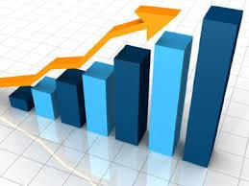
Risk #5: Increase in Expenses
Increasing amount of data=increasing amount of expenses
Might need more servers or cloud storage capacity
Additional security
Disaster Recovery

Slide 13
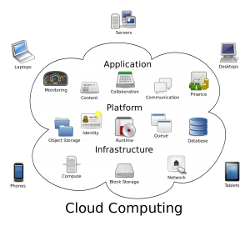
Risk #6: Data Stored in the Cloud
Relies on another company for protection of data
Highly attractive target for cyber criminals

Slide 14
Big Data Risk Mitigation
No clear Understanding of Big data
Traditional roles of data producers - changed
Sensitivity
Volume
<>Traditional control are less relevant

Slide 15
Controls
Employee Laptops
Encryption
Remote tracking
Automatic Update
Report lost/stolen Laptops
Authorization

Slide 16
Controls
Portable Devices - Small Size - Ease of use
Training
Updated acceptable use policy
Blocking access
Encryption
Audit trail
Labelling
Report if lost/stolen

Slide 17
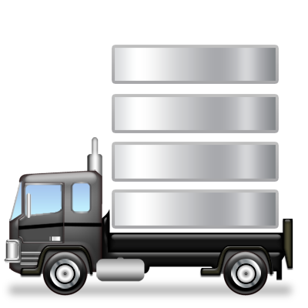
Controls
Transportation of Data
Encryption algorithms
Copy
Record details of Transfer

Slide 18
Controls
Emails sent over the companys network:
Training
Email security system
Periodic notifications
Encryption

Slide 19
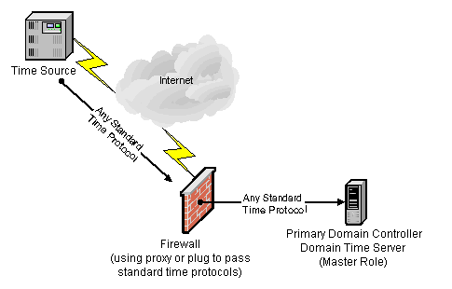
Controls
Firewall
List of services & ports
Permissible traffic
Protocols
Traffic monitoring
Review

Slide 20
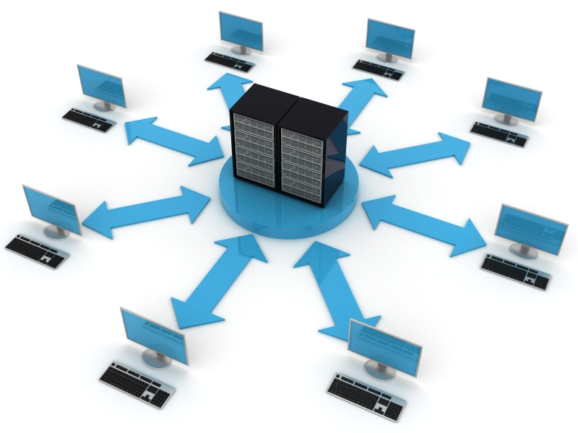
Controls
In an event that leads to loss or compromise of an organization's data - the Backup and Restore process should be implemented.
Data backups
Secure location
Authorized personnel
Test CIA

Slide 21
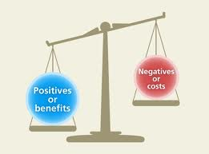
Controls
Big Data if not properly utilized could outweigh the benefits
Retention
Sanitization
Protection of log files
Approval
Regulated temperature
Server door

Slide 22
Controls
Controls to mitigate internal risk
Terminated employees
Fire suppression system
Assigning access
Database Administrator - Decoy

Slide 23
References
http://www.datacenterjournal.com/it/big-data-bigger-security-risks/
http://www.forbes.com/sites/sungardas/2013/12/18/big-data-brings-four-big-risks/
https://gigaom.com/2012/06/17/does-big-data-mean-big-risks-for-businesses/
http://www.scaledb.com/big-data.php
http://books.google.com/books?id=Wu_xeGdU4G8C&pg=PA3#v=onepage&q&f=false
http://www.ijis.net/ijis7_1/ijis7_1_editorial.pdf
http://www.techrepublic.com/blog/big-data-analytics/redefining-risk-for-big-data/
http://scitechconnect.elsevier.com/wp-content/uploads/2013/09/Controls-and-Safeguards.pdf
http://www.isaca.org/Journal/Past-Issues/2012/Volume-2/Pages/Testing-Controls-Associated-With-Data-Transfers.aspx
http://www.isaca.org/Journal/Past-Issues/2012/Volume-1/Pages/Evaluating-Access-Controls-Over-Data.aspx
Book - Big Data Computing - Edited by Rajendra Akerkar

