Slide 1
Biometric Authentication
Andrea Blanco
Binglin Li
Brian Connelly

Slide 2
What is Biometric Authentication
Biometrics Authentication is associated with utilization of distinctive physiological characteristics for identifying individuals.
Biometrics Authentication can be used in almost any application that requires the accurate identification of an individual. This ranges from computers where a fingerprint scan on the mouse can verify the identity of a user to nuclear power plants where various biometrics are used to restrict access to the critical systems.

Slide 3
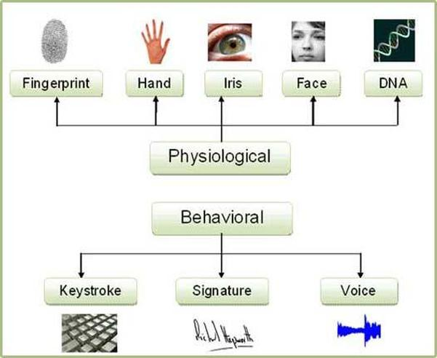
Types of Biometric Authentication

Slide 4
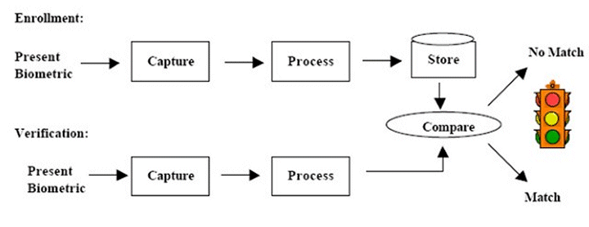
How does Biometric Authentication work

Slide 5
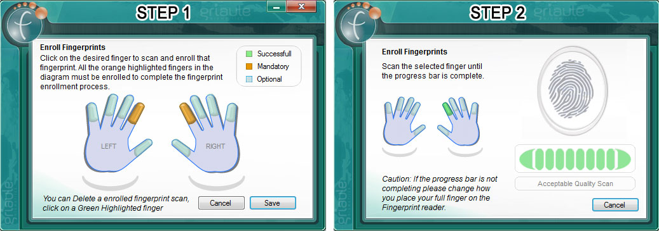
How does Biometric Authentication work
Example of Fingerprint Enrollment

Slide 6
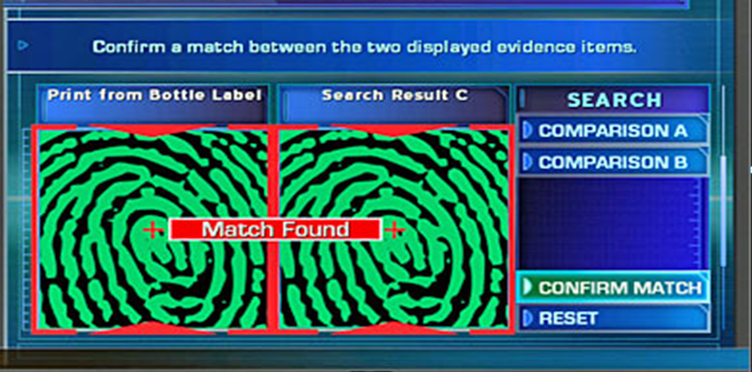
How does Biometric Authentication work
Example of Fingerprint Verification

Slide 7
Advantages
No need to remember:
Special access codes
Required password
No need to carry:
Physical access cards
Personal Identification such as driver licenses
Creates more difficulty in counterfeiting personal identification details due the fact that biometrics are not easily lost, stolen, hacked, duplicated, or shared. Biometrics amplify existing security techniques like password requirements.
Office of Biometric Identity Management Identification Services
“To authenticate, users have to supply a password ("something they know") as well as information from a second factor – typically "something they have," such as a one-time password generator token.” ¹
1 http://www.esecurityplanet.com/trends/biometric-authentication-how-it-works.html

Slide 8
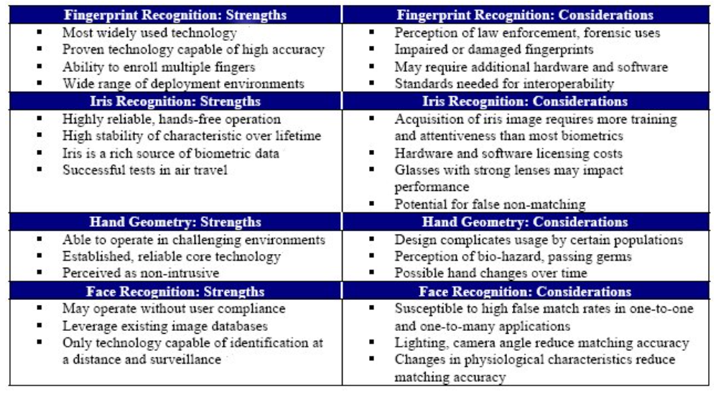
Biometrics Strengths and Considerations

Slide 9
Risks and Controls
 | Definition | Controls
Spoofing and Mimicry Attacks | Artificial finger made with silicon, pictures and speech synthesis tools can deceive the sensor. | Interactive authentication and/or vitality detection
Server Side – Fake Template Risks | On server-based architecture,an impostor can insert a template under someone else’s name | Strong security policy, encryption, preventive and detective controls
Communication Links Risks | Data could be captured from the communication channel and used another time to gain access | System integration and/or rejection of identical signals
Component Alteration Risks | A Trojan Horse can act as a manipulator of each component’s output | Strong security policy, system integration into one hardware security module

Slide 10
Risks and Controls (Cont…)
 | Definition | Controls
Noise and Power Loss Risks | Power fluctuation or flooding of a biometric sensor with noise data | Well-implemented security policy
Enrollment, administration, and system use risk | Poor enrollment, system administration and system use procedures increase the risk | Well designed and implement security policy and procedures
Residual Characteristic Risk | Residual biometric of a previous user is sufficient to allow access | Technology assessment and interactive authentication
Similar Template – Similar Characteristics Risk | A fraudulent user who has similar characteristics to a legit user can deceive the system | Technology assessment and calibration review
Notes:
Biometric factors are not secrets as passwords or tokens are which could be spoofed
Biometric factors cannot be revoked or changed
System compatibility issues
Costs
False Positives and False Negatives
Office of Biometric Identity Management Identification Services

Slide 11
Residual Risks
Criminals may use the information stored on advanced systems to commit crimes and compromise the safety and security of individuals.
Countries may opt to share the information gathered on individual personal identification details
Violation of privacy, safety and constitutional laws of certain countries.

Slide 12
Example Risk Video

