Slide 1
Frameworks, Standards and Regulations
IT Auditing and Cyber Security
Spring 2014
Instructor: Liang Yao (MBA, MS, CIA, CISA, CISSP)

Slide 2
Frameworks and Standards
Committee of Sponsoring Organization(COSO)
Control Objectives for Information and Related Technology (COBIT)
IT Infrastructure Library (ITIL)
ISO 27001
National Security Agency INFOSEC Assessment Methodology
Frameworks and standard trends

Slide 3
COSO
Initiated in 1985
Internal control and framework formed in 1992
AICPA/AAA/FEI/IIA/IMA
Key Categories:
  Effectiveness and efficiency of operations
  Reliability of financial reporting
  Compliance with applicable laws and regulations
The only framework for IC used by SEC, PCAOB

Slide 4
Internal Control Key Concepts
Internal control is a process
Internal control is affected by people
Internal control can only provide “reasonable assurance”
Internal control is geared to the achievement of objectives in one or more separate by overlapping categories

Slide 5
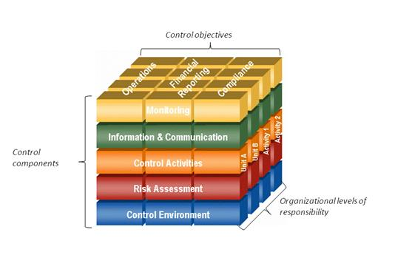
COSO Cube

Slide 6
COSO Cube
Control Environment – Tone from the top
Risk Assessment – Identification and Analysis Risks
Control Activities – Policies and procedures
Information and Communication – Enable managers and staff to carry out responsibilities
Monitoring – Assess the quality of the performance
Each components are NOT isolated

Slide 7
ERM
Internal Environment
Objective Setting
Event Identification
Risk Assessment
Risk Response
Control Activities
Information and Communication
Monitoring

Slide 8
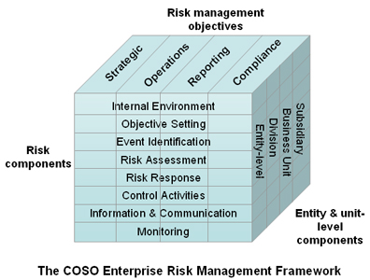
ERM

Slide 9
COSO’s Effect on IT Controls
General Computer Controls
  IT Governance and Management
  IT Infrastructure
  Security Management
  HW and SW Acquisition and Development
  Services Delivery and Support, etc
Application Controls
  SDLC
  SOD
  Access Control, etc.

Slide 10
COBIT
First published in April 1996
Control Objective Domains
  Plan and organize
  Acquisition and implementation
  Delivery and support
  Monitor and evaluation

Slide 11
COBIT
Seven Qualities of Information
  Effectiveness
  Efficiency
  Confidentiality
  Integrity
  Availability
  Compliance
  Reliability
Control Objectives and Control Activities

Slide 12
COBIT
Standards for good practice of IT controls
Technology platform independent
Management and process owner-oriented
A de facto standard for IT governance

Slide 13
IT Governance
Complexity of IT environment
Fragmented or poorly performing IT infrastructure
Enterprise vs. ad hoc solution
IT cost
Reactive vs. proactive IT management
Communication gaps between IT and Business management
IT’s role in business strategies

Slide 14
IT Governance
Compliance with Laws and Regulations
Scarcity of skilled staff
Application ownership
Competing IT resources/priorities among business units
Flexibility and nimbleness
Risk exposure
External environment change

Slide 15
ITIL
Developed by the U.K government in mid 80s
  Provides best practices describing how to plan, design and implement effective service management capabilities
  Ref. to Week 1 class information slides for more details about ITIL

Slide 16
ISO 27001
International Organization for Standards (ISO)
ISO 27001, 17799, BS 7799 – Information Security Practice
1333 security controls in 11 areas
  Security policy
  Information security organization
  Asset management
  Human resource security
  Physical and environment security
  Communication and operations management
  Access control
  Information system acquisition, development and maintenance
  Security incident management
  BCP
  Compliance

Slide 17
Regulations
The Sarbanes-Oxley Act of 2002
The Gramm-Leach-Bliley Act
State level privacy regulations, e.g. California SB 1386
The Health Insurance Portability and Accountability Act of 1996
EU Commission and Basel II
Payment Card Industry Data Security Standard

Slide 18
Regulations
Regulatory Impact on IT Audit
IIA and ISACA Guidelines for establishing IT control and audit processes

Slide 19
SOX
Response from the corporate scandals:
  Enron/Arthur Anderson
  Tyco, Adephia, Worldcom, HealthSouth…
Focus on Internal Control Over Financial Reporting
Impact on Public Corporations
  Executives to attest to the adequacy and effectiveness of ICOFR
  Controls must be audited externally
  CEOs & CFOs are held accountable for (reports generated by systems and applications)

Slide 20
SOX
Section 101
  Establishing of PCAOB as the governance agency to regulate accounting firms such as Big 4
Section 302
  CEOs & CFOs are responsible for all internal controls
Section 404
  Attestation that IA are in place, documented and effective
Section 409
  Disclosure for significant changes

Slide 21
SOX
IT specific controls required for SOX compliance
  Access control
    Authentication and authorization
    Physical and Logical access
    Re-certification, etc.
  Change control
    Request/review/approval
    Back-out plan/schedule
  Data management
    Data transfer
    Database structure
    Data element consistency
    Physical control of data
    Data backup
  IT operations
  Network operations
  Asset management

Slide 22
GLBA
Financial Institutions
How FIs’ customer information may be shared
Customer privacy provisions
Opt-out requirement
Section 501B
  Ensuring the confidentiality of customer information
  Protecting against anticipate threats to customer records
  Protecting against unauthorized access to customer information that could result in substantial impact to the customer

Slide 23
GLBA
Interagency Guidance
  Office of Currency Comptroller (OCC)
  Federal Reserve (FRB)
  Federal Deposit Insurance Corporation (FDIC)
Control Requirements

Slide 24
GLBA
Written Information Security Program
Risk Assessment and Management
Access Control for Customer Information Systems
Physical Access Control for areas containing customer information
Encryption (data at rest, data in transition, data in use)
Change control
Dual control/SOD/employee back ground check
Security Monitoring
Incident response and notification
Disposal customer information

Slide 25
Other Privacy Regulations
California SB 1386 – the most visible state laws dealing with breaches of security that cause private information to be breached: disclosure
EU Directive on the Protection of Personal Data
Canada PIPEDA

Slide 26
HIPAA
Passed in 1996 by Congress
IT relevant – prescribe a standard methodology for security; standardize the format for health-related information
HIPAA Privacy and Security Rules
  HIPAA Privacy Rules
  HIPAA Security Rules

Slide 27
HIPAA
  HIPAA Privacy Rules
    Administration controls designed to protect patient information
    Effective April 2003
  HIPAA Security Rules
    Technical controls: network perimeter protection, encryption, and workstation security
    Ref. to page 432, Table 17-1 HIPAA Rule Requirements

Slide 28
PCI Data Security Standard
Payment Card Industry Data Security Standard
Not a law
Mandatory compliance for participants in the card payment-processing industry
Not only adopt, but also validate the compliance of the standard

Slide 29
PCI Data Security Standard
Level 1/High Risk Merchant
  Quarterly internal and external scan
  Independent validation of compliance by a QSA
  ROC
Others
  Self-evaluation (SAQ)
Common Adopted data security standards and practices
Not a panacea – Recent Target Data Breach

