Slide 1
Intrusion Detection
Reuven, Dan A.
Wei, Li
Patel, Rinku H.

Slide 2
Background

Slide 3
Definition of Intrusion Detection
A device dedicated to monitoring network and system resources of a company for signs of malicious activity or unauthorized access
Can be hardware or software
IDS differs from other vulnerability assessment tools in that it provides real time metrics
A Detective Control

Slide 4
Who needs to be involved in determining What ids is best for your company?
Information Security Officers
Network Administrators
Database Administrators
Senior Management
Operating System Administrators
Data owners

Slide 5
Why Doesn’t Everyone Have One?
Numerous different types of IDS’s
Can be very expensive
Requires periodic maintenance
Difficult to configure
Numerous false positives

Slide 6
Unauthorized Access
Outsider – Someone does not have authorized access privileges
Gain Access
Gain possession of valid system credentials
Social Engineering
Guessing Username & Password
Exploit system vulnerability lead to high-privileged access
Administrator account (Windows)
Root-equivalent account (Unix, Linux)
Steal data
Attack other systems
Virus
Worm
Backdoor
Blended malware
Trojan horse
Kernel-level root kit
User-level root kit

Slide 7
Attackers and Motives
Script kiddy
Mercenary
Nation-state backed
Joy rider
Mercenary
Possess skills
Sell them to purchaser
Computer Crime
Nation-state Backed:
Against other nations
Malware injection
System compromises
Script Kiddy
Little or no skills
Download and utilize others’ exploits
Joy Rider
Potentially significant skills
For “Pleasure”

Slide 8
Risks

Slide 9
Most Common Attacks
Ping of death
SYN Flood
TCP/IP spoofing
Man in the middle
Port scan
DNS Hijack
Notes:
http://www.isaca.org/Journal/Past-Issues/2001/Volume-6/Pages/Intrusion-Attack-Penetration-Some-Issues.aspx#ap1

Slide 10
Ping of death
First detected in 1996
Ping:
Command to test a machine for reachability
Fragmented and sent over network
Resembled at the destination
Size of the packets > Internal buffer overflow
Bad Impact:
Operating System hard to react
Crash, System abort, or hang up

Slide 11
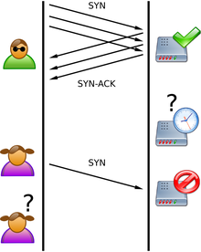
SYN Flood
TCP/IP - Three-hand shake
Using sequence-number prediction techniques
Device run out of memory to crash

Slide 12
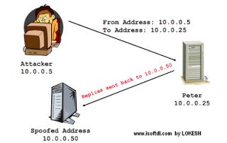
TCP/IP spoofing
Attackers use a spoofed IP address
Impair the service or crash the system

Slide 13
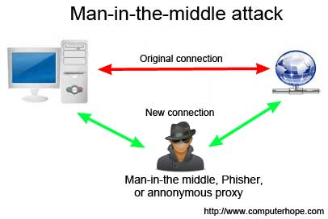
Man in the middle
Port scan
Hackers discover services they can break into
Well-known ports
Find potential weakness that can be exploited

Slide 14
DNS Hijack
Gain access to an upstream DNS server
Divert traffic to a fake web page
Modify DNS record
Queries for the original web site divert to fake web site
People land on a spoofed site at another IP address

Slide 15
Risks
Legal and regulatory requirements
Involve electronic environment and electronic system
Accounting regulations: SOX
Privacy regulations
Court rules
Managing public and stakeholder expectations
Affected by major or minor computer incidents
Exposure of confidential information
Unavailability of systems
Unreliable information
Dependency on information systems
Increased outage cost
Delay of detection and response to an outage will cost significant amounts of money
Confidentiality
Integrity
Availability

Slide 16
Control

Slide 17
IDS Log Contents Focus ON…
Detection
Recognition
Identification
Confirmation
Prosecution
Notes:
Detection – indicates the occurrence of a possible intrusion.
Recognition – indicates the type of attack.
Identification – indicates declaring the exploits used to achieve the intrusion.
Confirmation – indicates that an attack plan is deduced.
Prosecution – indicates the identity of the originator of the intrusion

Slide 18
Techniques
Intrusion Systems
Architectures

Slide 19
Active VS Passive
Active
Automatically block suspected and active attacks in progress
Passive
Alert an operator in the event of a suspected or active attack
Requires little to no human interaction once configured
Incapable of performing any protective or corrective functions on its own

Slide 20
Network-based vs Host-based
Network-based
Hardware with a network interface card (NIC) dedicated to operating in promiscuous mode segregated across different network segments.
Host-based
Intended to monitor only the system it is actively running on
Monitors multiple computers simultaneously
Not concerned with other network traffic

Slide 21
Knowledge vs Behavior Based
Knowledge-based
References a known constantly updated database of known and recorded malicious software to match against active network traffic.
Behavior-Based
Performs deep packet inspection on real time network activity
More common than behavior based
Also known as signature based
Determines malware based on a heuristic approach.

Slide 22
Knowledge Based Scanning
Cheaper and easier to operate
Less false alarms
Will only be able to detect known viruses and malware
Requires constant updates
Depends on file signatures
Many known viruses can bypass through an IDS’s defenses with obfuscation

Slide 23
Behavior & Heuristic Scanning
Involves first running the file under scrutiny in a virtual/sandboxed environment
Does not rely on signatures, attempts to analyze what the file does
Highly dependent on artificial intelligence
Can cause network delays during peak hours
Capable of detecting malware that has yet to be discovered
Does not require constant updates

Slide 24
Heuristic Scanning Disadvantages
Share of inconveniences
Long time the scan takes
Depend on data too much
Increased number of false positives

Slide 25
Thank You

