Slide 1
IT Service Delivery And Support Week Ten
IT Auditing and Cyber Security
Spring 2014
Instructor: Liang Yao (MBA MS CIA CISA CISSP)

Slide 2
IT Service Delivery and Support
Information Security
Recent Security Incidents
Security Objectives
Security Process
Governance
Information Security Risk Assessment
Information Security Strategy
Security Controls Implementation
Security Monitoring

Slide 3
IT Service Delivery and Support
Top 10 2012 Security Incidents
# 10. Wyndham Hotels –
credit card information were stored in plain text
Data was stolen THREE times in two years
Over 600,000 credit card numbers fell into the wrong hands
$10.5 billion in fraudulent transactions was reported
Gaining attention from the Federal Trade Commission
# 9. Yahoo
More than 400,000 plaintext Yahoo passwords were posted on the Internet on July 11th
the "Tech-Company-Shoulda-Known-Better" factor
SQL Injection

Slide 4
IT Service Delivery and Support
#8. Apple
A million Apple Unique Identifiers (UDIDs) were released by “AntiSec”
The group claims to have 11 million more UDIDs
Leveraged a Java vulnerability to access authentication related information
To embarrass FBI, which was in the midst of investigating the hacktivist group Anonymous.
# 7. Global Payments
Theft of about 1.5 million credit cards
Include Track 2 data – can be used to clone credit cards
names, addresses and social security numbers were apparently not breached
Impact merchants and consumers

Slide 5
IT Service Delivery and Support
# 6. Ghostshell
1.6 million government and contract accounts were posted to Pastebin records by “Team Ghostshell”
Involving aerospace, the defense industry, financial services and law enforcement
Stolen data included names, email addresses, passwords, phone numbers and various forms of administrator account information.
“ProjectWhiteFox”- intended to attract support for freedom of information on the Internet.
# 5. LinkedIn
6.5 million Linkedin passwords (compromised of “unsalted SHA-1 hashes)
Passwords were published in various places on the Web
Team effort to crack the passwords

Slide 6
IT Service Delivery and Support
4. Nationwide Insurance, Allied Insurance Companies
PII information breach - 1.1 million customers and applicants
including names, Social Security numbers, driver's license numbers, date of birth and possibly marital status, gender, occupation and employment information
No Medical information and credit card numbers
High value of the information
3. South Carolina
Approximately 3.8 million tax records and nearly 400,000 credit card numbers were stolen from the South Carolina Department of Revenue.
Over 2 million incidents of information theft were also nabbed through the same spearphishing exploit that stole employee usernames and passwords to gain access to the sensitive data.
Improper password policies and failure to encrypt social security numbers were key enablers of the operation
It's believed to be the largest data theft from a state government.

Slide 7
IT Service Delivery and Support
#2. Zappos
Personal details on 24 million people were hacked and stolen
Information lncluding names, home addresses, email addresses, phone numbers, the last four digits of credit card numbers, and passwords
The company stepped up with a highly proactive response that involved new passwords and increased numbers of call center folks to help victims navigate the situation.
1. The Biggest Breach Of 2012: The Government Sector
Government sector, which, according to Boston-based security vendor Rapid7, has reported 268 individual data breaches over a period of roughly three years.
In all, governments reportedly exposed more than 94 million records containing personally identifiable information.
The data reveals that the number of breaches has continued to escalate each year since 2009. And, it's expected that the likely tally for 2012 will actually double the number from 2011.
In addition to hacking incidents, the numbers include unintended disclosure, the loss or theft of portable devices and physical loss of devices.

Slide 8
Security Objectives
Availability-The ongoing availability of systems addresses the processes, policies, and controls used to ensure authorized users have prompt access to information. This objective protects against intentional or accidental attempts to deny legitimate users access to information or systems.
Integrity of Data or Systems-System and data integrity relate to the processes, policies, and controls used to ensure information has not been altered in an unauthorized manner and that systems are free from unauthorized manipulation that will compromise accuracy, completeness, and reliability.
* Underlying Models for IT Security, NIST, SP800-33, p. 2

Slide 9
Security Objectives (Cont.)
Confidentiality of Data or Systems-Confidentiality covers the processes, policies, and controls employed to protect information of customers and the institution against unauthorized access or use.
Accountability-Clear accountability involves the processes, policies, and controls necessary to trace actions to their source. Accountability directly supports nonrepudiation, deterrence, intrusion prevention, security monitoring, recovery, and legal admissibility of records.
Assurance-Assurance addresses the processes, policies, and controls used to develop confidence that technical and operational security measures work as intended. Assurance levels are part of the system design and include availability, integrity, confidentiality, and accountability. Assurance highlights the notion that secure systems provide the intended functionality while preventing undesired actions.

Slide 10
Information Security Processes
Information Security Risk Assessment-A process to identify and assess threats, vulnerabilities, attacks, probabilities of occurrence, and outcomes.
Information Security Strategy-A plan to mitigate risk that integrates technology, policies, procedures, and training. The plan should be reviewed and approved by the board of directors.
Security Controls Implementation-The acquisition and operation of technology, the specific assignment of duties and responsibilities to managers and staff, the deployment of risk-appropriate controls, and the assurance that management and staff understand their responsibilities and have the knowledge, skills, and motivation necessary to fulfill their duties.

Slide 11
Information Security Processes (Cont.)
Security Monitoring-The use of various methodologies to gain assurance that risks are appropriately assessed and mitigated. These methodologies should verify that significant controls are effective and performing as intended.
Security Process Monitoring and Updating-The process of continuously gathering and analyzing information regarding new threats and vulnerabilities, actual attacks on the institution or others combined with the effectiveness of the existing security controls. This information is used to update the risk assessment, strategy, and controls. Monitoring and updating makes the process continuous instead of a onetime event.
Security risk variables include threats, vulnerabilities, attack techniques, the expected frequency of attacks, financial institution operations and technology, and the financial institution's defensive posture. All of these variables change constantly. Therefore, an institution's management of the risks requires an ongoing process.

Slide 12
Governance
Management Structure
“Information security is a significant business risk that demand engagement of the Board of Directors and senior business management. It is the responsibility of everyone who has the opportunity to control or report the institution's data. Information security should be supported throughout the institution, including the board of directors, senior management, information security officers, employees, auditors, service providers, and contractors. Each role has different responsibilities for information security and each individual should be accountable for his or her actions. Accountability requires clear lines of reporting, clear communication of expectations, and the delegation and judicious use of appropriate authority to bring about appropriate compliance with the institution's policies, standards, and procedures.” FFIEC IT Examination Handbook

Slide 13
Governance
Responsibility and Accountability
Board
Executive Management
Staff and Line-of-Business Managers
Internal Auditors

Slide 14
Governance (Cont.)
Board
Central oversight and coordination,
Assignment of responsibility,
Risk assessment and measurement,
Monitoring and testing,
Reporting, and
Acceptable residual risk.

Slide 15
Governance (Cont.)
Senior Management (security)
Clearly support all aspects of the information security program;
Implement the information security program as approved by the board of directors; Establish appropriate policies, procedures, and controls; Participate in assessing the effect of security issues on the financial institution and its business lines and processes;
Delineate clear lines of responsibility and accountability for information security risk management decisions;
Define risk measurement definitions and criteria;
Establish acceptable levels of information security risks; and
Oversee risk mitigation activities.

Slide 16
Governance (Cont.)
Senior Management (Integrity)
Ensure the security process is governed by organizational policies and practices that are consistently applied,
Require that data with similar criticality and sensitivity characteristics be protected consistently regardless of where in the organization it resides,
Enforce compliance with the security program in a balanced and consistent manner across the organization,
Coordinate information security with physical security, and
Ensure an effective information security awareness program has been implemented Information Security Booklet throughout the organization.

Slide 17
Governance (Cont.)
Staff & Line Managers
Contribute to design and implementation of IT activities
Review and monitor security controls
Define security requirements
Internal Auditors
Assess information control environments, including understanding, adoption and effectiveness
Validate IS efforts and compare current practices to industry standards
Recommend improvement

Slide 18
Information Security Risk Assessment
Key Steps
Gather Necessary Information
Identification of Information and Information Systems
Analyze the Information
Classify and Rank Sensitive Data, Systems, and Applications
Assess Threats and Vulnerabilities
Evaluate Control Effectiveness
Assign Risk Ratings

Slide 19
Information Security Risk Assessment
Key Risk Assessment Practices
Multidisciplinary and Knowledge Based Approach
Systematic and Central Control
Integrated Process
Accountable Activities
Documentation
Enhanced Knowledge
Regular Updates

Slide 20
Information Security Strategy
Architecture Considerations
Control Objectives for Information and Related Technology (CobiT) - provides a broad and deep framework for controls.
IT Infrastructure Library (ITIL) - provides a list of recognized practices for IT service management.
ISO 17799 - provides a library of possible controls that can be included in an architecture and guidance in control selection.
BITS (Bank Information Technology Secretariat) and other industry publications for discrete controls, such as vendor management.

Slide 21
Information Security Strategy
IS Policies and Procedures
Implementing through ordinary means, such as system administration procedures and acceptable-use policies;
Enforcing policy through security tools and sanctions;
Delineating the areas of responsibility for users, administrators, and managers;
Communicating in a clear, understandable manner to all concerned;
Obtaining employee certification that they have read and understood the policy;
Providing flexibility to address changes in the environment; and
Conducting annually a review and approval by the board of directors.

Slide 22
Information Security Strategy
Technology Design
Outsourced Security Services

Slide 23
Security Controls Implementation
Access Control
Access Rights Administration
Authentication
Shared Secret Systems
Token Systems
Public Key Infrastructure
Encryption
Biometrics
Authenticator Reissuance
Behavioral Authentication
Device Authentication
Mutual Authentication
Authentication for Single Sign-On Protocols

Slide 24
Security Controls Implementation
Examples of Common Authentication Weaknesses, Attacks, and Offsetting Controls:
Dictionary and brute force
Warehouse attacks, (compromise an entire authentication mechanism)
Social engineering,
Client attacks (password, PKI key, etc),
Replay attacks,
Man-in-the-middle attacks, and
Hijacking.

Slide 25
Security Controls Implementation
Network Access
Layers of Access Control
Group network servers, applications, data, and users into security domains (e.g., untrusted external networks, external service providers, or various internal user systems);
Establish appropriate access requirements within and between each security domain;
Implement appropriate technological controls to meet those access requirements consistently; and
Monitor cross-domain access for security policy violations and anomalous activity.

Slide 26
Security Controls Implementation
Network Access
Network configuration considerations
Identifying the various applications and systems accessed via the network,
Identifying all access points to the network including various telecommunications channels (e.g., wireless, Ethernet, frame relay, dedicated lines, remote dial-up access, extranets, Internet),
Mapping the internal and external connectivity between various network segments,
Defining minimum access requirements for network services (i.e., most often referenced as a network services access policy), and
Determining the most appropriate network configuration to ensure adequate security and performance.

Slide 27
Security Controls Implementation
Firewalls - (**NIST Special Publication 800-41, "Guidelines on Firewalls and Firewall Policy." is a collection of components (computers, routers, and software) that mediate access between different security domains.)
Types of Firewalls
Packet Filter Firewalls
Stateful Firewalls
Application Firewalls

Slide 28
Security Controls Implementation
Packet Filter Firewalls
Weaknesses associated with packet filtering firewalls include the following:
The system is unable to prevent attacks that exploit application-specific vulnerabilities and functions because the packet filter does not examine packet contents.
Logging functionality is limited to the same information used to make access control decisions.
Most do not support advanced user authentication schemes.
Firewalls are generally vulnerable to attacks and exploitation that take advantage of vulnerabilities in network protocols.
The firewalls are easy to misconfigure, which allows traffic to pass that should be blocked.

Slide 29
Security Controls Implementation
Stateful Firewall: is a firewall that keeps track of the state of network connections (such as TCP streams, UDP communication) traveling across it. The firewall is programmed to distinguish legitimate packets for different types of connections. Only packets matching a known active connection will be allowed by the firewall; others will be rejected.

Slide 30
Security Controls implementation
Application-Level Firewalls
The primary disadvantages of application-level firewalls are as follows:
The time required to read and interpret each packet slows network traffic. Traffic of certain types may have to be split off before the application-level firewall and passed through different access controls.
Any particular firewall may provide only limited support for new network applications and protocols. They also simply may allow traffic from those applications and
protocols to go through the firewall.

Slide 31
Security Controls Implementation
Firewall Policy
Firewall topology and architecture,
Type of firewall(s) being utilized,
Physical placement of the firewall components,
Monitoring firewall traffic,
Permissible traffic (generally based on the premise that all traffic not expressly allowed is denied, detailing which applications can traverse the firewall and under what exact circumstances such activities can take place),
Firewall updating,
Coordination with security monitoring and intrusion response mechanisms,
Responsibility for monitoring and enforcing the firewall policy, Protocols and applications permitted,
Regular auditing of a firewall's configuration and testing of the firewall's effectiveness, and
Contingency planning.

Slide 32
Security Controls Implementation
Firewall Vulnerability
Spoofing trusted IP addresses,
Denial of service by overloading the firewall with excessive requests or malformed packets,
Sniffing of data that is being transmitted outside the network,
Hostile code embedded in legitimate HTTP, SMTP, or other traffic that meet all firewall rules,
Attacks on unpatched vulnerabilities in the firewall hardware or software,
Attacks through flaws in the firewall design providing relatively easy access to data or services residing on firewall or proxy servers, and
Attacks against computers and communications used for remote administration.

Slide 33
Security Controls Implementation
Firewall Access Control Best Practices:
Hardening the firewall by removing all unnecessary services and appropriately patching, enhancing, and maintaining all software on the firewall unit
Restricting network mapping capabilities through the firewall, primarily by blocking inbound ICMP (Internet Control Messaging Protocol) traffic;
Using a ruleset that disallows all inbound and outbound traffic that is not specifically allowed;
Using NAT and split DNS to hide internal system names and addresses from external networks (split DNS uses two domain name servers, one to communicate

Slide 34
Security Controls Implementation
Firewall Access Control Best Practices:
Using proxy connections for outbound HTTP connections;
Filtering malicious code;
Backing up firewalls to internal media and not backing up the firewall to servers on protected networks;
Logging activity, with daily administrator review
Using security monitoring devices and practices to monitor actions on the firewall and to monitor communications allowed through the firewall
Administering the firewall using encrypted communications and strong authentication, accessing the firewall only from secure devices, and monitoring all administrative access;
Limiting administrative access to few individuals; and
Making changes only through well-administered change control procedures.

Slide 35
Security Controls Implementation
Other Network Access Related Concerns:
Malicious Code Filtering
Outbound Filtering
Network Intrusion Prevention Systems
Quarantine
DNS Placement

Slide 36
Security Controls Implementation
Wireless Issues
Treating wireless networks as untrusted networks, allowing access through protective devices similar to those used to shield the internal network from the Internet environment;
Using end-to-end encryption in addition to the encryption provided by the wireless connection;
Using strong authentication and configuration controls at the access point and on all clients;
Using an application server and dumb terminals;
Shielding the area in which the wireless LAN operates to protect against stray emissions and signal interference; and
Monitoring and responding to unauthorized wireless access points and clients.

Slide 37
Security Controls Implementation
Remote Access
Disallow remote access by policy and practice unless a compelling business justification exists.
Require management approval for remote access.
Regularly review remote access approvals and rescind those that no longer have a compelling business justification.
Appropriately configure remote access devices.
Appropriately secure remote access devices against malware (see "Malicious Code Prevention").

Slide 38
Security Controls Implementation
Remote Access
Appropriately and in a timely manner patch, update, and maintain all software on remote access devices.
Use encryption to protect communications between the access device and the institution and to protect sensitive data residing on the access device.
Periodically audit the access device configurations and patch levels.
Use VLANs, network segments, directories, and other techniques to restrict remote access to authorized network areas and applications within the institution.

Slide 39
Security Controls Implementation
Remote Access
Implement controls consistent with the sensitivity of remote use. For example, remote use to administer sensitive systems or databases may include the following controls:
Restrict the use of the access device by policy and configuration;
Require two-factor user authentication;
Require authentication of the access device;
Ascertain the trustworthiness of the access device before granting access;
Log and review all activities (e.g. keystrokes).

Slide 40
Security Controls Implementation
Remote Access
If remote access is through modems:
Require an operator to leave the modems unplugged or disabled by default, to enable modems only for specific and authorized external requests, and disable the modem immediately when the requested purpose is completed.
Configure modems not to answer inbound calls, if modems are for outbound use only.
Use automated callback features so the modems only call one number (although this is subject to call forwarding schemes).
Install a modem bank where the outside number to the modems uses a different prefix than internal numbers and does not respond to incoming calls

Slide 41
Security Controls Implementation
Remote Access
Log remote access communications, analyze them in a timely manner, and follow up on anomalies.
Centralize modem and Internet access to provide a consistent authentication process, and to subject the inbound and outbound network traffic to appropriate perimeter protections and network monitoring.
Log and monitor the date, time, user, user location, duration, and purpose for all remote access.
Require a two-factor authentication process for remote access (e.g., PIN-based token card with a one-time random password generator, or token-based PKI).

Slide 42
Security Monitoring
Architecture Issues
Activity Monitoring

Slide 43
Security Monitoring
Architecture Issues
Network traffic policies that address the allowed communications between
computers or groups of computers,
Security domains that implement the policies,
Sensor placement to identify policy violations and anomalous traffic,
The nature and extent of logging,
Log storage and protection, and
Ability to implement additional sensors on an ad hoc basis.

Slide 44
Security Monitoring
Activity Monitoring
Network Intrusion Detection Systems
Honeypots
Host Intrusion Detection Systems
Log Transmission, Normalization, Storage, and Protection
Condition Monitoring
Self Assessments
Metrics
Independent Tests

Slide 45
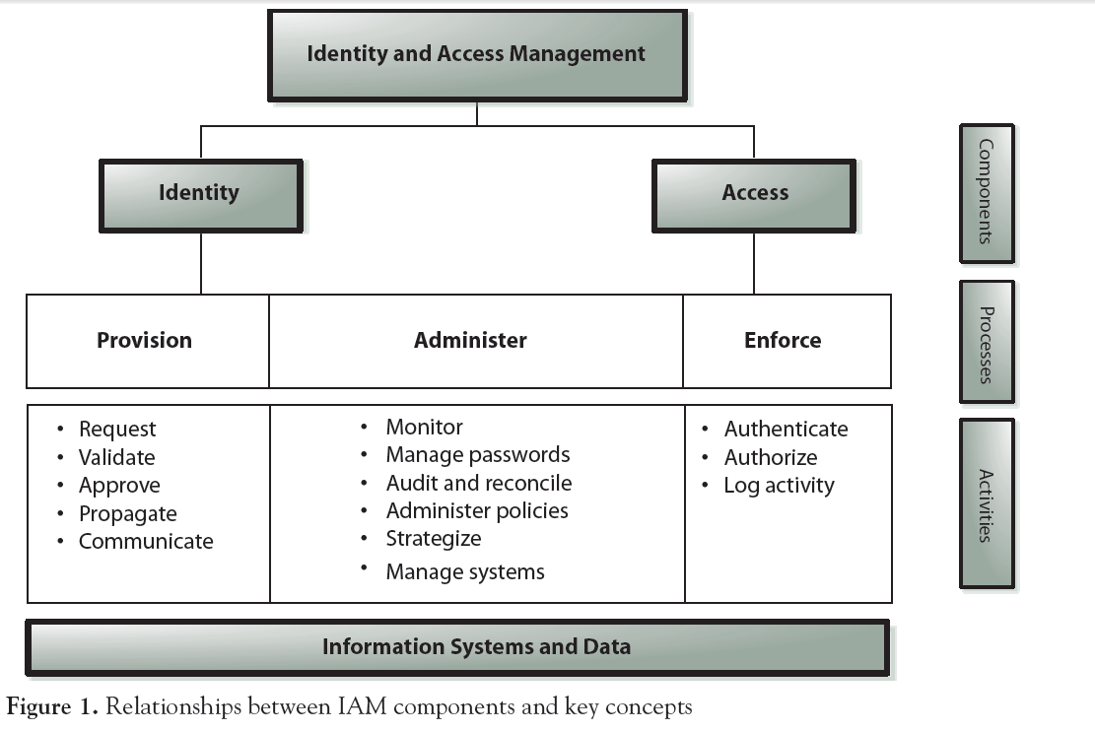
Identify Management

Slide 46
