Slide 1
IT Service Delivery And Support Week Eleven – Auditing Application Control
IT Auditing and Cyber Security
Spring 2014
Instructor: Liang Yao (MBA MS CIA CISA CISSP)

Slide 2
Application Controls
Transactional Applications vs. Support Application
Application Controls Objectives
Application Control Types
Application Control vs. Infrastructure Control (GCC)
Why Relying on Application Controls
Application Auditors Roles and Responsibilities
Application Control Risk Assessment Approach
Documentation Techniques

Slide 3
Application Controls
Transactional Applications vs. Support Application
Transactional Applications (SAP R/3, Oracle Financials, etc.)
Accounting applications
Repository for financial, operational and regulatory data
Reporting applications (sales orders and invoices, etc.)
Support Applications (emails, fax sw, document imagining, etc)

Slide 4
Application Controls
Application Controls Objectives
Input data is accurate, complete, authorized, and correct.
Data is processed as intended in an acceptable time period.
Data stored is accurate and complete.
Outputs are accurate and complete.
A record is maintained to track the process of data from input to storage and to the eventual output
GTAG – Auditing Application Controls

Slide 5
Application Controls
Application Control Types
Input Controls – These controls are used mainly to check the integrity of data entered into a business application, whether the data is entered directly by staff, remotely by a business partner, or through a Web-enabled application or interface. Data input is checked to ensure that is remains within specified parameters.
Processing Controls – These controls provide an automated means to ensure processing is complete, accurate, and authorized.
Output Controls – These controls address what is done with the data and should compare output results with the intended result by checking the output against the input.
Integrity Controls – These controls monitor data being processed and in storage to ensure it remains consistent and correct.
Management Trail – Processing history controls, often referred to as an audit trail, enables management to identify the transactions and events they record by tracking transactions from their source to their output and by tracing backward. These controls also monitor the effectiveness of other controls and identify errors as close as possible to their sources.
GTAG – Auditing Application Controls

Slide 6
Application Controls
Application Control vs. Infrastructure Control (GCC)
GCC
Logical access controls over infrastructure, applications, and data. System development life cycle controls. Program change management controls.
Physical security controls over the data center.
System and data backup and recovery controls.
Computer operation controls.
GTAG – Auditing Application Controls

Slide 7
Application Controls
Application Control vs. Infrastructure Control (GCC)
Application Controls
Determining whether sales orders are processed within the parameters of customer credit limits.
Making sure goods and services are only procured with an approved purchase order.
Monitoring for segregation of duties based on defined job responsibilities.
Identifying that received goods are accrued
Ensuring fixed-asset depreciation is recorded accurately in the appropriate accounting period.
Determining whether there is a three-way match among the purchase order, receiver, and vendor invoice.
GTAG – Auditing Application Controls

Slide 8
Application Controls
Why Relying on Application Controls
Reliability
More reliable than manual controls (automated vs. human intervention)
Relationship with GCC (Change Management, SOD, etc.)
Benchmarking
Application Controls won’t change very often
Rely on general controls
Identify “Changes” of the Environment
Changing of Application Controls Without Changing Code (Parameter changes and configuration changes)
Time and Cost Saving
Less Time to test than manual controls (frequency of the manual controls)
Can be Test Once Using Automated Tools
GTAG – Auditing Application Controls

Slide 9
Application Controls
Application Auditors Roles and Responsibilities
Understand Business Process Associated with the Application audited (Building Industry Specialties)
Consultant During the Application Development
Independent Risk Assessment
Education
How the risk profile will change once the new application is brought online.
Known inherent control weaknesses in the applications under development.
Prospective solutions to mitigate identified weaknesses.
The various services auditors can provide to management as part of the system’s development efforts.
Control Testing
Application Review
GTAG – Auditing Application Controls

Slide 10
Application Controls
Application Control Risk Assessment Approach
Define the Assets (application, database, supporting technology, etc.)
Define the Risk Factor Associated with the Application Under Review:
Primary application control
Design effectiveness
Natural of the application (in-house developed vs. on-shelf, commercial applications)
Data Classification
Frequency of Changes related to the Application and Complexity of Changes
Financial Impact
Reliance on GCC controls
Audit History
GTAG – Auditing Application Controls

Slide 11
Application Controls
Business Process Method vs. Single Application Method
Business Process Method
Top-down review approach
Review all applications support one Business Process
Typically apply to ERP review
Single Application – controls within one application or module
Logical Access Control needs to be reviewed no matter which method was used.
GTAG – Auditing Application Controls

Slide 12
Application Controls
Documentation Techniques
Flowchart
Process Narratives
Procurement
Requisition
PO Processing
Receiving
Receiving Goods
Accounting Review and Reconciliation
Buyer Review
Accounts Payable
A/P receives invoice from the Suppliers
Payment Requests
Month-end Reconciliation
GTAG – Auditing Application Controls

Slide 13
Application Controls
Documentation Techniques
Testing
Inspection of system configurations.
Inspection of user acceptance testing, if conducted in the current year.
Inspection or re-performance of reconciliations with supporting details.
Re-performance of the control activity using system data.
Inspection of user access listings.
Re-performance of the control activity in a test environment (using the same programmed procedures as production) with robust testing scripts.
CAAT – ACL, SAS, SQL, Excel, Crystal Report, Access, etc.
GTAG – Auditing Application Controls

Slide 14
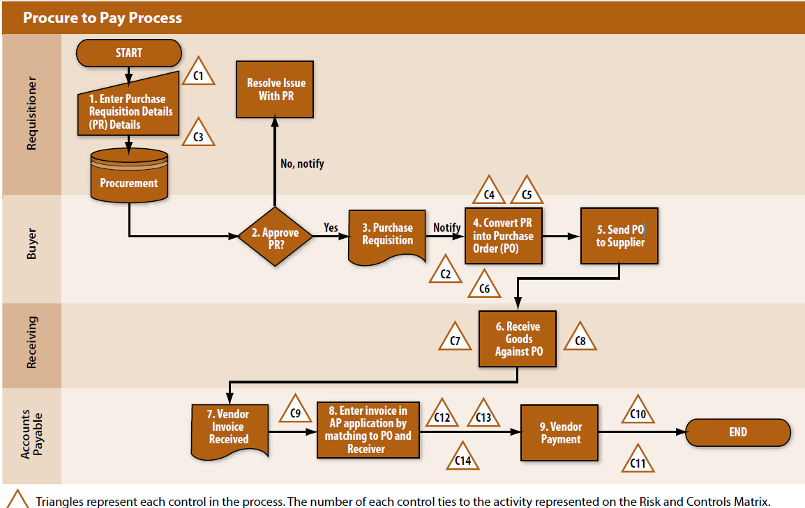
Summary

Slide 15
Sample Audit Program
Sample Application Audit Program – Chapter 13 Auditing Application (page 312 of IT Auditing Text Book)

