Slide 1
Cloud Computing
Oyinkan Adedun Adeleye
Caitlyn Carney Tyler Nguyen

Slide 2
Definition
What is the Cloud?
On-demand service model for IT provision, often based on virtualization and distributed computing technologies.
Applications and data stored and maintained on shared machines in a web-based environment
Can include web-based applications, web-hosted services, centralized data centers and server farms, and platforms for running and developing applications.
Key Terms:
Cloud Service Provider (CSP)
Multi-tenancy
Notes:
Cloud Service Provider (CSP) – third party vendor that provides application delivery, hosting, monitoring, and other services through cloud computing
Multi-tenancy – usually the customer of is a single tenant among many tenants sharing common resources and technologies of the CSP

Slide 3
Overview
Cloud Deployment Models:
Private
Community
Public
Hybrid
Cloud Service Delivery Models:
Software as a service (SaaS)
Platform as a service (PaaS)
Infrastructure as service (IaaS)
Notes:
Cloud Deployment Models:
Private- infrastructure is operated solely for an individual organization and managed by that organization or a 3rd party, can be on or off organization’s premises
Community- infrastructure shared by several organizations and supports a specific community that has common interests
Public- infrastructure is available to the general public or a large industry group and is owned by CSP
Hybrid- infrastructure is composed of two or more clouds (private/community/public) that remain unique entities but are bound together by standardized or proprietary technology that enables data and application portability
Cloud Service Delivery Models
Software as a service (SaaS):
available on demand
Via Internet remotely.
Examples: online word processing and spreadsheet tools, CRM services
web content delivery services (Salesforce CRM, Google Docs, etc).
Platform as a service (PaaS):
allows customers to develop new applications using APIs deployed and configurable remotely.
The platforms offered include development tools, configuration management, and deployment platforms.
Examples:Microsoft Azure, Force and Google App engine.
Infrastructure as service (IaaS):
Provides virtual machines and other abstracted hardware and operating systems which may be controlled through a service API.
Examples include Amazon EC2 and S3, Terremark Enterprise Cloud, Windows Live Skydrive and Rackspace Cloud.

Slide 4
Benefits of Cloud Computing
Decreased capital costs
Decreased IT operating costs
No hardware or software installation or maintenance
Scalability & Flexibility
Speed of Deployment
Specialized/Highly abstracted resources
Environmental Considerations
Notes:
Lower capital cost
Scalability and flexibility and better alignment of technologies
Lower IT operating costs
No IT maintenance
Specialized/Highly abstracted resources
Speed of Deployment
Environmental

Slide 5
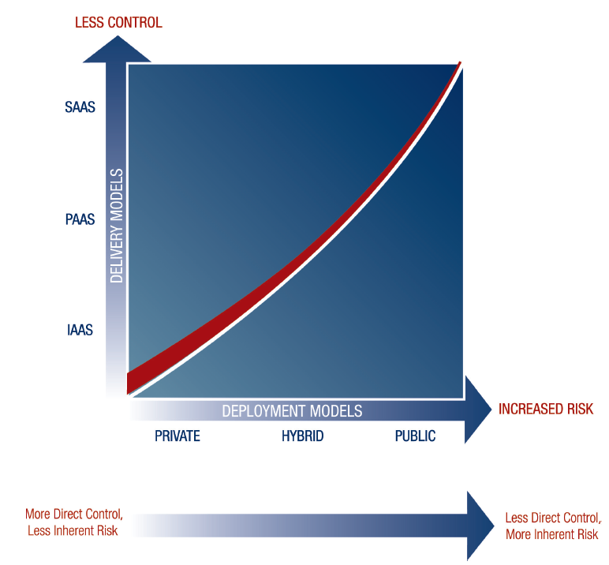
Risk Relationship with Cloud Models

Slide 6
Cloud Computing Risks
Lack of Total Control
Reliability/System availability
Netflix experienced a total outage for two days
Christmas eve and Christmas Day
Cloud Provide, Amazon had a service outage
Lack of Transparency
Notes:
Lack of Transparency
A CSP is unlikely to disclose its methodology, processes, and controls because they often have competing customers. Customers have little insight into storage locations, algorithms, and controls used to secure components of the system architecture or how
Customer data is segregated in the cloud

Slide 7
Cloud Computing Risks
Non-Compliance (Regulatory, Disclosure)
Getting stuck with a provider;
Proprietary code
Data Security
Cloud service provider viability
Most providers are young companies
Longevity and profitability is questionable
Notes:
Getting Stuck/Vendor lock in – Not all cloud providers are the same; software, hardware, configurations and settings are different. SO incase
Of a serious problem that warrants leaving a current supplier, disengaging could be a long and tedious process/
Security – Since cloud providers house data of multiple customers on their servers, they manage a large amount of data than most organizations even
Large organizations; so they are more prone to cyber attacks. So to be secure, a cloud provider has to be in tune with every of its customers business needs
And workflow. But whether they can do that is questionable
Viability – as we speak many csp are reducing their service offerings because many are not yet profitable. So many of them might eventually go through a
Consolidation period
Hence, customers might face operational disruptions

Slide 8
Cloud Computing Controls
Risk | Controls
Loss of IT Governance Lack of Transparency | Management oversight and operations monitoring controls Assessments of CSP control environment: Control related inquiries in RFP Right to audit clause in SLA Interviews with CSP to determine how certain risk events would be addressed Require internal audit evaluation or independent audit reports (i.e. SOC 2)
Unauthorized Cloud Activity | Cloud Policies & Controls: Cloud usage policy List of approved cloud vendors CSP relationship management
Notes:
Unauthorized cloud activity
Policies and controls
Lack if Transparency
Assessments of the CSP control environment
Risks: Loss of internet connection
Data availability and business continuity and Disaster Recovery
Security and compliance data leakage, and data jurisdiction
Data classification policies and processes
Encryption
Include Third-party audit report in the contract
Perform internal audit of cloud providers. Ensure certain controls are being tested, exclusion of pertinent systems, or other factor that require on-site testing.
Make sure to Vulnerability/penetration testing results from service provider’s audit report.
Transparency and relinquishing direct control
Manage oversight and operations monitoring controls
Reliability, Performance, high-value cyber-attach target
Incident management
Vendor Lock-in
Preparation of an exit strategy
Noncompliance with disclosure requirements
New disclosures in financial reporting
Noncompliance with regulations
Monitoring of the external environment

Slide 9
Cloud Computing Controls
Risk | Controls
Security, Non-compliance, Data Leakage | Data Classification Policies: Defining purpose and ownership of different types of organizational data Mapping legal, regulatory, IP, and security requirements to various types of data Determining sensitivity (public, restricted, highly sensitive) Determining requirements for data transmission (i.e encryption methods) Non compliance with regulations: Monitoring of external environment Non compliance with disclosure requirements: New disclosures in financial reporting

Slide 10
Cloud Computing Controls
Risk | Controls
Reliability & Performance, System Availability | Incident management controls Disaster Recovery/BCP controls Processes to monitor system availability Automated tools to provide resources on demand for cloud solution from another service provider Review SLAs to ensure CSP will provide adequate response in event of system failure
High Value Cyber-Attack Target | Incident management controls Host only nonessential and non-sensitive data on third party CSP solutions Deploy encryption over data hosted on cloud solutions Have a defined fail-over strategy
Vendor lock-in and lack of application portability or inoperability | Prepare an exit strategy/contingency plan for overall cloud strategy

Slide 11
Conclusion
Cloud computing is a widely used and growing technology. Gartner predicts it will be a $140 billion industry by 2014.
Many cloud-based solutions are available in today’s market, each with unique risks.
It is essential that organizations effectively manage the key risks associated with their specific cloud infrastructure in order to fully take advantage of opportunities presented by the cloud.
Notes:
Feel free to add/elaborate on anything you think should be included here.

Slide 12
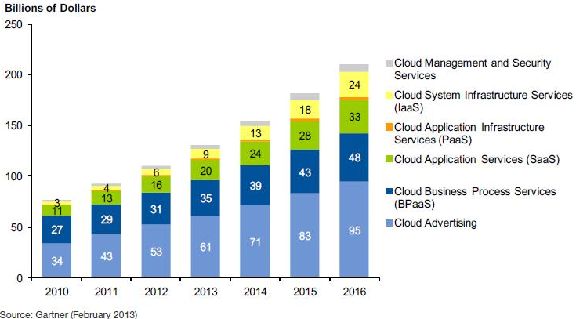
Cloud Services Market by Segment

Slide 13
Sources
http://www.coso.org/documents/Cloud%20Computing%20Thought%20Paper.pdf
https://resilience.enisa.europa.eu/cloud-security-and-resilience/publications/cloud-computing-benefits-risks-and-recommendations-for-information-security
https://www.f5.com/pdf/white-papers/controlling-the-cloud-wp.pdf
http://www.cliftonlarsonallen.com/Risk-Management/The-Benefits-and-Risks-of-Cloud-Computing.aspx
http://aimdegree.com/research/ebriefings/eb-betcher.php
http://www.forbes.com/sites/louiscolumbus/2013/02/19/gartner-predicts-infrastructure-services-will-accelerate-cloud-computing-growth/

