Slide 1
Mobile Banking
By: Chenyu Gong, Jalal Hafidi, Harika Malineni

Slide 2
Background
According to Forrester Research, approximately 46% of bank accounts will be in mobile format by 2017
Definition: Conducting financial transactions through mobile devices.
Three types of mobile banking
SMS Mobile Banking
Web Banking
Mobile Applications
Need multi layer controls

Slide 3
Risks
Internal
External
Security
Employees fraud
Lack of maturity of Fraud tools and controls of Fraud tools and controls
Privacy violations relative to application collection and distribution of data
Reputation
Security
Authentication
Unauthorized system access

Slide 4
Confidentiality Risks
Employees fraud
Authentication
Transaction
Privacy
Application collection and distribution of data
Phishing Attacks

Slide 5
Integrity
Manipulation of Data
In Use
In Transit
At rest

Slide 6
Availability Risks
Maturity of wireless Infrastructure
Service Interruption (Uptime/ Down time)
Natural Disaster
Hardware and Operating System failure
Targeted Attacks- Ex: DDoS

Slide 7
Other Risks
Complexity of the network
Multiple players involved in the attack
Effects All (C.I.A)
Security of the operating system of the device

Slide 8
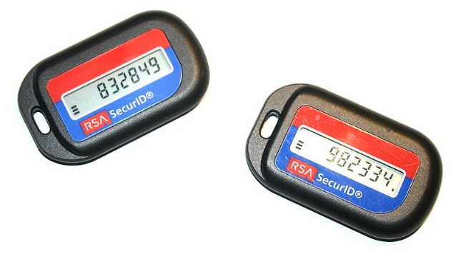
Controls
One-Time Password / Security Token
Strong BCP / DR plans
Segregation of duties
penetration testing for vulnerabilities,
monitor to detect anomalies
Deployment of communication security measures
firewalls, password management, encryption techniques, and proper authorization of end use
SSAE 16 to validate third party operations
Customer Awareness program
Email Alerts/ Liability Agreements
Periodic external audits
Mobile malware protection
Pending Transactions/ Clearing period.

Slide 9
Residual Risk
Inactive/ Dormant accounts

Slide 10
Questions??

