Slide 1
Open Systems Interconnection
Developed by International Org. for Standardization (ISO)
A set of design standards for different types of network HW & SW to communicate each other
Seven layers provides the functions required for network communication
Control passes from one layer to the next
Each layer provides headers (encapsulation) to facilitate communications handling and synchronization
Higher layers rely on SW/firmware and provide more logical functionality
Lower layer rely on HW

Slide 2
Open Systems Interconnection
Application – application-communication interface
Presentation – code conversion & data reformatting
Session – allow user identification by name; communicate message between application
End User Systems
Transportation – send message, end-to-end integrity
Network – Routing and switching
Transport
Data link – Transport packets from source to destination. Formatting of packets
Physical – Cabling
Media Access

Slide 3
Open Systems Interconnection
Average Person Seems To Need Data Process.
Exhibit 4.17 Page 272

Slide 4
Open Systems Interconnection
The Application layer
The purpose of the Application layer is to manage communications between applications.
A standard Application layer program such as FTP or SMTP interacts with a program that is running at the local workstation.
The programmer who has written a word processing application writes the program to interact with a standard application that exists at the Application layer.
The word processor uses the standard network application to save, copy, or delete files.
This is the layer where the applications receive data and request data.
All other layers work for this layer. Think of the Application layer as the CEO of the OSI model.

Slide 5
Open Systems Interconnection
The Presentation Layer
The Presentation layer is the layer below the Application layer and above the Session layer.
The Presentation layer adds structure to packets of data being exchanged. The primary job of the Presentation layer is to ensure that the message gets transmitted in a language or syntax that the receiving computer can understand.
The protocols at the Presentation layer may translate the data into an understandable syntax and then compress and maybe encrypt the data before passing it down to the Session layer.
It presents the data to the Application layer, and the Application layer is so important.

Slide 6
Open Systems Interconnection
The Session Layer
The Session layer is below the Presentation layer. It controls the dialog during communications.
The Session layer protocols set up sessions, or connections.
These protocols cover such topics as how to establish a connection, how to use a connection, and how to break down the connection when a session is completed.
After a connection is established, the Session layer protocols check for transmission errors. The Session layer also adds control headers to the data packets during the exchange of data.

Slide 7
Open Systems Interconnection
The Transportation Layer
Below the Session layer is the Transport layer. The Transport layer can guarantee that packets are received.
The Transport layer also can establish a connection and send acknowledgments as packets are received.
The protocols in this layer provide the means to establish, maintain, and release connections for the hosts involved in communication.

Slide 8
Open Systems Interconnection
The Network Layer
The Network layer, which is below the Transport layer, is responsible for routing the packet based on its logical address.
The Network layer fragments and reassembles packets if necessary. It also moves the packets of data from the source to the destination and across networks if necessary.
Routing happens at the network layer.

Slide 9
Open Systems Interconnection
The Data Link Layer
Below the Network layer is the Data-Link layer, which is where the data is prepared for final delivery to the network.
The packet is encapsulated into a frame (which is a term used to describe the bundle of binary data).
Protocols at this layer aid in the addressing and error detection of data being transferred.
The Data-Link layer is made up of two sublayers: the Logical Link Control (LLC) sublayer and the Media Access Control (MAC) sublayer.
Each sublayer provides its own services. The LLC sublayer is the interface between Network layer protocols and the media access method, for example, Ethernet or Token Ring. The MAC sublayer handles the connection to the physical media, such as
twisted-pair or coaxial cabling.

Slide 10
Open Systems Interconnection
At the bottom of the OSI model is the Physical layer.
The topics at this layer determine how the sending and receiving bits of data move along the network’s wire.
Think of the actual bits moving from the network card on your computer to the wire on the network.
A “blue-collar” layer. This layer works down in the trenches putting the bits on the wire and taking them off of the wire.
At this layer we talk about the data in bits and packets.
The Physical Layer

Slide 11
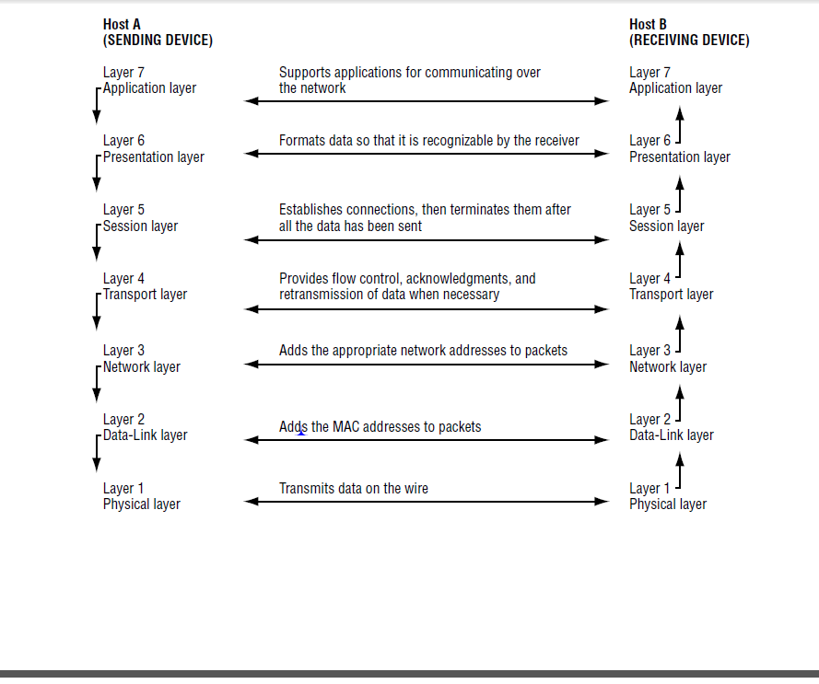
OSI Workflow (Sybex TCP/IP Foundations, by Andrew G. Blank)

Slide 12
OSI Workflow (Sybex TCP/IP Foundations, by Andrew G. Blank)
Packets are created at the top of the OSI model, the Application layer. The Application layer gets the data needs to be transmitted and passes the packet down to the Presentation layer, where a header is added on the packet. The Presentation layer passes the packet down to the session layer, then to transportation layer, network layer and so on. Each layer adds a header on the packet until the Physical layer gets the packets. The Physical layer merges the packet onto the network wire, and the data continues on its way to the destination.

Slide 13
OSI Workflow
At the destination, the packet moves in the opposite direction, from the bottom of the model to the top. The Physical layer at the destination protocol stack takes the packet off of the wire and passes it up to the Data-Link layer. The Data- Link layer examines the header that the sending Data-Link layer put on the packet. If this is not the destination for this packet, the packet is discarded. If this is the destination for this packet, the Data-Link layer protocols strip off the Data- Link header that the sender had put onto the packet and pass the rest of the packet up to the Network layer. This continues at every layer until the data reaches the top of the stack.
In this way, each layer of the sending host communicates with the same layer of the receiving host. This is called peer-layer communication.
Peer-layer communication is that each layer in the sending host communicates with its peer layer in the receiving host.
Notice that each layer has specific responsibilities that aid in communicating with the other host.

Slide 14
TCP/IP
The Internet uses TCP/IP protocol to establish the connections between the clients and servers and reliably move message between them.
TCP/IP are:
Layer 3 and 4 protocols
Add headers to the data
IP Header
TCP header
Application Data

Slide 15
TCP/IP
Why TCP/IP?
Support from Vendors
As stated earlier, TCP/IP receives support from many hardware and software vendors. This means that the TCP/IP suite is not tied to the development efforts of a single company. Instead, the choice to use TCP/IP on a network can be based on the purpose of the network and not on the hardware or software that has been purchased.
Interoperability
One of the major reasons why the TCP/IP suite has gained popularity and acceptance so universally is that it can be installed and used on virtually every platform. For example, using TCP/IP, a Unix host can communicate and transfer data to a DOS host or a Windows host. A host is another name for a computer or device on a network. TCP/IP eliminates the cross-platform boundaries.
** Sybex TCP/IP Foundations

Slide 16
TCP/IP
Why TCP/IP?
Flexibility
TCP/IP is an extremely flexible protocol suite, and in later chapters you will learn about some features that contribute to this flexibility. Examples of TCP/IP’s flexibility include the latitude an administrator has in assigning and reassigning addresses. An administrator can automatically or manually assign an IP address to a host, and a TCP/IP host can convert easy-to-remember names, such as www.sybex.com, to a TCP/IP address.
Routability
A limitation of many protocols is their difficulty in moving data from one segment of the network to another. TCP/IP is exceptionally well adapted to the process of routing data from one segment of the network to another, or from a host on a network in one part of the world to a host on a network in another part of the world. TCPP/IP grew out of the military’s need for a reliable, flexible networking standard.

Slide 17
TCP/IP
Internet Protocol (IP):
Carry the source and destination network addresses
Routers look at the destination address to determine how to router the message to the correct destination

Slide 18
TCP/IP
Transmission Control Protocol (TCP):
Guaranteed delivery of the packet contents
Verification of message length, detects lost or added characters
Checksum algorithm detects modified bits
Packet sequence number detects missing packets and ensures correct assembly of packets
Connection based protocol – requires two system to acknowledge all received messages

Slide 19
Network Services and TCP/IP Ports
Network Services Samples:
NFS
Email
Printer
DHCP
Directory Services
Network Management Services
Remote Services

Slide 20
Network Services and TCP/IP Ports
TCP/IP Ports
The unique identifier for program that is accessible through a network connection.
Ensure communication between clients and servers do not know each other
For example: Web sever programs – Port 80, all browsers are configured by default to send web requests to port 80. It helps guarantee that when you see your browser to visit a web site, you will probably succeed in reaching the web server.
Range:
0 – 1023 Well know ports
1024 – 49151 Registered ports
49152-65535 Dynamic/private ports

Slide 21
Network Services and TCP/IP Ports
Well Known Ports and Risks
Port 7: Echo
Port 20 – 21: FTP
Port 23: telnet
Port 25: SMTP
Port 53: DNS
Port 69: TFTP
Port 80: HTTP
Port 110: POP3 Mail
Port 161, 162: SNMP (Simple Network Management Protocol)
Port 1252: Lotus Notes Mail
Port 5190: AOL Instant Message and AOL Client
Well Know Ports Number posted online
Port Scan - Hacker can scanner those well known TCP/IP ports to determine information about a host computer. Using an open, unsecured port an intruder may exploit the port for an attack on a system.

Slide 22
URL and IP Address
The URL is the WWW address of documents and other resources.
Similar to a complete “mailing address” which indicates the location of a specific document, file or other electronic resource
General format of URL: service://host/path_to_file_or_page
Sample services: ftp, htttp, https
IP Address: 32 bit numbers ranging from 0 to 255
Internet address are assigned by regional network information centers:
InterNIC: global (www. Internic.net)
ARIN: US, Canada, Latin America (www. Arin.net)
RIPE: Europe (www.ripe.net)
APNIC: Asian Pacific (www.apnic.net)

Slide 23
URL Inherent Risk
The inherent risk with URL is that it provides a hacker with the path to a file or directory.
It is critical that the files and directories have strong security to prevent unauthorized access to the information contained here.
“Web-defacing” – When a hacker breaks into the file and changes the web-page code to embarrass the institution.

Slide 24
Subnet
Historical classful network architecture
Class | Leading bits in address (binary) | Range of first octet (decimal) | Network ID format | Host ID format | Number of networks | Number of addresses per network
A | 0 | 0–127 | a | b.c.d | 2⁷ = 128 | 2²⁴ = 16777216
B | 10 | 128–191 | a.b | c.d | 2¹⁴ = 16384 | 2¹⁶ = 65536
C | 110 | 192–223 | a.b.c | d | 2²¹ = 2097152 | 2⁸ = 256

Slide 25
Subnet
A subnetwork, or subnet, is a logically visible subdivision of an IP betwork. The practice of dividing a network into two or more networks is called subnetting.
All computers that belong to a subnet are addressed with a common, identical, most-significant bit-group in their IP address. This results in the logical division of an IP address into two fields, a network or routing prefix and the rest field or host identifier. The rest field is an identifier for a specific host or network interface.

Slide 26
Subnet
Traffic between subnetworks is exchanged or routed with special gateways called routers which constitute the logical or physical boundaries between the subnets.
The benefits of subnetting vary with each deployment scenario. In the address allocation architecture of the Internet using Classless Inter-Domain Routing (CIDR) and in large organizations, it is necessary to allocate address space efficiently. It may also enhance routing efficiency, or have advantages in network management when subnetworks are administratively controlled by different entities in a larger organization. Subnets may be arranged logically in a hierarchical architecture, partitioning an organization's network address space into a tree-like routing structure.

Slide 27
DNS
Domain Name System is a distributed databases that associated a user friendly domain name with an IP address. (Name -> Telephone #)
www.yahoo.com (98.139.183.24)
Worldwide primary DNS servers to contain each registered domain name and matching IP address
IPS and institutions may have its own DNS servers for translating internal domain names and subnet IP addresses
User Request -> local DNS servers -> if not -> higher level DNS server -> repeat the process until the IP address returns to the browser. (the information will be saved in the local DNS server: hosts file.)
# This is an example of the hosts file:
127.0.0.1 localhost loopback ::1 localhost

Slide 28
Web Technologies and Risks
HTML
Active Contents
Cookies
Java
JavaScript
ActiveX

Slide 29
Web Technologies and Risks
HTML
The primary mechanism for formatting and displaying information on web pages. It is a series of tags that define text size, text style, text placement, text color, graphic content, etc.
Active Content
Active content has the ability to download data and/or programs from the server to the client machine to be stored and or/executed on the client machine.
Active Content examples: cookies, Java, Java Script, ActiveX
Used to enhance application capability and provide a user friendly experience
Risk: introduce various security and control problems, e.g downloading executable code from unknown source.)

Slide 30
Web Technologies and Risks
Cookies
Small files stored on the client’s machine containing information for the server to identify user, user preference, user’s last access to the site, etc.
Privacy concern
Recording user activities
Capture and store sensitive information such as user names and passwords, credit card information, etc.
Web browser can be configured not to accept “cookies”
Auditor should determine if cookies contain clients’ sensitive information, location of the cookies and security controls to protect the repositories.

Slide 31
Web Technologies and Risks
Java
A complied programing language
Placed on the web server
Browser will download the program and execute the “Applets”
No action required from the client end; applet is downloaded and automatically runs on your browser
Examples: calculation of the cost of the shopping cart; animated characters in an electronic greeting card, etc.
Relatively safe: applets run in a restricted area in your computer’s memory that prevents the program from accessing files or inflicting virus.

Slide 32
Web Technologies and Risks
JavaScirpt
A scripting language
Less complex than other web languages
Scripts are sent from a sever to a client machine and interpreted as the HTML tags are interpreted
Add additional capabilities and flexibilities to HTML such as drop-down boxes, interactive forms; change text color when mouse runs over it
Can not inflict virus or access files
Quality of the programming code (will the code do what it expected? -> change control

Slide 33
Web Technologies and Risks
Active X
Code that is sent from a server to a client and executed on the client machine
It CAN interact with the client machine and other network or internet resources – High risk and big concerns
Active X can run malicious code such as virus, read/write to client files, shared files on network, run on operating system commands
Active X is part of web design or not? change control?
Permit Active X or not? Firewall Configuration

