Slide 1
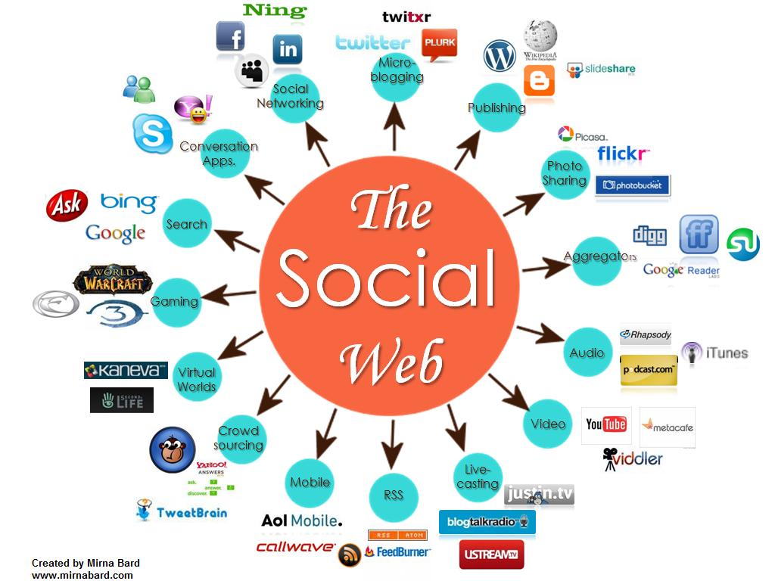
Social Media
Jeevan Kaur, Michael Mai, Jing Jiang
Notes:
image credit: http://www.igenii.com/blog/wp-content/uploads/2012/10/social-media-image.jpg

Slide 2
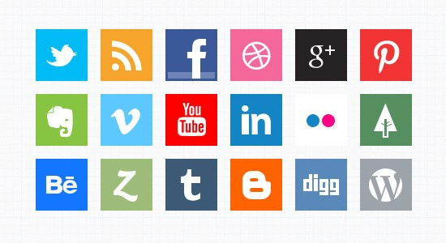
Recent News
45,000 Facebook logins hijacked
760 Companies hit by foreign countries hacking operation
8 out of 10 companies are talked about on Twitter
680,747 views per corporate YouTube Channel
845 million Active Facebook users

Slide 3
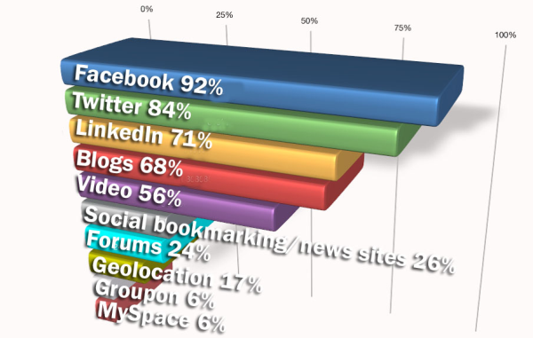
What is Social Media?
Social media refers to the means of interactions among people in which they create, share, and exchange information and ideas in virtual communities and networks
Types:
Facebook - 100 million/3 months
Twitter- 140 million, 340 million tweets/day
LinkedIn- 135 million
Blogs - 150 million
Youtube- Training videos (Red Robin Restaurant)
Notes:
image credit: http://www.imagemediapartners.com/blog/bid/51814/What-Social-Media-Tools-are-Experienced-Marketers-Using

Slide 4
Benefits
24/7 communications with customers and prospects
Increasing customer loyalty
Diversifying marketing channels
Building new business opportunities
Increasing collaboration among employees
Finding, attracting or reaching new customers
Building personal, professional and organizational networks
Notes:
image credit: http://socialgratification.com/wp-content/uploads/2013/09/social-media-benefits.jpg

Slide 5
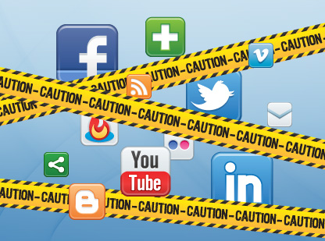
Risks
Organization
Brand/Reputation Loss
Trademark Infringement
Loss of Control Over Content
Privacy Risk
Lack of Situational Awareness
Copyright Issue
Data
Unauthorized disclosure
Intellectual Property leakage
People
Loss of Prod
Social Engineering/ Impersonation
HR Policy Violations
Identity Theft
Technology
Vulnerabilities
Virus/Worms/Trojans
Impact network availability (DOS)
Notes:
image credit: http://cdn2.hubspot.net/hub/158743/file-28053174-jpg/images/social-media-risk.jpg?t=1365436170000

Slide 6
Controls
Strategy and Governance
Risk assessment
Establish social media policy
People
Establish user agreements for social media use
Conduct awareness training
Understand communication channels
Technology
Anti-virus softwares
Content filtering - DLP
Incident response plan
Process
Alignment of business processes with social media policies
Change management of controls

Slide 7
Auditing Social Media
Program Governance & Oversight
Review policies and procedures
Evaluate procedures to review and approve content
Determine the nature of periodic risk assessment and documentation
Alignment of Activities W/ Enterprise Strategy
Existence of Strategy documentation
Review objective & metrics to measure progress - risk appetite
Evaluate process for cosistency w/ overall enterprise

Slide 8
Auditing Cont’d
Compliance w/ Laws and Regulations
Assessment of activities with legal requirements
Evaluate the involvement of legal in use of social media technologies
Operational Risk Management
Use of technological tools to monitor and restrict usage
Evaluate the access procedure
Employee training and awareness program
Notes:
image credit: http://www.dottourism.com/wp-content/uploads/2013/09/social-audit.jpg

Slide 9
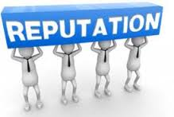
Auditing Cont’d
Reputational Risk Management
Evaluate management’s distinction of consumer complaints received through social media and social media incidents
Assess the monitoring process for integrity and fairness to consumers
Notes:
image credit: https://encrypted-tbn3.gstatic.com/images?q=tbn:ANd9GcQQ81wfomBUDvU1txyKUNiBeh_4co54FUkalsgMn5Di5Gz3rPDW

Slide 10
Recommendations
Define Malware categories and current threats
Training in prevention, identification
, containment, and eradication of malware
Update Organization Security Policy to address major social media security
Safeguard Browsing Practice
Implement layers of automated anti-malware software

Slide 11
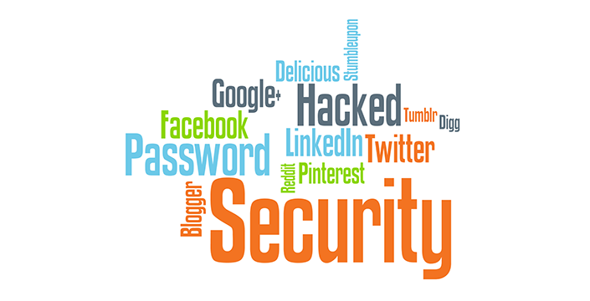
Conclusion
Social Media is the core of future communication
Leveraging access security and usage
Understanding current threats and Malware
Safeguarding information
Increasing Security Awareness of Social Media

