Slide 1
Protecting Information Assets
Week 1

Slide 2
Secure Computing is a Myth
When it comes to digital security, there’s no such thing as an impenetrable defense. But you can mitigate risks by following sound operating practices.
Robert D. Austin and Christopher A.R. Darby
^{2003 Harvard Business School}

Slide 3
Welcome
Introductions
Course Objectives
Readings
Grading
  Participation & Class Blog
  Case Analysis
  Mid-term Exam and Final
Typical Class Session
Semester Schedule
Week 1: The Risk IT Framework

Slide 4
Announcements
IT Career Fair
What day? September 24, 2014 (Wednesday)
What Time? 11am-3pm
Where? Alter Hall

Slide 5
Course Objectives
In this course you will gain an understanding the importance of and techniques related to managing information assets including logical, physical, and environmental security along with disaster recovery and business continuity
The Key subject areas that are covered in the course are:
  Information Security Risk Identification and Management
  Security Threats and Mitigation Strategies
The first half of the course, leading up to the mid-term exam, will focus on Information Security Risk Identification and Management.
The second half of the class will cover the details of security threats and the mitigation strategies that are used to mange risk.

Slide 6
Course Objectives
In this course you will gain an understanding the importance of and techniques related to managing information assets including logical, physical, and environmental security along with disaster recovery and business continuity
The Key subject areas that are covered in the course are:
  Information Security Risk Identification and Management
  Security Threats and Mitigation Strategies
The first half of the course, leading up to the mid-term exam, will focus on Information Security Risk Identification and Management.
The second half of the class will cover the details of security threats and the mitigation strategies that are used to mange risk.

Slide 7
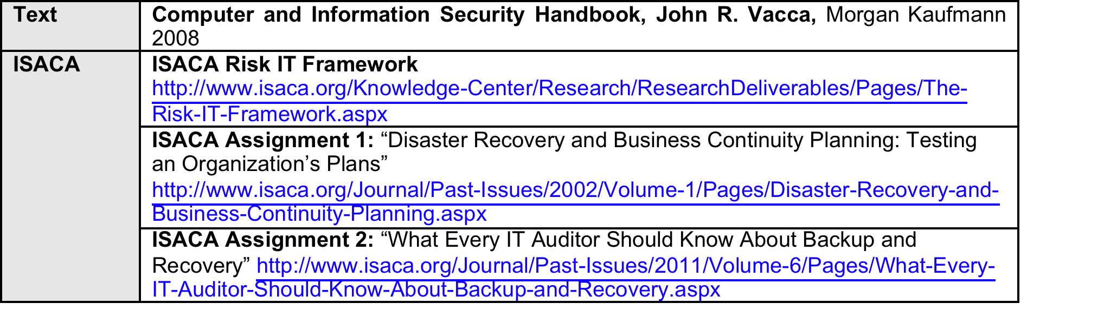
Reading Assignments

Slide 8
Reading Assignments (cont.)

Slide 9
Grading
Item | Percent of Total Points
Participation | 20%
Case Analysis | 30%
Mid-term Exam | 25%
Final Exam | 25%
Total | 100%

Slide 10
Participation
Preparation before each class – To facilitate active participation in the class I request that you do the following before noon on the day of the class:
Briefly address, summarize and post as a comment on the class blog : one key point you took from one of the assigned reading. (One or two sentences per reading)
I will also require that you identify, and are prepared to discuss, an article about a current event in the Information Security arena each week. Each student is expected to contribute a link to an article to the online class discussion each week. An ideal article would be tied thematically to the topic of the week. However, any article you find interesting and would like to share is welcome. The deadline for posting is noon on the day of class.

Slide 11
Participation
Participation during class – We will typically start each session with “opening” questions about the assigned readings and case study. We will also discuss “in the news” articles that you have discovered and posted to the class blog. I may ask for volunteers, or I may call on you. Students called on to answer should be able to summarize the key issues, opportunities, and challenges in the case study. All students should be prepared to answer these questions.
Another important aspect of in-class participation is completion of in-class assignments and contribution to any break-out activities.
Participation between classes – To facilitate ongoing learning of the course material, we will also discuss course material on the class blog in between class. Participation is encouraged BUT NOT REQUIRED. Reading and commenting on these analyses will further the quality of our in-class discussions.

Slide 12
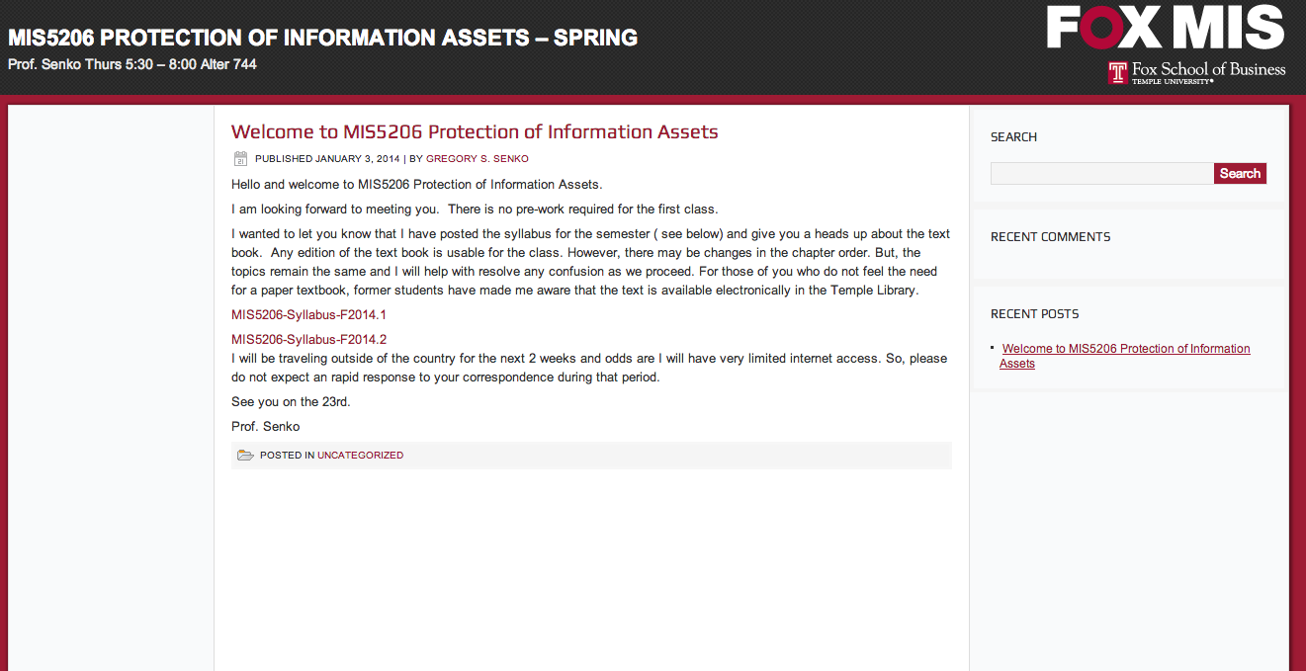
http://community.mis.temple.edu/mis5206senkof2014/

Slide 13
Case Studies
We will do two formal cases that require a written analysis
To complete this requirement you must:
  Address the questions I will provide
  Do a one page report exploring the issues
  Email to me by midnight the Tuesday before the class meets

Slide 14
Exams and the Final
Exams
  One Mid-term Exam
  Final Examination
Weekly Quiz
  Practice exam questions
  Grades for quizes do not count toward the grade
  Taking the quiz counts toward participation score

Slide 15
Semester Schedule
Schedule is laid-out in the Syllabus
http://community.mis.temple.edu/mis5206senkof2014/
I am considering conducting a few fo the classes online

Slide 16
In the News
U.S. venture firm Kleiner Perkins suffers security breach
(Reuters) - California detectives are investigating a July computer theft at storied venture capital-firm Kleiner Perkins Caufield & Byers, a spokeswoman for the Menlo Park police said on Thursday.
The theft may put Kleiner in jeopardy of losing valuable financial data and making the firm the latest in a long list of businesses that have lost sensitive information to thieves. In this case, the information was taken by physical, not electronic, means.
http://www.reuters.com/article/2014/08/22/us-usa-crime-kleiner-idUSKBN0GM03J20140822

Slide 17
The RiskIT Framework
What is ISACA?
  With more than 86,000 constituents in more than 160 countries, ISACA (www.isaca.org) is a leading global provider of knowledge, certifications, community, advocacy and education on information systems assurance and security, enterprise governance of IT, and IT-related risk and compliance.
  Founded in 1969, ISACA sponsors international conferences, publishes the ISACA® Journal, and develops international information systems auditing and control standards. It also administers the globally respected Certified Information Systems AuditorTM (CISA®), Certified Information Security Manager® (CISM®) and Certified in the Governance of Enterprise IT® (CGEIT®) designations.

Slide 18
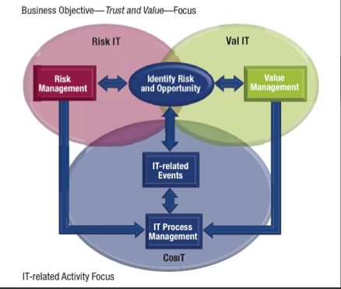
The RiskIT Framework
COBIT is an IT governance framework and supporting toolset that allows managers to bridge the gap between control requirements, technical issues and business risks.
The Risk IT framework is to be used to help implement IT governance, and enterprises that have adopted (or are planning to adopt) COBIT as their IT governance framework can use Risk IT to enhance risk management.
http://www.youtube.com/watch?v=hBH-Osh4Gm8

Slide 19
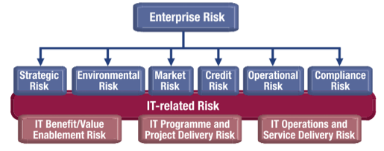
The RiskIT Framework
IT risk is business risk—specifically, the business risk associated with the use, ownership, operation, involvement, influence and adoption
of IT within an enterprise. It consists of IT-related events and conditions that could potentially impact the business. It can occur with both uncertain frequency and magnitude, and it creates challenges in meeting strategic goals and objectives.

Slide 20
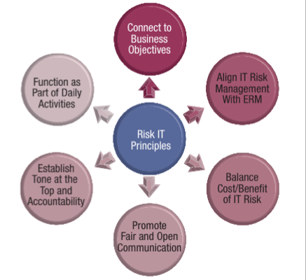
The RiskIT Framework
The Risk IT framework is about IT risk—in other words, business risk related to the use of IT. The connection to business is founded in the principles on which the framework is built, i.e., effective enterprise governance and management of IT risk, as shown in the adjacent diagram

Slide 21
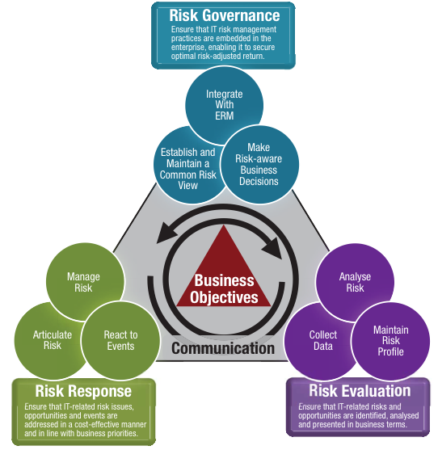
The RiskIT Framework
The risk management process model groups key activities into a number of processes. These processes are grouped into three domains. The process model will appear familiar to users of COBIT and Val IT: substantial guidance is provided on the key activities within each process, responsibilities for the process, information flows between processes and performance management of the process.

