Slide 1
MIS 5208 – L4
The ACL Environment
Ed Ferrara, MSIA, CISSP
eferrara@temple.edu

Slide 2
Working with Expressions
Expressions are statements used primarily to create filters and computed fields.
They perform:
Calculations,
Specify logical conditions,
Create values that do not exist in the data file.
Expressions can be:
Named and saved as part of a project or else created just for immediate use.
The output of an expression can be returned in any of the four data types: logical, character, numeric, and datetime.

Slide 3
ACL for Windows
Profile and Help - View or update your user profile, sign out of ACL Launchpad, or view online Help.
Organization selector - Switch between accounts (organizations) you have access to using this drop-down list.
Recent Analytics Files - Open recently accessed ACL projects or analysis apps.
Sample Files - Open pre-built ACL projects that include a variety of sample data.
Open - Open an existing ACL project, analysis app, or GRC project.
Create - Create a new Analytic Project or Workflow in Results Manager for organizing, tracking, and remediation of exceptions.
Community - Ask questions, share product ideas, contact support and access templates, content, training and other resources as part of your ACL subscription.

Slide 4
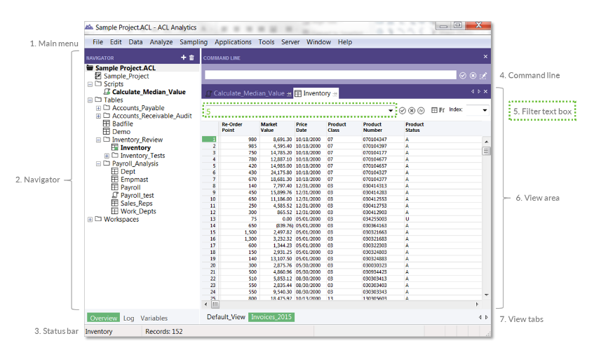
Interface and Basic Navigation

Slide 5
ACL Interface and Basic Navigation

Slide 6
ACL Analytics Envionment
Project
The project is similar to a file folder within a filing cabinet; supporting documentation items for each audit are filed in separate, clearly named folders.
For each new analysis or audit, a new project should be created to contain the relevant documentation.
Projects are files with .acl extensions and are named by the user when they are first created.
There are several item types within the project: table layouts, Views, the log, folders, and scripts.
To create a new project select File > New > Project.

Slide 7
ACL Analytics Envionment
Table layout
When an ACL Analytics project is first created, it is empty; this is because the source file(s) are stored outside of the project. Creating a table layout links the source file to the project.
In the ACL Analytics Environment Process Diagram, the source data file (AP2016.dat) is linked to the project via the table layout AP2016. Table layouts contain various information.
Data path to the location of the source data file
Field names, start positions, lengths, types, number of decimal places and datetime formats
Named expressions (calculated fields and named filters)
View definitions

Slide 8
ACL Analytics Envionment
View
A View determines how data is displayed on the screen within ACL Analytics.
Whenever a table layout is created, a View (named Default_View) is automatically generated that contains all of the fields in the table at the time of creation.
If you only want to work with certain fields, you can create a new View that has the desired fields. A table layout can have multiple Views.
Changing a View does not affect the underlying table layout or other Views.
If a table layout was created with 20 fields, the Default View for that table would also contain 20 fields. Additional Views could contain any of those 20 fields.
Views can be accessed from the tabs across the bottom of the ACL Analytics screen. In The ACL Analytics Environment process diagram, the table layout, ProductType, has a Default View and two additional Views.

Slide 9
ACL Analytics Envionment
Log file
A log file records most analysis steps and results. When a project is first created, a log file is automatically created and linked to it.
The log file has the same name as the project that it is linked to, but with a .log extension. In the ACL Analytics Environment process diagram (previous page), the log is named APAudit2016.log.
Consider the process of totaling a numeric field (running the TOTAL command on it).
The result of the Total command can't be written to the source file because ACL Analytics is a read only application.
Instead, the result of the Total is written to the log file. All log results include a date and time stamp along with the name of the table on which the result was produced.
Results can be seen at the time that the result was created and they can be retrieved later.

Slide 10
ACL Commands
ACL Analytics commands are pre-defined routines and are organized into three menu bar choices: Data, Analyze, and Sampling.
Menu Bar Choice | Intended Purpose | Example
Data | Manipulate (combine or reorder) data. | Join | Combine two tables.
 |  | Sort | Reorder the sequence of data.
Analyze | Understand (test) data. | Duplicates | Identify any duplicates.
 |  | Classify | Calculate subtotals by category.
Sampling | Create and evaluate sample pools. | Sample | Select a sample of records from a specific population.

Slide 11
ACL Commands

Slide 12
Logs
About the log
The log provides a chronological record of work performed on a project. The log automatically records every step taken in a project.
This provides an audit trail of the analysis, and allows users to retrace and/or re-create the steps taken to produce their results, print a report, or create a script to repeat the analysis process.
Each analysis step is written to the log as an entry, with log entries organized into log sessions.

Slide 13
The Log

Slide 14
Basic ACL Analytics Environment
Source files, such as an Excel file reside outside of the ACL project.
Corresponding .FIL files are created for each source file. .FIL files also reside outside of the ACL project and are referenced by the table layout. In a way, the table layout acts as a window to the .FIL file.
You can view the log in the Navigator of your project.

Slide 15
Sub Files
When a new table is created as the result of running a command a .fil sub file is created.
In the image to the right, the source file AR 2016.dat is 129 KB and contains Accounts Receivable data for all of 2016.
If we use the Extract command to create a new table, AR_Q1_2016, that contains only the AR data from the first quarter, a sub file, AR_Q1_2016.fil is created. Since AR_Q1_2016 is a subset of the AR_2016 file, it makes sense that it is only 32 KB.
AR_2016 contains data for the full year, but analysis is to be performed on Q1 data.
Use the Extract command to create a sub-file containing Q1 data.
Subsequent analysis will be faster on the smaller, sub-file.
ACL Analytics commands that create new tables always create new sub-files with .FIL extensions.

Slide 16
Data Analysis Cycle
1. Plan
2. Import
3. Prepare
4. Analyze
5. Report
Plan your work prior to starting the project
Formulate clear objectives
Develop a concise strategy
Budget resources effectively
Import Data Outlined in Plan
Locate specific data files and identify specific files
Acquire and create table layouts for source files
Prepare your data analysis
Understand data quality of source files
Identify incorrect date ranges
Incorrect totals
Missing transactions
Etc
Analyze the prepared data
Consider data integrity issues
Many objectives could take many steps – proving your hypothesis
Understand the audience
Will the report be admitted to legal proceedings – considered as evidence?
Consider outcomes and what the final report will include

Slide 17
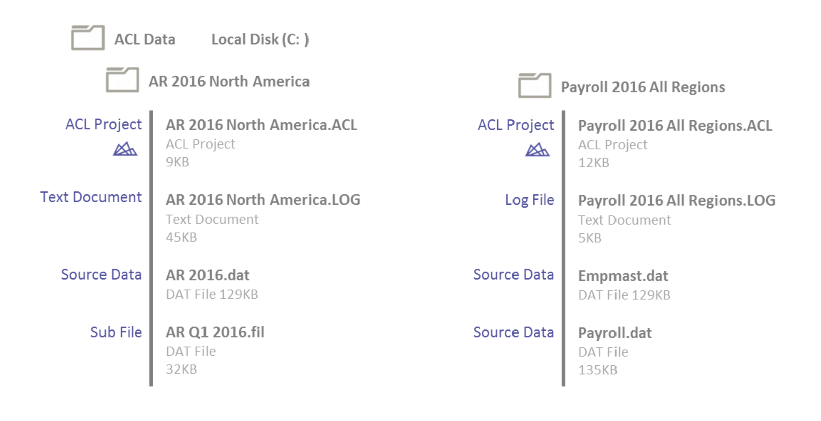
Best Practices
Organized, Organize, Organize
Use folders and subfolders to organize your work
Use well-defined naming conventions
Useful when searching for items
Helps in the interpretation of your work
Use Descriptive names (e.g. file B is not a good name unless there is a data map)

Slide 18
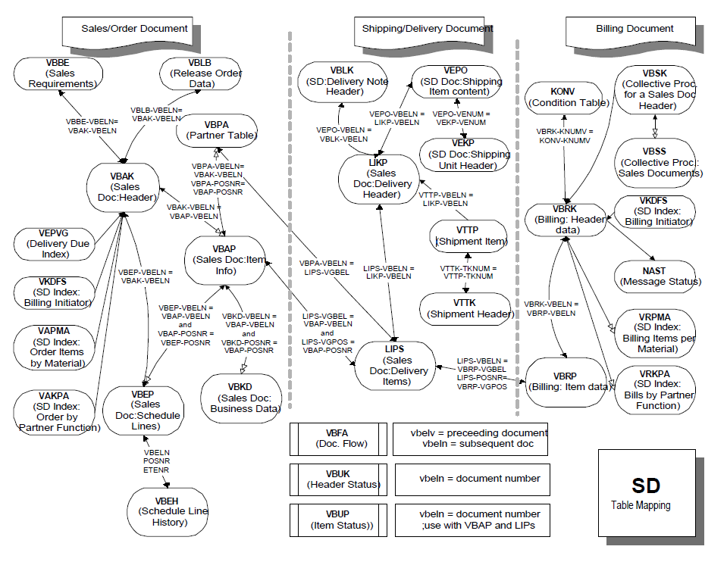
Data Map with Data File Sources Noted
Source: Ernst & Young

Slide 19
Questions
?
?
?
?
?
?

Slide 20
Thank you.

