Slide 1
MIS 5208 – L5
Audit Command Language Fundamentals
Ed Ferrara, MSIA, CISSP
eferrara@temple.edu

Slide 2
Working with Expressions
Expressions are statements used primarily to create filters and computed fields.
They perform:
Calculations,
Specify logical conditions,
Create values that do not exist in the data file.
Expressions can be:
Named and saved as part of a project
Created just for immediate use (temporary)
The output of an expression can be returned in any of the four data types:
logical
character
numeric
datetime
Filters (Logical expressions)
Filters are logical expressions, that select records in your analysis file based on a particular - evaluating each record as being:
True
False
Logical expressions restrict the viewed records based on the expression criteria
For example, you can create a filter that selects only records that fall within a specified range of dates.

Slide 3
Computed Fields
A computed field is:
Virtual
Derived from a calculation that references either physical field(s) and/or previously created computed field(s).
Return:
Character (character)
Numeric (numeric)
Date (datetime)
Logical values
Conditional or unconditional.
Once created, they can be treated as physical fields.
ACL Analytics evaluates expressions from left to right, according to the following rules:
Operators are evaluated in order of arithmetic precedence.
Use parentheses ( ) to modify the order in which the expression is evaluated.
Each operator works only if its operands are of an acceptable type.

Slide 4
Using Expressions
Valuable and flexible tool - use them to:
Perform a wide range of calculations
Create filters
Prepare data for analysis
Create computed fields
Expression Content
Data fields
Functions
Literals
Constants
Variables
Arithmetic or logical operators
Source: ACL Analytics On Line User Guide (https://enablement.acl.com/helpdocs/analytics/12/user-guide/en-us/Default.htm#cshid=using-expressions)

Slide 5
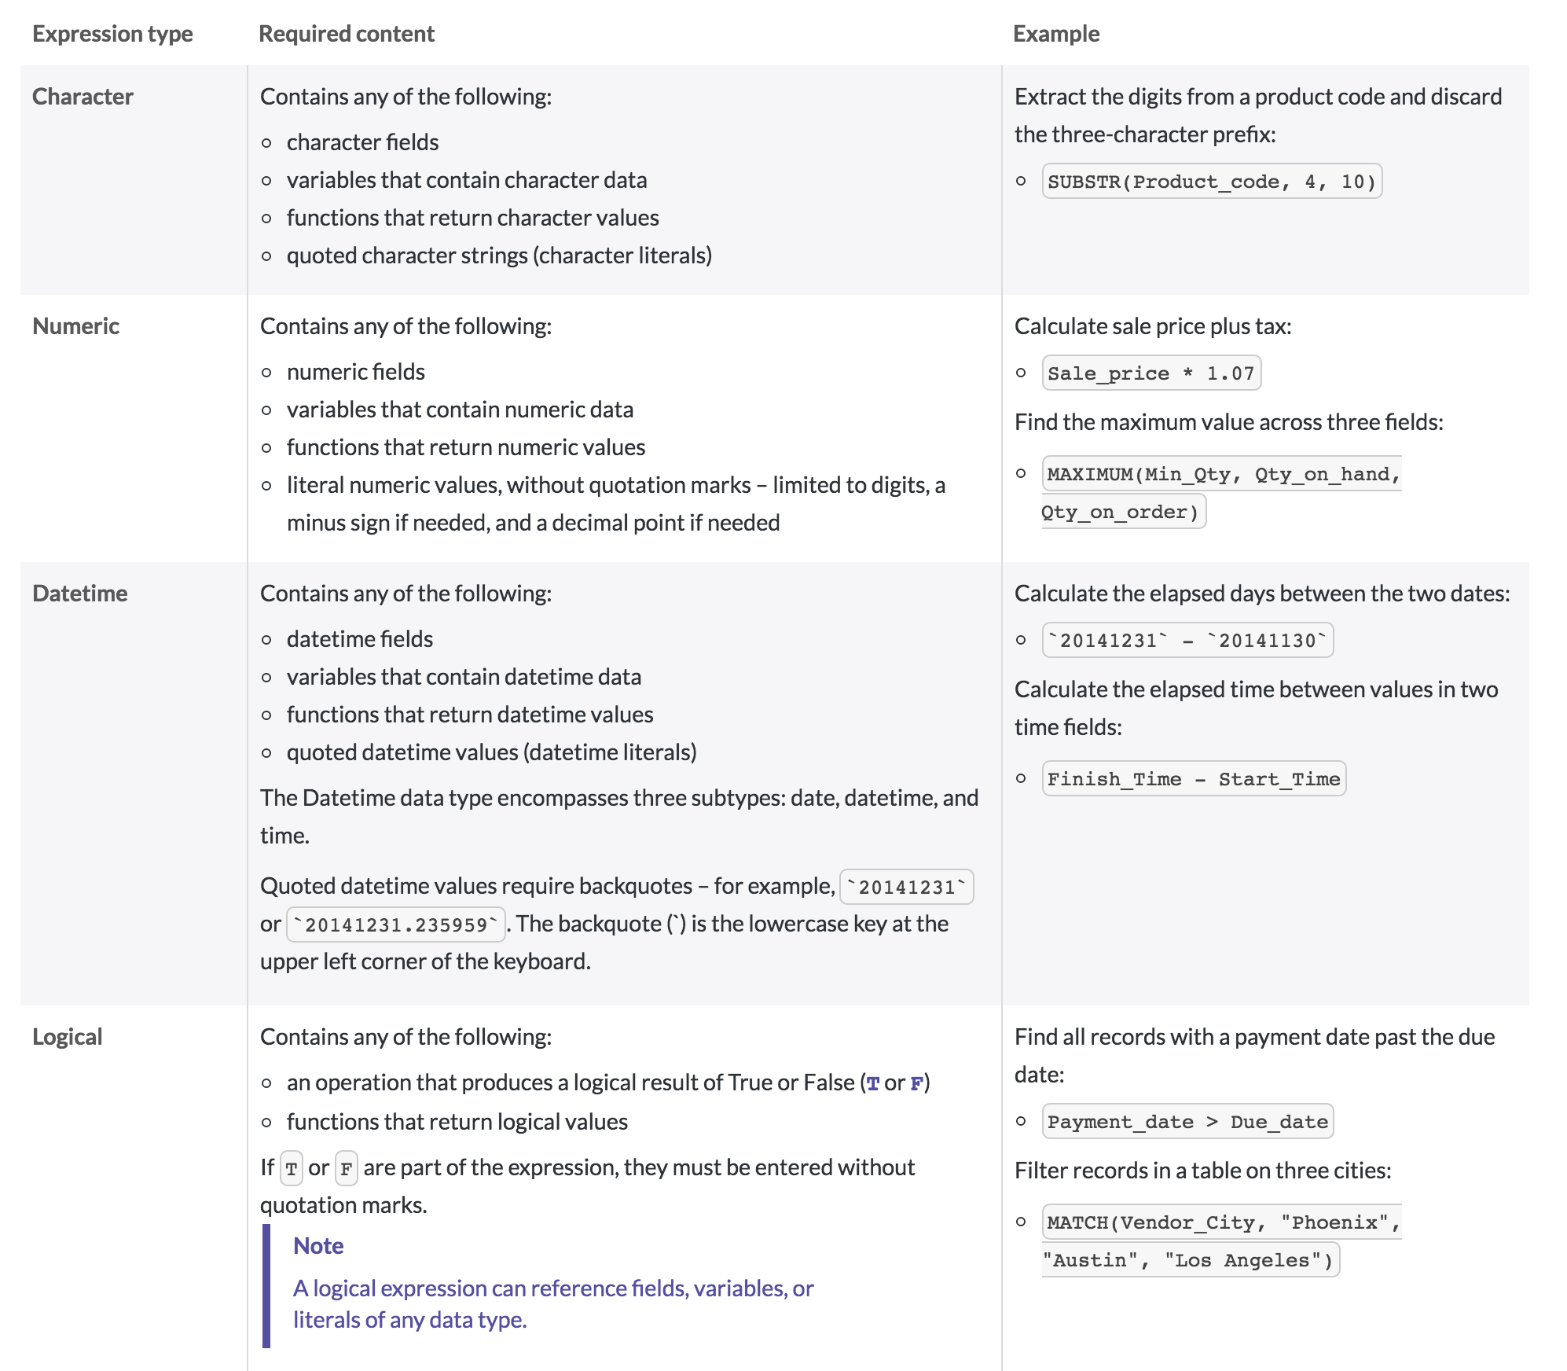
Using Expressions
Source: ACL Analytics On Line User Guide (https://enablement.acl.com/helpdocs/analytics/12/user-guide/en-us/Default.htm#cshid=using-expressions)

Slide 6
Using Expressions
Source: ACL Analytics On Line User Guide (https://enablement.acl.com/helpdocs/analytics/12/user-guide/en-us/Default.htm#cshid=using-expressions)

Slide 7
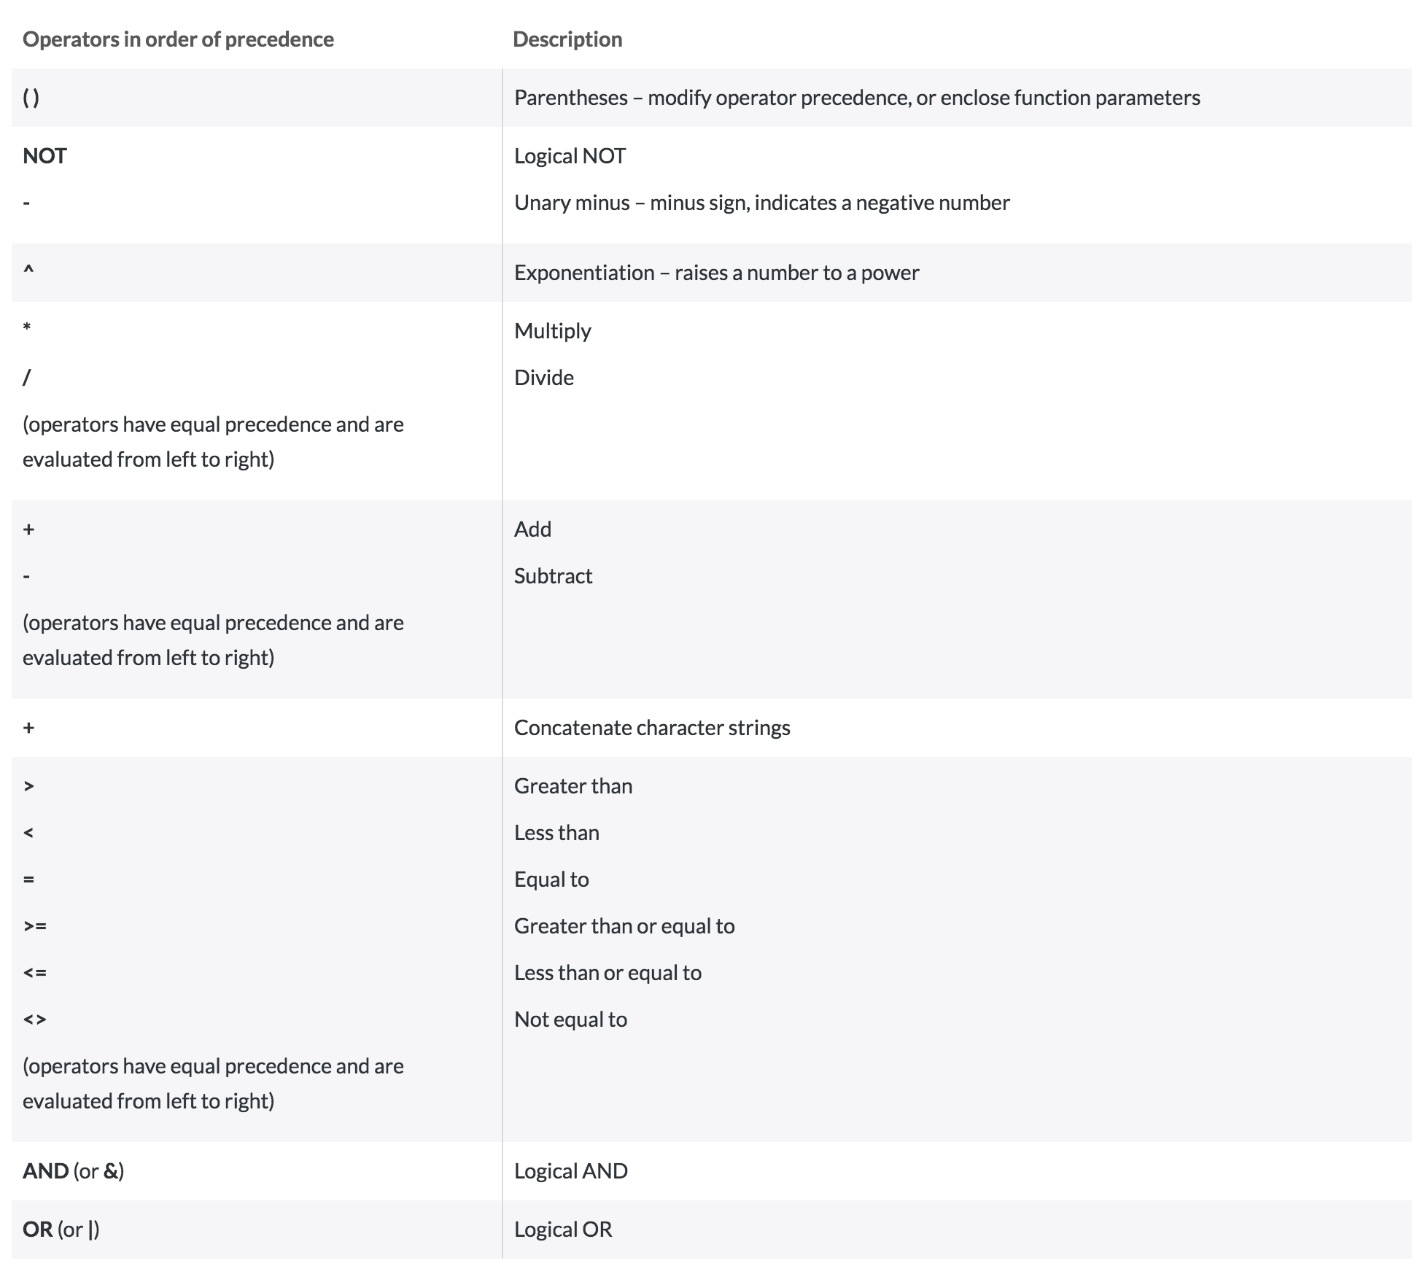
Expression Operators

Slide 8
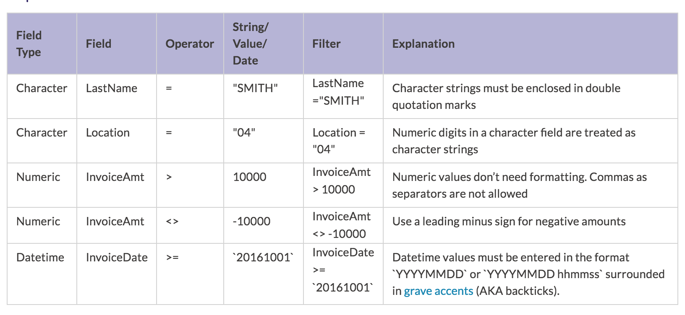
Filtering
A filter sifts records, only returning those that meet specified conditions; filters evaluate as true or false and return records that meet the specified conditions.
The values in the filter syntax govern which records will be returned after applying the filter.
Filters are constructed using a combination of field names, operators, and strings, dates, or values.
Source: ACL Analytics Foundations (https://academy.acl.com/unit/view/id:7465)

Slide 9
Create Filters and Quick Filters
Source: ACL Analytics Foundations (https://academy.acl.com/unit/view/id:7466)

Slide 10
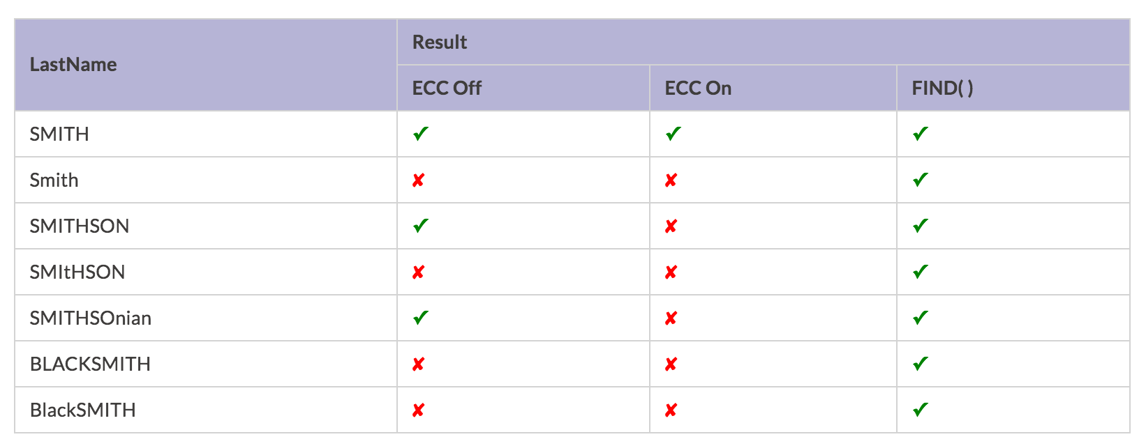
Searching Using Filters
Search for a Starting String
Filters can be used to find specific words. By default, search behaves like a wildcard (looks for every occurrence where the value begins with the filter string; it doesn’t matter what is after the string).
When the filter, fieldname = "string" is constructed:
The string being searched for must be at the start of the field.
Alpha characters (A-Z) are case sensitive
Only character fields can be used for word searches.
The search can be performed on any characters within the field (A-Z, 0-9, or symbols).
The wildcard behavior is controlled by Exact Character Comparisons (ECC).
If ECC is on, the remainder of the field value after the search for string must be blank in order for it to be picked up.
The table shows how values will evaluate if ECC is turned on or off.
Source: ACL Analytics Foundations (https://academy.acl.com/unit/view/id:7467)
Consider the filter LastName = "SMITH"

Slide 11
Turning ECC On / Off
ECC can be found under Tools > Options >Table.
Source: ACL Analytics Foundations (https://academy.acl.com/unit/view/id:7467)

Slide 12
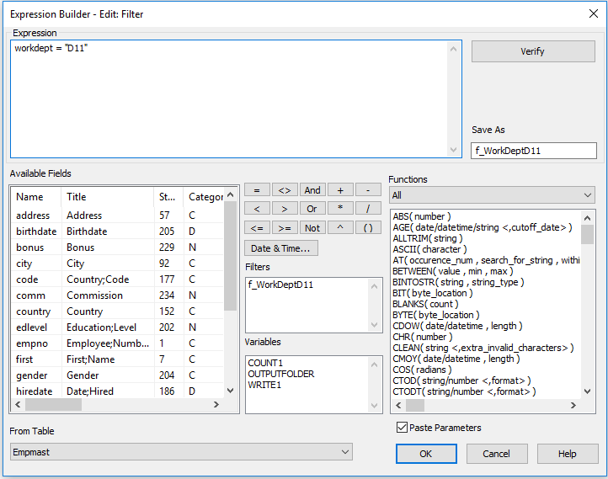
Expression Builder
Source: ACL Analytics Software v12

Slide 13
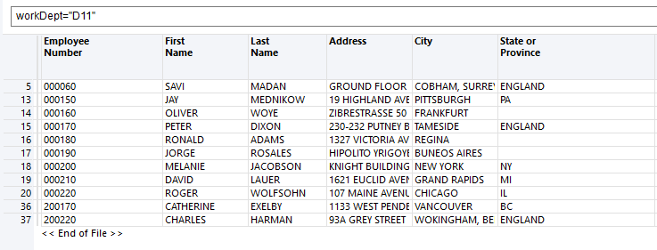
Applying Filters – Dynamic & Programmatic
ECC can be found under Tools > Options >Table.
Source: ACL Analytics Software v12

Slide 14
Searching
Search for a Starting String
Filters can be used to find specific words. By default, the search behaves like a wildcard (looks for every occurrence where the value begins with the filter string; it doesn’t matter what is after the string). When the filter, fieldname = "string" is constructed:
The string being searched for must be at the start of the field.
Alpha characters (A-Z) are case sensitive
Only character fields can be used for word searches.
The search can be performed on any characters within the field (A-Z, 0-9, or symbols)
Source: ACL Analytics Foundations (https://academy.acl.com/unit/view/id:7467)

Slide 15
Filter & Searching Class Activity

Slide 16
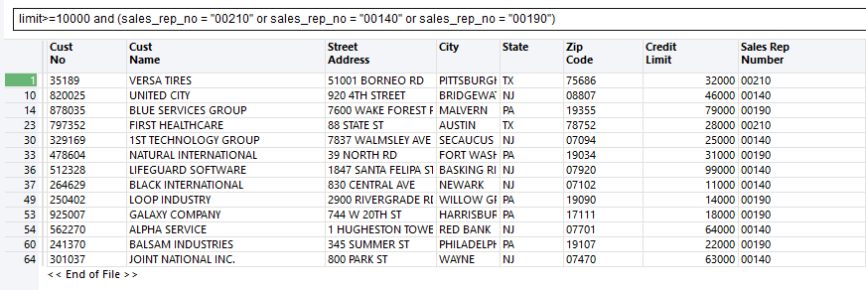
Filter with Conditionals
How many customers have a credit limit of at least $10,000 AND belong to Sales Rep 00210, 00140, or 00190?

Slide 17
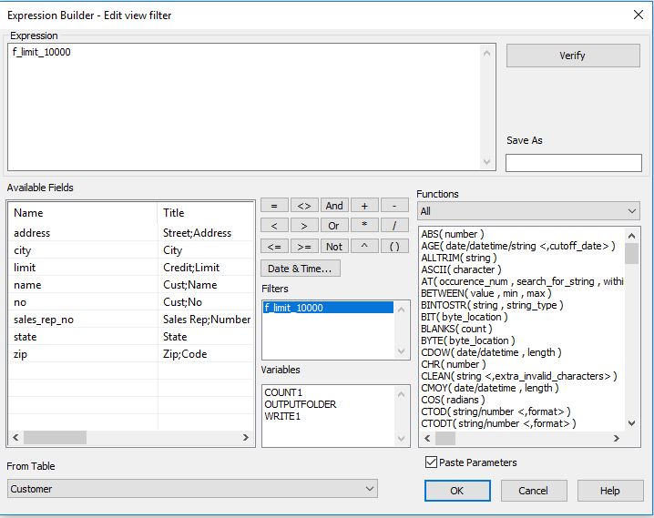
Filters with Expression Builder

Slide 18
Class Activity
How many customers have a credit limit of at least $10000 AND belong to Sales Rep 00210, 00140, or 00190?
Create a filter named limit_less_10000.
Using your saved filter, limit_less_10000, build a filter that will display customers who do not have a limit of at least $10000. Which operator will accomplish this?
Create a filter names f_limit_less_10000. Using your saved filter, build a filter that will display customers who do not have a limit of at least $10000. Which operator will accomplish this?
How many customers have a credit limit less than $10000?
How many customers belong to Sales Rep 00210?
In total, how many customers belong to Sales Rep 00210, 00140, or 00190?

Slide 19
Unconditional Computed Fields
An unconditional computed field applies the same expression to every record in the file.
Note:
A computed field must be named and always saved to your work file.
Example:
In a sales transaction file, every transaction requires a discount to be calculated on the final amount at 10%.
The expression needs to be applied unilaterally (unconditionally) to every record.
Source: ACL Analytics Foundations ( https://academy.acl.com/unit/view/id:7470)

Slide 20
Unconditional Computed Fields

Slide 21
Computed Fields
Only exist in the table and are not a part of the data source.
Must be named.
Can return a character, numeric or date output.
The rules for using the Expression Builder to create a computed field are similar to those for creating a filter as detailed in the Expression Builder page.
Computed
Field
Unconditional
(Same Expression Applied)
Conditional
(Different Expression Applied Based On Each Condition)

Slide 22
Thank you.
Computed Field Class Activity

Slide 23
Class Activity
Background: Since pay checks are issued monthly, the pay_per_period for each employee should equal 1/12th of their salary:
Calculate the variance (difference) between the original salary field and the computed field, c_SalaryRecalc, create another field called c_SalaryVariance.
Positive values in the c_SalaryRecalc field should reflect pay period overpayments.
Select Edit > Table Layout.
Click the Add a New Expression button.Under name enter c_SalaryRecalc.Click on the f(x) button and enter the syntax pay_per_period * 12 .
Click OK.
Click the green checkmark to accept the entry.
Don’t close the table layout window.
Using the syntax pay_per_period * 12, create a computed field, named c_SalaryRecalc, to recalculate the salary for each employee.
Next to the original salary field, add the c_SalaryRecalc and c_SalaryVariance fields to your view.
What is the total variance? (TOTAL command).
For a more detailed breakdown of the variance, you can run the STATISTICS command on the c_SalaryVariance field.
Notice how many of the variances are for only 4 cents?
Filter to exclude variances +/- 5 cents using the filter c_SalaryVariance > .05 OR c_SalaryVariance < -.05

Slide 24
Conditional Computed Fields
When different calculations need to be applied based on different conditions within the file, one expression, known as a conditional computed field, can be created. In a conditional computed field, values are calculated conditionally.
Note:
A computed field must be named and always saved.
In a conditional computed field, different values are assigned when a specified condition is met.
Every conditional computed field has a default value which is the value that is assigned if none of the conditions are met.

Slide 25
Conditional Computed Fields

Slide 26
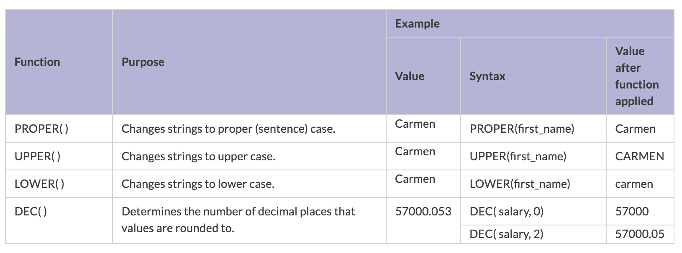
Functions
Functions are used to apply calculations for a wide variety of purposes.

Slide 27
Between

Slide 28
Between
To learn more about a specific function, select Help > Contents and enter the function name.
Can be accessed from the function list, on the right side of the expression builder.
Can be sub-listed into one of eight categories:
all, bit/char, conversion, date & time
financial, logical, math
miscellaneous, and string
By default, the Paste Parameters check-box is checked, meaning that when a function is selected from the list, the parameter prompts are pasted into the expression.

Slide 29
Computed Field – YEAR() Function

Slide 30
Class Activity Computed Field

Slide 31
YEAR() Function
Create a computed field, c_HireYear, that calculates the year that each employee was hired in.
In the Empmast table, right-click in the View and select Add columns.
Click Expr...
In the Save As text box, enter c_HireYear.
In the Functions list, scroll down to the YEAR( ) function and double-click on it so that it appears in the Expression text box.
Double-click on the 'date/datetime' parameter so that it is highlighted.
In the Available Fields list, scroll down to hiredate and double-click on it so that it replaces 'date/datetime' in the Expression text box.
Click Verify to confirm that the syntax is valid and then click OK to save the field and close the Expression Builder.
In the Add Columns dialog, click OK.

Slide 32
ABS() Function
Since pay cheques are issued monthly, the pay_per_period for each employee should equal 1/12th of their salary.
Click on the Edit View Filter button at the top of the view.
Enter the expression: ABS(c_SalaryVariance) > .05.
Click OK

Slide 33
Fixed Point Arithmetic (Rounding)
When calculating multiplication or division, ACL Analytics uses fixed-point arithmetic. This means that the result is rounded to the largest number of decimal places used in the expression.

Slide 34
Questions?

