Slide 1
MIS2508 Metrics & Data Visualization
Ed Ferrara, CISSP, MSIA
May 2017

Slide 2
First be a business leader and a security leader or fraud leader second; use business-driven security metrics to prove it.
Notes:
Theme slide

Slide 3
Agenda
Traditional thinking, traditional metrics
Think like the CEO and CFO: Communicate leadership and value.
Effective metrics
Seven key metrics: secure business alignment
Recommendations
Notes:
To add or remove rows in the table:
Select the table. Your cursor will change to an icon of two lines and an arrow above and below will appear on mouse-over of the baseline of the row.
Right-click and select INSERT > ROW BELOW. Or DELETE ROW.
To add a row after the last row, you can press [Tab], and the cursor will go to a new row.
Highlighting new areas:
Select the bracket group from the right bracket.
Hold SHIFT and pull cursor down over the next bullet item.
Select the previously highlighted text and in the HOME tab unclick the [B] button for bold, and click on the [A] button and choose the gray swatch (Gray-50%, Accent 5) second to last in the top row of the palette.
Select the text for the newly highlighted area and click the [B] button for bold, and click on the [A] button and choose black.

Slide 4
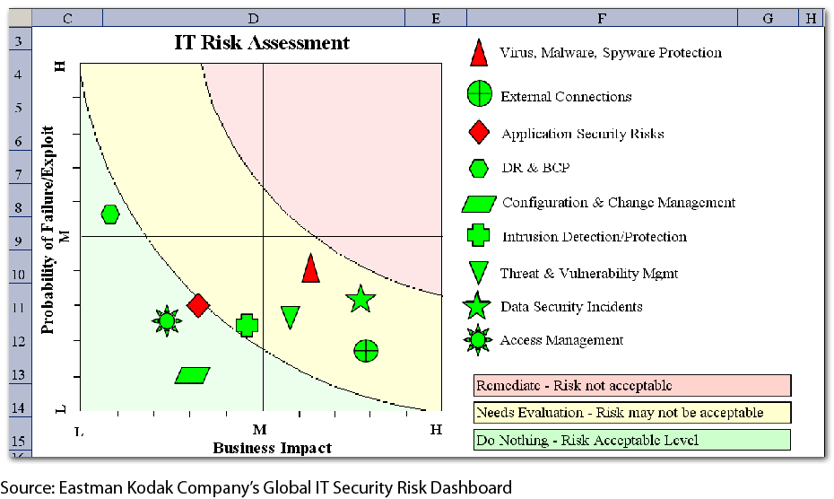
Risk management dashboard: traditional security metrics
The focus is often on operational metrics when reporting to senior leadership
Percentage of users who undergo background checks each year
Number of virus infections addressed during the year
Etc.

Slide 5
Operational security metrics
 | Control objective | Example security metric | Confi-dentiality | Integrity | Avail-ability | Com-pliance
PO | Plan and organize.
PO2 | Define the information architecture. | Percentage of systems compliant with security information architecture | Secondary | Primary | - | -
PO6 | Communicate management aims and direction. | Percentage of employees participating and passing security awareness training | - | - | - | Secondary
PO7 | Manage IT human resources. | Percentage of users who have undergone yearly background checks Percentage of position descriptions defining IS roles, responsibilities, skills, and certifications | Secondary | Secondary | Secondary | Secondary
PO8 | Manage quality. | Number of lines of code scanned without a security bug or concern | - | Secondary | - | -
PO9 | Assess and manage IT risks. |  | Primary | Primary | Primary | Secondary
PO9.1 | IT and business risk alignment | Percentage of critical assets/functions residing on compliant systems | Primary | Primary | Primary | Secondary
PO9.2 | Establishment of risk context | Percentage of critical assets/functions reviewed for physical security risks | Primary | Primary | Primary | Secondary
PO9.3 | Event identification | Percentage of events identified as potentially threatening to critical assets/functions. | Primary | Primary | Primary | Secondary
PO9.4 | Risk assessment | Percentage of critical assets/functions reviewed for quantitative risk assessment. | Primary | Primary | Primary | Secondary
PO9.5 | Risk response | Percentage of critical assets/functions modified in response to quantitative risk assessment. | Primary | Primary | Primary | Secondary
PO9.6 | Maintenance and monitoring of a risk action plan |  | Primary | Primary | Primary | Secondary
Source: COBIT – IT Governance Board
Notes:
--------------------------------
1) Plan and Organize
2) Acquire and Implement
3) Deliver & Support
4) Monitor & Evaluate

Slide 6
Agenda
Traditional thinking, traditional metrics
Think like the CEO and CFO: Communicate leadership and value.
Effective metrics
Seven key metrics: secure business alignment
Recommendations
Notes:
To add or remove rows in the table:
Select the table. Your cursor will change to an icon of two lines and an arrow above and below will appear on mouse-over of the baseline of the row.
Right-click and select INSERT > ROW BELOW. Or DELETE ROW.
To add a row after the last row, you can press [Tab], and the cursor will go to a new row.
Highlighting new areas:
Select the bracket group from the right bracket.
Hold SHIFT and pull cursor down over the next bullet item.
Select the previously highlighted text and in the HOME tab unclick the [B] button for bold, and click on the [A] button and choose the gray swatch (Gray-50%, Accent 5) second to last in the top row of the palette.
Select the text for the newly highlighted area and click the [B] button for bold, and click on the [A] button and choose black.

Slide 7
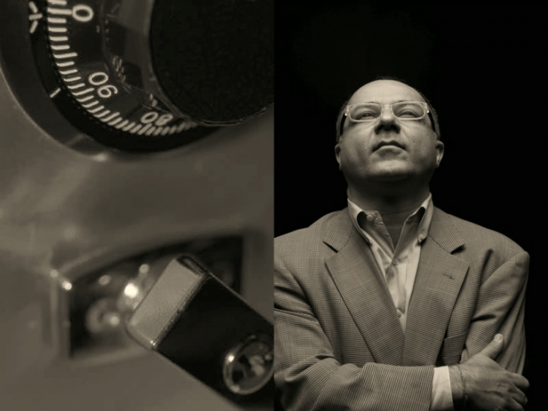
Think like your audience
InfoSec expertise
First generation
IT risk management
Second generation
Business risk
Cost reduction
IDS/IPS/AV
Asset valuation
ALE
Revenue growth
Strategic goals
Etc.
ROSI
Third generation
How does the CISO project credibility?
Resources
Notes:
The point I would like to make with this slide is that the Information Security Organizations like there Programs have a maturity curve. The first step in any program is to have the necessary information security expertise. The second is to be able to understand and in some ways predict or project forward the risk to the organization. The third is to fully understand business risk.

Slide 8
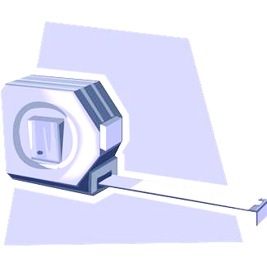
CISO leadership
“You get what you measure.”
CISO responsibilities are much broader than just operational security issues:
Economic, legal, regulatory
Human resources, compliance
Traditional IT information security concerns
CISOs need information for better decision-making.
Security metrics need to support decision-making and should drive broad-based risk management strategies.
CISOs need information to demonstrate the value they and their programs provide.
Security metrics need to demonstrate business alignment and support for the strategic and tactical goals of the business.

Slide 9
Agenda
Traditional thinking, traditional metrics
Think like the CEO and CFO: Communicate leadership and value.
Effective metrics
Seven key metrics: secure business alignment
Recommendations
Notes:
To add or remove rows in the table:
Select the table. Your cursor will change to an icon of two lines and an arrow above and below will appear on mouse-over of the baseline of the row.
Right-click and select INSERT > ROW BELOW. Or DELETE ROW.
To add a row after the last row, you can press [Tab], and the cursor will go to a new row.
Highlighting new areas:
Select the bracket group from the right bracket.
Hold SHIFT and pull cursor down over the next bullet item.
Select the previously highlighted text and in the HOME tab unclick the [B] button for bold, and click on the [A] button and choose the gray swatch (Gray-50%, Accent 5) second to last in the top row of the palette.
Select the text for the newly highlighted area and click the [B] button for bold, and click on the [A] button and choose black.

Slide 10
Effective reporting has an impact.

Slide 11
Effective metrics
Consistently measured
Cheap to gather
Uses numbers
Show Trends
Relevant to decision-makers
Presented graphically
Consistently measured — Provide benchmarks and opportunities for continuous improvement.
Cheap to gather — If metrics are expensive to gather, they will not be gathered.
Uses numbers — Uses numbers that show relationships.
Show Trends — Use numbers to show trends.
Relevant to decision-makers — Are these the numbers the CEO and CFO care about? Why?
Presented graphically — A picture is worth a thousand words.
Source: Andrew Jaquith, Security Metrics: Replacing Fear, Uncertainty, and Doubt, Addison-Wesley, 2007
Notes:
Consistently measured.
Metrics, measured consistently, provide benchmark data for current and future performance analysis. Without consistent measurement, metrics cannot be used to implement continuous improvement because there is no reliable baseline to begin measurement.
Cheap to gather.
The resources needed should not overburden the CISO and his or her department. Metrics should not require significant resources to collect. If information is expensive and time consuming to gather, it will not be cost effective to gather them.
Expressed as a cardinal number.
Cardinal numbers show quantity. That is why the CISO should use them for metrics reporting. For example, six of ten major business processes reviewed for security issues, or support for the two major business initiatives for fiscal year 2011, including the X merger and cost reduction of seven percent at two data operations centers. These metrics tell more than a qualitative statement like “improved overall security posture”.
Expressed using at least one unit of measure in if possible two dimensions.
Measurement will drive behavior. Comparing measurements across two dimensions such as number of defects over time better illustrates the trend of the metric. The trend in this case is more important than the metric itself.
As an organizational leader, the CISO should work to change the behavior of the organization to make it more secure, but also more efficient. Looking at the collected metrics over time will tell if the organization is making progress against its goals.
Relevant to decision makers.
Relevant, so they present pertinent information needed by organizational leadership. Metrics that are not relevant will result in very short meetings with decision makers. CISOs should present information that enables decision makers to make decisions. For example, if there are significant security deficiencies in a business process, the CISO should explain the deficiencies and associated risks in ways that are relevant to decision makers, such as lost customers, damage to brand, or increased cost.
Actuarially sound.
Actuarially sound so they provide input into current and future risk assessment. Actuarial analysis applies mathematical and statistical analysis to assess risk. Insurance companies employee actuaries to determine the pricing of insurance by comparing the probability of a loss as compared to the revenue generated by a policy.
Information security is in some respects an insurance problem because it costs resources to protect (secure) an information resource. The value of the protected resource needs to be higher than the cost to protect it. Using actuarially sound metrics give the CISO important information to justify security expenditures.
Presented graphically.
This is to show patterns and trends. I already mentioned showing trends. The next step is to show those trends graphically. Decision makers do not have time to read lengthy reports and documents.
PowerPoint and graphical representations should be the CISO’s tools of choice to present their chosen metrics. These presentations should be easy to explain and understand in a risk or executive committee meeting.

Slide 12
Seven example metrics: to secure* business alignment
Strategic alignment
Functional alignment
Efficiency and effectiveness
Quality and service levels
Demonstrate strategic alignment. Take ownership of the governance, risk and compliance management process.
Process measurement
Security is the business of People, Process and Technology.
Innovation
Report on the implementation of new technology leading to improved security and efficiency.
Compliance
The number of laws and regulations organizations must comply with are growing.
Define problem you are solving
Develop metrics that show how you can do more with less.
Business operations should be measured for quality.
Convince stakeholders of the need or opportunity,
Decide what tool you are going to use.
Automation is critical here.
Information security is not exempt.
Implement a six-sigma or similar program.
Understand the vulnerabilities presented by core business processes.
Report on your compliance activities.
* Pun Intended

Slide 13
Agenda
Traditional thinking, traditional metrics
Think like the CEO and CFO: Communicate leadership and value.
Effective metrics
Seven key metrics: secure business alignment
Recommendations
Notes:
To add or remove rows in the table:
Select the table. Your cursor will change to an icon of two lines and an arrow above and below will appear on mouse-over of the baseline of the row.
Right-click and select INSERT > ROW BELOW. Or DELETE ROW.
To add a row after the last row, you can press [Tab], and the cursor will go to a new row.
Highlighting new areas:
Select the bracket group from the right bracket.
Hold SHIFT and pull cursor down over the next bullet item.
Select the previously highlighted text and in the HOME tab unclick the [B] button for bold, and click on the [A] button and choose the gray swatch (Gray-50%, Accent 5) second to last in the top row of the palette.
Select the text for the newly highlighted area and click the [B] button for bold, and click on the [A] button and choose black.

Slide 14
Effective Metrics
Consistently measured
Cheap to gather
Uses numbers
Show Trends
Relevant to decision-makers
Presented graphically
Consistently Measured — Provide benchmarks and opportunities for continuous improvement.
Cheap to Gather — If metrics are expensive to gather, they will not be gathered.
Uses Numbers — Uses numbers that show relationships.
Show Trends — Use numbers to show trends.
Relevant to Decision-Makers — Are these the numbers the CEO and CFO care about? Why?
Presented Graphically — A picture is worth a thousand words.
Adapted From: Andrew Jaquith, Security Metrics: Replacing Fear, Uncertainty, and Doubt, Addison-Wesley, 2007
Notes:
Consistently measured.
Metrics, measured consistently, provide benchmark data for current and future performance analysis. Without consistent measurement, metrics cannot be used to implement continuous improvement because there is no reliable baseline to begin measurement.
Cheap to gather.
The resources needed should not overburden the CISO and his or her department. Metrics should not require significant resources to collect. If information is expensive and time consuming to gather, it will not be cost effective to gather them.
Expressed as a cardinal number.
Cardinal numbers show quantity. That is why the CISO should use them for metrics reporting. For example, six of ten major business processes reviewed for security issues, or support for the two major business initiatives for fiscal year 2011, including the X merger and cost reduction of seven percent at two data operations centers. These metrics tell more than a qualitative statement like “improved overall security posture”.
Expressed using at least one unit of measure in if possible two dimensions.
Measurement will drive behavior. Comparing measurements across two dimensions such as number of defects over time better illustrates the trend of the metric. The trend in this case is more important than the metric itself.
As an organizational leader, the CISO should work to change the behavior of the organization to make it more secure, but also more efficient. Looking at the collected metrics over time will tell if the organization is making progress against its goals.
Relevant to decision makers.
Relevant, so they present pertinent information needed by organizational leadership. Metrics that are not relevant will result in very short meetings with decision makers. CISOs should present information that enables decision makers to make decisions. For example, if there are significant security deficiencies in a business process, the CISO should explain the deficiencies and associated risks in ways that are relevant to decision makers, such as lost customers, damage to brand, or increased cost.
Actuarially sound.
Actuarially sound so they provide input into current and future risk assessment. Actuarial analysis applies mathematical and statistical analysis to assess risk. Insurance companies employee actuaries to determine the pricing of insurance by comparing the probability of a loss as compared to the revenue generated by a policy.
Information security is in some respects an insurance problem because it costs resources to protect (secure) an information resource. The value of the protected resource needs to be higher than the cost to protect it. Using actuarially sound metrics give the CISO important information to justify security expenditures.
Presented graphically.
This is to show patterns and trends. I already mentioned showing trends. The next step is to show those trends graphically. Decision makers do not have time to read lengthy reports and documents.
PowerPoint and graphical representations should be the CISO’s tools of choice to present their chosen metrics. These presentations should be easy to explain and understand in a risk or executive committee meeting.

Slide 15
Security Metrics – Audience Identification
Executives
Middle Management
Employees
Customers
Executive Support is Absolutely Necessary for the Success of Information Security
Executive Management Need Education & Information to make good business decisions
Middle-management support is essential.
The CISO must be functionally aligned – a team player, facilitator, and advisor achieving project objectives without compromising security.
End users are an essential part of any Information Security Strategy.
What Security Metrics would you publish to customers?
Advocacy
Buy-In & Support
Awareness
Trust

Slide 16
Best and Next Practices
Best Practices
Be selective in picking metrics
Measure effectiveness
Demonstrate Strategic Alignment
Demonstrate Functional Alignment
Think beyond the security organization
Employ resources outside the security organization
Focus on reporting and presentation
Present meaningful data customized for the audience.
Next Practices
Develop a closed-loop process
Encourage a culture of measurement and accountability
Augment technical metrics with process metrics
Focus on process effectiveness and efficiency

Slide 17
Metrics Maturity Model
Level |  | Characteristics
0 | Nonexistent | Not Understood
1 | Ad Hoc | Occasional, not consistent, not planned disorganized
2 | Repeatable | Intuitive, not documented occurs only when necessary
3 | Defined | Documented, predictable, evaluated occasionally, understood
4 | Measured | Well-managed, formal, often automated, evaluated
5 | Optimized | Continuous and effective, integrated, proactive, usually automated

Slide 18
Information Security Metrics Dashboard

Slide 19
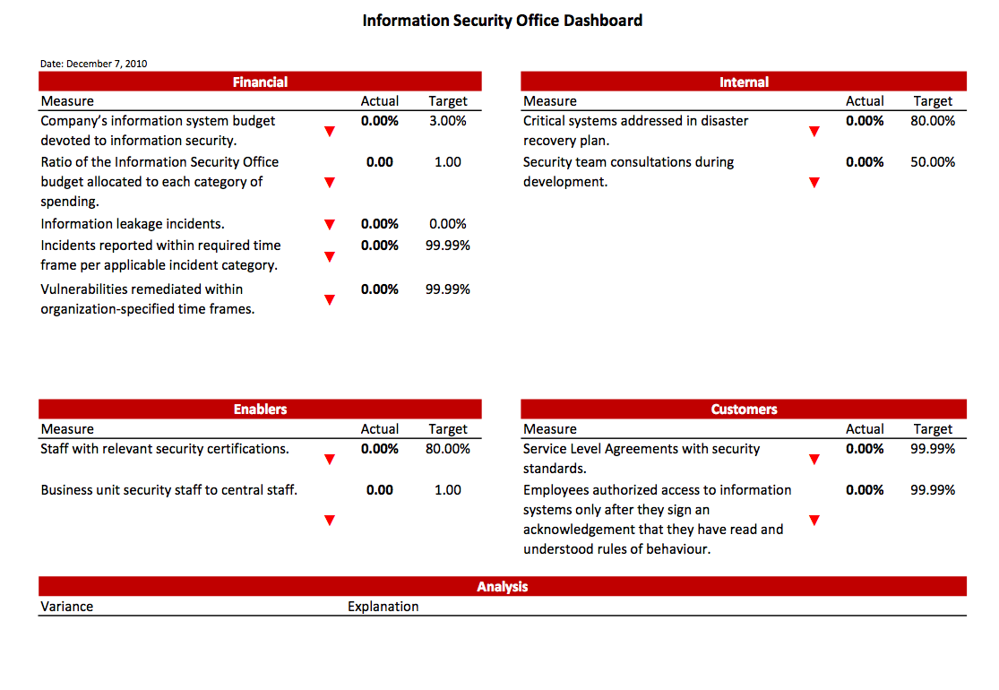
Information Security Metrics Dashboard

Slide 20
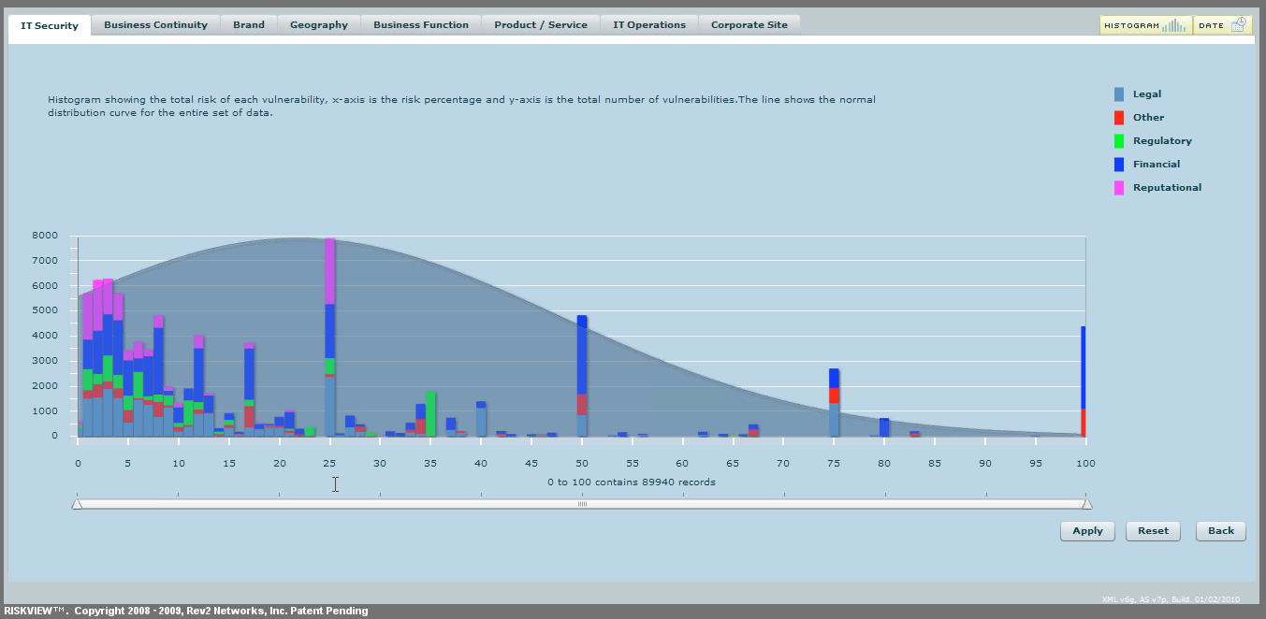
Example Information Security Dashboards

Slide 21
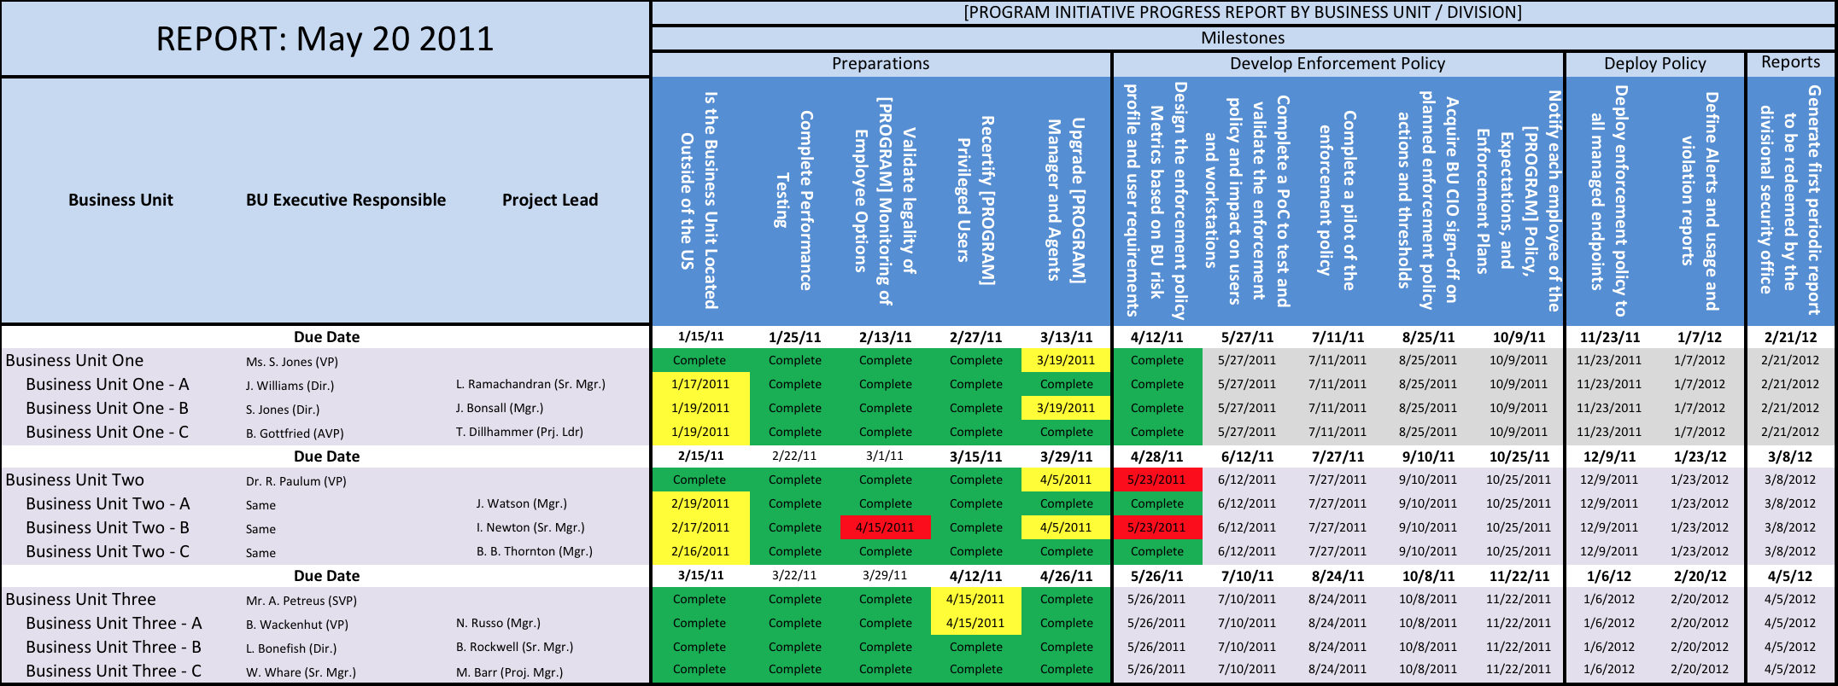
Information Security Metrics Dashboard Examples

Slide 22
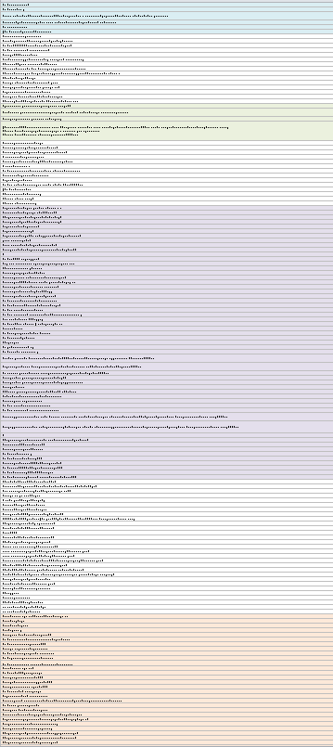
Metrics/Concerns Grouping
7 Metric Groups 25 Concern Areas 165 Metrics Candidates
Attacks | Attacks/Breaches, Scans/Probes, APT, Malware
Awareness/Mitigation | CDM, Monitoring
 | Incidence Response
 | Threat Intel
Compliance | Compliance
Data Protection | Corporate/IP Data, PII, Leakage
Infrastructure, End-Point Devices | Backup
 | Cloud
 | E-Mail
 | Hardware
 | Mobile Device Management
 | Network Security
 | Software
 | Supply Chain
 | Tools
 | WiFi Security
Manage/Plan | Change Management
 | COOP
 | Management, Planning, Policy, Strategy, Leadership of Security
 | Security Architecture, Amount, ROI, Asset Value & Priority of Security
People | Identity Management
 | Qualified Personnel
 | Training
 | User Activities, Insider Threat

Slide 23
7 Metrics Areas
Cybersecurity areas of concern have been grouped into Metrics categories. Numbers show how many times the area was cited by IT and cyber leadership.
Attacks
Attacks/Breaches (21)
APT (18)
Malware (7)
Awareness/Mitigation
Monitoring (14)
CDM (13)
Holistic understanding (6)
Blindspot Awareness (5)
Threat intel (4)
Metrics (1)
Incidence response (4)
Mitigation (1)
Data Protection
Data Stolen (13)
PII (10)
Data Leakage (11)
Manage/Plan
Management (17)
Policy (17)
Strategy (10)
Planning (4)
Prioritizing security (7)
Amount of security (4)
Security architecture (3)
Fragmented IT (2)
Change Management (2)
Procedures (7)
Communications with leadership (4)
Reputation (5)
Infrastructure/Devices
Mobile Device Mgt (8)
Wifi security (2)
ICS (3)
Cloud (3)
SCADA (1)
Data storage (1)
Hard drives (1)
Thumb drives (1)
Backup (2)
Best tools (6)
Oracle/Microsoft dominance (1)
Supply chain (5)
Physical Security (1)
People
User activities (21)
Insider threat (11)
Qualified personnel (15)
Training (9)
Identity Management (10)
Passwords (4)
Compliance
Compliance (15)
PCI (1)
Legal liability (3)

Slide 24
Performance Metrics Approach
DOE Mission Goals
Concerns
Remedies
Metrics
Executive Presentation Methods
DOE Business Needs
Priority:
1, 2, 3
Technical Difficulty:
Very High, High, Medium, Low
Capture Difficulty:
Very High, High, Medium, Low
Periodic
Reports
Rank:
High, Med, Low
Cost:
Very High, High, Medium, Low
Cost:
Very High, High, Medium, Low
Dashboard
Survey Percent
Organization Feasibility:
Very High, High, Medium, Low
Organization Feasibility :
Very High, High, Medium, Low
Lifecycle:
Active, Being Built, Under Consideration, None
Lifecycle:
Active, Being Built, Under Consideration, None
Overall Security Value
Overall Security Value
Tools
Tools

Slide 25
Metrics Dashboard Concepts
Security Overview
Attacks
 | 1 mo. | 6 mo. Trend
Overall Security Rating | 18 | 2%#
Overall Security Cost | 76 | 8%#
Security Objectives Maturity | 35% | 4%#
 | 1 Month | 6 Months | 1 Year
Attacks: | +6% | +4% | -2%
Severity Level:
 | 2
 |  | 3
 |  |  | 4
Manage/Plan
Awareness/Mitigation
Cyber/Business Alignment | 38% | 45%
IT Gov. Council Score
COOP Score
 | 8/1/2014 | 10/1/2014
High Risk
Med Risk
Low Risk
 | 7/1/2014 | 8/1/2014 | 9/1/2014 | 10/1/2014
*Risk Level = Vulnerability + Threat
4
of 1924
7
 | 2
1
3
5
 |  |  | 4
 | 2
FISMA Citations 86
of 10
Severity Score 3
of 100%
People
Compliance
Remediations 64%
 |  | 6 mo. Trend
User cyber training score avg. | 81% | 6%i
Privileged accounts without owner | 76 | 8%i
% of user violations + Severity | 45 | 4%#
6/1/2014
to
10/1/2014
Data Protection
Infrastructure/Devices
5
 | 1 Month | 6 Months | 1 Year
Asset Valuation Inventory Complete | 64% | 48% | 32%
Data Loss Rating
*Data Loss Rating = Data Loss # + Loss Severity
High Risk
Med Risk
Low Risk
 | 7/1/2014 | 8/1/2014 | 9/1/2014 | 10/1/2014
*TCP/IP Stack compliance via number of vulnerabilities
6
3
3
3
6
8

Slide 26
Metrics Dashboard Concepts
Security Overview
Security Overview gives an estimated security rating based on a combined weighted scoring of each metric’s estimated Security Value.
“Maturity” is based on the security objectives percentage complete, weighted by importance.
 | 1 mo. | 6 mo. Trend
Overall Security Rating | 18 | 2%#
Overall Security Cost | 76 | 8%#
Security Objectives Maturity | 35% | 4%#
Manage/Plan
Governance Council Score based on, 1) Is there an IT Governance Council? 2) Regular meetings?
3) Action Items assigned, tracked completed?
Has COOP plan been 1) Completed, 2) Updated how often, 3) Tested? 4) # of open weaknesses remaining?
Cyber/Business Alignment | 38% | 45%
IT Gov. Council Score
COOP Score
 | 8/1/2014 | 10/1/2014
 | 2
1
 |  |  | 4
 | 2
People
Personnel overview shows trend of cyber training scores , control over critical user accounts and violation number and average severity score.
 |  | 6 mo. Trend
User cyber training score avg. | 81% | 6%i
Privileged accounts without owner | 76 | 8%i
% of user violations + Severity | 45 | 4%#
Data Protection
Data Protection view is determined by data inventory completeness (with Asset Value) and update frequency. Data loss number is calculated with loss severity rating
 | 1 Month | 6 Months | 1 Year
Asset Valuation Inventory Complete | 64% | 48% | 32%
Data Loss Rating
*Data Loss Rating = Data Loss # + Loss Severity
3
6
8

Slide 27
Metrics Dashboard Concepts
To show percentage increase in attacks and average severity level. This chart shows attacks increasing, but severity decreasing.
Attacks
 | 1 Month | 6 Months | 1 Year
Attacks: | +6% | +4% | -2%
Severity Level:
 | 2
 |  | 3
 |  |  | 4
Threat awareness and mitigation metrics combined to show risk trend across months. Risk level is Vulnerability + Threat or Vulnerability + Threat + Consequence.
Awareness/Mitigation
High Risk
Med Risk
Low Risk
 | 7/1/2014 | 8/1/2014 | 9/1/2014 | 10/1/2014
*Risk Level = Vulnerability + Threat
4
of 1924
7
3
5
FISMA Citations 86
of 10
Severity Score 3
of 100%
Compliance tracks total number of violations, average severity of violation, and percent of remediation completed.
Compliance
Remediations 64%
6/1/2014
to
10/1/2014
Infrastructure/Devices scoring determined by number of vulnerabilities found on the TCP/IP stack (i.e., network devices, operating systems, application servers, middleware, etc.). Or, SIEM Scoring.
Infrastructure/Devices
5
High Risk
Med Risk
Low Risk
 | 7/1/2014 | 8/1/2014 | 9/1/2014 | 10/1/2014
*TCP/IP Stack compliance via number of vulnerabilities
6
3
3

Slide 28
Metrics: Scored & Tracked
Metrics can be scored and prioritized to allow for feasibility, implementation tracking, costs and overall security value.
Grp | Metric | Capture Difficulty | Technical Difficulty | Cost | Lifecycle | Security Value
AM | Average person-hours spent on threat mitigation per month | Med | Low | High | None | 4
At | Chart showing number of attacks, type of attacks, severity level percentages. | Med | Low | Med | Planning | 5
At | Cost per number of attacks | High | Med | Med | Complete | 5
P | Cyber SME experience years and annual training | Low | High | High | Design | 3
DP | Data loss number calculated with loss severity rating. | Low | Med | Low | Implem | 5
MP | Does a Security Architecture exist? Percent complete? | Med | Med | Med | Planning | 4
C | Identify number and duration of remediation strategies to increase FISMA scores. | High | High | Low | Planning | 3
C | Identify number and severity of gaps where controls, programs, or metrics are incomplete, missing, or ineffective. | Med | Low | High | Complete | 3
P | Number & severity of user security violations | Med | Med | Low | None | 3
ID | Number of minutes to detect new devices | High | Low | Low | Planning | 2
P | Number/percentage of system or privileged accounts without an owner. | Low | High | Med | Complete | 3
P | Percent personnel cyber trained, score percentages, | Med | Low | High | Planning | 2
ID | Percentage of automated asset inventory discovery recognized | Low | Low | Low | Complete | 2
ID | Version, patch compliance percentage for server, desktop OS, application software. | High | High | Med | Design | 2
AM | Vulnerability Rating to Threat priority list | Low | Med | Med | Implem | 4

Slide 29
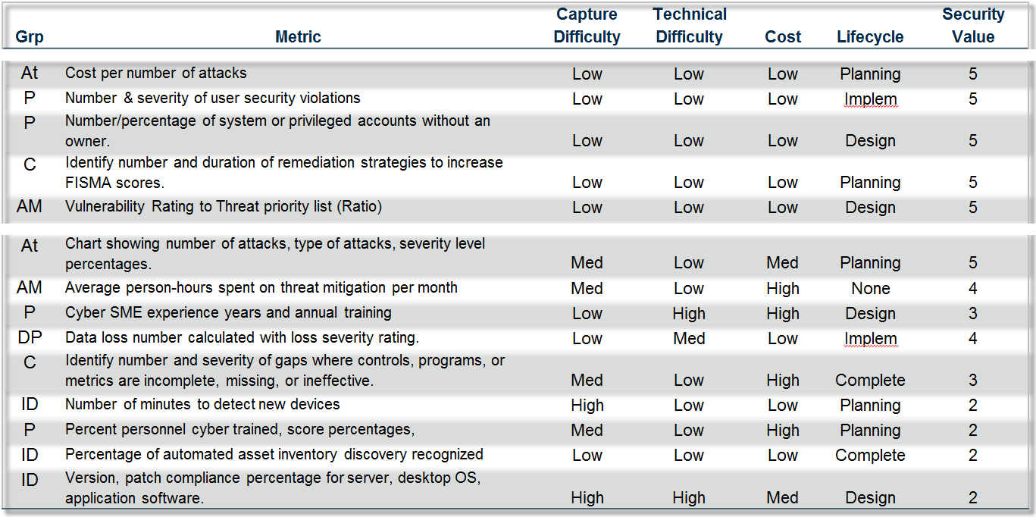
Identify Priority Metrics
Identify easy to capture metrics
…with a low cost
…and a high Security Value
Identify metrics with best ROI

Slide 30
Metrics Implementation Tracking
High Priority Metrics
On Schedule | 18
Behind | 7
Overdue | 2
Low/Med Priority Metrics
On Schedule | 32
Behind | 9
Overdue | 4
Implementation of new metrics or updates to existing metrics can be monitored.
ID | Metric | Security Value | Lifecycle | Due Date | Days to Completion | Schedule
65 | Cost per number of attacks | 5 | Planning | 5/17/2015 | 224 | On Schedule
23 | Number & severity of user security violations | 5 | Implem | 11/22/2014 | 32 | Overdue
142 | Number/percentage of system or privileged accounts without an owner. | 5 | Design | 7/6/2015 | 281 | Behind
17 | Identify number and duration of remediation strategies to increase FISMA scores. | 5 | Planning | 1/27/2015 | 102 | On Schedule
84 | Vulnerability Rating to Threat priority list (Ratio) | 5 | Design | 12/13/2014 | 41 | Overdue3
116 | Chart showing number of attacks, type of attacks, severity level percentages. | 5 | Planning | 12/19/2014 | 38 | Overdue
37 | Average person-hours spent on threat mitigation per month | 4 | None | 2/28/2015 | None | Behind
91 | Cyber SME experience years and annual training | 3 | Design | 5/17/2015 | 228 | On Schedule
112 | Data loss number calculated with loss severity rating. | 4 | Implem | 4/3/2015 | 193 | On Schedule
14 | Identify number and severity of gaps where controls, programs, or metrics are incomplete, missing, or ineffective. | 3 | Complete | 9/11/2015 | 342 | On Schedule
77 | Number of minutes to detect new devices | 2 | Planning | 6/25/2015 | 256 | On Schedule
59 | Percent personnel cyber trained, score percentages, | 2 | Planning | 2/7/2015 | 134 | Behind
26 | Percentage of automated asset inventory discovery recognized | 2 | Complete | 3/24/2015 | 168 | On Schedule

Slide 31
Dashboard View
October 2016
Readiness
Response
Recovery
High
Med
Low
High
Med
Low
High
Med
Low
Technology
Process
People
Governance
Technology
Governance
Governance
Technology
Process
Process
People
People
Attack Curve
Analysis: Late August timeframe showed drop in Readiness, which caused increase in attack penetration, leading to increase costs. Situation resolved in Sept/Oct.
Readiness
Readiness
Readiness
Recovery
Cost
Readiness
Readiness
Recovery
Response
Recovery
Cost
Response
Response
Recovery
Cost
Readiness
Response
Response
Recovery
Cost
Response
Recovery
Cost
Cost
May 2016
June 2016
July 2016
Aug. 2016
Sept. 2016
Oct. 2016

Slide 32
NIST Framework Categories?
7 Metric Groups 25 Concern Areas
Attacks | Attacks/Breaches, Scans/Probes, APT, Malware
Awareness/Mitigation | CDM, Monitoring
 | Incidence Response
 | Threat Intel
Compliance | Compliance
Data Protection | Corporate/IP Data, PII, Leakage
Infrastructure, End-Point Devices | Backup
 | Cloud
 | E-Mail
 | Hardware
 | Mobile Device Management
 | Network Security
 | Software
 | Supply Chain
 | Tools
 | WiFi Security
Manage/Plan | Change Management
 | COOP
 | Management, Planning, Policy, Strategy, Leadership of Security
 | Security Architecture, Amount, ROI, Asset Value & Priority of Security
People | Identity Management
 | Qualified Personnel
 | Training
 | User Activities, Insider Threat
NIST Framework
Alternative (to previous page)
Should we organize the metric groups using the NIST framework:
1) Identify
2) Protect
3) Detect
4) Respond
5) Recover
If we do that, we’re in great shape for “protect” and probably “identify”, but really light on “detect, respond, and recover”).
I don’t think that’s a problem, but more of an observation.
Detect
Recover
Respond
Protect
Identify

Slide 33
Agenda
Traditional thinking, traditional metrics
Think like the CEO and CFO: Communicate leadership and value.
Effective metrics
Seven key metrics: secure business alignment
Recommendations
Notes:
To add or remove rows in the table:
Select the table. Your cursor will change to an icon of two lines and an arrow above and below will appear on mouse-over of the baseline of the row.
Right-click and select INSERT > ROW BELOW. Or DELETE ROW.
To add a row after the last row, you can press [Tab], and the cursor will go to a new row.
Highlighting new areas:
Select the bracket group from the right bracket.
Hold SHIFT and pull cursor down over the next bullet item.
Select the previously highlighted text and in the HOME tab unclick the [B] button for bold, and click on the [A] button and choose the gray swatch (Gray-50%, Accent 5) second to last in the top row of the palette.
Select the text for the newly highlighted area and click the [B] button for bold, and click on the [A] button and choose black.

Slide 34
Recommendations
In the near term, Security & Risk Professionals need to:
Step 4: Demonstrate business leadership as well as security leadership.
Step 3: Report monthly or quarterly to the executive or risk committee.
Interview the key business leaders in your organization. Find out what business metrics they care about.
Report each metric: strategic, operational, etc.
Pick five to seven key metrics from the categories outlined in this presentation and work from there. Less than five is too few. More than seven will dilute the impact.
Use the criteria outlined in this presentation and make sure they align with the goals of the organization.
Step 2: Move up the maturity ladder.
Prepare a continuous improvement plan that creates alignment between information security and the business over an 18- to 24-month period.
Meet regularly with executive and/or risk committee members outside of formal executive or risk committee meetings.
Use the same seven key metrics in these conversations as well.
Don’t be afraid to change or tweak metrics that outlive their ability to demonstrate business and security value.
Step 1: Identify your organization’s priorities.
Show the key trends of each metric and its performance against objectives.
Conduct a four- to six-week metrics strategy assessment.

Slide 35
Recommendations
In the medium term in the next three to four years, Security & Risk Professionals need to:
Continue to mature the information security organization
Enhance the continuous improvement plan
Introduce performance improvement (Six-Sigma, TQM, etc.)
Embrace Enterprise Security Architecture standards.
Automate
Reporting,
Policies and Controls
Security Awareness Training
Compliance Activities

