Slide 1

The Impact of the Crooked “E”
The Enron Fraud and Scandal And What It Means to Business Today
Ed Ferrara
MIS5208 – Project 1 – Examples of Corporate Fraud
eferrara@temple.edu

Slide 2
Agenda
Facts About Enron – Company History
The Players – The Executives
Enron – So Many Dimensions of Fraud
A Chronology of Enron’s Collapse
The Aftermath
What It Means
References
Appendix A – Other perpetrators

Slide 3
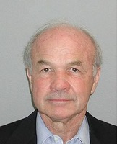
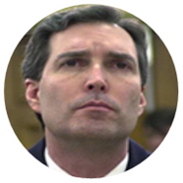
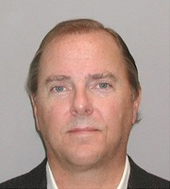
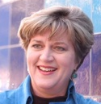
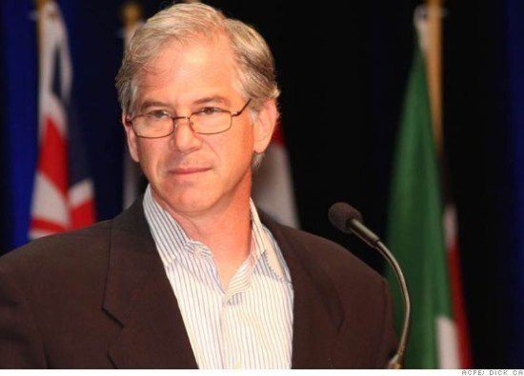
The Enron Players – The Executives
Ken Lay – Enron Chairman and CEO
Convicted on 29 criminal counts including conspiracy, securities and wire fraud. Dies in Aspen Colorado on July 5 2006 while awaiting sentencing for his convictions.¹
David Duncan – Andersen Partner – Enron
Partner responsible for Enron. Fired for failure to exercise “due professional care and the necessary skepticism”. Pled guilty to obstruction of justice – later rescinded plea, and struck deal with SEC.⁴
Jeffrey Skilling – Enron CEO
Convicted for fraud, conspiracy, insider trading and lying to auditors in the largest corporate fraud in history. More than 4,000 Enron employees lost their jobs, many lost their life savings, when Enron declared bankruptcy in 2001. Investors lost billions of dollars.²
Sherron Watkins – Enron VP Internal Audit
Watkins, who has never been charged with insider trading, sold almost $50,000 in stock after her August 2001 meeting with Lay — and before Enron shares became worthless months later. “No,” she told prosecutor John Hueston when he asked her if her stock sales were proper. “I had more information than the marketplace did.”⁵
Andrew Fastow
Charged with 78 counts of fraud due to his role in using off-balance sheet entities that did business with Enron. Disguised the company’s financial condition, pled guilty to two counts, forfeited $30 million, and agreed to testify as a government witness.³
Theft
(Misappropriation)
Corruption
Deceptive Statements
A complete list of executives involved in the fraud please see Appendix A.

Slide 4
Enron – So Many Dimensions of Fraud¹
Enron’s Multi-dimensional fraud
Energy Price Manipulation
Financial Statement Fraud
Securities Fraud
Wire Fraud
Stock Price Manipulation

Slide 5
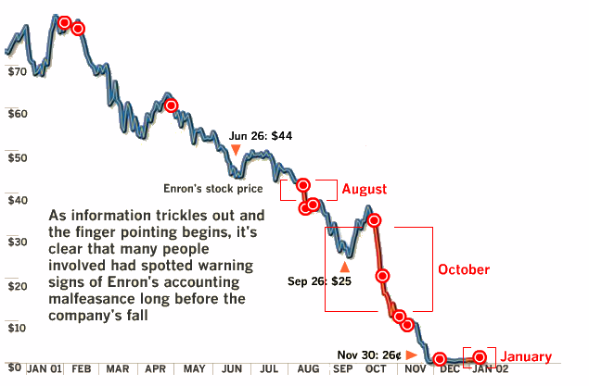
A Chronology of Enron’s Collapse¹
Feb 5
Andersen discusses dropping Enron as a client.
Feb 12
Jeffrey Skilling becomes CEO
May
Vice Chair Clifford Baxter complains about the “appropriateness” of Enron’s partnerships
Aug 15
Lay receives a warning letter from Sherron Watkins indicating improper accounting
Aug 20, 21
Lay sells 93000 shares – earns $2M, Urges employees to buy more stock
Oct 16
Enron reveals $1.2B loss of shareholder value
Oct 23
Andersen accelerates the shredding of Enron related documents
Nov 8
Andersen receives SEC subpoena, Enron admits inflating income by $600M since 1997
Dec 2
Enron files for bankruptcy
Jan 15
Enron suspended from NYSE

Slide 6
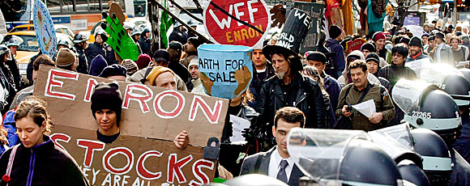
The Aftermath
“in my opinion, the problem today is 10 times worse than when Enron had its implosion … The things that Enron did, and that I did, are being done today, and in many cases they’re being done in such a manner that makes me blush — and I was the CFO of Enron.” He cited the continuing widespread use of off-balance-sheet vehicles, as well as inflated financial assumptions embedded in corporate pension plans. – Andrew Fastow ²
“I didn’t set out to commit a crime. I certainly didn’t set out to hurt anyone. When I was working at Enron, you know, I was kind of a hero, because I helped the company make its numbers every quarter. And I thought I was doing a good thing. I thought I was smart. But I wasn’t.” – Andrew Fastow ¹

Slide 7
What It Means
The Enron case is a classic example of the fraud triangle at work.
Companies today need to be exceptionally vigilant. It is too easy (seemingly) for corporate officers to commit fraud.
Fraud occurs at all levels of an organization. In Enron’s case it occurred at the highest levels of the company. Even those entrusted to protect the company from malfeasance (Sherron Watkins) were not immune to means, motive (pressure) and opportunity.
Sarbanes-Oxley signed into law in 2002 was passed by the US Congress in direct response to scandals such as Enron. The act requires¹:
CEO and CFO must review all financial reports.
Financial report does not contain any misrepresentations.
Information in the financial report is "fairly presented".
CEO and CFO are responsible for the internal accounting controls.
CEO and CFO must report any deficiencies in internal accounting controls, or any fraud involving the management of the audit committee.
CEO and CFO must indicate any material changes in internal accounting controls.
Integrity?
Opportunity
Weak Internal Process
& System Controls
Weak External Process & System Controls
Means
Motive
(Pressure)
Access:
Physical
System
Process
Personal
Gain
Classic Criminal & Fraudulent Activity²

Slide 8
Thank you

Slide 9
Endnotes
Slide 3
¹ Suddath, C. (2010). Hey, Hey, Hey, Goodbye - Kenneth Lay - Enron. Time. Retrieved from http://content.time.com/time/specials/packages/article/0,28804,2009445_2009447_2009502,00.html
² Smith, A. (2013). Enron convict Skilling to get out of jail early. CNN Money. Retrieved from http://money.cnn.com/2013/05/08/news/companies/skilling-enron/index.html
³Elkind, P. (2013). The confessions of Andy Fastow. Fortune. Retrieved from http://fortune.com/2013/07/01/the-confessions-of-andy-fastow/
⁴Reuters (2008). Accountant and S.E.C. Reach Deal in Enron Case. The New York Times. Retrieved from http://www.nytimes.com/2008/01/29/business/29enron.html?_r=0
⁵Associated Press. (2006). Enron whistleblower tells of ‘crooked company’ - Former manager, accountant Lay, Skilling ignored their warnings. NBCNews.com. Retrieved from http://www.nbcnews.com/id/11839694/ns/business-corporate_scandals/t/enron-whistleblower-tells-crooked-company/#.VOoEUPnF_18
Slide 4
¹ Elkind, P.; Gibney, Alex; McLean, Bethany. (2005). Enron: The Smartest Guys In The Room.
Slide 5
¹ Time Magazine. (2005). Enron’s Collapse. Time. Retrieved from http://content.time.com/time/interactive/0,31813,2013797,00.html
Slide 6
¹ Elkind, P. (2013). The confessions of Andy Fastow. Fortune. Retrieved from http://fortune.com/2013/07/01/the-confessions-of-andy-fastow/
² Ibid.
Slide 7
¹ Sarbanes Oxley 101. (2015). Sarbanes-Oxley Act Summary of Major Sections. Retrieved from http://sarbanes-oxley-101.com/sarbanes-oxley-compliance.htm
² Coderre, D. G. (2009). Computer Aided Fraud Prevention and Detection: A Step by Step Guide. John Wiley & Sons, Inc.
Appendix A
¹ Associated Press. (2005). A look at those involved in the Enron scandal. USA Today. Retrieved from http://usatoday30.usatoday.com/money/industries/energy/2005-12-28-enron-participants_x.htm

Slide 10
Appendix A
Other Enron Guilty Pleas
December 2005: Former Enron chief accounting officer Richard Causey. Originally indicted in January 2004, Causey was part of a unified defense team with Skilling and Lay for nearly two years until he decided to plead guilty to securities fraud. July 2005: Christopher Calger, a former executive in Enron's trading business, pleaded guilty to participating in an asset sale scheme to recognize earnings prematurely and improperly. October 2004: Timothy DeSpain, former assistant treasurer, pleaded guilty to conspiracy, and admitted lying or withholding pertinent information from credit rating agencies at the request of multiple superiors so the energy giant's financial picture appeared healthier than it was. August 2004: Kevin Hannon, former chief operating officer for the broadband unit, pleaded guilty to conspiracy for scheming with Rice and others to tout Enron's broadband network as having capabilities it didn't have to impress analysts and inflate company stock. August 2004: Mark Koenig, former head of investor relations, pleaded guilty to aiding and abetting securities fraud. August 2004: John Forney, former energy trader, pleaded guilty to wire fraud for manipulating energy markets during California's power crisis of 2000-2001 July 2004: Kenneth Rice, former broadband unit CEO, pleaded guilty to securities fraud. Admitted to conspiring with others to describe Enron's network control software as revolutionary and the network as up and running when neither was true so Enron stock would rise and he could profit from sales of inflated shares. May 2004: Paula Rieker, former No. 2 executive in investor relations. Pleaded guilty to insider trading for selling shares in mid-2001 upon learning that Enron's broadband unit lost more money than publicly disclosed. | January/May 2004: Lea Fastow, former assistant treasurer and wife of former finance chief Andrew Fastow, who quit Enron in 1997. Pleaded guilty first to a felony tax crime, admitting to helping hide ill-gotten gains from her husband's schemes from the government. Withdrew plea, then pleaded guilty in May to a newly filed misdemeanor tax crime. Released in July 2005 from year-long prison sentence. October 2003: David Delainey, former head of Enron's trading and money-losing retail energy units. Pleaded guilty to insider trading. September 2003: Ben Glisan Jr., former Enron treasurer, pleaded guilty to conspiracy. Admitted to helping design financial deals that enriched him and illegally kept investment losses off or manipulated Enron's books. Went straight to prison for a five-year term. Began cooperating with investigators in early 2004. February 2003: Jeffrey Richter, former Enron trader. Pleaded guilty to wire fraud, admitting to manipulating the California power market. November 2002: Larry Lawyer, pleaded guilty to filing false tax returns that didn't identify more than $79,000 in income over four years he received as "gifts" from Kopper for his work in one of Fastow's schemes. October 2002: Timothy Belden, former top Enron trader. Pleaded guilty to wire fraud for participating in trading schemes to manipulate California power markets. August 2002: Michael Kopper, former top Fastow aide. First Enron insider to plead guilty; pleaded guilty to two counts of conspiracy. Admitted to helping Fastow carry out schemes to help Enron manipulate its books while skimming millions for himself, Fastow and selected friends and colleagues.

