Slide 1
MIS 5208
Week 8: The Cyber Security Kill Chain
Ed Ferrara, MSIA, CISSP
eferrara@temple.edu

Slide 2
Agenda
What do Cyber Attackers Want?
How do they do what they do?
About the Cybersecurity Kill Chain

Slide 3
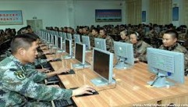
Serious Threats
Chinese Military Cyber-Force
Anonymous
Organized Crime
Technology as an Instrument
Fraud
Identity theft
Intellectual property infringement
Money laundering
Drug trafficking
Human trafficking
Organized crime activities
Child sexual exploitation
Cyber bullying
Technology as a Target
Hacking
Criminal botnets
Malware
Distributed Denial of Service
Russian Hacking
Syrian Electronic Army

Slide 4
Advanced Persistent Threats
Advanced
Broad list of attack types:
Technical
Social engineering
Malware
Persistent
Clearly defined mission
Long-term goals
Long term implications
(e.g. In the nation state sense: bugging and adversary’s embassy)
Threat
Intent to do large scale damage directed at:
Intellectual property
Business operations
"In 80 percent of the network compromises Mandiant has observed in the biotechnology and pharmaceutical industries, the threat activity was associated with Chinese government-sponsored Advanced Persistent Threat [APT] groups," Senior Threat Analyst Laura Galante told BioWorld Today. There may be as many as 20 such groups operating in China.”
“The increased activity against biotechnology firms coincided with the inclusion of pharmaceuticals and health care as strategic growth industries in China's 12th Five Year Plan (FYP), that covers 2011-2015.”
Source: http://www.bioworld.com/content/us-biopharma-firms-hit-cyber-attacks-china-0

Slide 5
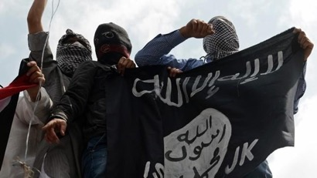
A cyber war could be disastrous
Important Considerations
Prepare for more-frequent and destructive nation-state and organized crime sponsored cyberattacks.
Understand that governments will now respond to cyberattacks aggressively.
Antivirus companies now report that they are struggling to classify and combat an average of 82,000 new malicious software variants attacking computers every day.
A large percentage of these strains are designed to turn infected computers into spam zombies that can be made to do the attacker’s bidding remotely.
Security giant McAfee said it detected more than twenty-five million new pieces of malware in the fourth quarter of 2014.²
1 Source: Bennett, Cory; Vlebeck, Elise. “Isis Preps for Cyberwar.” The Hill, 2015. 2 2014.Krebs, Brian (2014-11-18). Spam Nation: The Inside Story of Organized Cybercrime-from Global Epidemic to Your Front Door (pp. 4-5). Sourcebooks.

Slide 6
Virus Attack Activity

Slide 7
Using Data To Disrupt the Kill Chain

Slide 8
Changing Threat Environment
Hackers make more selling tools …
Vandalism
Theft
Tool Developers
Tools Sold & Licensed to Less Experienced Criminals
Personal
Gain
Motivation
Personal
Fame
Curiosity
Script
Kiddy
Hobbyist
Expert
Attacker Expertise

Slide 9
Malware Development Process
Development
Create malicious tool
Evasion
Obfuscate malware, create permutations
Q&A
Deployment
Deploy undetected samples
Test against detection engines

Slide 10
Underground Market

Slide 11
Tyupkin ATM Malware for Sale

Slide 12
Hansa

Slide 13
Malware Market
http://hansamkt3iph6sbb.onion/category/84/

Slide 14
Attacker vs. Defender
Attacker View
Attack Detection / Prevention
Breach Detection
Prepare Attack Method / Tools
Detection Evasion
Target Exploitation
Value Extraction
Defender View

Slide 15
Cyber Kill Chain
Step 1: Reconnaissance. The attacker gathers information on the target before the actual attack starts. He can do it by looking for publicly available information on the Internet.
Step 2: Weaponization. The attacker uses an exploit and creates a malicious payload to send to the victim. This step happens at the attacker side, without contact with the victim.
Step 3: Delivery. The attacker sends the malicious payload to the victim by email or other means, which represents one of many intrusion methods the attacker can use.
Step 4: Exploitation. The actual execution of the exploit, which is, again, relevant only when the attacker uses an exploit.
Step 5: Installation. Installing malware on the infected computer is relevant only if the attacker used malware as part of the attack, and even when there is malware involved, the installation is a point in time within a much more elaborate attack process that takes months to operate.
Step 6: Command and control. The attacker creates a command and control channel in order to continue to operate his internal assets remotely. This step is relatively generic and relevant throughout the attack, not only when malware is installed.
Step 7: Action on objectives. The attacker performs the steps to achieve his actual goals inside the victim’s network. This is the elaborate active attack process that takes months, and thousands of small steps, in order to achieve.

Slide 16
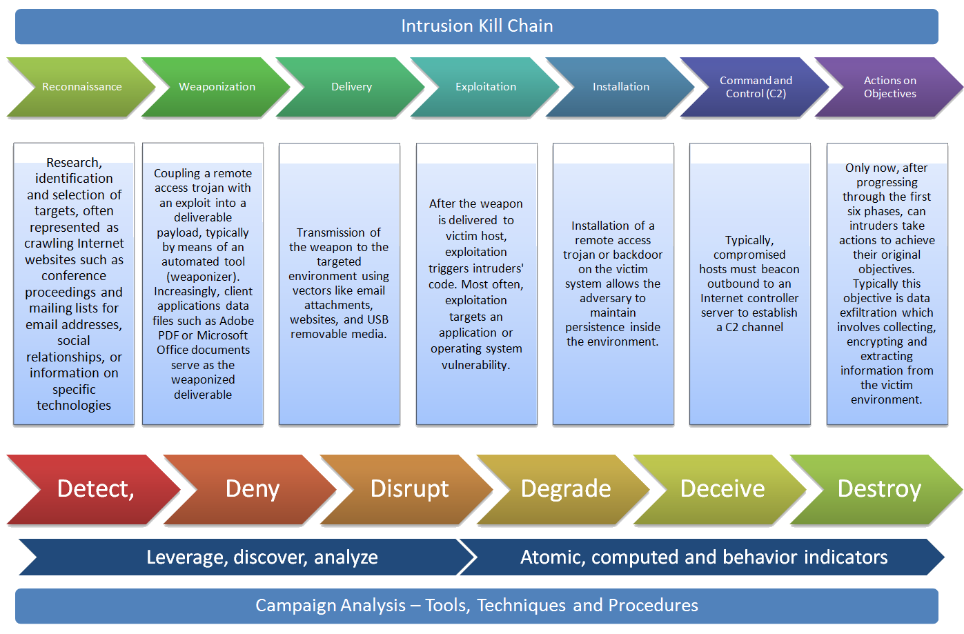
Cyber Kill Chain

Slide 17
Kill Chain Value
Post-Incident Analysis
The Kill Chain model systematically breaks down the attack. Using the KC as a framework to answer questions as to how the attack played out, and dissecting each step for what the adversary did and why it worked, may provide a wealth of understanding of the attack, the actor, and what should be done afterwards.
Communication
The Kill Chain offers a simple and powerful way to look at a very complex situation and tell a story. In a world driven by PowerPoint presentations, you can easily explain the concepts of the KC in terms that everyone will understand, without getting technical, and follow a linear approach to explain the details of the attack to your audience.
http://www.darkreading.com/attacks-breaches/leveraging-the-kill-chain-for-awesome/a/d-id/1317810

Slide 18
Splunk and the Kill Chain
There are four classes of data that security teams need to leverage for a complete view:
log data
binary data (flow and PCAP)
threat intelligence data
and contextual data.
If any of these data types are missing, there’s a higher risk that an attack will go unnoticed.
These data types are the building blocks for knowing what’s normal and what’s not in your environment.
This single question lies at the intersection of both system availability (IT operations and application) and security use cases.

Slide 19
Splunk and the Kill Chain
Effective data-driven security decisions require:
Tens of terabytes of data per day without normalization
Access data anywhere in the environment, including:
Traditional security data sources
Personnel time management systems
HR databases
Industrial control systems
Hadoop data stores and custom enterprise applications that run the business
Delivers fast time-to-answer for forensic analysis and can be quickly operationalized for security operations teams
Makes data more available for analysis and helps staff view events in context.
https://www.splunk.com/web_assets/pdfs/secure/Splunk_for_Security.pdf

Slide 20
Thank you

