Slide 1
Intro to Ethical Hacking
MIS 5211.001
Week 2
Site:

Slide 2
Conference Opportunity
BSides 2014 in Delaware
Link: http://www.securitybsides.com/w/page/81424469/BSidesDelaware2014
Past presentations are available on YouTube: http://www.youtube.com/user/BSidesDE

Slide 3
Tonight's Plan
In the news
Cyber Crime Laws
Network Components and their impact on penetration testing
Linux fundamentals

Slide 4
In The News
Submitted
http://www.wired.com/2014/08/car-hacking-chart/
What I noted
http://www.popsci.com/article/technology/mysterious-phony-cell-towers-could-be-intercepting-your-calls
http://krebsonsecurity.com/2014/09/banks-credit-card-breach-at-home-depot/

Slide 5
Cyber Crime Laws
Computer Fraud and Abuse Act (1030)
Obtaining National Security Information
Accessing a Computer and Obtaining Information
Trespassing in a Government Computer
Accessing to Defraud and Obtain Value
Damaging a Computer or Information
Trafficking in Passwords
Threatening to Damage a Computer
Attempt and Conspiracy

Slide 6
Cyber Crime Laws
Wiretap Act (2511)
Unlawful Access to Stored Communication (2701)
Identity Theft (1028)
Access Device Fraud (1029)
CAN-SPAM Act (1037)
Wire Fraud (1343)
Communication Interference (1362)
Source: Prosecuting Computer Crimes
http://www.justice.gov/criminal/cybercrime/docs/ccmanual.pdf

Slide 7
Cyber Crime Laws
Electronic Communications Privacy Act (2510)
Makes intercepting cell phones illegal
Cyber Security Enhancement Act of 2002 (145)
Life in prison if cause or attempt to cause a death
An amendment to USA Patriot Act

Slide 8
Sate Cyber Crime Laws
Many (Most) states have their own laws
In PA
Tit. 18 §7601
Misdemeanor - Unlawful transmission of e-mail is misdemeanor of 3rd degree; unless causes damage of $2,500 or more, then misdemeanor of 1st degree.
Felony - Unlawful use, disruption of service, theft, unlawful duplication, trespass and distribution of virus are felonies of 3rd degree
Source: http://criminallaw.uslegal.com/cyber-crimes/

Slide 9
International Cyber Crime Laws
Penetration testers need to comply with applicable laws in:
Country they are working in
Country or Countries the systems targeted are located in
Country or Countries they traverse
If any of the above take you out of the US, need to contact an appropriate lawyer.

Slide 10
Questions
?

Slide 11
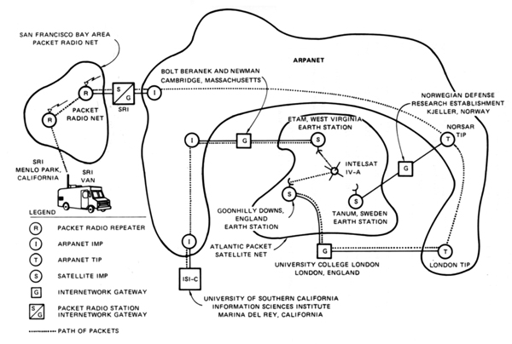
Networking
The very first internetworked connection:
Source: http://en.wikipedia.org/wiki/Internet_protocol_suite

Slide 12
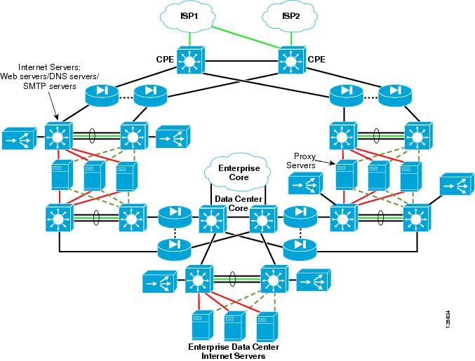
Networking
Today
Source: http://www.cisco.com/c/en/us/td/docs/solutions/Enterprise/Data_Center/ServerFarmSec_2-1/ServSecDC/2_Topolo.html

Slide 13
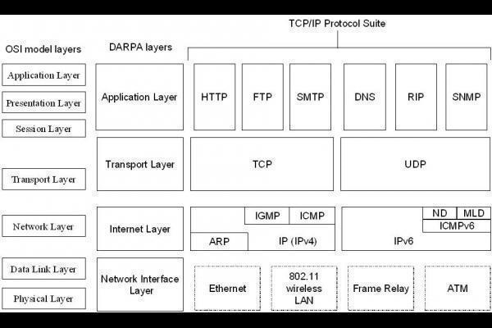
Internet Protocol Suite
How Data fits together:

Slide 14
A word about Ports
Ports – logical assignment to packets of data
Used to distinguish between different services that run over transport protocols such as TCP and UDP
IANA Registry:
http://www.iana.org/assignments/service-names-port-numbers/service-names-port-numbers.xhtml?&page=1

Slide 15
Protocols
What we will cover
IP
ICMP
UDP
TCP
ARP

Slide 16
IP Protocol
Internet Protocol
Primary protocol of the Internet Layer of the Internet protocol
Three main functions
For outgoing packets – Select the next hop host (Gateway)
For incoming packets – Capture the packet and pass up the protocol stack as appropriate
Error detection

Slide 17
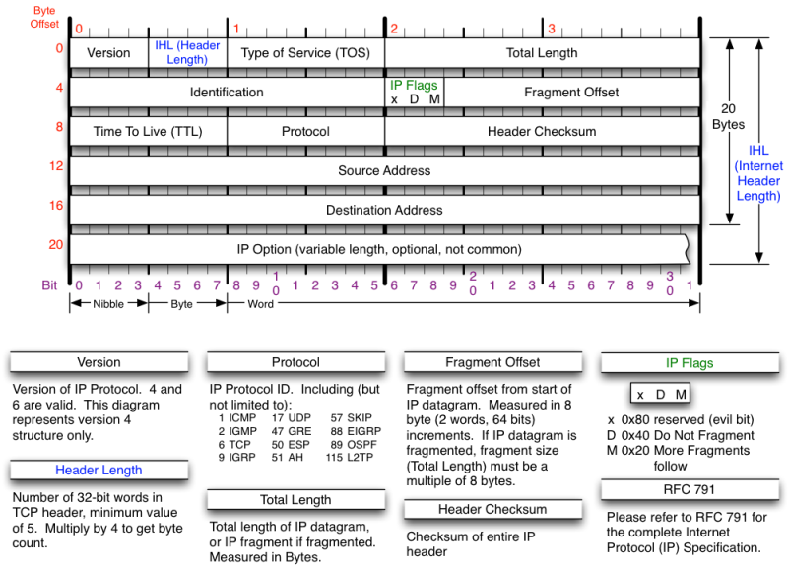
IP Protocol
Source: http://nmap.org/book/tcpip-ref.html

Slide 18
ICMP Protocol
Internet Control Message Protocol
Used by network devices to communicate status
Not typically used to exchange data
Does not have a “port” assignment
Not usually accessed by end-users accept for:
ping
traceroute

Slide 19
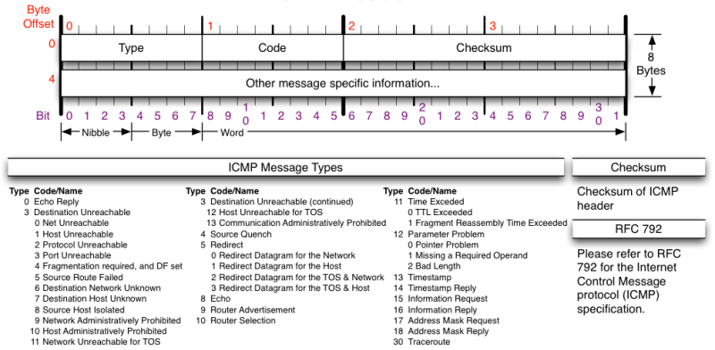
ICMP Protocol
Source: http://nmap.org/book/tcpip-ref.html

Slide 20
UDP Protocol
User Datagram Protocol
Simple transmission model with limited mechanisms
No guarantee of delivery
No acknowledgement of receipt
Does include checksum and port numbers

Slide 21
UDP Protocol
Source: http://nmap.org/book/tcpip-ref.html

Slide 22
TCP Protocol
Transmission Control Protocol
Sometimes called TCP/IP
Provides reliable, ordered and error checked delivery of a stream of data (or Octets) across local area networks, intranets, and public internet
This is the protocol used for HTTP, HTTPS, SMTP, POP3, IMAP, SSH, FTP, Telnet, and others

Slide 23
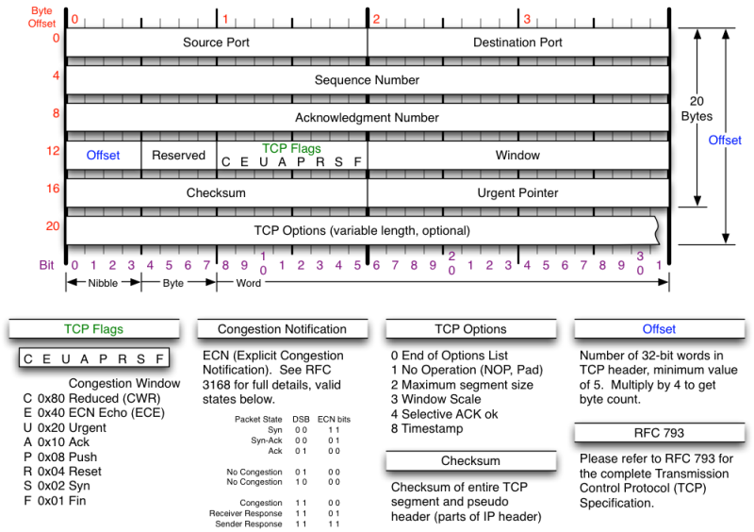
TCP Protocol
Source: http://nmap.org/book/tcpip-ref.html

Slide 24
ARP Protocol
Address Resolution Protocol
Used to convert an IP address to a MAC Address
MAC Address is the unique hardware address written into the hardware of every network card
Example: 6C-62-6D-05-F9-18
Tells me my Network Card comes from Micro-Star INTL CO., LTD in Taiwan (based on 6C-62-6D)
Can be altered by software

Slide 25
Network Components
Switches
Routers
Firewalls
Standard
Next Generation
Web Application
Load Balancers
Proxies
Reverse Proxies
DNS

Slide 26
Switches
Used to connect devices together on a network
Depending on functionality can operate at different layers of the OSI model
“Layer 1” – Hub – Traffic is not managed – Every packet repeated to every port
“Layer 2” – Data Link Layer – Some management – Switch knows MAC Address of locally connected devices and sends appropriate packets
“Layer 3” – Switch understands “routing” and knows what packets to pass out of the local segment
Microsoft Explanation of OSI Model : http://technet.microsoft.com/en-us/library/cc959881.aspx

Slide 27
Routers
Forwards packets between computer networks
Works to keep localized traffic inside and only passes traffic intended for targets outside the local network
Boundary between “Routable” and “Non-Routable” IP addressing

Slide 28
Non-Routable Addressing (Private)
10.0.0.0 to 10.255.255.255
Class A
16,777,216 addresses
172.16.0.0 to 172.31.255.255
Class B
1,048,576 addresses
192.168.0.0 to 192.168.255.255
Class C
65,536 addresses

Slide 29
Firewalls (Standard)
Standard Enterprise Firewalls are “2nd Generation”, implies stateful
Filters traffic based on:
Address
Port
Stateful: Retains enough data about previous packets to understand connection state

Slide 30
Firewalls (Next Generation)
Extend operation into the Application layer
Provides for Application layer filtering
Understands certain applications and protocols
Can determine if data inside a packet is consistent with the application or protocol

Slide 31
Firewalls (Web Application)
Similar to Next Generation, but retains even more information around “normal” web site activity
Builds a profile of how users interact with a website, and what the traffic should look like
Generates alerts when patterns change
Can generate false positives if web site undergoes high volumes of change

Slide 32
Network Address Translation (NAT)
Modifies network addresses in the IP datagram
Translation – Replaces the IP address in the packet with another address
Obscures addressing behind the NAT device, typically a firewall
Can convert non-routable addresses to routable addresses
Means the address you see is not necessarily the address of the target device

Slide 33
Load Balancers
Distributes sessions across multiple server
User does not “Know” what server is in use
May terminate SSL connection for server, improving server performance
May apply additional SSL restrictions outside of certification rules
Internal tester can usually direct access to a particular machine or cell via alternate port

Slide 34
Proxies
Intermediary between client machines and the rest of the network or internet
Can function as a NAT device
May be an embedded function of a firewall or may be stand alone
Uses
Content filtering
Logging and/or monitoring
Can obfuscate internal network details

Slide 35
Reverse Proxies
Similar to proxy, but typically sits in front of servers
Uses
Hides details of server infrastructure
Can perform SSL termination function
Can reduce server load by caching
Can be embedded in a load balancer or firewall, or may be a stand-alone device

Slide 36
DNS
Domain Name System
Consists of a tree of domain names
Example
Root -> .edu -> temples.edu
Basically the phone book for the internet

Slide 37
Servers
Examples
File
Web
Application
Database
Log

Slide 38
Typical Web Arrangement

Slide 39
Security Technologies
Intrusion Detection Systems (IDS)
Intrusion Prevention Systems (IPS)
Network Behavioral Anomaly Detection (NBAD)
Data Loss Prevention (DLP)
Host Intrusion Detection (HIDS)
Host Intrusion Prevention (HIPS)
Baseline and Host File Integrity

Slide 40
IDS and IPS
Analyzes packets and matches to known signatures to either alert or block traffic
Basically a burglar alarm for the network

Slide 41
NBAD
Network Flow Analysis
Flow is metadata about network traffic passing through the infrastructure
System profiles “Normal” behavior and alerts on deviation from normal

Slide 42
DLP
Monitors for activity against “sensitive” data.
Can be on servers and hosts
Can be on network
Typically knows what confidential or personally identifiable information PII looks like
Format of Social Security Numbers
Format of account numbers
Key words like Confidential, Account, etc…

Slide 43
HIDS and HIPS
Similar to IDS and IPS, but resides on individual servers or workstations
Augments AV software
Can generate a lot of noise
Can interfere with Scanning and Penetration Testing

Slide 44
Baseline and Host File Integrity
Establishes a baseline configuration for servers and monitors for deviation
Develops signature for key files on systems and monitors for change
Can help ensure systems stay configured as desired.
Last line of defense to detect compromise of a system.

Slide 45
Questions
?

Slide 46
Linux
What is Linux
Open source operating system
Many similarities with UNIX
Why do we care
Some tools only available in Linux
Some tools work better in Linux
Best open source attack suites are built on Linux
Kali
Samurai WTF (Web Testing Framework)

Slide 47
Logging In
For Kali the default password is toor
For Samurai the default password is samurai

Slide 48
root
“root” is the base admin account on a Linux system.
Should not be used for routine operations

Slide 49
SUDO
Used to execute commands that require root privilege
Requires user to supply their password, not the root password

Slide 50
Changing Passwords (passwd)
“passwd” command is used to change passwords
Any user can change their password by typing passwd at the command prompt.
Will be prompted to enter new password twice
“root” or sudo user can change others passwords with command:
passwd [login_name]

Slide 51
Changing Accounts
“su” command allows you to jump to another user account (with appropriate password of course)
“whoami” command tells you who you are logged in as

Slide 52
Linux File System

Slide 53
Navigating File System
Command cd [directory_name] changes directory
Command cd.. Moves up one level
Command pwd tells you were you are
Command cd by itself takes you to your home directory

Slide 54
Viewing Directories
Command ls lists directory content
Flags
-l – details including permissions
-a – shows all files
When in doubt use command “man ls”, this gives you the manual or man page for the command

Slide 55
Output from ls -la

Slide 56
Make and Remove Directories
Command mkdir creates directory
As before man mkdir gives you the manual
Command rmdir removes directory

Slide 57
Make and Remove Directories

Slide 58
Locate and Find
Command locate checks an index on system to look for common items
Command find searches file system
On my test implementation, find required sudo privileges

Slide 59
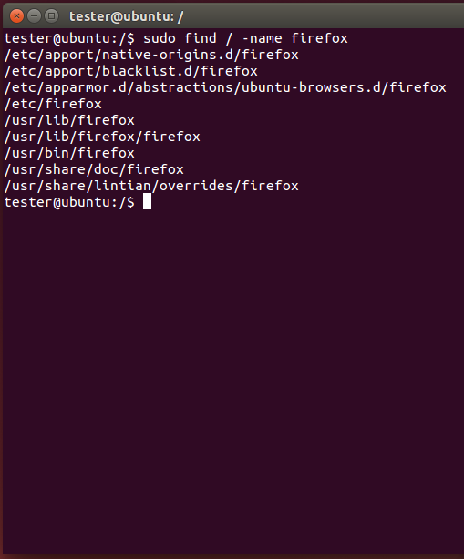
Locate and Find

Slide 60
Editing Files
Lots of choices, lets keep it simple
Command gedit opens a text editor
Command gedit test opens an existing file named test. If no such file exists, the file is created
Edit as wish, save when done

Slide 61
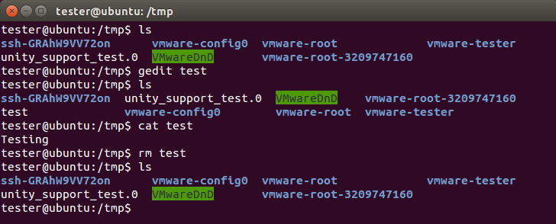
Editing Files

Slide 62
Viewing Files
Command cat shows content of a file

Slide 63
Looking at Output
Output often larger then screen
Commands less and more
Work similarly
less requires you hit q when done to return to command prompt
more dumps to command prompt when last screen is completed

Slide 64
Miscellaneous Commands
Command ps shows running processes
Lots of switches to refine results
Command CTRL-z interrupts running com
Command bg restores interrupted command to run in background
Command & tells job to run in background from the beginning
Command jobs shows jobs running
Command fg moves job to foreground

Slide 65
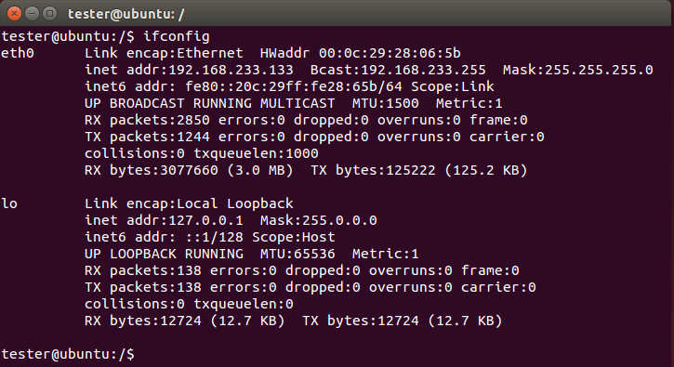
Network
Command ifconfig shows network configuration. Similar to ipconfig in windows

Slide 66
Netstat
Netstat prints information about the Linux networking subsystem. The type of information printed is controlled by the first argument, as follows:
(none) – By default, netstat displays a list of open sockets. If you don't specify any address families, then the active sockets of all configured address families will be printed.
--route , -r – Display the kernel routing tables. See the description in route(8) for details. netstat -r and route -e produce the same output.
--groups , -g – Display multicast group membership information for IPv4 and IPv6.
--interfaces, -I – Display a table of all network interfaces.
--masquerade , -M – Display a list of masqueraded connections.
--statistics , -s – Display summary statistics for each protocol.

Slide 67
Netstat

Slide 68
grep
grep searches the named input FILEs for lines containing a match to the given PATTERN. By default, grep prints the matching

Slide 69
Grep w/ netstat and ps
Try grep with netstat to see what is using http
netstat -nap | grep http
Try grep with ps to see if cron is running
ps aux | grep cron

Slide 70
Grep w/ netstat and ps

Slide 71
Going Further
Get VMWare and a Linux ISO
Kali
http://www.kali.org/downloads/
Ubuntu
http://www.ubuntu.com/download/desktop
Give it a try
All examples here where created in a clean, plain vanilla Ubuntu install

