Slide 1
Intro to Ethical Hacking
MIS 5211.001
Week 3
Site: http://community.mis.temple.edu/mis5211sec001f14/

Slide 2
Career Fair
Upcoming Career Fair for IT Students
September 24th
http://ibit.temple.edu/careerfair/

Slide 3
Tonight's Plan
Questions from last week
In the news
Google Hacking
Reconnaissance

Slide 4
Questions From Last Week
Weekly items
An article you found during the week related to hacking, pen-testing or that you think the class may find interesting.
Similar to the items in the news at the beginning of week 2's presentation
An observation and question from the reading.
Can post as comment to class blog, or send to me by e-mail

Slide 5
Questions From Last Week
MAC Address Assignments
Assigned by IEEE according to one of three rule
MAC-48
EUI-48
EUI-64 (New Standard)
Link for IEEE Site
http://standards.ieee.org/develop/regauth/oui/public.html
Questions From Last Week

Slide 6
Questions From Last Week
Cisco Guideline on Subnetting
http://www.cisco.com/c/en/us/support/docs/ip/routing-information-protocol-rip/13788-3.html

Slide 7
Questions From Last Week
Network Icons
Cisco
http://www.cisco.com/web/about/ac50/ac47/2.html
Microsoft
http://www.microsoft.com/en-us/download/details.aspx?id=4604

Slide 8
Questions From Last Week
Certifications
Starter Certs
CompTia’s Security+
CompTia’s Network+ or Cisco CCNA
Technical Certs
GIAC GSEC and GCIH
Higher Level Certs
ISC² CISSP
ISACA CISM

Slide 9
Questions From Last Week
Scripting
You will not need to write scripts for this course
You will likely find yourself looking at a few
Which scripting language to learn (Just my opinion)
Perl – The language of lots of tools – The language of Linux
Ruby – The language of many tools and “MetaSploit”
Python – The language of some tools
VBA – Microsoft’s Office language – Generally already installed in most enterprises
JavaScript – You can’t escape it, It’s everywhere – Especially if you move toward Web Application Testing

Slide 10
In The News
Submitted
https://www.trustedsec.com/uncategorized/powershell-reconnaissance/
http://www.csoonline.com/article/2604345/security-leadership/openssl-warns-vendors-against-using-vulnerability-info-for-marketing.html#tk.rss_news
http://thehackernews.com/2014/09/malware-can-bypasses-chrome-extension.html
http://www.technewsworld.com/story/80991.html
http://www.itsecurityguru.org/gurus/legalities-penetration-testing/#.VA_Wanl0yUl
http://www.darkreading.com/perimeter/mobile-cloud-partners-wheres-the-weak-link/d/d-id/1307064
http://www.theregister.co.uk/2014/09/03/car_makers_space_craft_manufacturers_infected_with_targeted_recon_tool/
https://twitter.com/hackappcom/status/505743531789406208
What I noted
http://krebsonsecurity.com/2014/09/in-wake-of-confirmed-breach-at-home-depot-banks-see-spike-in-pin-debit-card-fraud/
http://threatpost.com/research-finds-no-large-scale-heartbleed-exploit-attempts-before-vulnerability-disclosure/108161
http://arstechnica.com/tech-policy/2014/09/why-comcasts-javascript-ad-injections-threaten-security-net-neutrality/

Slide 11
Google Hacking
Search Bar Commands
-
Site:
Filetype:
Inurl:
Intitle:
Intext:
Allinurl:
Allintext:
Search Terms

Slide 12
-
Simple one that tells google to not include items that match what comes directly after “-”
Example:
Hacking –ethical – gives all results that include information about hacking as long as they do not include the term “ethical”

Slide 13
Site:
Site: restricts searches to a specific site
Examples
Site:edu – Restricts searches to only sites ending in .edu
Site:temple.edu – Restricts searches to a specific top level site
Site:mis.temple.edu –Restricts searches to a sub-site

Slide 14
Filetype:
Restricts searches to a specific file type
Examples
Filetype:pdf – Only responds with sites linked to Adobe documents with file extension of pdf
Filetype:xls – Only responds with sites linked to Microsoft spreadsheets documents with file extension of xls
Filetype:xlsx – Only responds with sites linked to Microsoft spreadsheets documents with file extension of xlsx – Excel’s newer file format

Slide 15
Inurl:
Restricts searches to sites where specific word or phrase is in the url
Examples
inurl:"/root/etc/passwd“
inurl:admin
inurl:j2ee/examples/jsp
inurl:backup

Slide 16
Intitle:
Restricts searches to sites where specific words are used in the title of a page
Examples
intitle:index.of
intitle:"Test Page for Apache"
intitle:"Apache Status"
intitle:"PHP Explorer"

Slide 17
Intext:
Restricts results to documents containing term in the text
Examples
intext:"root:x:0:0:root:/root:/bin/bash"
intext:"SteamUserPassphrase="
intext:"SteamAppUser=" -"username" -"user"
intext:"Usage Statistics for

Slide 18
Allinurl:
Restricts results to those containing all the query terms you specify in the URL
Examples
allinurl:/hide_my_wp=
allinurl:"/main/auth/profile.php"
allinurl:"owa/auth/logon.aspx"
allinurl:forcedownload.php?file=

Slide 19
Allintext:
Restricts results to those containing all the query terms you specify in the text of the page
Examples:
allintext: /iissamples/default/
allintext: "Please login to continue..."
allintext:"Browse our directory of our members top sites or create your own for free!"
allintext:"fs-admin.php"

Slide 20
Search Terms
Key search terms
“index of /”
“Please re-enter your password it must match”

Slide 21
Google Hacking References
GoogleGuide
http://www.googleguide.com/advanced_operators_reference.html
Exploit Database
http://www.exploit-db.com/
Wikipedia
http://en.wikipedia.org/wiki/Google_hacking
Google Hacking Volume 2
http://www.amazon.com/Google-Hacking-Penetration-Testers-Johnny/dp/1597491764/ref=sr_1_1?ie=UTF8&qid=1410311674&sr=8-1&keywords=google+hacking

Slide 22
Reconnaissance
Attacker gathers publicly available data
People
Corporate culture
Technologies in use
Terminology
This is an important step as it will help focus later activities

Slide 23
Inventory
Maintain an inventory of what you find
Keep a log bog
Create a spreadsheet
Whatever works for you
Record key information
IP Addresses
Target names
Search queries used
Oss in use
Known vulnerabilities
Any passwords found

Slide 24
More on Inventory
Leave room to annotate future information that may be discovered as you go
Examples:
Open ports from port scanning
Search from compromised hosts
Etc…

Slide 25
Competitive Intelligence
Think like a business competitor
Lines of business
Major products or services
Who’s in charge
Officers
VPs
Press Releases
Where are their physical locations
Who are the major competitors in there market place
The same kind of information you would gather for a job interview.

Slide 26
Search Engines
Don’t just use Google
Bing
Yahoo
Ask
DuckDuckGo
All search engines filter data, but they don’t all filter the same way

Slide 27
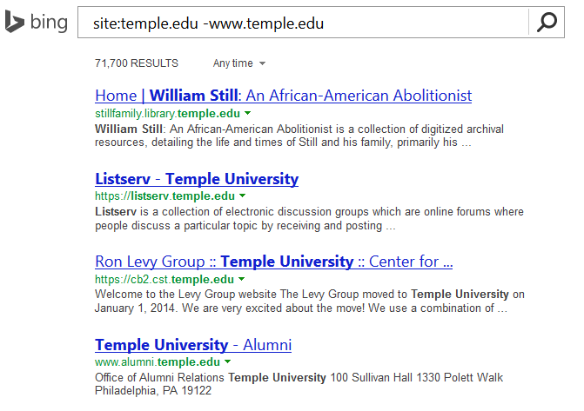
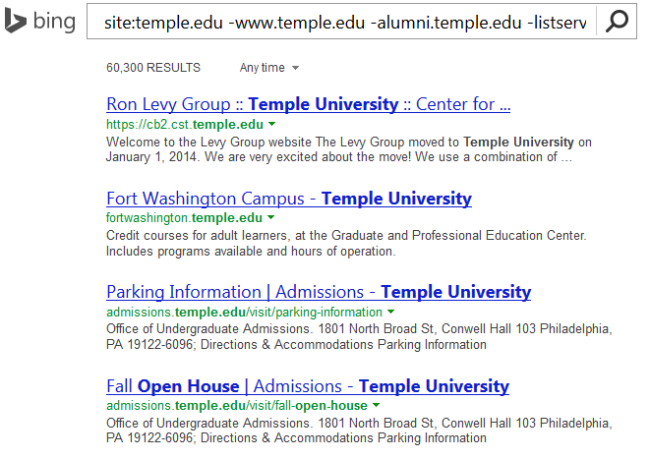
Google w/ “-”
Combine techniques from Google Hacking
Site:temple.edu -www.temple.edu

Slide 28
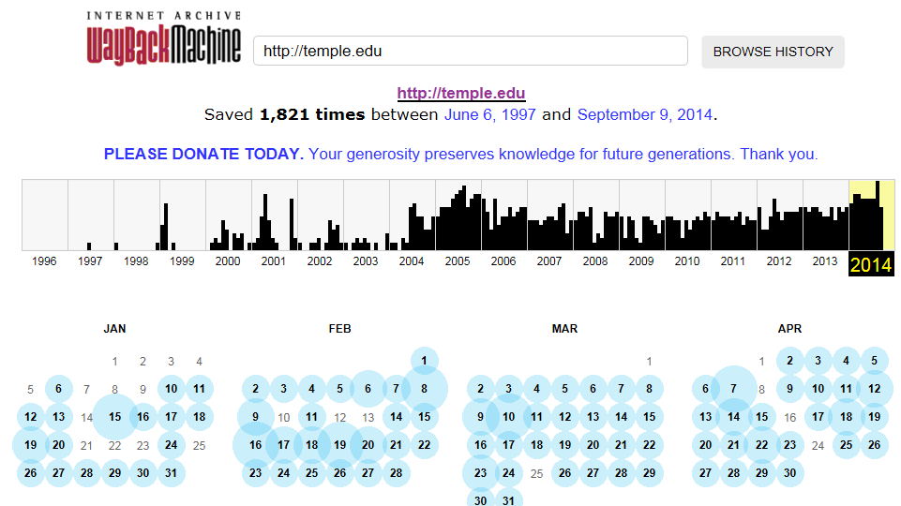
Older Versions of Websites
WayBack Machine
http://archive.org/web/web.php

Slide 29
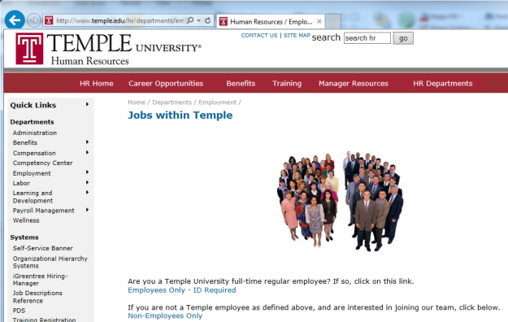
Open Job Posting
Job requirements can often provide insight into technologies in use, and where staffing shortages may result in weaknesses
Check multiple sites
Monster.com
Dice.com
Organizations site
http://www.temple.edu/hr/departments/employment/jobs_within.htm
Local job sites
http://regionalhelpwanted.com/philadelphia-jobs/?sn=83

Slide 30
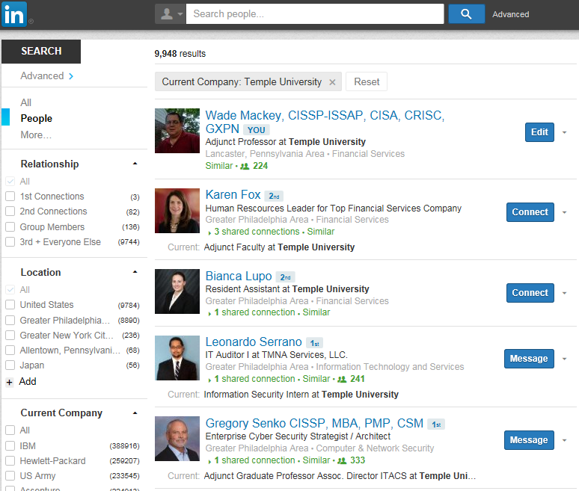
People
LinkedIn
Facebook

Slide 31
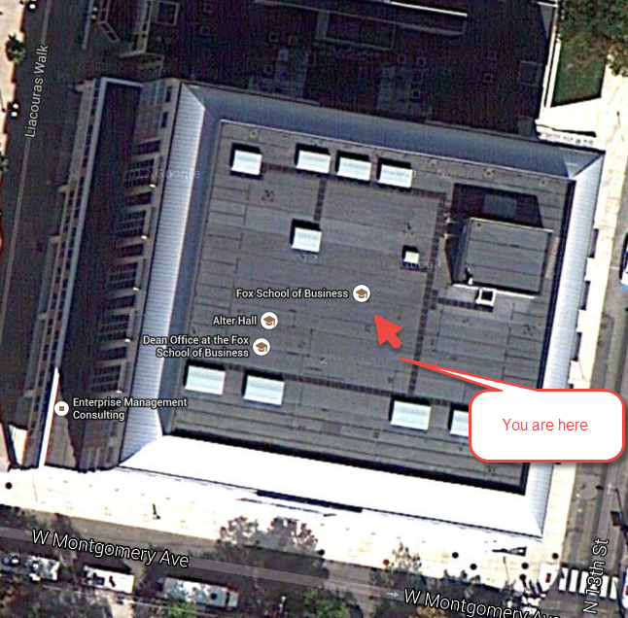
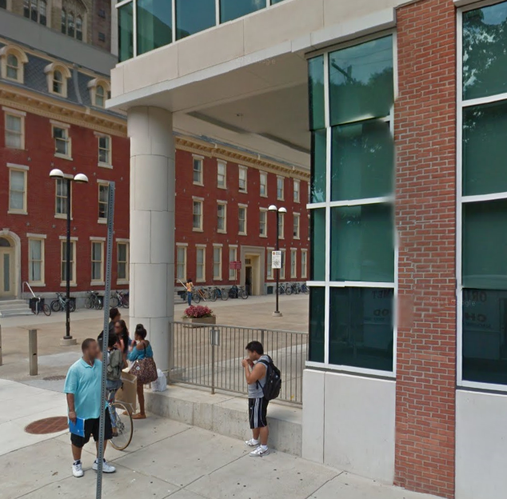
Don’t Forget About Maps
Google Maps
MapQuest
Google Earth

Slide 32
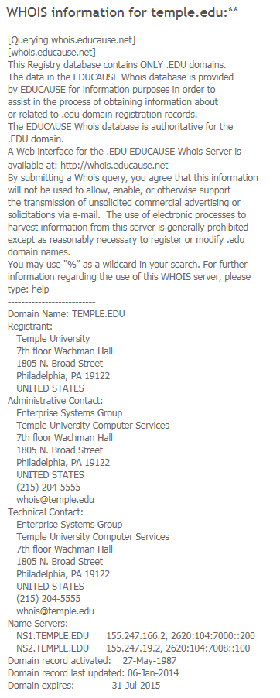
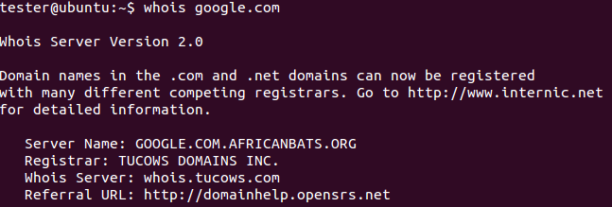
Whois
Whois
Database to lookup domain name, IP address and who registered the address
Web based or Command Line
whois google.com
http://www.networksolutions.com/whois/index.jsp

Slide 33
ARIN
American Registry for Internet Numbers
Regional Internet Registry for US, Canada, and many Caribbean islands
ARIN is one of five regional registries
Provides services related to the technical coordination and management of Internet number resources

Slide 34
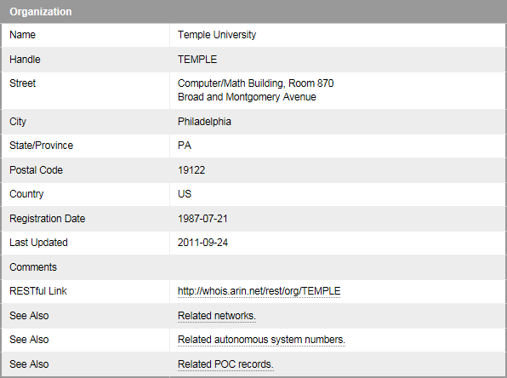
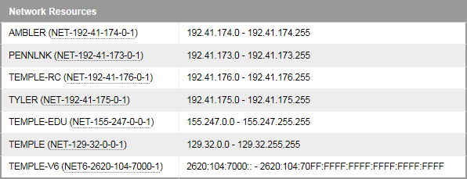
ARIN
Results

Slide 35
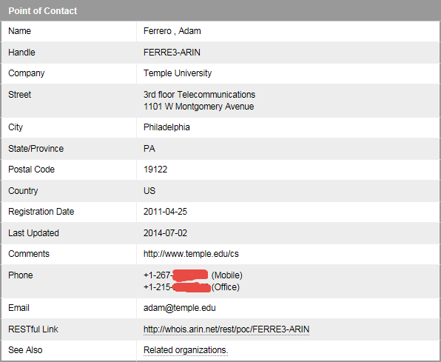
ARIN

Slide 36
DNS
Querying DNS Server
Examples
By domain name
Nslookup temple.edu OR nslookup ns1.temple.edu
Interactive
Nslookup
Followed by prompts
See next slide
Type exit to get out of interactive mode

Slide 37
DNS

Slide 38
Dig (Domain Information Groper)
The Dig command is used to gather additional DNS information
May also be used to make zone transfers.
Zone transfers may include details around other assets within an organization.
CAUTION, don’t go further then basic dig command on the next page as you may start triggering alerts in more security focused organizations.

Slide 39
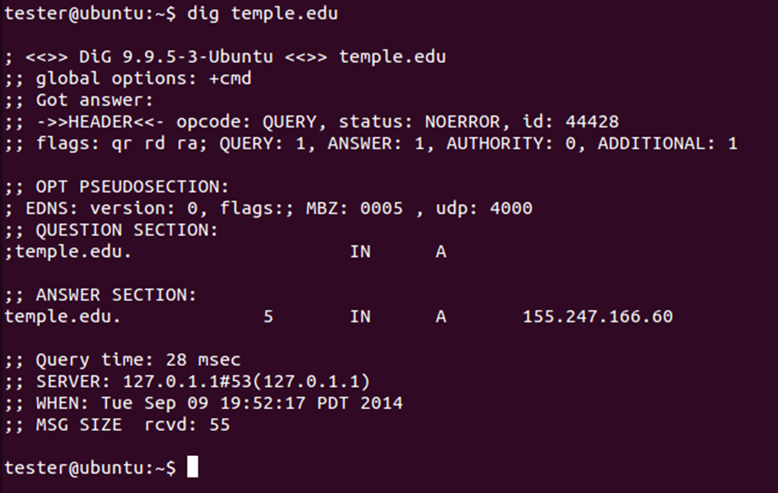
Dig
Example:

Slide 40
More on Dig
http://www.thegeekstuff.com/2012/02/dig-command-examples/
http://www.cyberciti.biz/faq/linux-unix-dig-command-examples-usage-syntax/

Slide 41
Windows Dig
Dig is available for windows 7
Site:
http://www.isc.org/downloads/bind/

Slide 42
DNS Query Websites
http://www.dnsstuff.com/tools
http://dnsquery.org/
http://network-tools.com/nslook/

Slide 43
More Tools
Sensepost
https://github.com/sensepost
BiLE-Suite – The Bi-directional Link Extractor
A suite of perl scripts to find targets related to a given site

Slide 44
Google Cache
The little green down arrow

Slide 45
Google Cache
&strip=1 – It’s magic
Right click the cache button and copy shortcut
Paste short cut into notepad and append &strip=1 to the end
Copy and paste into URL
Now you get Google’s cache without leaving a footprint in the target servers logs

Slide 46
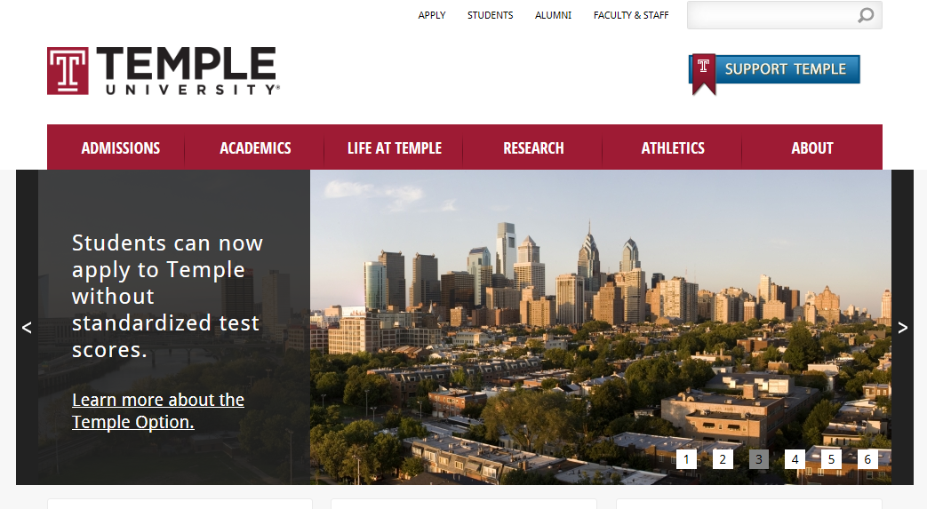
Google Cache (Example)
Without &strip=1

Slide 47
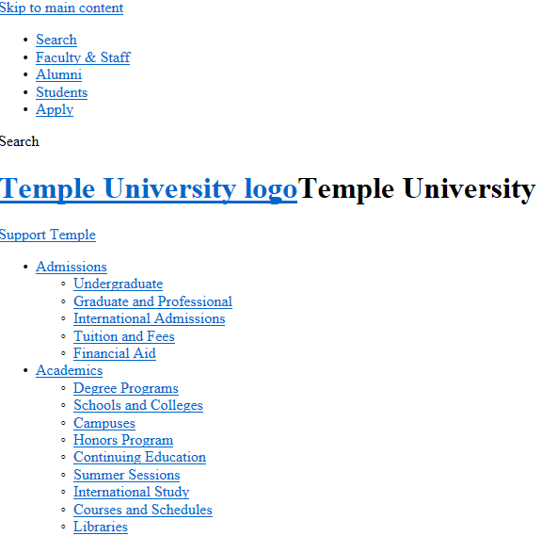
With &strip=1

Slide 48
Due for Next Week
1st formal assignment
From Syllabus
(student presentations) Reconnaissance exercise using only publicly available information, develop a profile of a public company or organization of your choosing
You may work in teams, or separately
One to two page Executive Summary
Short (no more then three slides, no welcome slide) presentation
See “Exercise Analysis” tab for more details

Slide 49
Questions
?

