Slide 1
Intro to Ethical Hacking
MIS 5211.001
Week 4
Site: http://community.mis.temple.edu/mis5211sec001f14/

Slide 2
Conference Opportunity
OWASP Philly
Lunch Meeting Thursday September 25th
Topic: Securing The Android Apps On Your Wrist and Face
Presenter: Jack Mannino
Link to Group: https://www.owasp.org/index.php/Philadelphia
Link to Event: http://www.eventbrite.com/e/owasp-philly-lunch-meeting-tickets-13142911803

Slide 3
Tonight's Plan
In the news
Student Presentations
Scanning
Types
TcpDump
Hping3
Beginning Nmap

Slide 4
In The News
Submitted
http://www.scmagazine.com/google-says-gmail-credential-dump-not-result-of-company-breach/article/371092/
http://articles.philly.com/2014-09-13/news/53855445_1_pennsylvania-health-system-patient-information-desktop-computer
http://www.darkreading.com/home-depot-breach-may-not-be-related-to-blackpos-target/d/d-id/1315636
http://thehackernews.com/2014/09/twitter-vulnerability-allows-hacker-to_16.html
http://betanews.com/2014/08/19/gchq-accused-of-scanning-entire-nations-for-hacking-vulnerabilities/
http://www.pcworld.com/article/2606962/apple-pay-could-put-an-end-to-data-breaches.html
http://www.cio.com/article/2683235/security0/how-to-choose-the-best-vulnerability-scanning-tool-for-your-business.html
What I noted
http://queue.acm.org/detail.cfm?id=2668966 Network Routing
http://www.bbc.com/news/technology-29203776 (Cannon Printer and Doom

Slide 5
Student Presentations

Slide 6
Scanning
Goals
Find live network hosts, Firewalls, Routers, Printers, etc…
Work out network topology
Operating systems used
Open ports
Available network services
Potential vulnerabilities
While minimizing the chance of disrupting operations

Slide 7
Type of Scans
Sweep – Send a series of probes (ICMP ping) to find live hosts
Trace – Use tools like traceroute and/or tracert to map network
Port Scanning – Checking for open TCP or UDP ports
Fingerprinting – Determine operating system
Version Scanning – Finding versions of services and protocols
Vulnerability Scanning

Slide 8
More on Types
Order works from less to more intrusive
Sweeps are unlikely to disrupt anything, probably will not even alert security systems
Vulnerability scans may cause system disruptions, and will definitely light up even a marginally effective security system

Slide 9
Targeting
Always target by IP address
Round Robbin DNS (Think basic load balancing) may spread packets to different machines and corrupt your results

Slide 10
Big Scans
Targeting a large number of addresses and/or ports will create a very long scan
Need to focus on smaller scope of addresses and a limited number of ports
If you have to scan large addresses space or all ports consider:
Multiple scanners
Distributed scanners (Closer to Targets)

Slide 11
Sniffers for Scanning
Some Pen Testers suggest running a sniffer to watch activity
Detect errors
Visualize what is happening

Slide 12
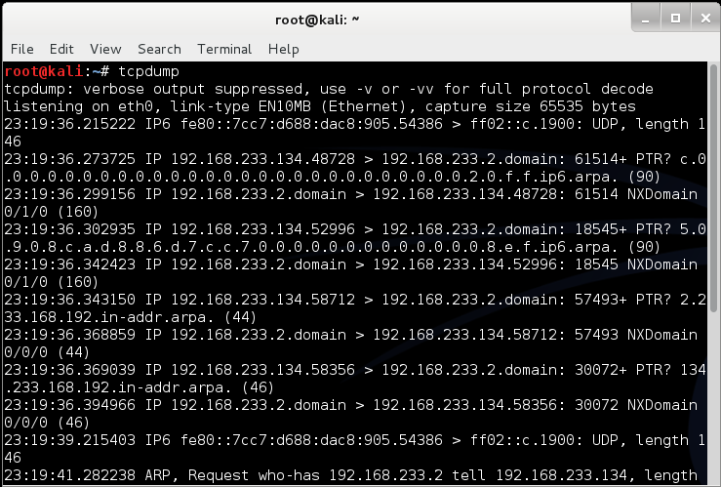
tcpdump
Linux sniffer tool is tcpdump

Slide 13
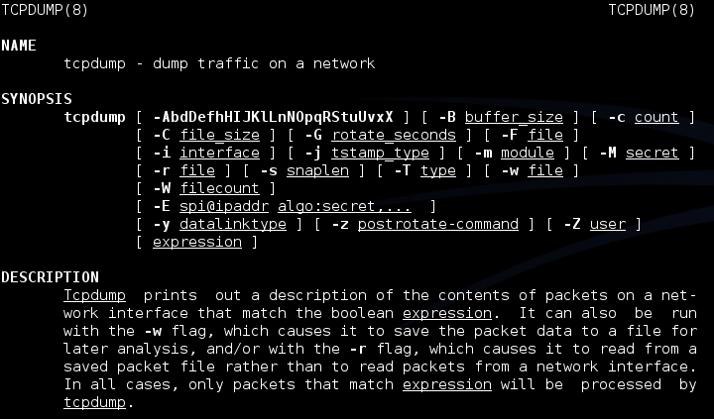
tcpdump
Remember Man page for tcpdump is already installed

Slide 14
tcpdump
Basic Communications
Try tcpdump -nS
Looking for pings

Slide 15
tcpdump
If you are not root:
Remember: sudo tcpdump
Can filter for specific IP
Try: tcpdump –nn tcp and dst 10.10.10.10
Try: tcpdump –nn udp and src 10.10.10.10
Try: tcpdump –nn tcp and port 443 and host 10.10.10.10
FYI
-n : Don’t resolve hostnames.
-nn : Don’t resolve hostnames or port names.
More detailed How To:
http://danielmiessler.com/study/tcpdump/

Slide 16
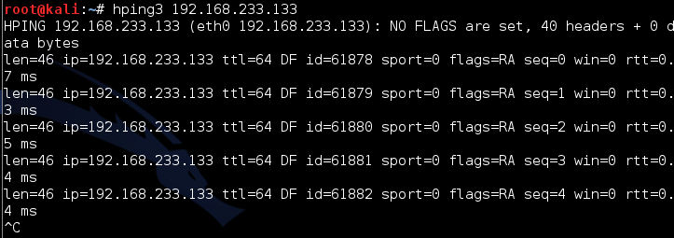
Network Sweeps
Hping3
One target at a time
Caution: Windows firewalls may block functionality

Slide 17
Hping3
Can spoof source
--spoof
Example
Hping3 –spoof 10.10.10.10 10.10.10.20
Sets source to 10.10.10.10
Sets destination to 10.10.10.20

Slide 18
Hping3
Targets ports
-- destport [port]
Example
Hping3 10.10.10.10 –p 53
Targets port 53 on 10.10.10.10
Target multiple port

Slide 19
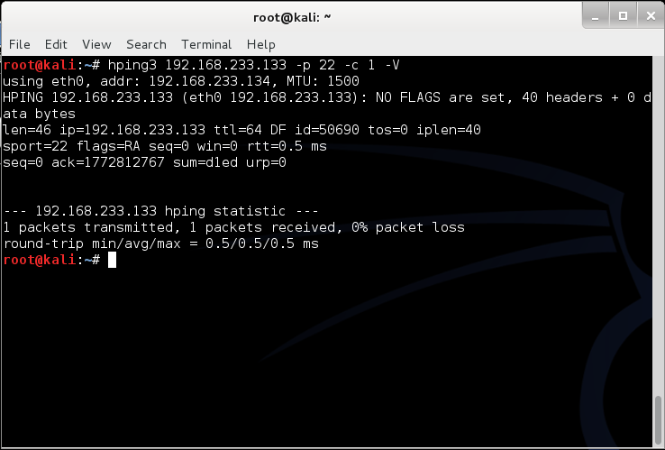
Example targeting port 22 with count “-c” and verbose “-V”

Slide 20
Nmap
Nmap is a network mapper
Very basic example
Just pings a machine and confirms it exists

Slide 21
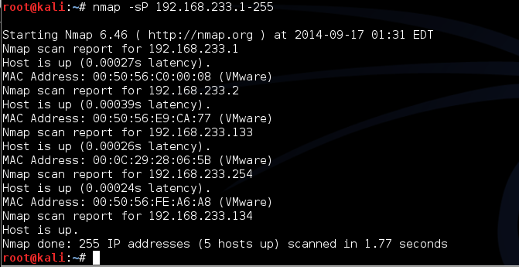
Now we take it up a notch
Lets check an entire class “C” address
Example:
Try: nmap –sP 192.168.1-255

Slide 22
Due for Next Week
2nd Assignment will be postponed to allow for more material around Scanning

Slide 23
Questions
?

