Slide 1
Intro to Ethical Hacking
MIS 5211.001
Week 5
Site: http://community.mis.temple.edu/mis5211sec001f14/

Slide 2
Conference Opportunity
ISSA – Delaware Valley
  Friday September 26th
  Topics:
    Security Vulnerabilities in Automobiles
    Vendor Management
    Using Risk Strategically
    Human Side of Data Protection
    Big Data Behavioral
Register
  http://www.issa-dv.org/meetings/registration.php
Agenda
  http://www.issa-dv.org/meetings/agendas/Agenda_ISSA-DV_2014-09-26.pdf

Slide 3
Tonight's Plan
Questions from last week
In the news
Nmap
  Fundmentals
  Scan and Scan Options
  ZenMap

Slide 4
Questions
CVE – Common Vulnerabilities and Exposures
  http://cve.mitre.org/
  Database of known vulnerabilities
Basically, this is the list that the vulnerability scanner industry writes against

Slide 5
In The News
Submitted
  http://www.infosecurity-magazine.com/news/android-flaw-spells-privacy/
    Accepting flaws?
  http://www.welivesecurity.com/2014/08/28/google-dorks/
    External DNS information?
  https://www.blackhat.com/html/webcast/10092014-cyberspace-as-battlespace.html
  http://www.bbc.com/news/technology-29279213
    XSS Vulnerability
    Other tools for enumeration?
  http://thehackernews.com/2014/09/yahoo-quickly-fixes-sql-injection_19.html
    Building out VPN?

Slide 6
In The News
http://www.businessweek.com/articles/2014-09-18/home-depot-hacked-wide-open
http://www.citon.com/7-notable-cyber-attacks-of-last-7-years/
http://thehackerspost.com/2014/09/massachusetts-institute-technologymit-hacked-sahoo.html
http://www.myfoxdc.com/story/26610194/tech-company-finds-mysterious-fake-cell-towers-in-dc-area

Slide 7
In The News
What I noted
  http://motherboard.vice.com/read/a-deep-web-service-will-leak-your-documents-if-the-government-murders-you
  http://threatpost.com/researcher-discloses-wi-fi-thermostat-vulnerabilities/108434
  https://blog.lookout.com/blog/2013/09/23/why-i-hacked-apples-touchid-and-still-think-it-is-awesome/
  http://www.csoonline.com/article/2687265/application-security/remote-exploit-in-bash-cve-2014-6271.html

Slide 8
First, A Little Refresher
Recall, two principle packet types
  TCP (Transmission Control Protocol)
    Connection oriented
    Reliable
    Sequenced
  UDP (User Datagram Protocol)
    Connectionless
    Best effort (Left to higher level application to detect loss and request retransmission if needed)
    Independent (un-sequenced)

Slide 9
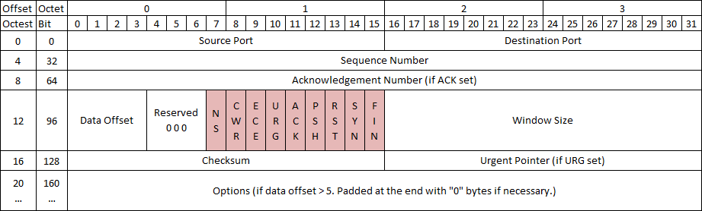
TCP Protocol
Number of flags have grown over the years, adding flags to the left as new ones are approved
With nine flags, there are 512 unique combinations of 1s and 0s
Add the three reserved flags and the number grows to 4096

Slide 10
TCP Control Bits
Control bits also called “Control Flags”
Defined by RFCs 793, 3168, and 3540
Currently defines 9 bits or flags
  See: http://en.wikipedia.org/wiki/Transmission_Control_Protocol

Slide 11
Three Way Handshake
Every “Legal” TCP connection begins with a three way handshake.
Sequence numbers are exchanged with the Syn, Syn-Ack, and Ack packets

Slide 12
How This Applies to Scanning
Per the RFC (793)
A TCP listener on a port will respond with Ack, regardless of the payload
Listener responds with a Syn-Ack
Therefore, if you get a Syn-Ack, something that speaks TCP was listening on that port

Slide 13
Behaviors
Port Open
Port Closed or Blocked by Firewall

Slide 14
Behaviors 2
Port Inaccessible (Likely Blocked by Firewall)
Port Inaccessible (Likely Blocked by Firewall)
Note: Nmap will mark both as “filtered”

Slide 15
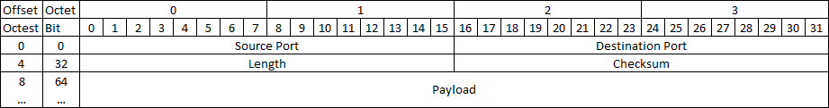
UDP Protocol
As you can see, UDP is a lot simpler.
  No Sequence Numbers
  No flags or control bits
  No “Connection”
As a result
  Slower to scan
  Less reliable scanning

Slide 16
Behaviors
Port Open
Port Closed or Blocked by Firewall

Slide 17
Behaviors 2
Port Inaccessible
Could be:
  Closed
  Blocked going in
  Blocked coming out
  Service not responding (Looking for a particular payload)
  Packet simply dropped due to collision

Slide 18
On to Nmap the Tool
Written and maintained by Fyodor
http://nmap.org/
Note: Lots of good info on the site, but the tutoriak is a bit out of date. Latest info was put in a book and is sold on Amazon
  http://www.amazon.com/Nmap-Network-Scanning-Official-Discovery/dp/0979958717/ref=sr_1_1?ie=UTF8&qid=1411443925&sr=8-1&keywords=nmap

Slide 19
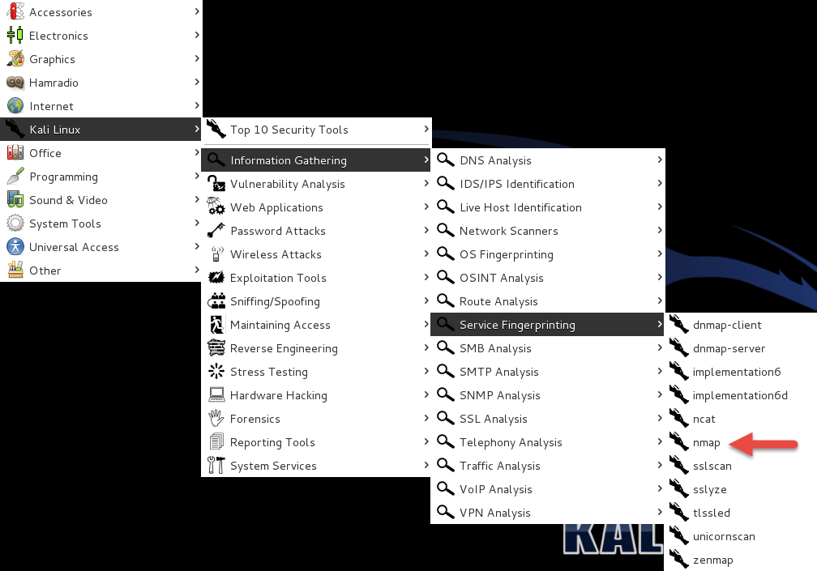
Nmap Location On Kali

Slide 20
A Suitable Target
Metasploitable
  Deliberately vulnerable version of Linux developed for training on Metasploit
  We’ll use it here since there will be worthwhile things to find with nmap.
http://sourceforge.net/projects/virtualhacking/files/os/metasploitable/metasploitable-linux-2.0.0/download
UserID: msfadmin Password: msfadmin

Slide 21
Heads Up
After downloading the zip file, extract to a convenient location. VMWare should have created a folder in “My Documents” called “Virtual Machines”
Let Kali get started first
Then, select “Open a Virtual Machine” and navigate to the folder for metasploitable. Then launch.
You get a prompt asking if you moved or copied the VM, select “Moved”
Once started, login and issue command ifconfig to get you IP address and your done.

Slide 22
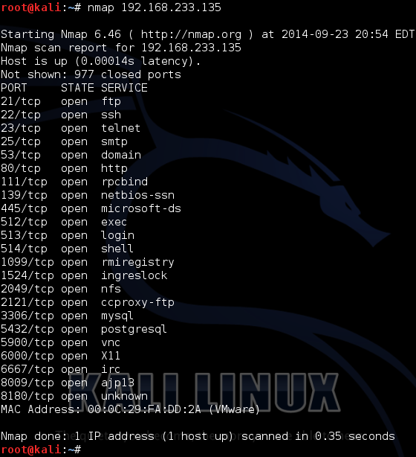
Back to Nmap
Lets try something simple
Nmap 192.168.233.135

Slide 23
What This Tells Us
There are a number of interesting ports here
  ftp
  Ssh
  telnet
  Smtp (Mail)
  domain (DNS)
  http (Web Server)
Keep in mind, ports are “commonly associated” with these services, but not guaranteed
http://www.iana.org/assignments/service-names-port-numbers/service-names-port-numbers.xhtml

Slide 24
Points to Remember
-n – Don’t resolve host names
-nn – Don’t resolve host names OR port names
-v – Verbose, tell me more
-vv – Really Verbose, tell me lots more
-iL – Input from list, get host list from a text file
--exclude – Don’t scan a particular host
--excludefile – Don’t scan hosts from a text file
Remember – “man nmap”

Slide 25
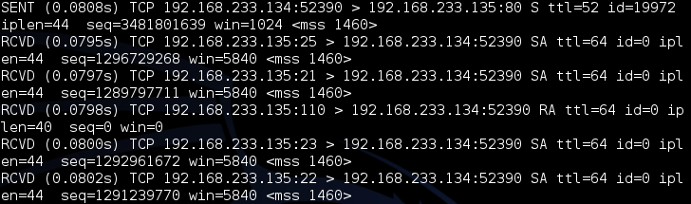
--packet-trace
Nmap prints a summary of every packet sent or received
May want to limit ports “-p1-1024” or less
There are also
  --version-trace
  --script-trace

Slide 26
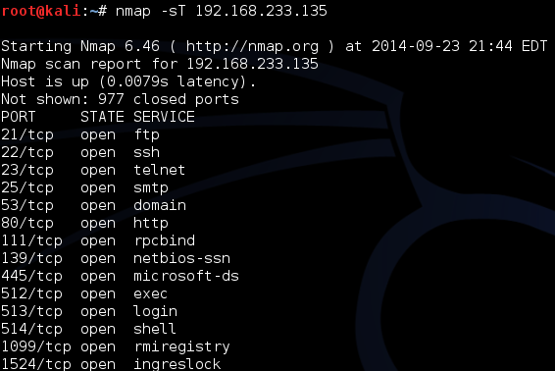
Basic Scan Types
-sT – TCP connect() scanning
  If connect succeeds, port is open

Slide 27
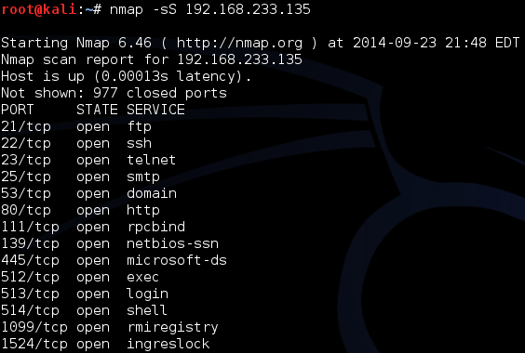
Basic Scan Types
-sS – SYN stealth Scan
  If SYN-ACK is received, port is open

Slide 28
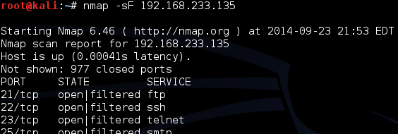
FIN Scan
-sF – Like SYN Scan, less likely to be flagged
  Closed port responds w/ RST, Open port drops
  Works on RFC 793 compliant systems
    Windows not compliant, could differentiate a Windows system

Slide 29
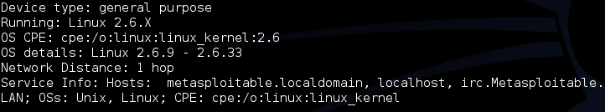
Other Options
-sN – Null scan
  Similar to FIN
-sX – Xmas tree scan
  Sets FIN, PSH, and URG
-sM – Maiman scan
  sets FIN and ACK
All work by looking for the absence of a RST

Slide 30
Roll Your Own
--scanflags
  Example:
    Nmap –scanflags SYNPSHACK –p 80 19

Slide 31
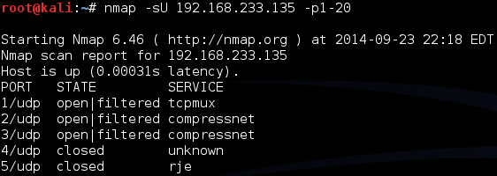
UDP Scans
-sU – 0 Byte UDP Packet
  Port unreachable – Port is closed
  No response – Port assumed open
  Very time consuming
  20 ports took 5.46 seconds, -sT scan only took 0.15

Slide 32
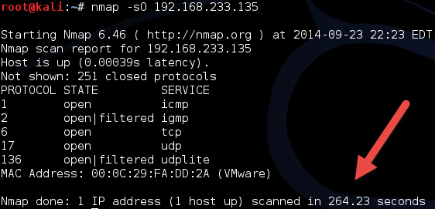
Protocol Scan
-sO – Looks for IP Protocols supported
  Sends raw IP packets without additional header information
  Takes time

Slide 33
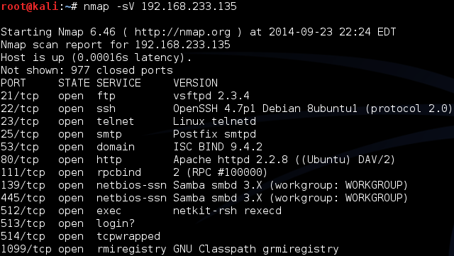
Version Detection
-sV – Attempts to determine version of services running

Slide 34
More on Version
-A – Looks for version of OS as well

Slide 35
Still More on Version Scan
-O – Fingerprint the operating system
-A = -sV + -O

Slide 36
Nmap Scripting Engine
Also known as NSE
  Written in “Lua”
  Activated with “-sC” or “- - script”
Categories
  Safe
  Intrusive
  Malware
  Version
  Discovery
  Vulnerability

Slide 37
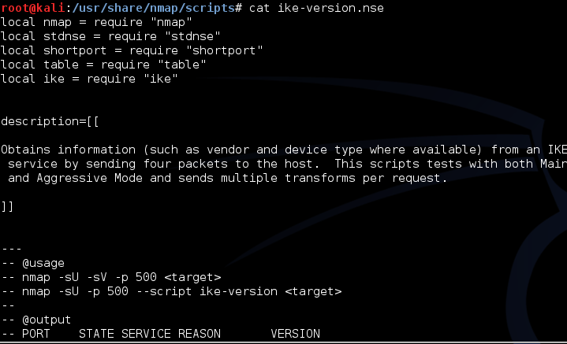
Script Location
In Kali, nmap scripts are located in:
  /usr/share/nmap/scripts
Can view using either “cat” OR gedits

Slide 38
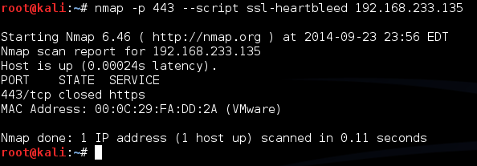
Script Example
SSL-Heartbleed
Try: nmap –p 443 --script ssl-heartbleed {target}
In this case, 443 is not even open

Slide 39
Zenmap
Graphical User Interface for nmap
Why did we just spend that time on the command line?
  Better control
  Better understanding

Slide 40
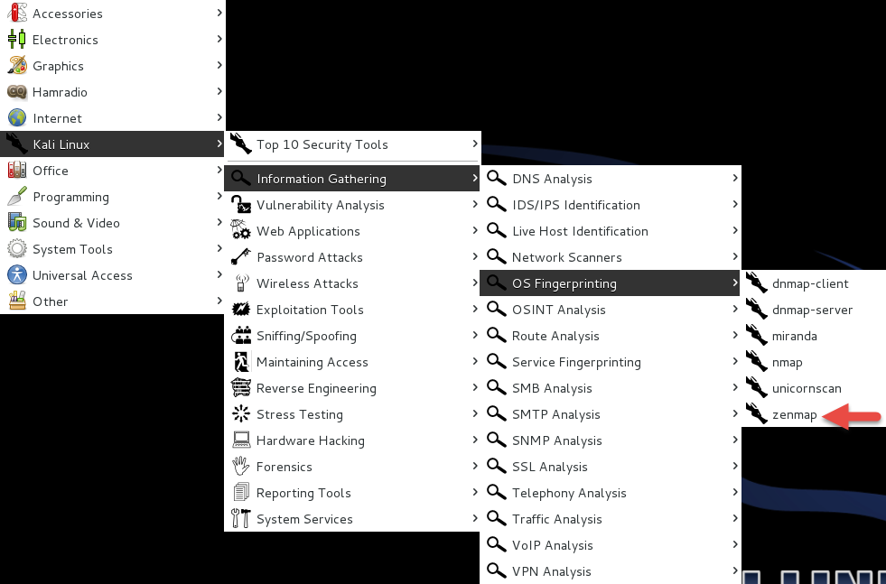
Zenmap Location

Slide 41
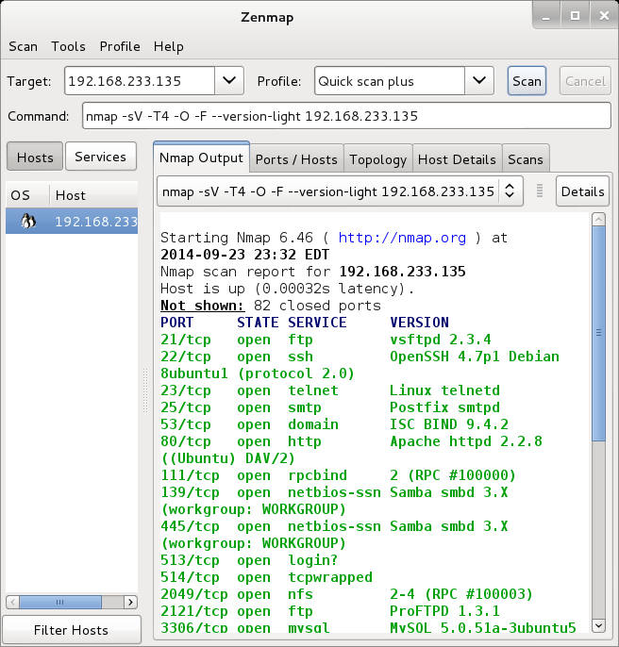
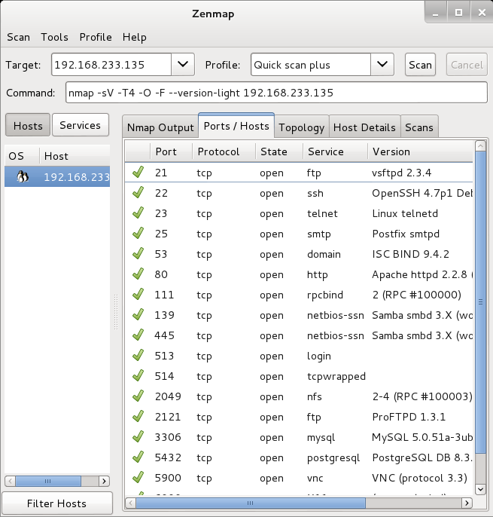
Zenmap Scan

Slide 42
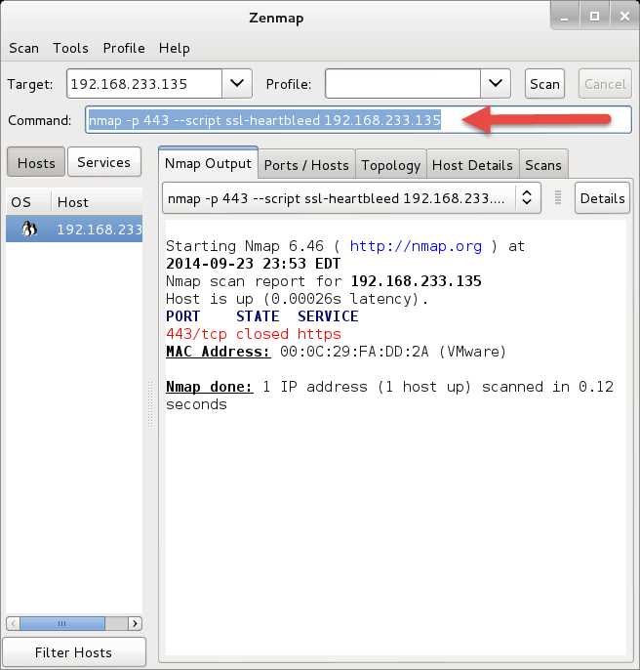
Still Really a Command Line
Look at the arrow
You can add to command line
Remember that SSL-hearbleed script

Slide 43
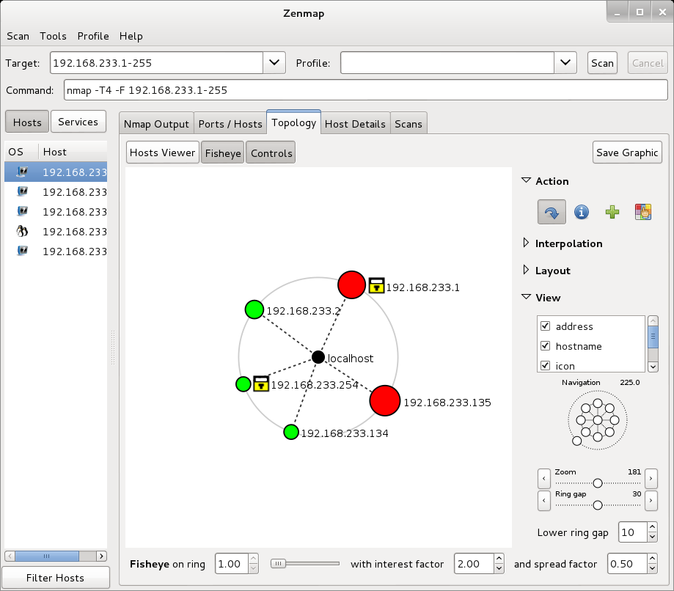
With a few Extras

Slide 44
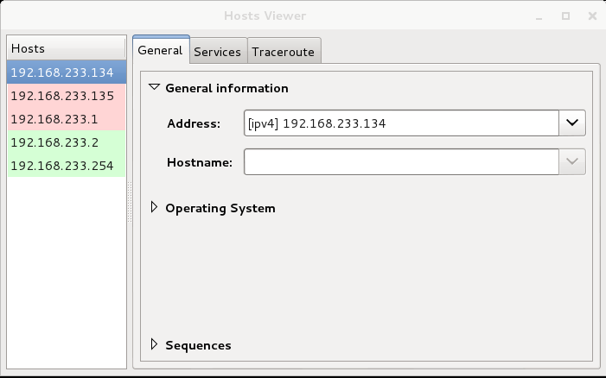
And More

Slide 45
Zenmap Reference
https://www.linux.com/learn/tutorials/381794-audit-your-network-with-zenmap?format=pdf

Slide 46
Due for Next Week
Readings and Articles as usual
Class will be by Webex
I will set up and mail info to all by Sunday

Slide 47
Questions
?

