Slide 1
Intro to Ethical Hacking
MIS 5211.001
Week 6
Site: http://community.mis.temple.edu/mis5211sec001f14/

Slide 2
Career Fair
Received the following note:

Slide 3
Tonight's Plan
News from ISC² and ASIS Conference
In the news
Nessus
Next Week

Slide 4
In The News
Submitted
http://defensesystems.com/articles/2014/08/15/drones-can-hack-wifi-networks.aspx
http://www.fool.com/investing/general/2014/09/28/home-depot-vs-target-diy-centers-data-breach-was-w.aspx
http://www.scmagazine.com/reports-suggest-home-depot-was-hit-by-the-mozart-malware/article/373976/
http://www.forbes.com/sites/patrickmoorhead/2014/09/29/hewlett-packard-designates-printing-a-first-class-iot-security-platform/

Slide 5
In The News
More
Bash
http://bits.blogs.nytimes.com/2014/09/26/companies-rush-to-fix-shellshock-software-bug-as-hackers-launch-thousands-of-attacks/?_php=true&_type=blogs&_r=0
https://access.redhat.com/announcements/1210053
http://www.pcworld.com/article/2688932/improved-patch-tackles-new-shellshock-attack-vectors.html
http://www.itnews.com/exploits-vulnerabilities/84263/six-key-defenses-against-shellshock-attacks?source=ITNEWSNLE_nlt_itndaily_2014-09-30

Slide 6
In The News
More
http://www.joystiq.com/2014/09/30/hackers-charged-with-xbox-one-valve-call-of-duty-data-theft/
http://www.ehackingnews.com/2014/09/data-breach-at-tripadvisors-viator.html
http://www.darkreading.com/application-security/how-a-major-bank-hacked-its-java-security/d/d-id/1316216?
http://www.waratek.com/Waratek/media/SiteMedia/Documentation/DataSheet-Waratek-Application-Security-vs-3.pdf
http://www.businessweek.com/news/2014-09-29/supervalu-finds-separate-data-breach-in-computer-network

Slide 7
In The News
More
http://www.informationweek.com/cloud/software-as-a-service/amazon-reboots-cloud-servers-xen-bug-blamed/d/d-id/1316093

Slide 8
In The News
What I noted
http://arstechnica.com/apple/2014/09/apple-patches-shellshock-bash-bug-in-os-x-10-9-10-8-and-10-7/
https://threatpost.com/fbi-to-open-up-malware-investigator-portal-to-external-researchers/108590
http://www.dailydot.com/politics/tor-mozilla-firefox/

Slide 9
Nessus
Started in 1998 as an open source security scanning tool
Changed to a close sourced tool in 2005, but has remained “free” for personal use.
Surveys by sectools.org indicate Nessus remains the most popular vulnerability scanners
Not installed with Kali

Slide 10
The Nessus Server
Four basic parts to the Nessus server:
Nessus-core
Nessus-libraries
Libnasl
Nessus-plugins

Slide 11
Plugins
Plugins are the scripts that perform the vulnerability tests.
NASL – This is the Nessus Attack Scripting Language which can be used to write your own plugins.

Slide 12
Defining Targets
Hosts
Server.domain.edu
172.21.1.2
Subnet
192.168.100.0
Address range
192.168.1.1-192.168.1.10

Slide 13
Vulnerability Scanning
Scanning methods:
Safe
Destructive
Service recognition – Will determine what service is actually running on a particular port.
Handle multiple services – Will test a service if it appears on more then one port.
Will test multiple systems at the same time.

Slide 14
Viewing Reports
Nessus will indicate the threat level for services or vulnerabilities it detects:
Critical
High
Medium
Low
Informational
Description of vulnerability
Risk factor
CVE number

Slide 15
Common Vulnerabilities and Exposures
CVE created by http://www.cve.mitre.org/
Attempting to standardize the names for vulnerabilities.
CVE search engine at http://icat.nist.gov/
Notes:
SANS Institute Weekly Critical Vulnerability Analysis Report http://www.sans.org, also Reading Room and Internet Storm Center

Slide 16
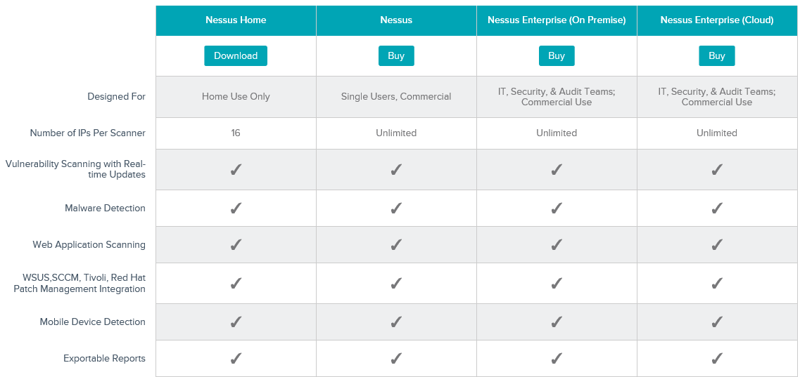
Options

Slide 17
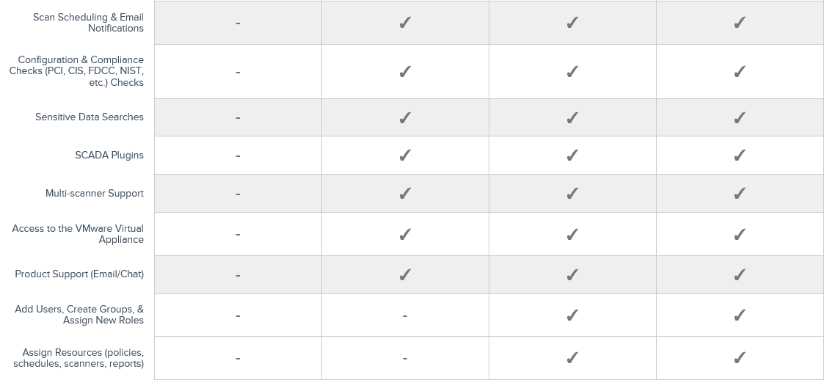
Options
http://www.tenable.com/products/nessus/select-your-operating-system

Slide 18
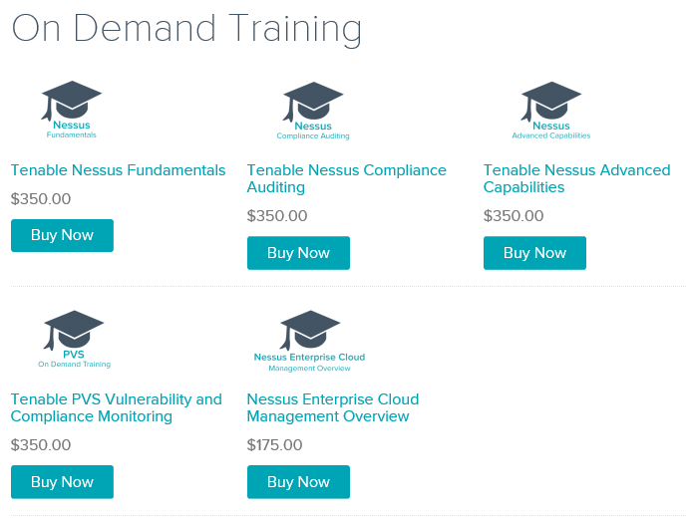
Nessus Sponsored Training

Slide 19
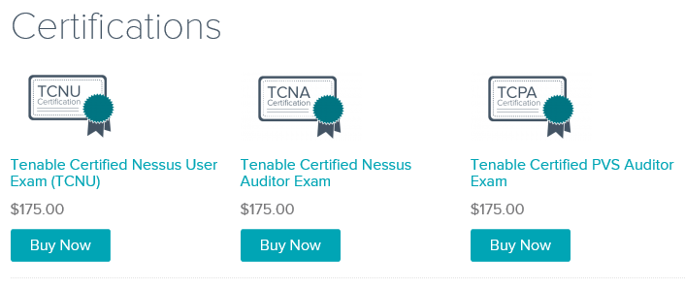
Certification Options
https://store.tenable.com/index.php?main_page=index&cPath=2

Slide 20
Architecture
Nessus is built on a classic client/server model.
The server portion may reside on a separate machine, or on the same machine as the client
The client is the interface that you will interact with to execute scans

Slide 21
Getting Nessus
Download from Tenable Security
http://www.tenable.com/products/nessus/select-your-operating-system
Before installing, go to registration page and get the activation code
http://www.tenable.com/products/nessus-home
Run the MSI package and follow the prompts
Install will also install PCAP and then take you to the registration page.
Enter activation code and follow the prompts to get updates and plugins

Slide 22
Documentation
Documentation for Nessus is available here:
http://static.tenable.com/documentation/nessus_4.2_user_guide.pdf
You will also get a link to this location during the install.

Slide 23
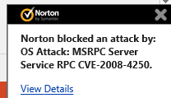
AV and Firewalls
You will need to turn off Anti-Virus and Firewall in order to get an effective scan or you will see this:
Before you do this, disconnect from any and all networks.
You will likely still get some blocking as AV doesn’t like to give up.

Slide 24
Location
Nessus is installed here:

Slide 25
Getting Started
You should end up looking at web page hosted from your machine.
Book mark the page to save time getting back
URL will look like this:
https://localhost:8834/html5.html

Slide 26
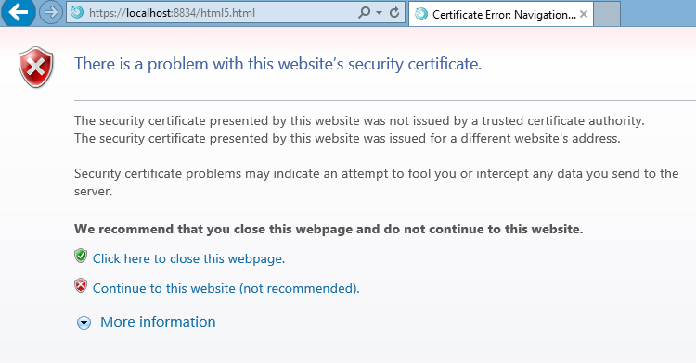
SSL Warning
When you first go to site, you will need to click on continue to the website.:

Slide 27
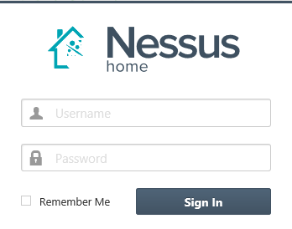
Logging In
Start

Slide 28
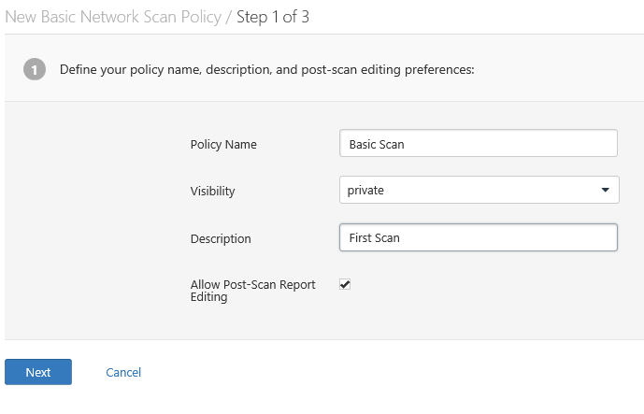
Policies
Scans are based on policies, you will need to create that first.

Slide 29
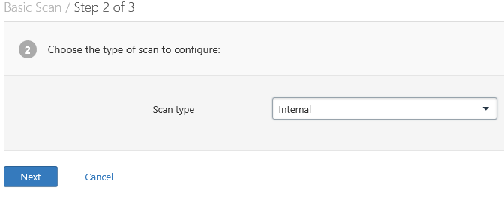
Policies 2
Next

Slide 30
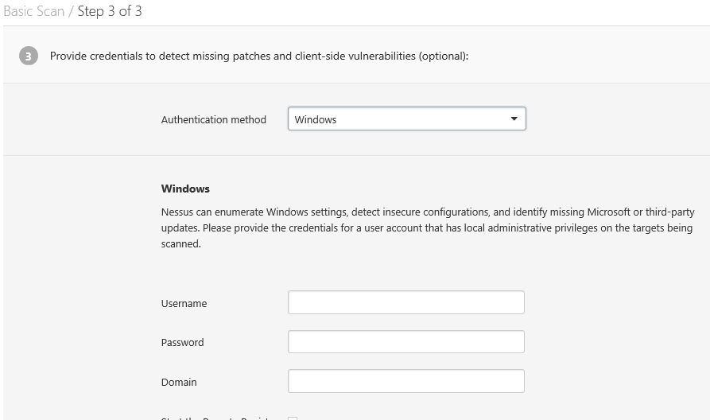
Policies 3

Slide 31
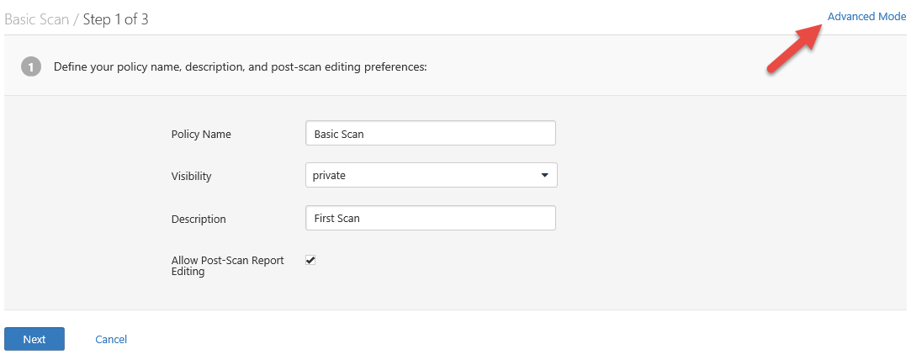
There are many more options

Slide 32
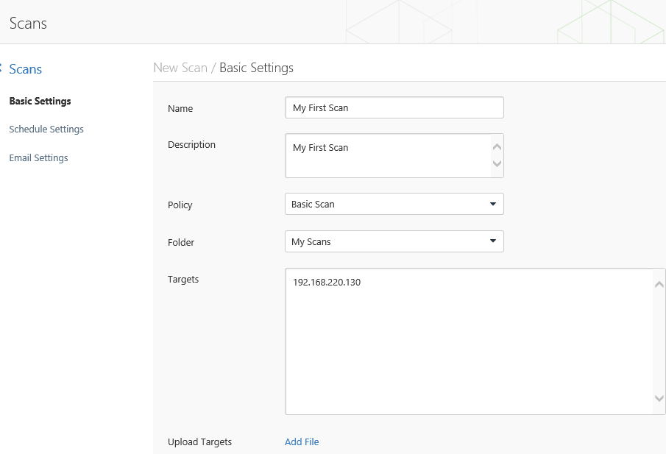
Creating A Scan

Slide 33
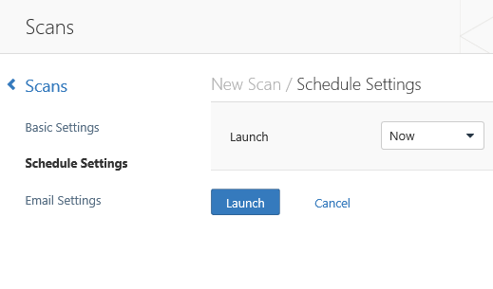
Scheduling A Scan

Slide 34
Scan Status
Once your scan has started you will see a status field like this:

Slide 35
Scan Status
Once completed you will get the following notification:

Slide 36
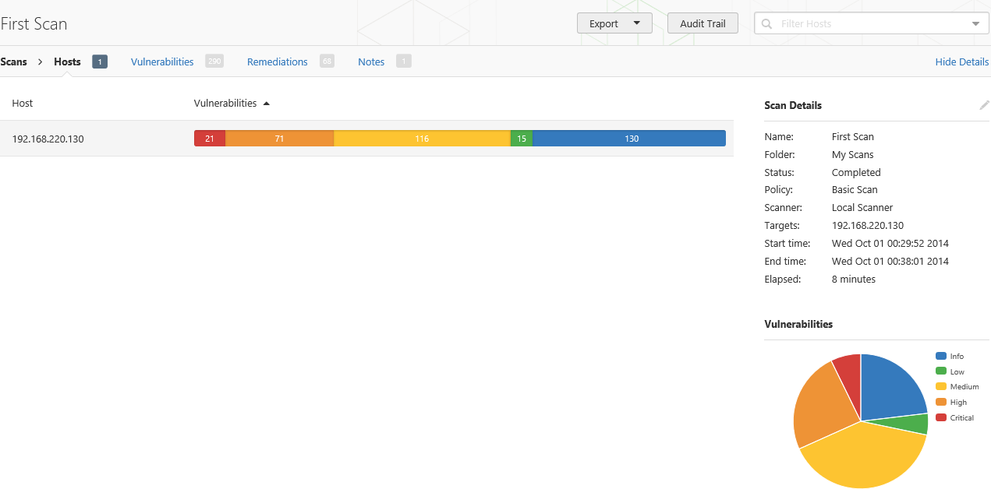
Output From First Scan

Slide 37
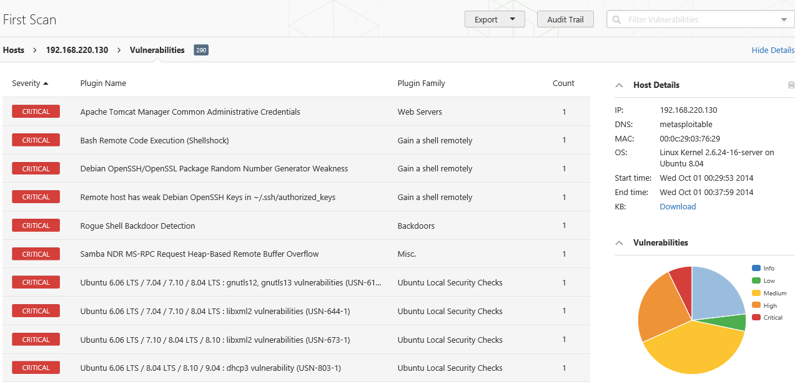
Clicking on scan gives details

Slide 38
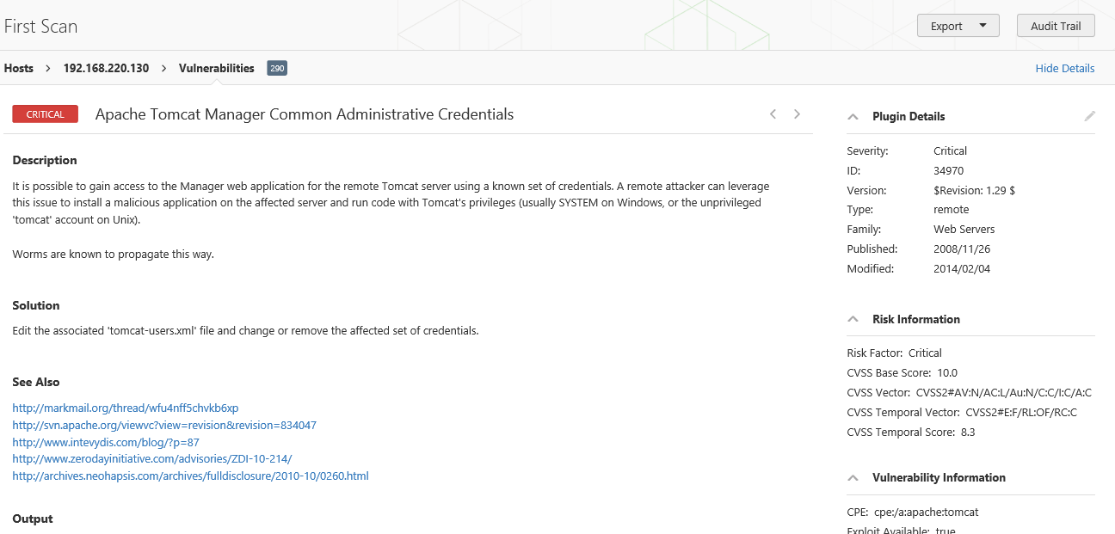
Continuing to drill down

Slide 39
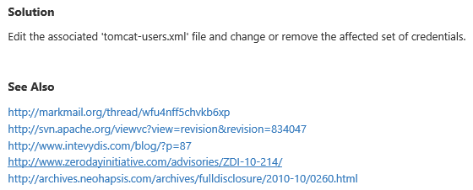
Good Information
Important to note:
Also

Slide 40
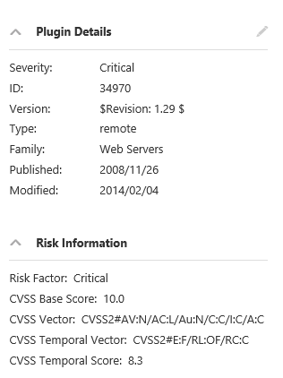
Criticality
Note on criticality
The “Critical” risk factor is without any mitigating controls being taken in to account
Vulnerabilities need to be evaluated in context

Slide 41
More on Results
These results were obtained, even though Anti-Virus continued blocking multiple techniques.
Consider setting up a scanning machine without any AV or Host Firewall.

Slide 42
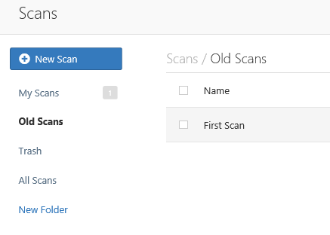
Organizing Scans
In short order you will gather a large collection of scans
Use the built in folder system to move scans off of the main page

Slide 43
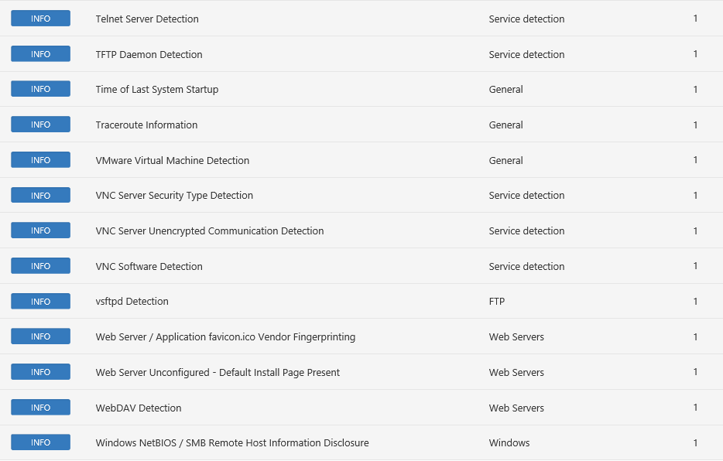
Don’t Forget the Info

Slide 44
Info Vulnerabilities
The least significant vulnerabilities are classified as “Info” or informational.
These are often very useful in understanding details of the asset being scanned.

Slide 45
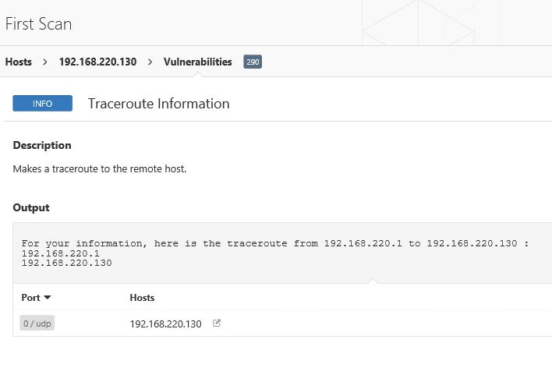
For Instance

Slide 46
Next Week
Mid-Term
Will cover weeks 1-5. Will not include information from tonight
Questions will come from the presentation material
Exam will be multiple choice
NetCat
Potentially
Batch Scripting

Slide 47
Questions
?

