Slide 1
Intro to Ethical Hacking
MIS 5211.001
Week 7
Site: http://community.mis.temple.edu/mis5211sec001f14/

Slide 2
Tonight's Plan
Mid-Term
In the news
NetCat

Slide 3
In The News
Submitted
http://www.cnet.com/news/at-t-warns-1600-customers-of-data-breach/

Slide 4
In The News
What I noted
http://www.securityweek.com/hackers-compromised-yahoo-servers-using-shellshock-bug
http://www.datacenterdynamics.com/focus/archive/2014/10/stromasys-emulates-legacy-hardware-cloud
http://the-digital-reader.com/2014/10/06/adobe-spying-users-collecting-data-ebook-libraries/#.VDS-f3l0yUl
http://krebsonsecurity.com/2014/10/huge-data-leak-at-largest-u-s-bond-insurer/
http://www.dailydot.com/politics/gmail-tor-lockout-problem/

Slide 5
Netcat
Netcat is a utility used by Penetration Tester and Hackers to establish network connections over UDP or TCP.
Takes “Standard In”, and sends it across the network as data
Receives network data and puts it on “Standard Out”
Messages from netcat itself go on “Standard Error”

Slide 6
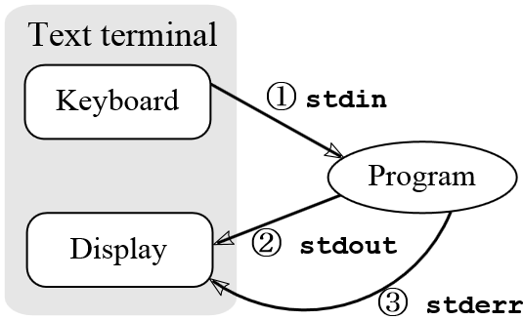
A Word About stdin, stdout, and stderror
These are terms from programming that refer to expected streams in software
As an example
stdin would be the keyboard
Stdout would be the screen
Stderror may be dropped or sent to logging
From: http://en.wikipedia.org/wiki/Standard_streams#Standard_error_.28stderr.29

Slide 7
Netcat in Linux and Windows
In Linux netcat is typically installed and can be activate simply by typing “nc” at the command line
In Windows, the file is not installed
A version can be downloaded from:
http://nmap.org/ncat/
Once downloaded and extracted type “ncat” at the command line to get started
Note – AV will likely automatically remove it

Slide 8
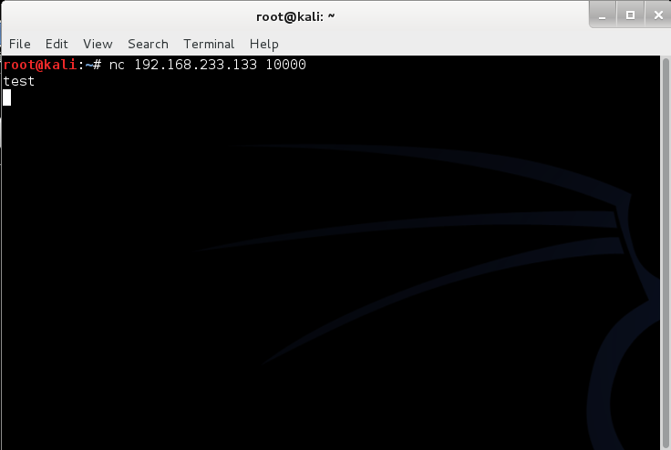
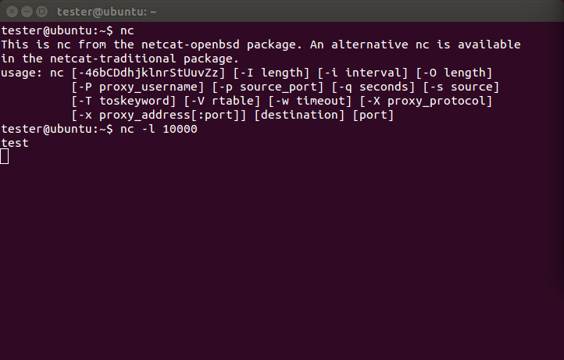
Simple Demo

Slide 9
Netcat Structure
Basic format is
Send
$nc [Target IP] [Remote Port]
Receive
$nc [flag(s)] [Local Port]
Assumes TCP unless –u flag is set forcing to UDP
Link to SANS Cheat Sheet
URL: http://www.sans.org/security-resources/sec560/netcat_cheat_sheet_v1.pdf

Slide 10
Pipes
So, netcat can send what I type to another machine. So what!
The pipe commands “|”, “>”, and “<“ let you do more interesting things
For example, transfer a file between systems
$nc –l –p [Local Port] > [Out File]
Listen on local port and store result in file
$nc –w3 [TargetIP] [Port] < [In File]
Push file to target IP on port
See SANS Cheat Sheet on previous page for more examples

Slide 11
Port Scanning
You can even use netcat as a simple port scanner
Example
$nc –v –n –z –w1 [Target IP] [Starting Port] – [Ending Port]
Systematically attempts to connect on each port within the defined range
Note:
-v – Verbose
-n – Do not resolve names
-z – Do not send data
-w1 – Wait no more then one second to connect

Slide 12
Next Week
2nd formal assignment
From Syllabus
(student presentations) (student presentations) Scanning exercise targeted against only systems you personally own, develop a profile of the targeted machine or machines. You may work in teams, or separately
One to two page Executive Summary
Short (no more then three slides, no welcome slide) presentation
See “Exercise Analysis” tab for more details

Slide 13
Next Week
Readings and Articles as usual
We will be covering
Social Engineering
Encoding
Encryption

Slide 14
Questions
?

